Slide 1
Business Process Management – Business Task Manager (BTM)
Concepto de Arquitectura de la Solución

Slide 2


Arquitectura Lógica del Producto
Canales
Aplicaciones
Worklist
Native App
Native App
Servicios
Servicios
SOA API
REST API
Componentes de Servicios
EJB
Data Access
Backend
EvoSoft-DataBase

Slide 3
Componente de la Arquitectura
Aplicaciones
worklist-portal
worklist-mobile
spring framework
Servicios
worklist-ws
worklist-rest
Componentes de Servicio
worklist-ejb
worklist-dac
quartz-scheduler
Proveedores
EvoSoft-DataBase

Slide 4
Organización de la Implementación Maven
<pom> worklist
<jar> worklist-dac
<war> worklist-ws
<war> worklist-portal
<war> worklist-rest
<ejb> worklist-ejb
<ear> worklist-ear
<pom> worklist-mobile
<app> worklist-ios
<app> worklist-android

Slide 5
Human Task Manager
<<WebService>> taskOperations
<<WebService>> humanTaskParticipantPortType
<<WebService>> leanTaskOperations
<<WebService>> leanTaskCallbackOperations
<<WebService>> clientParticipantPortType
<<EJB>> taskOperations
<<EJB>> humanTaskParticipantPortType
<<EJB>> leanTaskOperations
<<EJB>> leanTaskCallbackOperations
<<EJB>> clientParticipantPortType
MDR Repository

Slide 6
Servicios SOA
XXXXXX
registerLeanTaskDefinition
unregisterLeanTaskDefinition
listLeanTaskDefinitions
createLeanTask
createLeanTaskAsync

Slide 7
Concepto Visual del Producto

Slide 8
Worklist Portal
[ LOGO ]
Welcome “ianache” | Administración | Logout
[Analíticas de Trabajo]
My Tasklist
Business Activity Monitoring
Task Management
View as:
Table
Calendar
New task
Task ID
Task title
Owner
Assignee
Due date
00001
Aprobar diseño del curso SI184 [ Auto asignar ] [ Liberar ] [ Ejecutar ]
ianache
12/01/2014
00001
Aprobar nueva currícula [ Auto asignar ] [ Liberar ] [ Ejecutar ]
jperez
ianache
12/04/2014
|<
<
>
>|
Business Process Management – Business Task Manager Copyright © Evolución del Software 2014

Slide 9
Ejemplo: Aplicación – proceso de negocio

Slide 10
Un ejemplo de una My Task List: Alumno
My Tasklist
Business Activity Monitoring
View as:
Table
Calendar
New task
Task ID
Task title
Owner
Assignee
Due date
00001
Presentar solicitud y documentación sustentatoria [ Auto asignar ] [ Liberar ] [ Ejecutar ]
system
mrodiguez
12/01/2014
00001
Subsanar observación a solicitud de convalidación No 2014021 [ Auto asignar ] [ Liberar ] [ Ejecutar ]
system
mrodiguez
12/04/2014
|<
<
>
>|

Slide 11
Ciclo de Vida de una Tarea Humana

Slide 12
Hasta
CREATED
READY
IN_PROGRESS
RESERVED
COMPLETED
SUSPENDED
OBSOLETE
REMOVED
FAILED
Desde
CREATED
X
X
X
X
X
X
skip
X
X
READY
X
forward, remove
start
claim, delegate
X
supend
skip
remove
X
IN_PROGRESS
X
forward, release
resume
delegate,stop
complete
X
skip
X
fail
RESERVED
X
forward, release
start
delegate, resume
X
X
skip
X
X
COMPLETED
X
X
X
X
X
X
X
X
X
SUSPENDED
X
resume
resume
resume
X
X
X
X
X
OBSOLETE
X
X
X
X
X
X
X
X
X
REMOVED
X
X
X
X
X
X
X
X
X
FAILED
X
X
X
X
X
X
X
X
X

Slide 13
Definición de los estados
ESTADO | DESCRIPTION
READY | La tarea se encuentra lista para que un miembro del grupo de participantes que ha sido nominado para realizar la tarea pueda reclamarla y con ello reservarla para ejecutarla.
RESERVED | La tarea ha sido asignada a un participante específico para su ejecución. Los demás participante ya no podrán ejecutar la tarea.

Slide 14
Esquema de Comunicación
Human Task Specification Service Interface

Slide 15
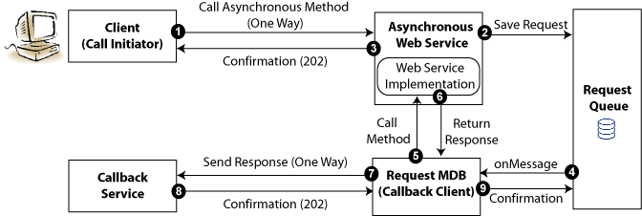
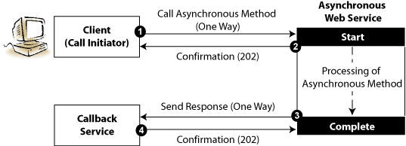
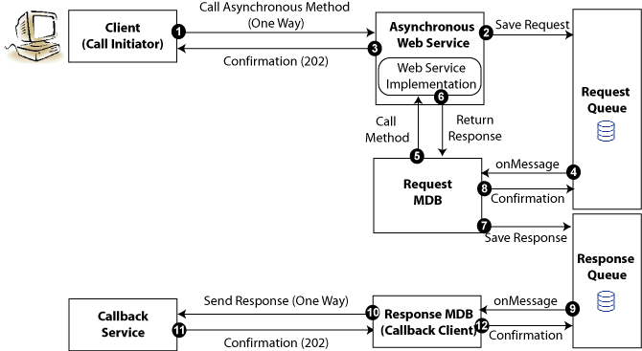
Comunicación Asíncrona
Notes:
Referencias:
http://docs.oracle.com/cd/E23943_01/web.1111/e15184/asynch.htm
When the callback service receives a response, it needs a way to correlate the response back to the original request. This is achieved using WS-Addressing and is handled automatically by the SOA runtime.
The client sets the following two fields in the WS-Addressing part of the SOAP header:
ReplyTo address—Address of the callback service.
MessageID—Unique ID that identifies the request. For example, a UUID.
The callback client sends the MessageId corresponding to the initial request in the relatesToId field in the WS-Addressing header. If additional data is required by the callback service to process the response, clients can perform one of the following tasks:
Clients can send the data as a reference parameter in the ReplyTo field. Asynchronous Web services return all reference parameters with the response, so the callback service will be able to access the information.
If sending the data as part of the asynchronous request message is not practical, then the client can save the MessageID and data required to the local data store.

