Slide 1
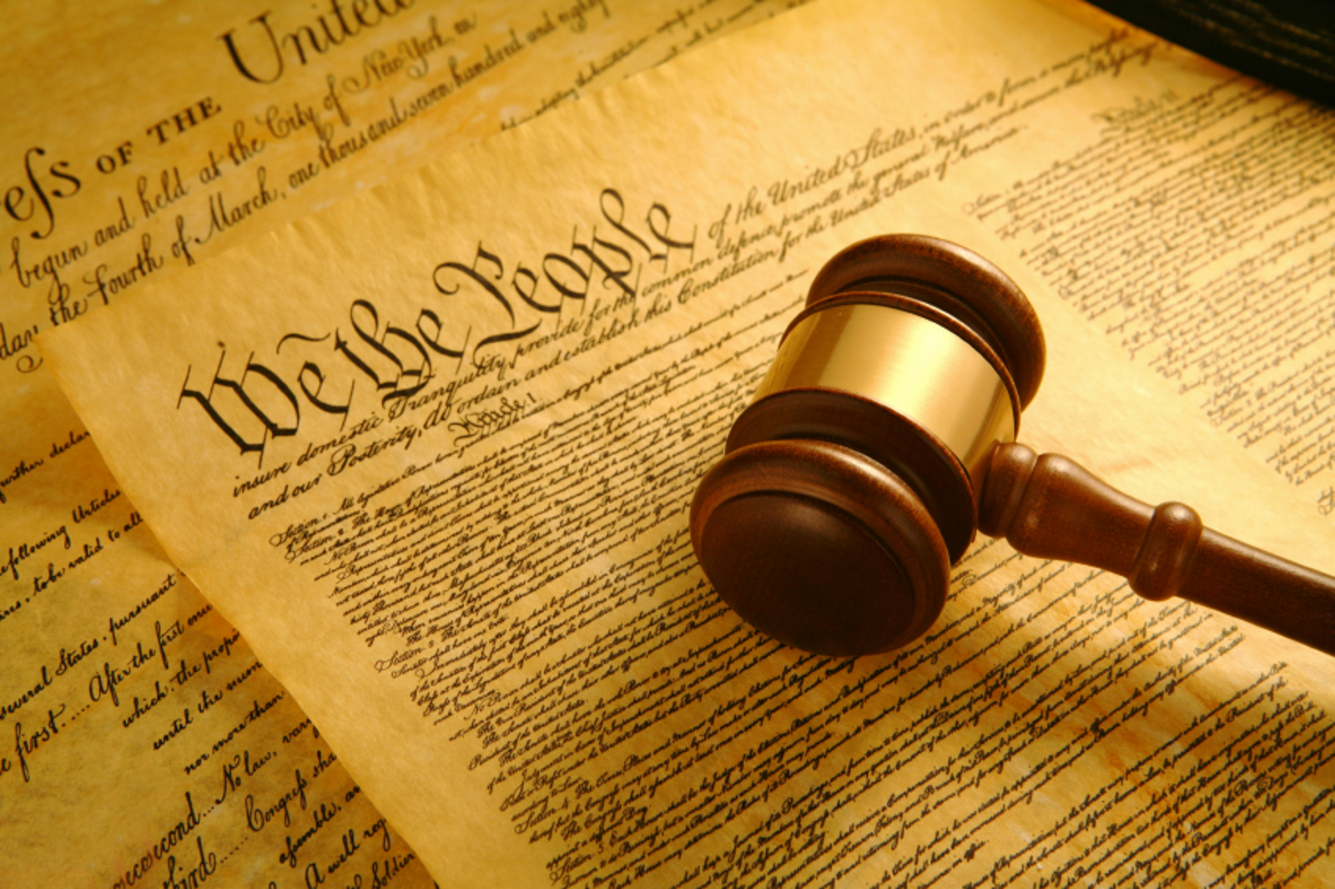
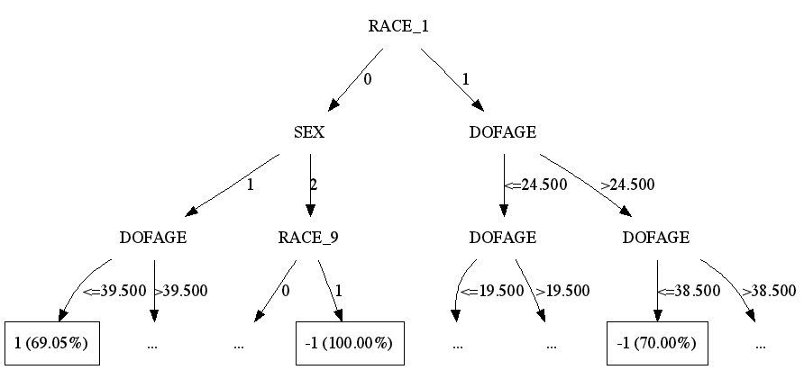
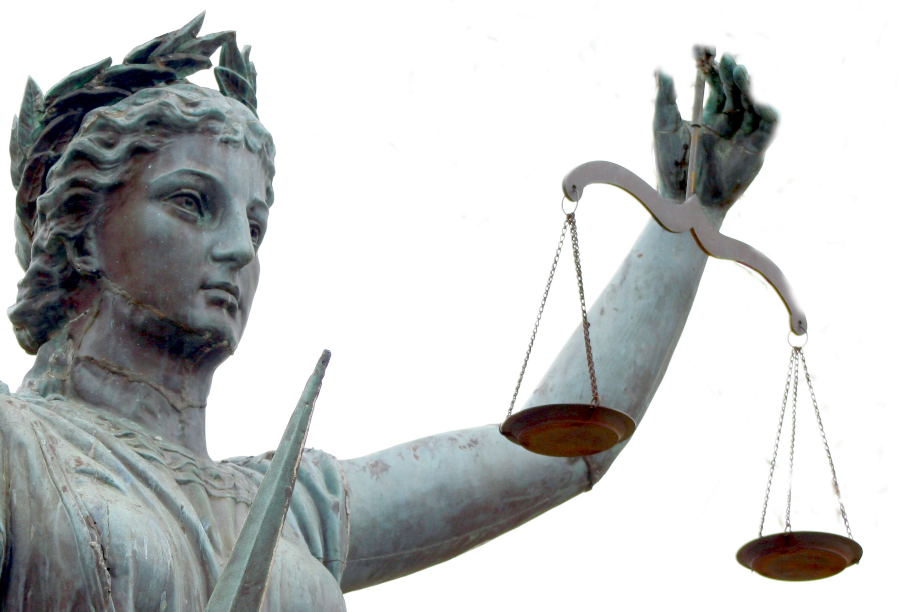
Predicting Criminal Sentencing
Justin Cheng jc882
Yunchi Luo yl477
Jane Park jp624
CS 4780 Fall ‘11
Final Project
Advisor: Igor Labutov
Instructor: Thorsten Joachims
Machine learning the justice system
Statistics
Motivation
Human judges use a combination of objective knowledge of law and some subjective judgment to determine a criminal’s sentence. We use machine learning techniques learned in class to create a predictor for criminal sentences using the Pennsylvania sentencing data from 1998. From these predictors, we determine the most critical factors involved in criminal sentencing.
Questions
Can we create a machine that can, with reasonable accuracy, match the decisions of the human judges and reveal the true factors that influence sentences? Are sentences determined solely and fairly according to just the crime, as the judges swore under oath, or are other variables, such as demographics, interfering with the decisions? If the judges are making purely objective decisions, is it possible to reverse-engineer parts of the law by looking at the sentences that criminals received?
Methods
Bayes, Decision tree (C4.5), Linear SVM, kNN
Label being predicted: INCMIN (minimum incarceration time)
Variable sets used:
DEMO[graphics]: SEX, DOFAGE (age on date of offense), RACE
CRIME: FINE, GRADE (), COMPLETE (), DOS_UNO (date of sentence), COUNTY (), PCSOFF (), PCSSUB (), DOF_UNO (date of offense), DISP (disposition)
BASE: DEMO + CRIME
“I […] solemnly swear that I will administer justice without respect to persons, and do equal right to the poor and to the rich, and that I will faithfully and impartially discharge and perform all the duties incumbent upon me. […] under the Constitution and laws of the United States. So help me God.”
– Oath of United States Justices and Judges
Findings
Variable Correlation Map
Variable Set | Method | Accuracy
DEMO | Bayes | 0.629
 | C4.5 | 0.659
 | Linear SVM | 0.637
 | kNN | 0.643
CRIME | Bayes
 | C4.5
 | Linear SVM
 | kNN
RACE | Bayes
 | C4.5
 | Linear SVM
 | kNN
TODO: some sort of conclusion after getting more data.
Top part of decision tree using DEMO
Conclusion & Remaining Work
“[method], using variables x, x, x, can predcict the criminal’s sentence with xx accuracy. ”
We will repeat our experiments using varying subsets of variables, and include more variables describing aspects of the criminal, offense, and trial that we have not incorporated yet.
References
Pennsylvania Commission on Sentencing. PENNSYLVANIA SENTENCING DATA, 1998. ICPSR version. State College, PA:Pennsylvania Commission on Sentencing, 2000. Ann Arbor, MI: Interuniversity Consortium for Political and Social Research, 2002.

