Slide 1
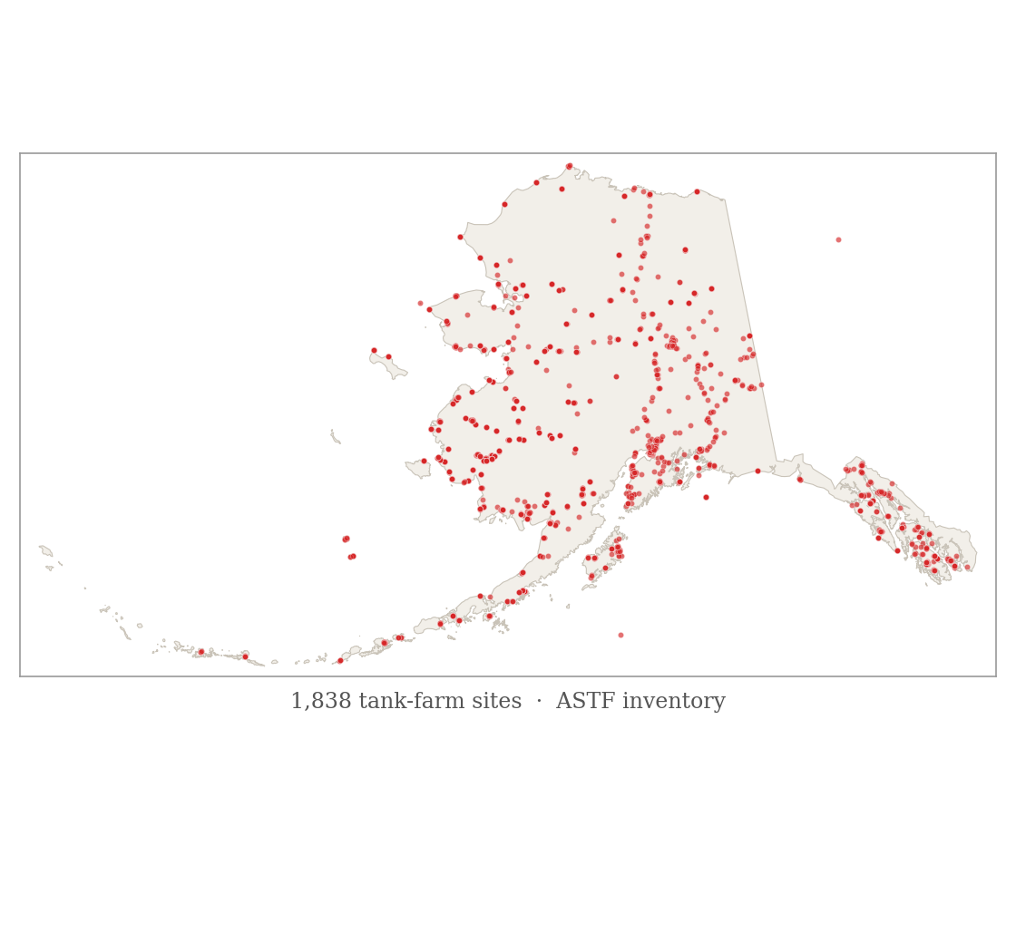
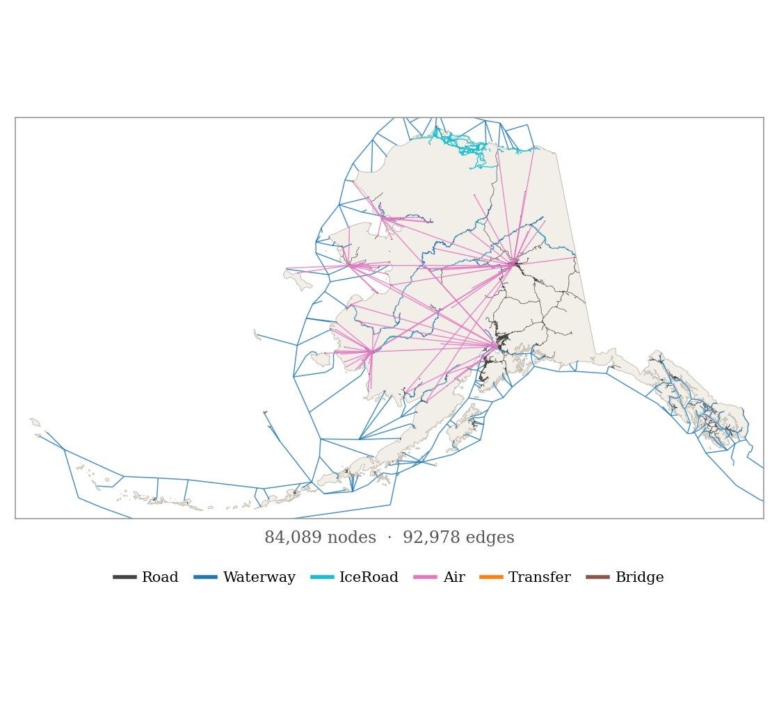
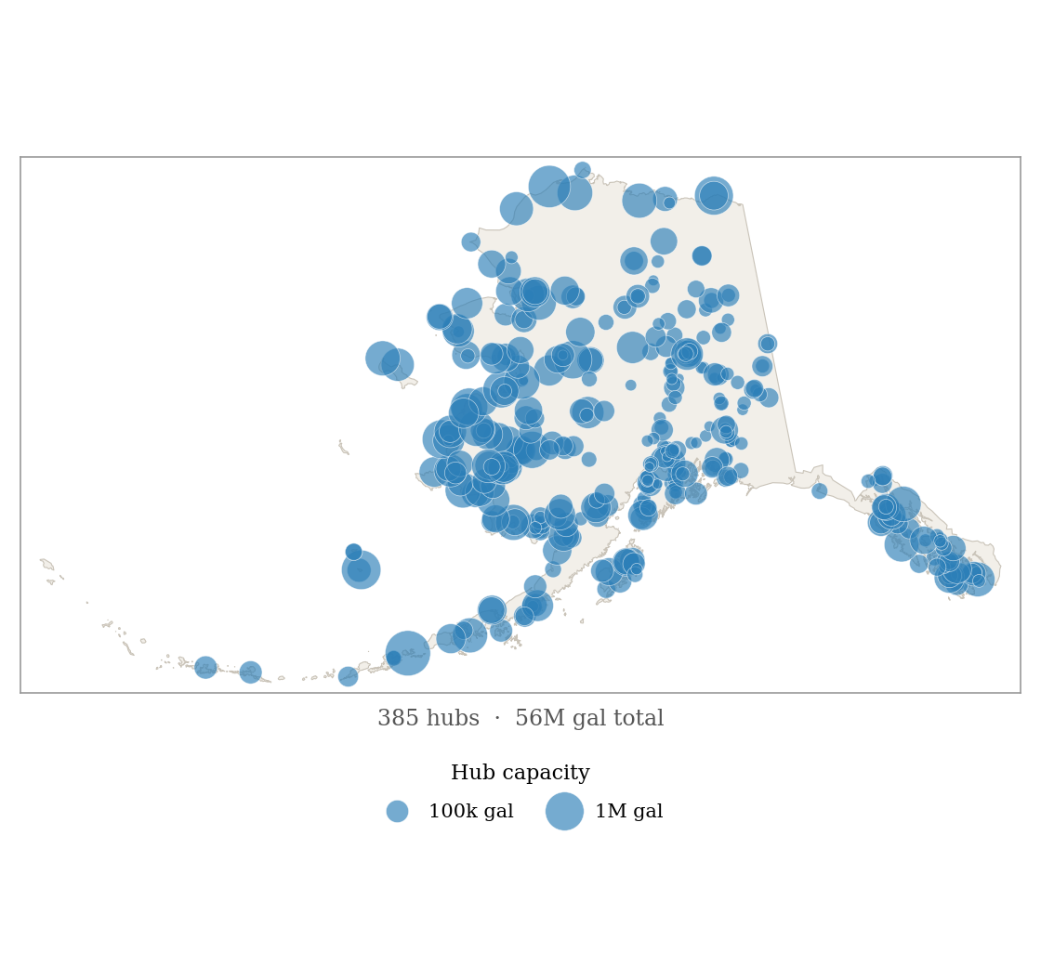
Fuel disruption & community impacts ignite an urgent need for data deliverables built on this geospatial data
A. Bulk fuel facilities
B. Multimodal spatial network
C. Tank capacity at hubs
D. Socio-economic & cost context (reserved)
? → $
Reserved for the missing link:
The data exists — qualitative and quantitative — but is not yet joined to the network above.
• community demand & population
• cost of energy burden
• delivery cost per gallon
• disruption / outage events
how do we connect them?

