Slide 1
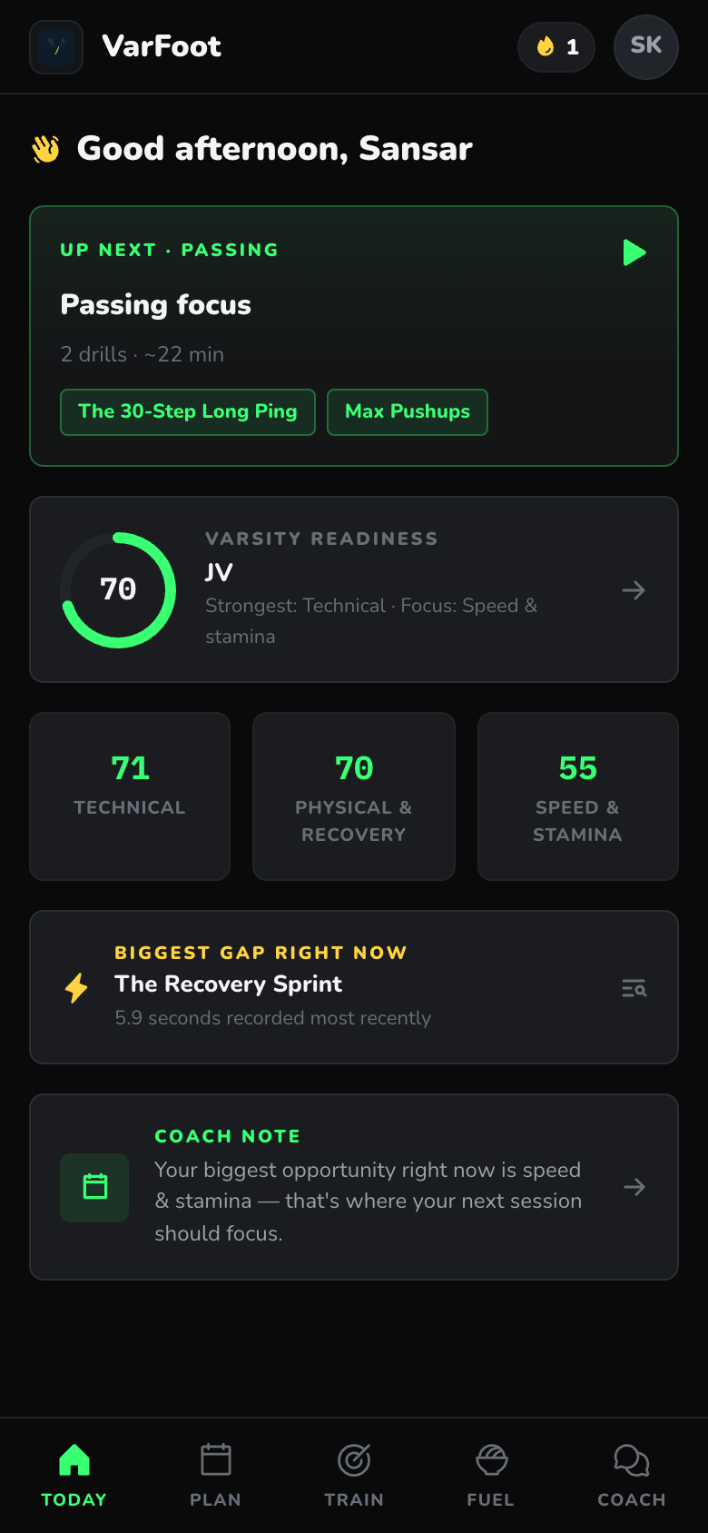
LEXHACK '26 / BUILD SOMETHING REAL FOR SOMEONE
VarFoot
A personalized AI soccer roadmap for athletes trying to make varsity.
Changing future athletes all around the world. Built by Sansar Karki & Saaransh Jinna — and built for a real one chasing varsity.
70
35
1
readiness
days to tryouts
next session
Notes:
Lead with the line: I built this for myself. A personalized AI soccer roadmap for athletes trying to make varsity.

Slide 2
@sansar.mp4
BUILT FOR A REAL PERSON
1,100+ followers
This was built for me.
[ Insert a clean screenshot of the @sansar.mp4 profile here — handle + follower count ]
Sansar Karki — an incoming freshman trying to make varsity soccer. I have been documenting the journey publicly, so this is not a hypothetical user.
-
Instagram: @sansar.mp4
-
1,100+ followers following the varsity push
-
Real training clips, a real public goal, a real deadline
Notes:
Proof this is real: public Instagram journey at @sansar.mp4, 1,100+ followers. Add the profile screenshot before presenting.

Slide 3
THE REAL PROBLEM
Motivation was never the issue. A plan was.
The question was never:
"Will I put in the work?"
I was training hard, posting the journey, and staying consistent. What I did not have was a system that told me what to work on and whether it was moving me toward varsity.
It was:
-
Training hard, but guessing at priorities.
"What exactly should I work on today to become varsity-ready?"
-
No baseline, no benchmark, no ranked next step.
-
No clear line from a weakness to a drill to tryout-readiness.
Notes:
Frame it as my own problem: effort was there, a system was not.

Slide 4
WHY EXISTING SOLUTIONS FAIL
Everything available solves a different problem.
-
Generic YouTube drills are not personalized to my position or weaknesses.
-
Coaches give team feedback and are not available every day.
-
Fitness apps track workouts but do not understand soccer tryouts.
-
Nutrition apps are not built around a teen athlete with soccer-specific goals.
The result: a motivated player can spend months on the wrong work and never know it.
Notes:
Each existing option is generic where I needed specific.

Slide 5
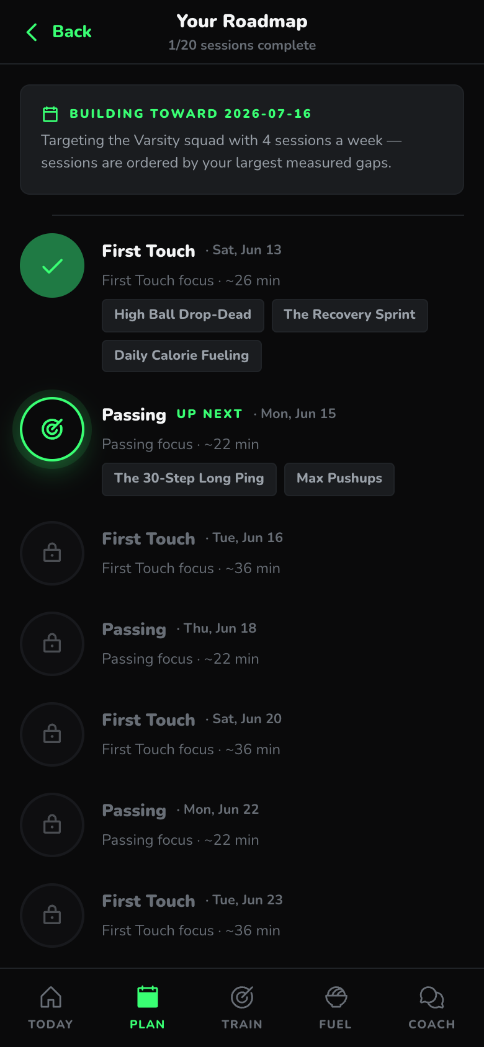
THE VARFOOT SOLUTION
One loop: assess, diagnose, plan, train, fuel, coach.
VarFoot turns the goal into a repeatable system the player can run without waiting for a coach to personalize every session.
-
Assessment across technical, physical, speed, recovery, and fueling.
-
Weakness diagnosis: every drill ranked weakest-first.
-
Personalized roadmap built from real gaps and the tryout date.
-
Daily sessions, fuel support, and a grounded AI coach.
Notes:
Assessment -> weakness diagnosis -> roadmap -> daily sessions -> fuel -> AI coach.

Slide 6
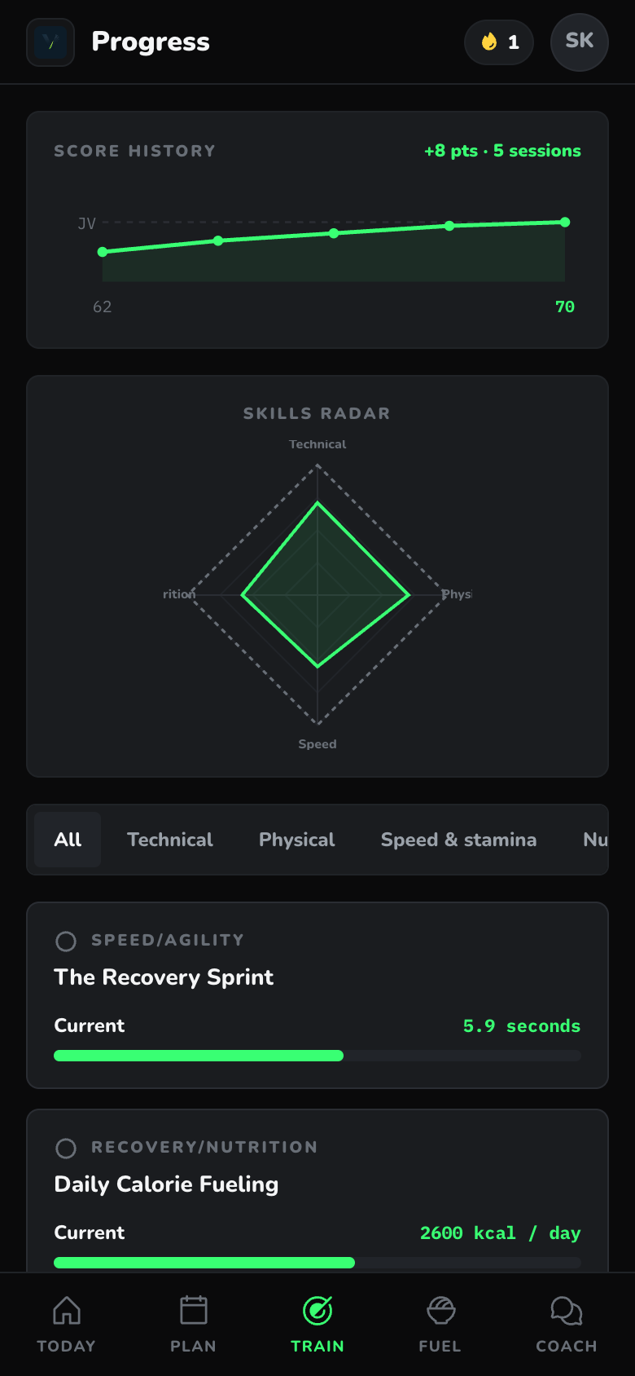
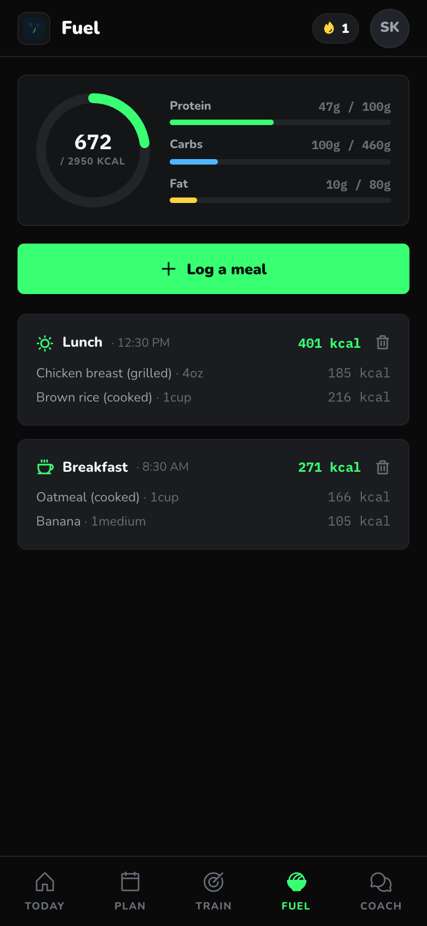
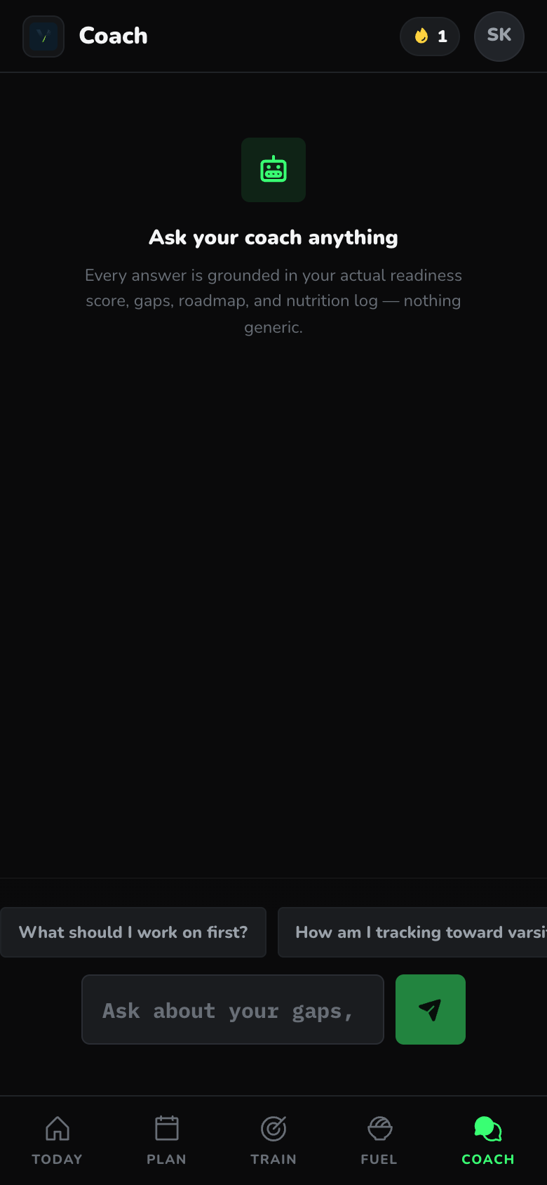
DEMO FLOW
Click Explore demo athlete — it loads my profile.
Judges see the app populated as Sansar, an incoming freshman chasing varsity, with no onboarding required.
-
Onboarding / assessment baseline.
-
Personalized plan and a training session.
-
Drill guidance with diagrams.
-
Fuel tab and the AI coach.
Notes:
Live order: assessment, plan, session, drill, fuel, coach. Use the demo athlete; mention the full assessment exists.

Slide 7
TECHNICAL EXECUTION
A real working app, not a mockup.
50
0-100
USDA
35/35
drill catalog
readiness model
live food data
tests passing
-
Next.js 16 + React 19 + TypeScript, installable as a PWA.
-
Gemini 3.1 Flash Lite streaming AI coach + roadmap summaries.
-
Supabase auth + PostgreSQL with row-level security for sync.
-
USDA FoodData Central API for real macro math.
-
Deterministic, unit-tested scoring and roadmap engine.
-
Teen-safe nutrition guardrails; deployed on Vercel.
Notes:
Stack: Next.js/PWA, Supabase, Gemini, USDA, deterministic engine, 50-drill catalog, safe AI guardrails, Vercel.

Slide 8
IMPACT
It turns a vague dream into a daily plan.
VarFoot helps an athlete like me know what to do, why it matters, and how today's session connects to the tryout goal.
-
Every session traces back to a measured weakness.
-
Progress is checked against varsity, not vibes.
-
The same problem belongs to thousands of players with no plan.
Notes:
Impact: the goal finally becomes actionable, and it generalizes beyond me.

Slide 9
WHAT CHANGED BECAUSE OF VARFOOT
Before and after.
BEFORE
AFTER
-
Random training, unclear priorities.
-
Personalized daily sessions from ranked weaknesses.
-
No way to know if the work matched the varsity goal.
-
Progress tracked against the tryout date.
-
Effort without a system.
-
A coach-like assistant that always knows the next step.
Notes:
Contrast the before/after so judges feel the change.

Slide 10


ABOUT THE CREATORS
Two 8th graders from Andover, MA.
Sansar Karki
Saaransh Jinna
Doherty Middle School · @sansar.mp4
Wood Hill Middle School
Trying to make varsity soccer as a freshman and documenting the journey to 1,100+ followers. Builds apps and is into AI and robotics. VarFoot is the system he wished he had — so he built it.
Training to make the AHS tennis team; into robotics and math. Plays piano and any sport with friends. Brings the same athlete-chasing-a-spot perspective to how VarFoot is designed.
Notes:
We are two 8th-grade athletes from Andover. Sansar is the soccer player VarFoot was built for; we built it together.

Slide 11
CLOSING
Built for someone real: me.
VarFoot was built for one athlete with a real, public goal. If it can help me chase varsity, it can help thousands of athletes with the same goal and no plan.
-
Live app: varfoot.vercel.app
-
Demo button: Explore demo athlete (loads Sansar's profile)
-
Public journey: @sansar.mp4
Notes:
Close on the thesis: a real tool built by an athlete for himself, based on a real public varsity journey.

