Slide 1
Comparison of player quality on outcome for Esports(CS:GO) vs Sports(basketball)
Jhet Cabigas, Saul Mooradian, Jesse Coulson, Adam Sanden

Slide 2
Introduction
CS:GO is a first person shooter video game that is round based where the first team to win 16 rounds wins
Both basketball and CS:GO are 5v5 games and that rely heavily on teamwork, so it lends itself well to comparison
We want to explore how variations in player skill on a team impact the outcome of a game
e.g. Is having one star player on a team with 4 below average better than having 5 average players?
In this project we want to explore all the player statistics that can contribute towards rating a player then create models based on these ratings

Slide 3
Exploring the NBA Dataset
Jhet Cabigas, Saul Mooradian

Slide 4
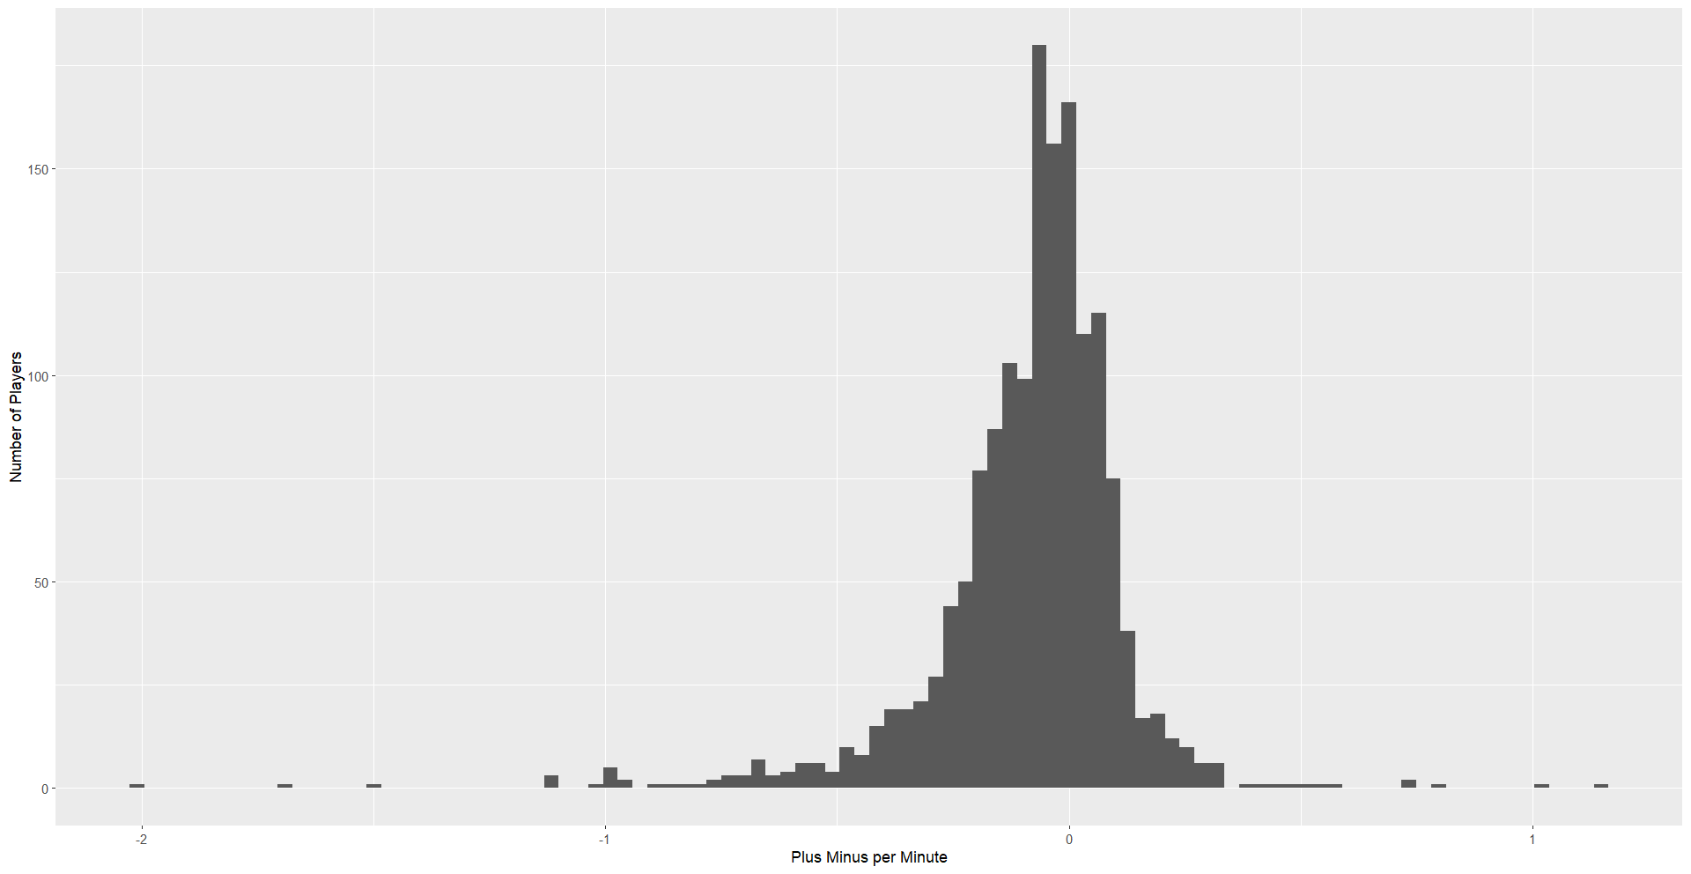
Plus Minus and Player Ranking
Plus Minus - The net points scored by the players team while the player is on the court (calculated as the points scored by their team minus the points scored by the opposing team).
Top 10 players - Who ranked the best based on this metric?

Slide 5
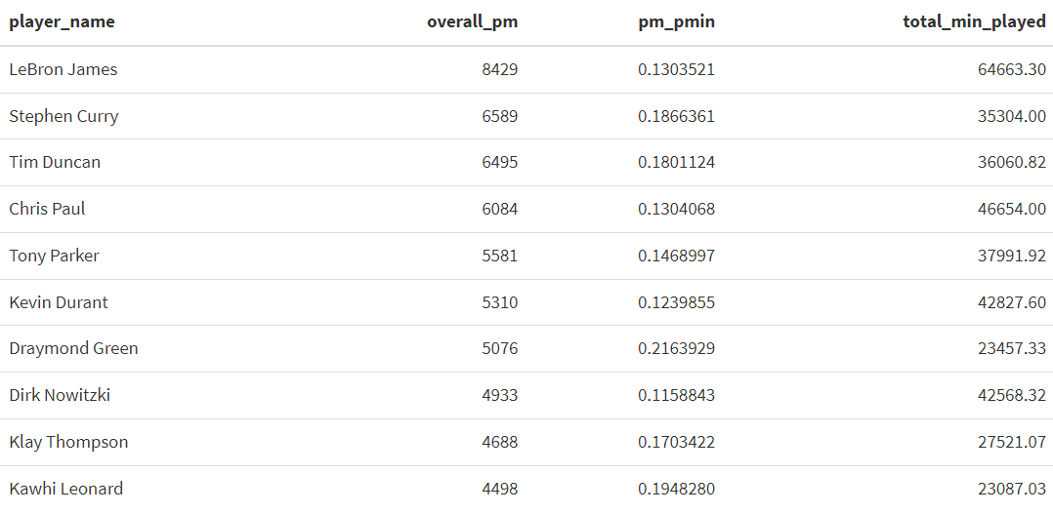
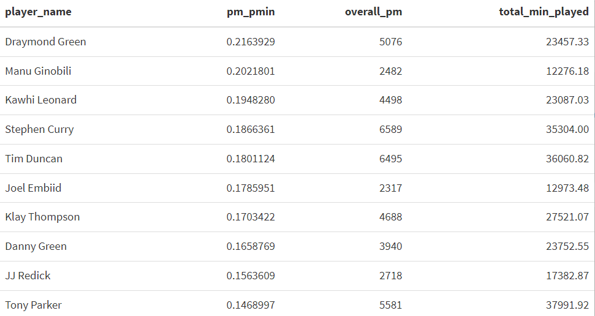
Top 10 Players
Both top 10 rankings are filled with players that are often considered stars
Lebron James , Dirk Nowitzki, and Kevin Durant all appear when the players were ranked by overall plus minus, but do not show up in the plus minus per minute rankings.
All of these players played well into their thirties. Ranking each basketball player each year may help us avoid this ranking issue. Controlling for overall team strength would be smart if possible.

Slide 6
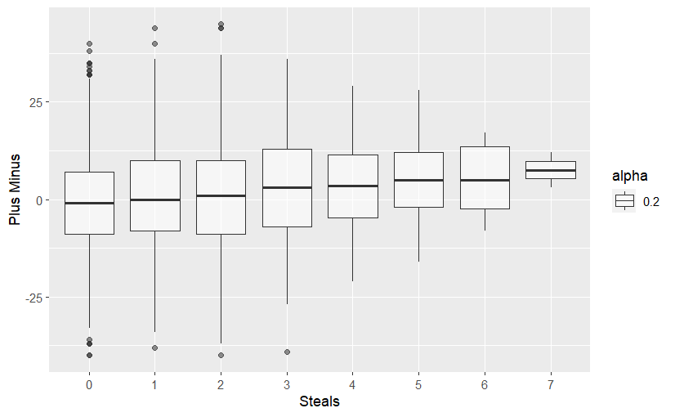
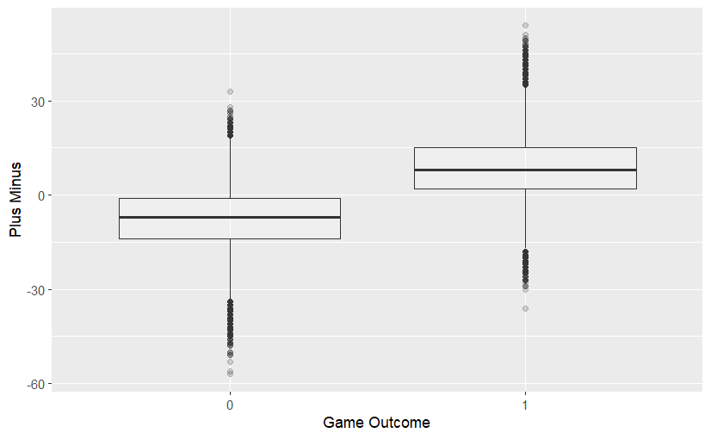
Trend Exploration
When plotting plus minus against the big 5 stats (points, steals, rebounds, assists, and turnovers), we see correlations between high performance in these stats and positive plus minus values.
As a player’s steals increases, their plus minus trends upward.
Finally, plotting plus minus against each game’s outcome shows a strong correlation between a positive plus minus and winning.

Slide 7
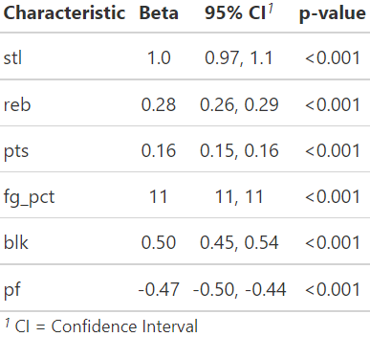
Initial Modeling
After picking out variables (best subsets and theory) that seemed important for predicting plus minus, we created a linear regression model to estimate their significance.
Key takeaway: All these important basketball statistics are highly significant in predicting plus minus.

Slide 8
Exploring the CS:GO dataset
By Jesse Coulson & Adam Sanden

Slide 9
CS:GO dataset
This dataset looks at professional matches of CS:GO
A lot of matches in the dataset were from 3 game series so we filtered for one game series to match the basketball data more closely
We have different variables that will go towards a player statistics such as kills, deaths, assists, kda, and rating
Rating is a special variable that was native in the dataset, it is derived from hltv.org and is well regarded by the community
Don’t know the exact formula but we also want to see its relationship to game outcomes

Slide 10
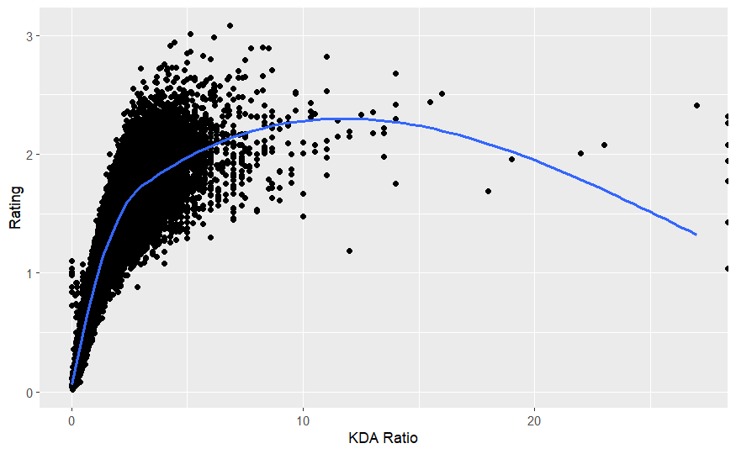
Trend Exploration
KDA is the ratio of kills, deaths, and assists. A KDA of 1 means they got just as many kills and assists as deaths.
Since we don’t know know an exact formula for rating we want to see how an important statistic such as KDA relates to it

Slide 11
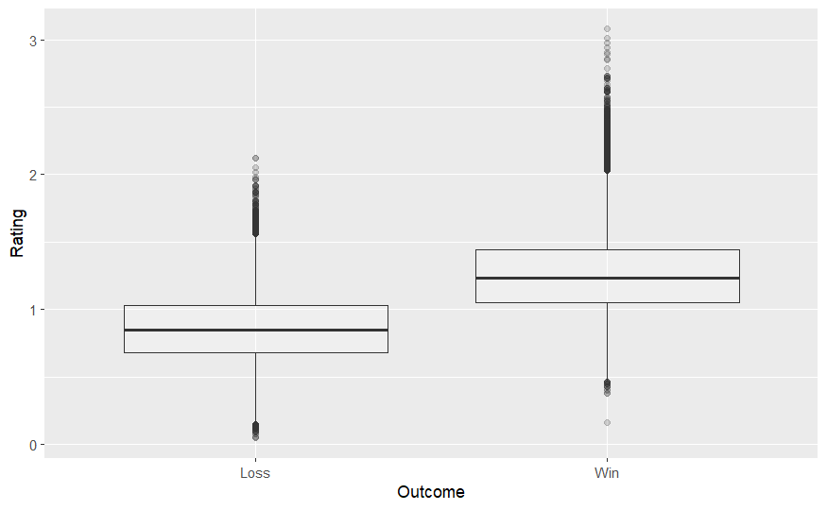
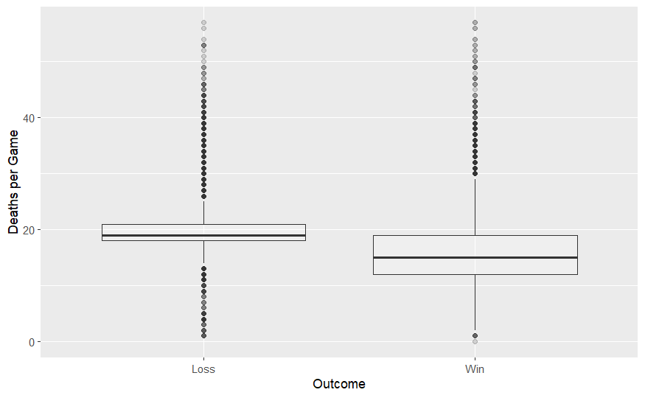
Trend Exploration
As we can see from these box plots the team with the higher average rating has a significant correlation with being the team that wins the match
We can also see only a slight negative correlation between the team with the higher number of deaths and winning.

Slide 12
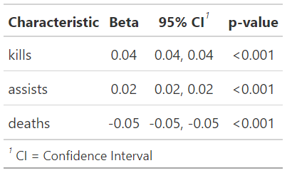
Initial Modeling
We used a linear regression model to see the impact of a few key variables on player rating.
Our model predicts that for each additional kill player rating increases by 0.04.
The relationship between assists and rating is positive.
The relationship between deaths and rating is negative.
The player rating variable seems like a descent indicator of player skill

Slide 13



Beginning to answer data science question
Data science question: Looking for how variations of player skill combinations impact the outcome of a game
Calculated the average rating of a player, then created 3 datasets based on one standard deviation above, below, and in the middle of the mean rating
Combined these three datasets into one that holds all players and ratings

Slide 14
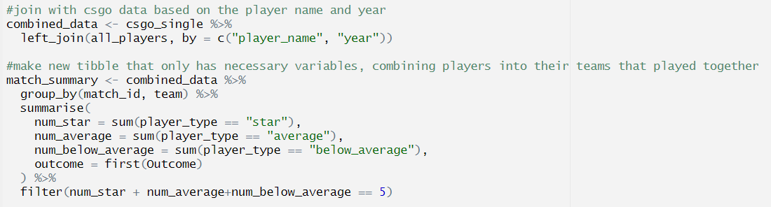
Creating final dataset
Joined the ratings dataset with original long data to gain per match information with team composition
Made a new tibble with necessary variables, combining players into their teams
Used summarise to get counts of each player type, filter was needed because of a few outlier games where it said there were more than 5 players

Slide 15
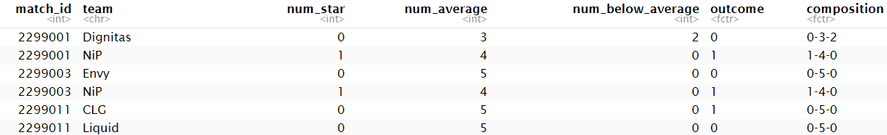

Final dataset
Created a composition categorical variable that was one variable to represent the other three
Not every composition is represented, so we had to drop those to run glm, with more data this would not be a problem

Slide 16
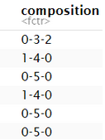
Composition variable
The reason we had to make a team composition categorical variable is to deal with multicollinearity
This is when variables are highly correlated with each other e.g. if there are 4 star players there can only be 1 in avg or below avg
If this is not addressed each variable’s contribution will be inaccurately represented. Having one categorical variable solves this

Slide 17
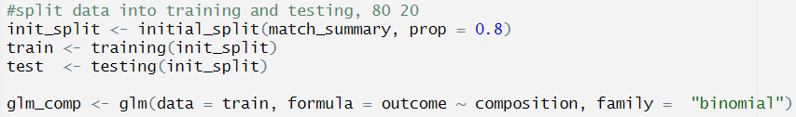
Final Models introduction
Split data into training and testing
Because of multicollinearity, only doing one categorical variable as input for model
Models are logistic regression with binomial family which means the target variable is binary
Only allows outcome to be win or loss and not a continuous value like other linear models
For csgo the accuracy on predicting outcomes was 55% and basketball was 54%

Slide 18
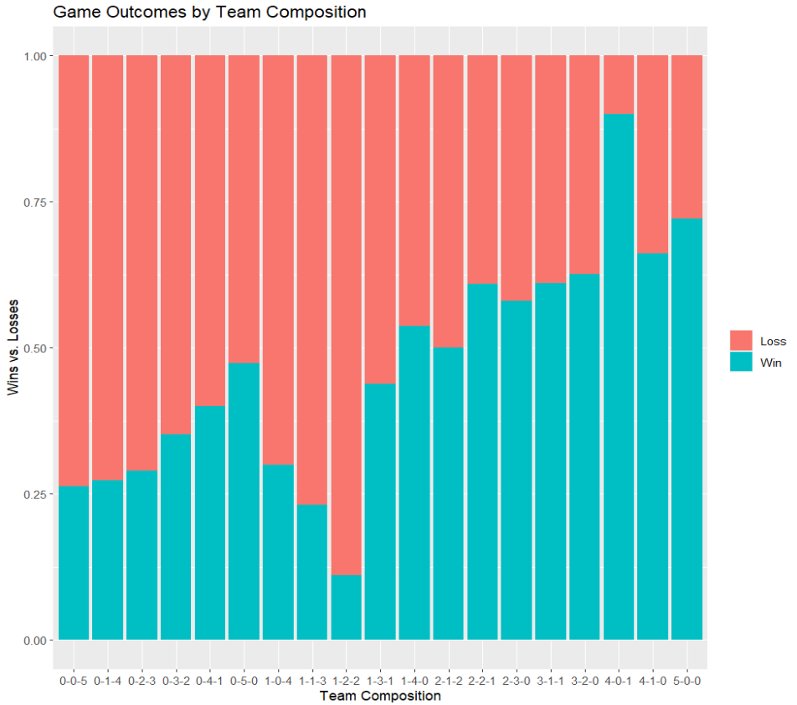
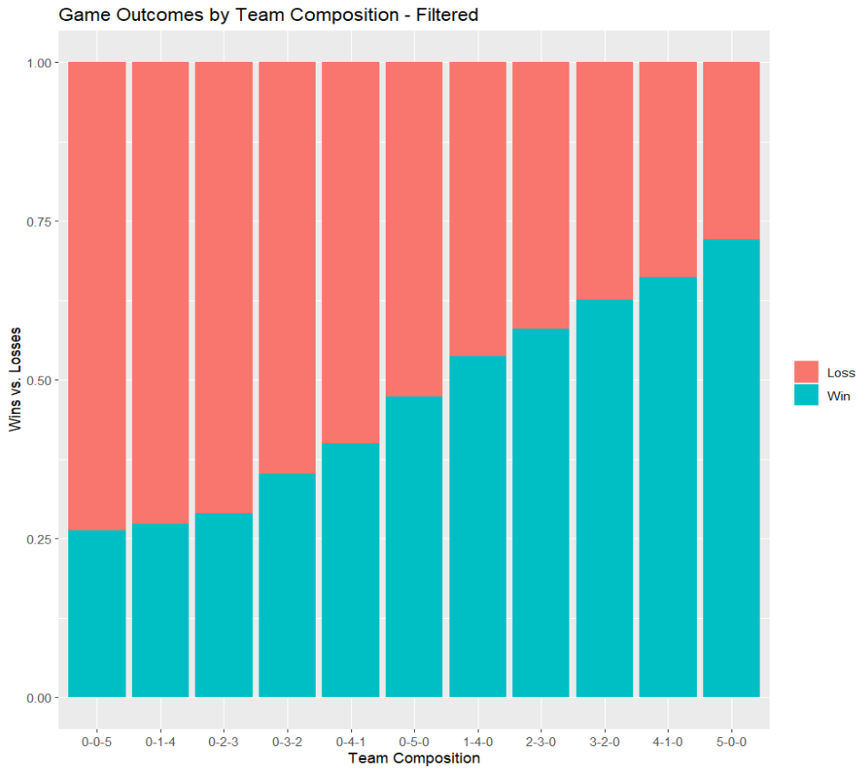
Model Interpretation
Unfiltered vs. Filtered Categories (Basketball)

Slide 19
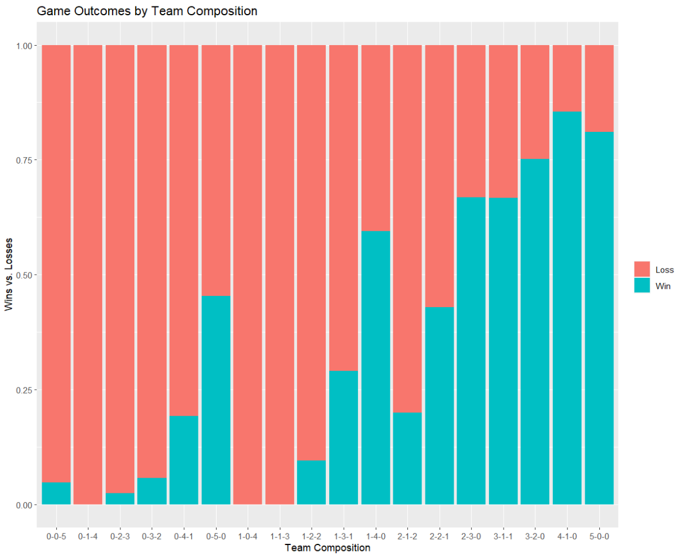
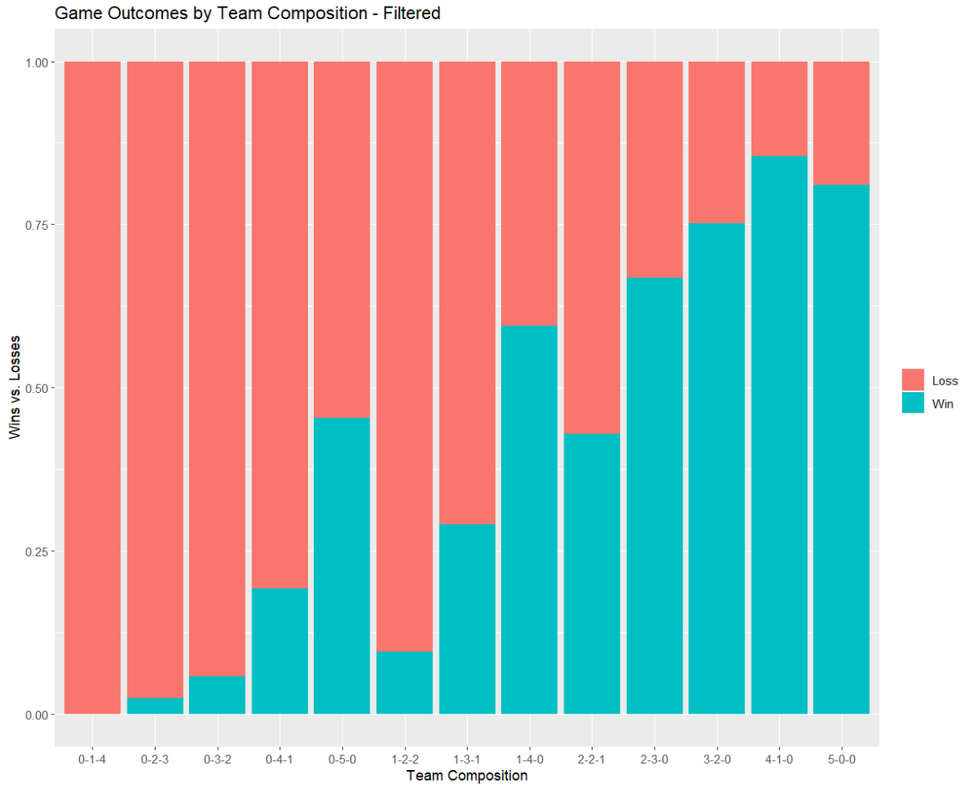
Model Interpretation
Unfiltered vs. Filtered Categories (CS:GO)

Slide 20
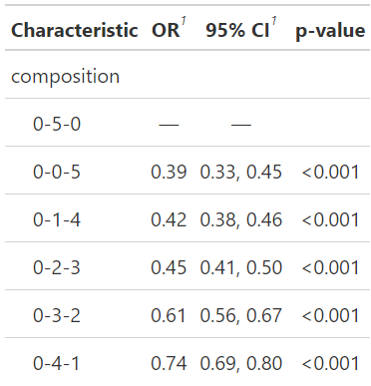
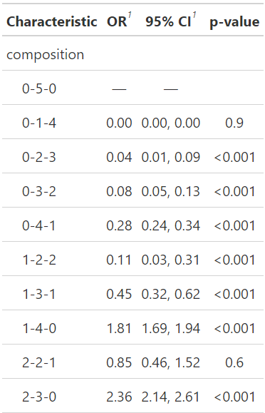
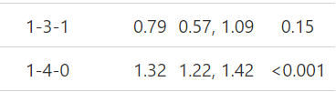
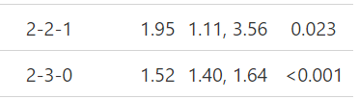

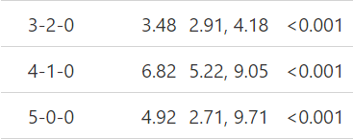
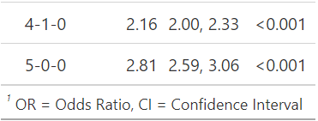
Composition Comparison
Compositions with less than 30 observations were included in the model, but not reported in the tables.
CS:GO has a very sharp curve, meaning individual player skill has a more potent effect on game outcome.
Basketball
CS:GO

Slide 21
Key Differences and Interpretation
Interpretation
Basketball - A team composition with 5 star players has 2.81 (2.59, 3.06) times the odds of the game outcome being a win compared to a team composition of 5 average players.
CS:GO - A team composition with 5 star players has 4.92 (2.71, 9.71) times the odds of the game outcome being a win compared to a team composition of 5 average players.
Key Differences
Composition | Basketball | CS:GO
0-2-3 | 0.45 | 0.04
0-3-2 | 0.61 | 0.08
0-4-1 | 0.74 | 0.28
1-4-0 | 1.32 | 1.81
5-0-0 | 2.81 | 4.92

Slide 22
Comparing Trends
Basketball
CS:GO
As the overall performance of a composition increases, the odds of winning a CS:GO match increases much faster than in basketball.

Slide 23
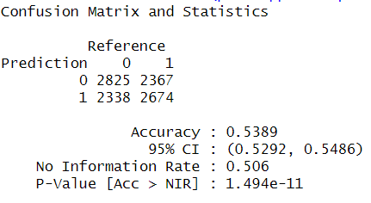
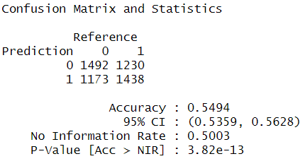
Model Performance
Basketball confusion matrix
Csgo confusion matrix
Filtering out compositions with low sample sizes had minimal effects on the model accuracy
RMSE, R², or MAE are not meaningful for logistic regression
We can look at accuracy instead

Slide 24
Limitations
Conclusions
Is our classification of a star good?
The basketball performance measures and models did not account for the presence of substitution players.
The number of observations for the CS:GO dataset was limited a little bit because we removed all of the data from matches that were best of 3
Not enough data to display all composition combinations
Odds of winning increase fairly proportionally with the overall skill of the team.
In both data sets having more below average players negatively affects the chances of winning.
However CS:GO is a much more volatile game than Basketball, where a single player is much more capable of both carrying and throwing the entire game.

Slide 25
Future Works
Does the relationship remain in sports with other team sizes?
At what price point is it no longer optimal to acquire a star player?
How do other performance measures affect the relationship?
Exploring the impact of other covariates on outcome.
i.e. Home vs. Away

