Slide 2
S_3
10
S_4
40
S_6
S_9
40
10
5
S_7
S_1
15
S_5
30
20
30
20
S_8
20
S_2
S_10

Slide 3
S_3
10
40
S_6
40
10
5
S_7
S_1
15
S_5
30
20
30
20
S_8
20
S_10
0
S_4
S_7
S_8
S_2
S_9

Slide 4
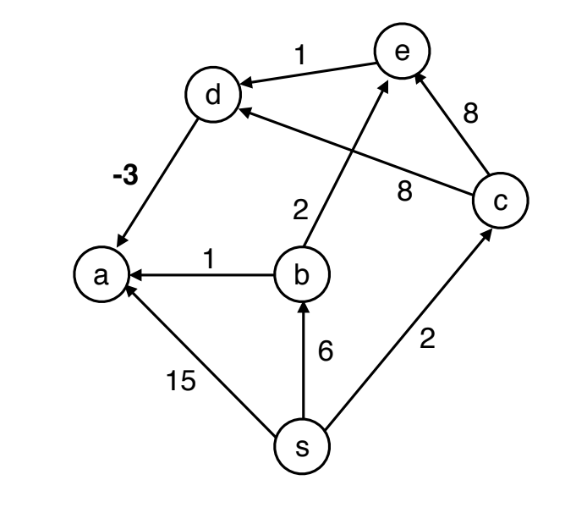

Slide 5
10
s
a
b

