Slide 1
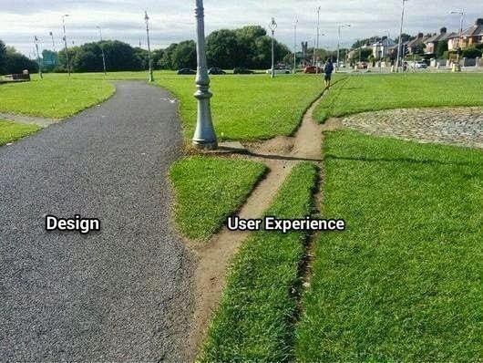

Getting started with the big idea
How I bootstrapped my prototype on a shoestring budget
This “Death by Powerpoint” is offered to you by
Jean Christophe Diomard Arrazau<jcda@roo.red>
Founder of Roo.red
http://keybase.io/jcda

Slide 2
Getting started with the big idea
How I bootstrapped my prototype on a shoestring budget
Table of contends
Pre requisites (How to get them ?)
Basic Concepts.
Where to get help ?
Breaking down the project.
Conclusion.

Slide 3
Getting started with the big idea
How I bootstrapped my prototype on a shoestring budget
Table of contends
Pre requisites (How to get them ?)
Basic Concepts.
Where to get help ?
Breaking down the project.
Conclusion.

Slide 4
Getting started with the big idea
How I bootstrapped my prototype on a shoestring budget
Table of contends
Pre requisites (How to get them ?)
Basic Concepts.
Where to get help ?
Breaking down the project.
Conclusion.

Slide 5

Getting started with the big idea
How I bootstrapped my Minimal Viable Product on a shoestring budget
Pre requisites (How to get them ?)
      Bash (http://tldp.org/guides.html )
      Ssh (http://www.openssh.com/ )
      Git ( http://www.git-scm.com/ )
      Text editor
        Vim
        Emacs
        Other ?
      Specifics:
        (MS win) Cygwin ( http://cygwin.com/ )
        (MacOSX) Brew ( http://brew.sh )

Slide 6
Getting started with the big idea
How I bootstrapped my prototype on a shoestring budget
2. Basic Concepts.
        Availability
        Scalability
        Resilience
        Accountability

Slide 7
Getting started with the big idea
How I bootstrapped my prototype on a shoestring budget
2. Basic Concepts.
        Availability
                High availability
                Single point of failure
                Software
                Hardware
                Power
                Outside Attacks
                Bugs

Slide 8
Getting started with the big idea
How I bootstrapped my prototype on a shoestring budget
2. Basic Concepts.
        b) Scalability
        It works for 100 users per min … Will it work for 100 000 ? what about 100 001 ?
        What is DRY ?

Slide 9
Getting started with the big idea
How I bootstrapped my prototype on a shoestring budget
2. Basic Concepts.
        b) Scalability
        It works for 100 users per min … Will it work for 100 000 ? what about 100 001 ?
        What is DRY ?

Slide 10

Getting started with the big idea
How I bootstrapped my prototype on a shoestring budget
2. Basic Concepts.: Resilience
                When things go wrong ...
                Backups ? Tested ?
                How quickly can you restore ?
                Which version ?
                Post mortem ?
                Remediation ? Documentation ?

Slide 11
Getting started with the big idea
How I bootstrapped my prototype on a shoestring budget
2. Basic Concepts: Accountability
Logs ?
What to look at ? Metrics .
Users, login attempts, storage, OS updates.
Tickets
Documentation
IT DOES NOT EXIST IF IT IS NOT WRITTEN

Slide 12
Getting started with the big idea
How I bootstrapped my prototype on a shoestring budget
Table of contends
Pre requisites (How to get them ?)
Basic Concepts.
Where to get help ?
Breaking down the project.
Conclusion.

Slide 13
Getting started with the big idea
How I bootstrapped my prototype on a shoestring budget
3. Where to get help ? (There are catches)
      a) For free
            Duckduckgo
            StackOverflow
            Github
            IRC
            Youtube
      b) For money
            Elance
            Airpair
            Books

Slide 14
Getting started with the big idea
How I bootstrapped my prototype on a shoestring budget
Table of contends
Pre requisites (How to get them ?)
Basic Concepts.
Where to get help ?
Breaking down the project.
Conclusion.

Slide 15
Getting started with the big idea
How I bootstrapped my prototype on a shoestring budget
4. Breaking down the project.(more details inside)
Simplified view:
database
Framework
Webserver
Infrastructure

Slide 16
Getting started with the big idea
How I bootstrapped my prototype on a shoestring budget
4. Breaking down the project.
  Infrastructure:
      DNS
      Cloud → cost, helps to bootstrap ( caveat : make it difficult to leave if too many great features )
          Firewall (ports 80, 443, 22)
          HA
          Storage
  Webserver :
        OS (linux: reliance, price, widely known, documentation, support, remote access )
        Nginx ( apache used to be great )
        Fail2ban
        Logwatch
        Exim (simple email server )
        Tmux (console)
        Python
                Virtualenv - > Framework

Slide 17
Getting started with the big idea
How I bootstrapped my prototype on a shoestring budget
Table of contends
Pre requisites (How to get them ?)
Basic Concepts.
Where to get help ?
Breaking down the project.
Conclusion.

Slide 18
Getting started with the big idea
How I bootstrapped my prototype on a shoestring budget
Framework
Django
Edge as bootstrap
(u)wsgi
Celery
Database
For tests : sqlite (default)
Then : - Postgresql ( fully supported by Django )
- MongoDB
- NOSQL
- ?

Slide 19
Getting started with the big idea
How I bootstrapped my prototype on a shoestring budget
Conclusion.
Things can change ( something else that might be better )
Works for me != Works for you

Slide 20
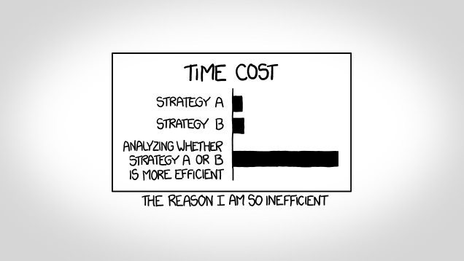
Getting started with the big idea
How I bootstrapped my prototype on a shoestring budget
On the other hand :

Slide 21
Getting started with the big idea
How I bootstrapped my prototype on a shoestring budget
Thank You
Do not hesitate to contact me: jcda@roo.red

