Slide 1
MSL Companion
A case study on how to use LLMs to empower MSL teams at Bristol Myers Squibb.
Oct 18, 2024
Jose de la Garza

Slide 2
Objectives
Identify a solution that uses LLMs to inform, train and empower MSL teams by using custom data.
Create a prototype that will showcase the benefits of an MSL companion to drive further investment in AI.

Slide 3
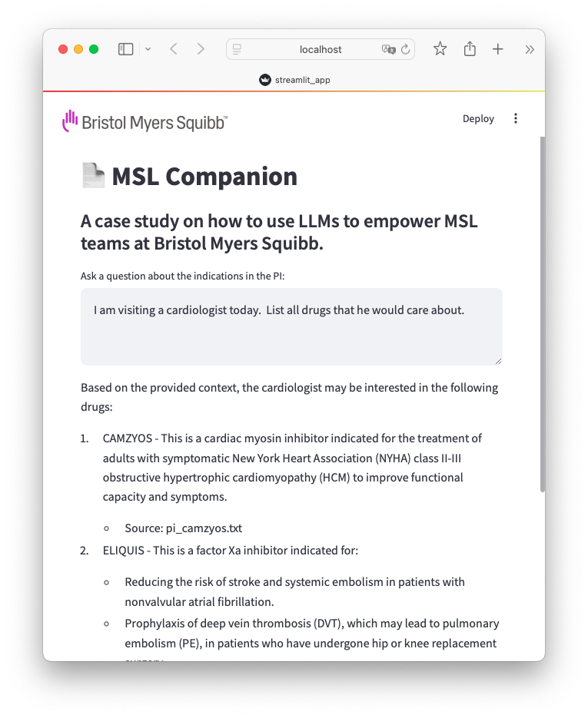
MSL Companion
MSL Companion can make indication information available at the fingertips.
A web-based solution using the latest technology:
Python
Streamlit.io, a Python library to build data apps.
… and the latest LLM modeling:
OpenAI GPT-4o.
Prompt tuning.
RAG (Retrieval-Augmented Generation) document search, top 17 drugs manufactured by BMS.

Slide 4
Demo & Code Review

Slide 5
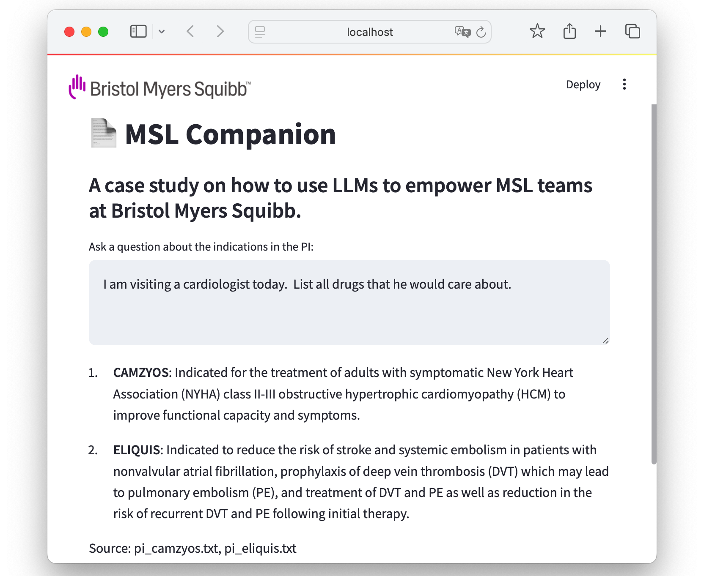
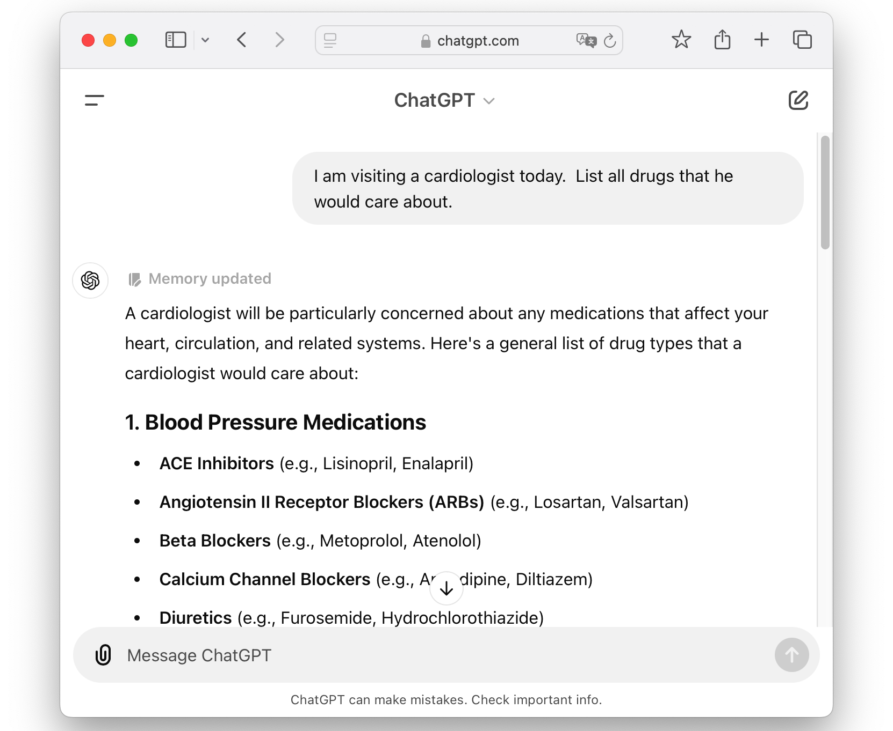
MSL Companion vs ChatGPT: Results Are More Relevant to BMS MSL team

Slide 6
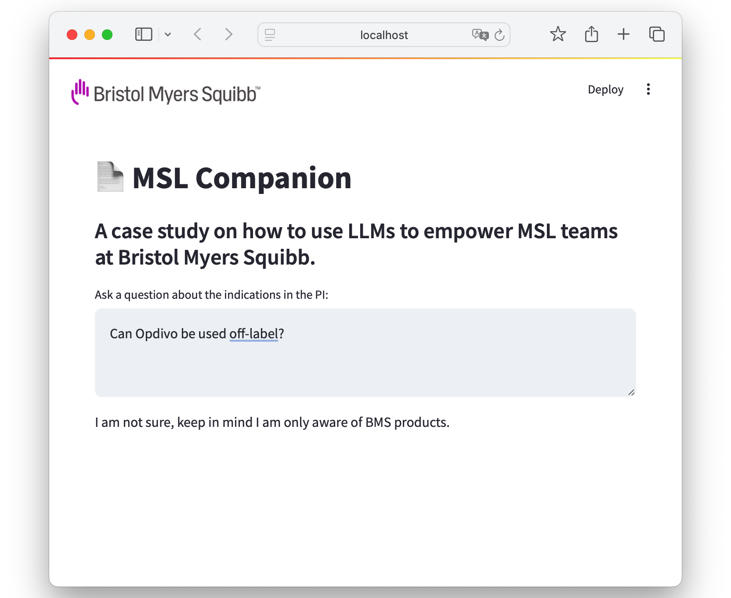
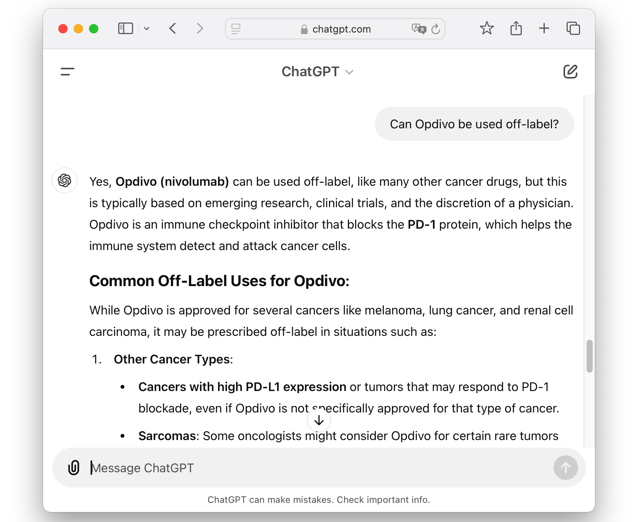
MSL Companion vs ChatGPT: Limited Breadth of Answers Improves Reliability

Slide 7
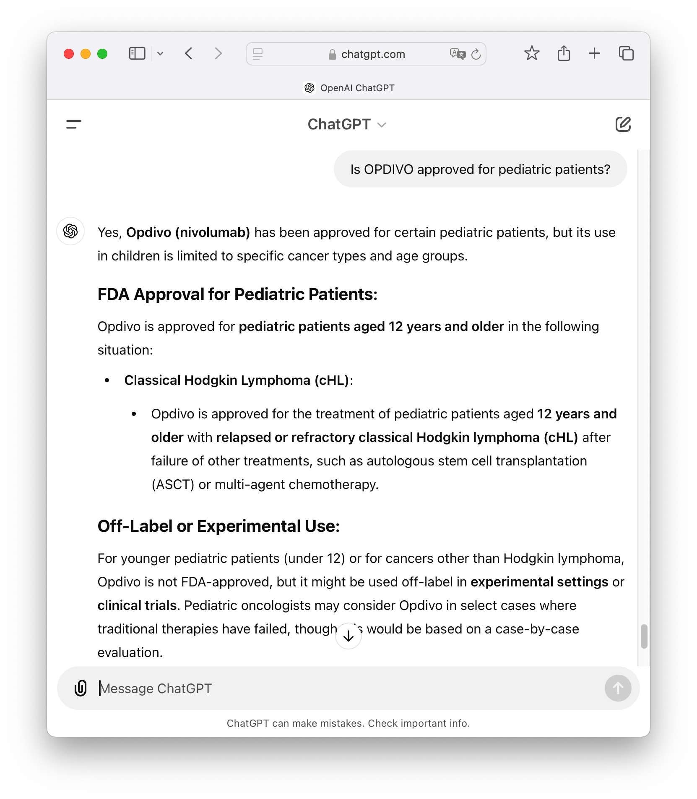
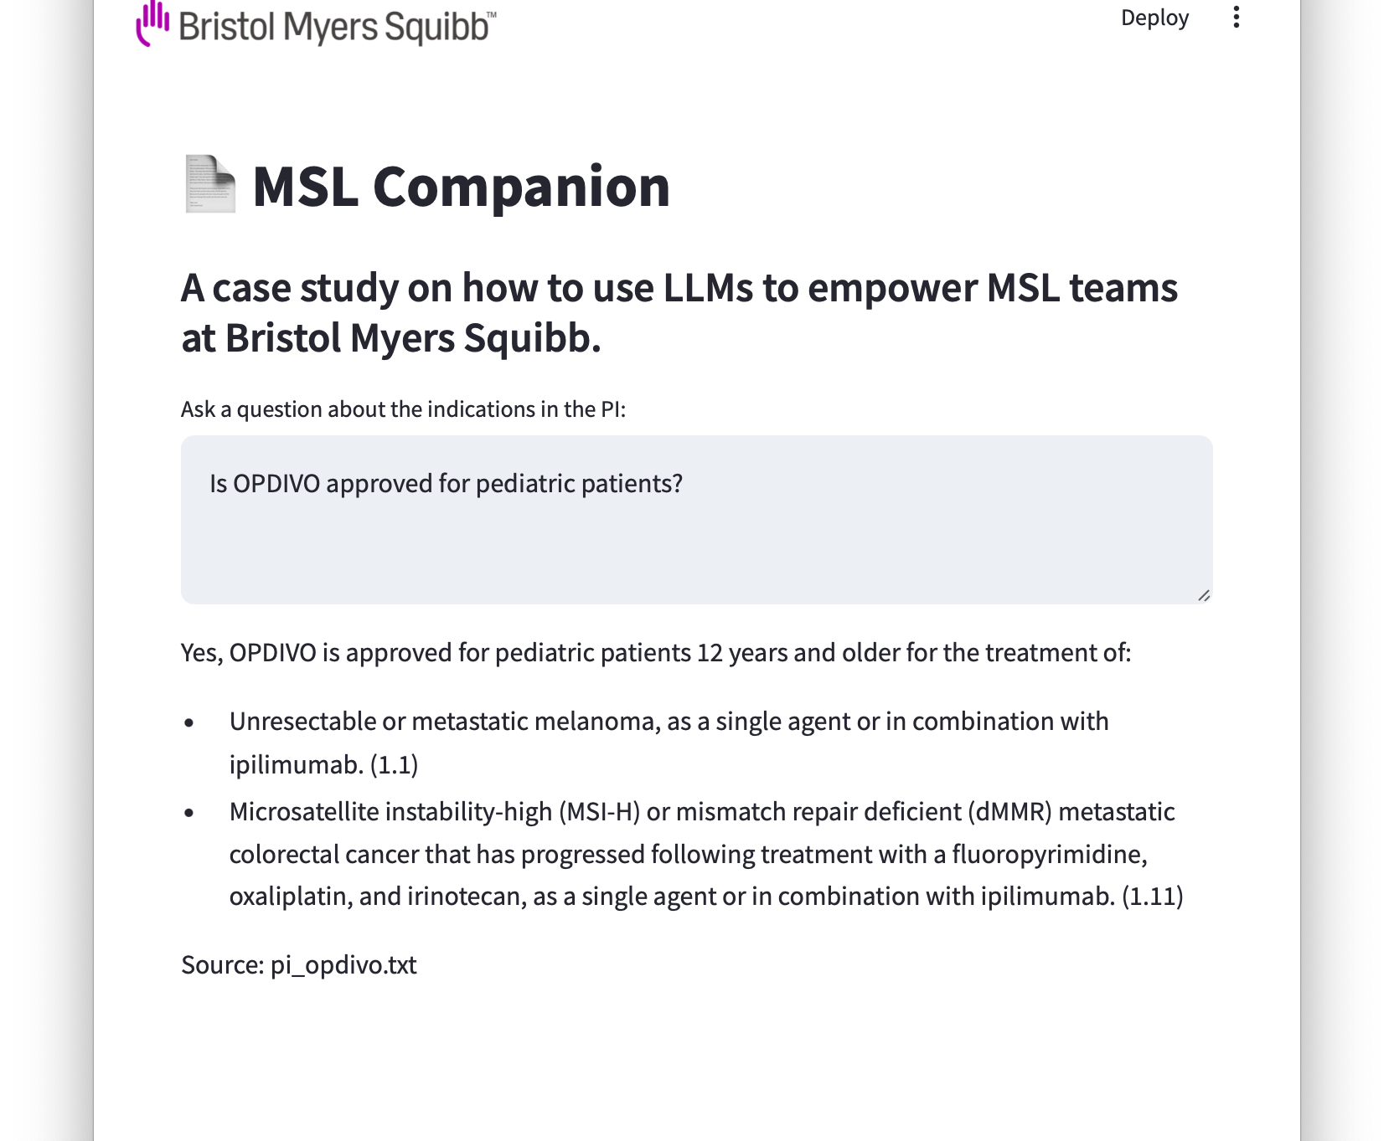
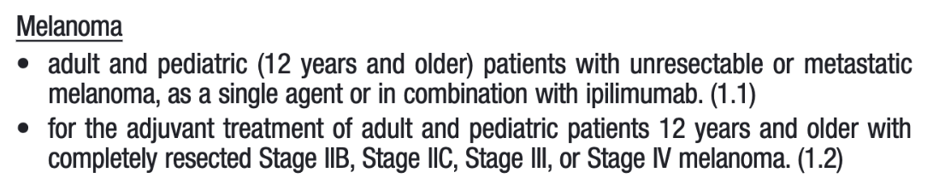
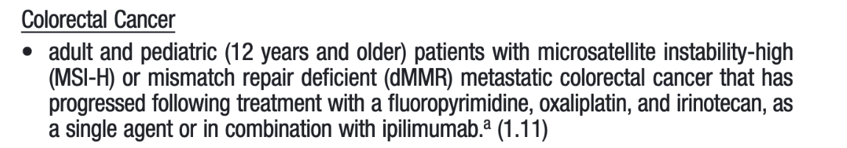
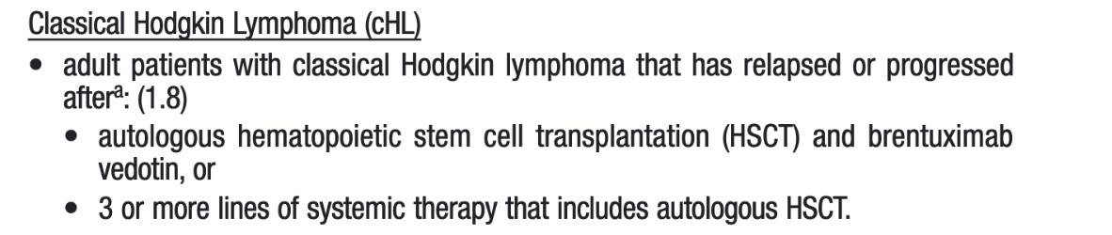
MSL Companion vs ChatGPT Mitigate Incorrect Answers (Hallucination)

Slide 8
Future Potential Enhancements
Enable web links to each source PI.
Enable other information in the PI.
Enable other information relevant to MSLs, including proprietary information.
Enable open-source models like Llama that can be hosted in-house to limit the risk of proprietary data being sent externally.

Slide 9
Jose de la Garza
jose.delagarza@gmx.net

