Slide 1
MSL Companion
A case study on how to use LLMs to empower MSL teams at Bristol Myers Squibb.
Oct 18, 2024
Jose de la Garza

Slide 2
Objectives
Identify a solution that uses LLMs to inform, train and empower MSL teams by using custom and proprietary data.
Create a prototype that will showcase the benefits of an MSL companion to drive further investment in AI.

Slide 3
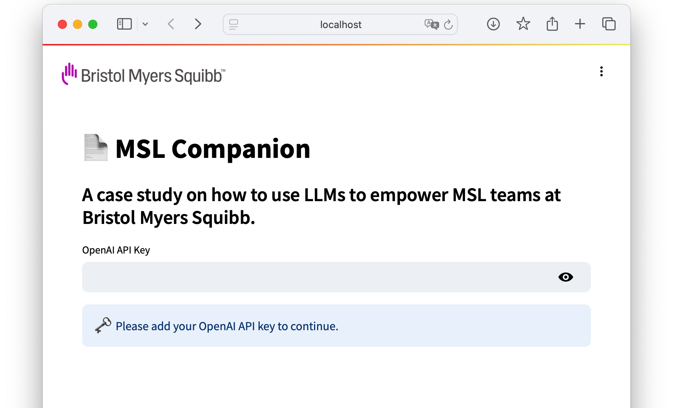
MSL Companion
A web-based solution implemented using:
Python
OpenAI ChatGPT.
Streamlit.io, a Python library to build web-based apps.
Langchain, a Python library to orchestrate chat-oriented applications.
RAG (Retrieval-Augmented Generation) document search, initially top 27 drugs by sales manufactured by BMS.
A tool that showcases specific use cases for MSLs.

Slide 4
Jose de la Garza
jose.delagarza@gmx.net

