Slide 1
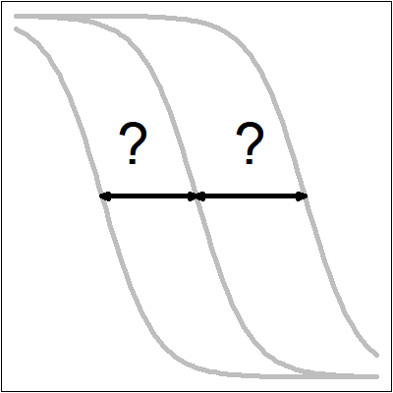
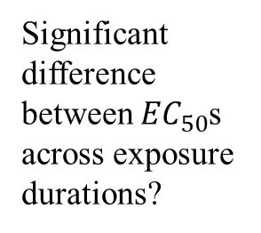
Significant difference between ${EC}_{50}$s across exposure durations?
Step 1
Yes
No
Fit td2pLL
(Account for effect of exposure duration)
Fit single 2pLL (Ignore effect of exposure duration)
Step 2

