Slide 1
Week 12

Slide 2
Warm-up (10 minutes)
Check out the Lending Club dataset here: https://www.openintro.org/data/index.php?data=loans_full_schema
Download the csv, store it in a logical location on your computer, convert it to a dataframe, and indicate what your hypothesis is about which factors influence if someone will pay their loan back.

Slide 3
Today's Activities
Warmup (15 mins)
Review Homework (15 mins)
Lambda Functions (35 mins)
Break (10 mins)
Intro to Machine Learning (35 mins)
Break (10 mins)
Group Exercise (60 mins)

Slide 4
Panel for Next Week
Angelique Zeringue – Data Science Competency Lead at Daugherty
Brittany Minor – Medical Informaticist at WashU, LaunchCode Data Science TA
Jeromey Farmer – Global Head of Data and Analytics at Kynetec, Professor at WashU, Girl Scouts of Eastern Missouri Board Member
Michelle Lacy – Biotechnology Data Engineering Lead at Bayer
Susan King – Data and Analytics Lead at Daugherty

Slide 5
Lambda
Notes:
https://www.geeksforgeeks.org/applying-lambda-functions-to-pandas-dataframe/

Slide 6
Break (10 Minutes)
Attendance word: CSSConjurer

Slide 7
What is Machine Learning?
Machine learning (ML) is the study of computer algorithms that improve automatically through experience and by the use of data.[1] It is seen as a part of artificial intelligence. Machine learning algorithms build a model based on sample data, known as "training data", in order to make predictions or decisions without being explicitly programmed to do so. – Wikipedia
Machine-learning algorithms use statistics to find patterns in massive* amounts of data. And data, here, encompasses a lot of things—numbers, words, images, clicks, what have you. If it can be digitally stored, it can be fed into a machine-learning algorithm. – MIT
Machine learning is the concept that a computer program can learn and adapt to new data without human intervention. Machine learning is a field of artificial intelligence (AI) that keeps a computer’s built-in algorithms current regardless of changes in the worldwide economy. - Investopedia

Slide 8
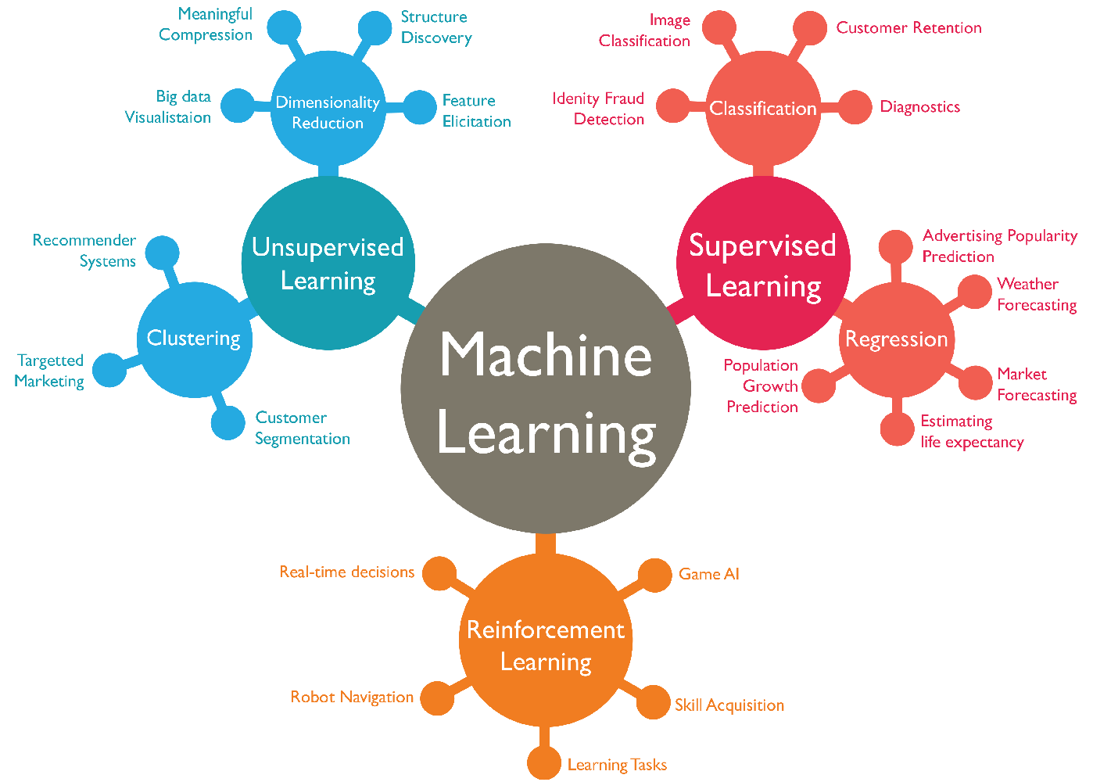

Slide 9
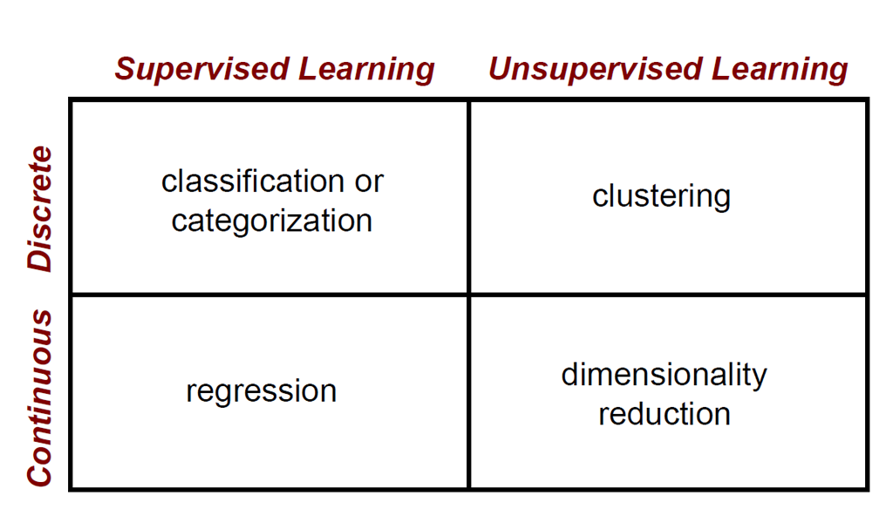

Slide 10
Preprocessing
Cleaning up null values
Data cleaning (dashes, odd characters, etc)
Handle missing data
Remove extreme outliers
One-Hot encoding
Convert Categorical values to numerical (sometimes that is the same as 3)
Standardization/Normalization
Deal with multicollinearity (can be caused by 3)

Slide 11
Feature Engineering
Definition: selecting variables that are the best predictors for what were trying to predict
Computation times are high if we have too many features, and too many features can lead to over-fitting

Slide 12
Cross Validation
Definition: testing performance of a machine learning model
How we do this:
Train a model using a subset of the data
Test model performance using a different subset
With or without replacement

Slide 13
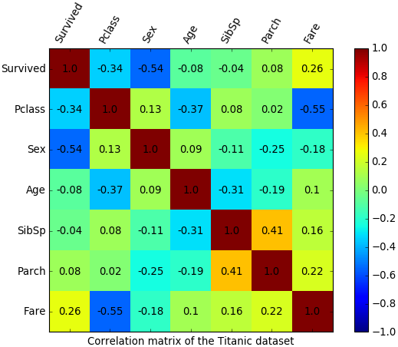
Correlation Matrix

Slide 14
Practice (5 mins)
What is the difference between supervised and unsupervised learning? Provide an example of when you would do each

Slide 15
Break (10 Minutes)
Attendance word:CSSConjurer

Slide 16
Week 12 Group Exercise
Once you finish and have submitted your exercise in Canvas via a github link, use the remaining time to work on your homework.

