Slide 1

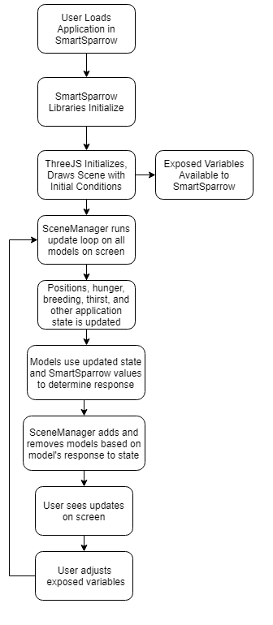
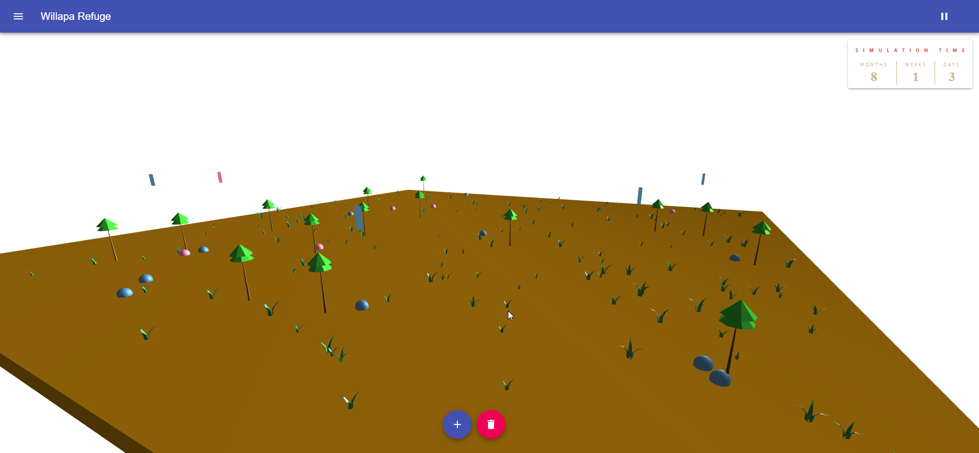
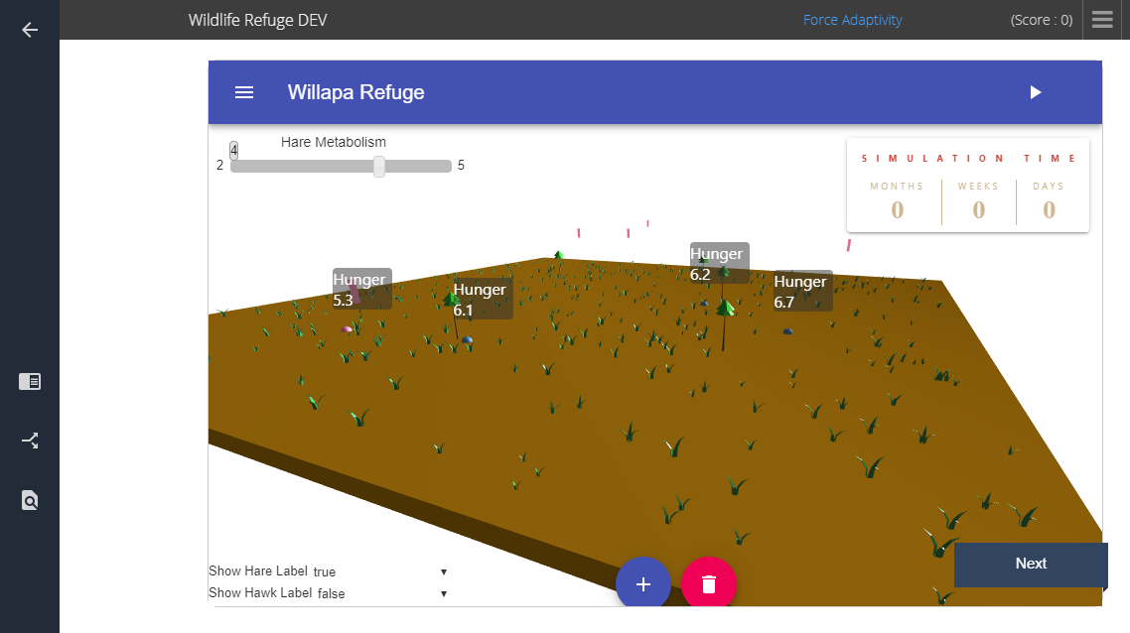

Wildlife Refuge
Jacob Cerda; Thongphanh Duangboudda; Enos Franceschini; Maxwell Heller; Andrew Thyng
Background
Implementation
Result
The Wildlife Refuge is a project aimed at delivering an interactive learning simulation to a wide variety of students through a platform called Smart Sparrow. The simulation’s goal is to demonstrate the effects changing ecosystem parameters has on wildlife stability. Smart Sparrow allows websites to expose data to the platform so content authors with non-technical knowledge can create a variety of lessons with targeted learning goals and outcomes.
The Wildlife Refuge is implemented as a purely client side web application utilizing ReactJS for some minor user interface elements. The bulk of the project leverages an open source framework called ThreeJS, which handles rendering 3D objects in the browser. The majority of the project is written in JavaScript.
Simulation running outside of Smart Sparrow.
Simulation running inside Smart Sparrow with UI control overlay

