Slide 1
FreeRTOS

Slide 2
Introdução
O FreeRTOS é uma aplicação que ajuda a desenvolver sistemas embarcados mais complexo, fornecendo um código base que cuida de fazer o time-sharing entre “processos” no microcontrolador e, dependendo dos defines usados, várias outras funções. Algumas delas, são para compartilhamento seguro de memória (variáveis) entre processos e temporização das tarefas.

Slide 3
Ele não é
Um SO como o Windows e o Linux, mesmo o embarcado.
Uma abstração do hardware (de forma a simplificar e padronizar o acesso a hardware).
Uma plataforma cheia de aplicativos com um sistema de arquivos

Slide 4
Super-loop
Init
Task1
Task2
Dificuldade em temporização
Dificuldade em reuso de código
Task3

Slide 5
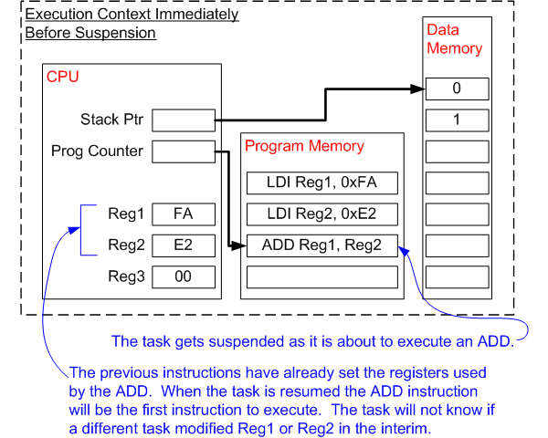
Troca de contexto
Salva os dados dos registradores na memória e
preenche com os dados da outra task. Mudando a task
que está sendo executada.

Slide 6
Arquivos base
Comuns
tasks.c,
queue.c
list.c
Específicos
port.c
portmacro.h

Slide 7
Específico a plataforma
Define o tamanho das variáveis usadas 16-bits ou 32-bits
Direção do crescimento da stack
Periodo do tick
Alinhamento de memória
Macos de troca de contexto
Des/habilitar interrupções

Slide 8
config.h
#ifndef FREERTOS_CONFIG_H
#define FREERTOS_CONFIG_H
/* Here is a good place to include header files that are required across
your application. */
#include "something.h"
#define configUSE_PREEMPTION 1
#define configUSE_PORT_OPTIMISED_TASK_SELECTION 0
#define configUSE_TICKLESS_IDLE 0
#define configCPU_CLOCK_HZ 60000000
#define configTICK_RATE_HZ 250
#define configMAX_PRIORITIES 5
#define configMINIMAL_STACK_SIZE 128
#define configMAX_TASK_NAME_LEN 16

Slide 9
config.h
#define configMINIMAL_STACK_SIZE 128
#define configMAX_TASK_NAME_LEN 16
#define configUSE_16_BIT_TICKS 0
#define configIDLE_SHOULD_YIELD 1
#define configUSE_TASK_NOTIFICATIONS 1
#define configUSE_MUTEXES 0
#define configUSE_RECURSIVE_MUTEXES 0
#define configUSE_COUNTING_SEMAPHORES 0
#define configUSE_ALTERNATIVE_API 0 /* Deprecated! */
#define configQUEUE_REGISTRY_SIZE 10
#define configUSE_QUEUE_SETS 0
#define configUSE_TIME_SLICING 0
#define configUSE_NEWLIB_REENTRANT 0
#define configENABLE_BACKWARD_COMPATIBILITY 0
#define configNUM_THREAD_LOCAL_STORAGE_POINTERS 5

Slide 10
config.h
#define configENABLE_BACKWARD_COMPATIBILITY 0
#define configNUM_THREAD_LOCAL_STORAGE_POINTERS 5
#define configSTACK_DEPTH_TYPE uint16_t
#define configMESSAGE_BUFFER_LENGTH_TYPE size_t
/* Memory allocation related definitions. */
#define configSUPPORT_STATIC_ALLOCATION 1
#define configSUPPORT_DYNAMIC_ALLOCATION 1
#define configTOTAL_HEAP_SIZE 10240
#define configAPPLICATION_ALLOCATED_HEAP 1
/* Hook function related definitions. */
#define configUSE_IDLE_HOOK 0
#define configUSE_TICK_HOOK 0
#define configCHECK_FOR_STACK_OVERFLOW 0

Slide 11
config.h
#define configUSE_TICK_HOOK 0
#define configCHECK_FOR_STACK_OVERFLOW 0
#define configUSE_MALLOC_FAILED_HOOK 0
#define configUSE_DAEMON_TASK_STARTUP_HOOK 0
/* Run time and task stats gathering related definitions. */
#define configGENERATE_RUN_TIME_STATS 0
#define configUSE_TRACE_FACILITY 0
#define configUSE_STATS_FORMATTING_FUNCTIONS 0
/* Co-routine related definitions. */
#define configUSE_CO_ROUTINES 0
#define configMAX_CO_ROUTINE_PRIORITIES 1
/* Software timer related definitions. */

Slide 12
config.h
/* Software timer related definitions. */
#define configUSE_TIMERS 1
#define configTIMER_TASK_PRIORITY 3
#define configTIMER_QUEUE_LENGTH 10
#define configTIMER_TASK_STACK_DEPTH configMINIMAL_STACK_SIZE
/* Interrupt nesting behaviour configuration. */
#define configKERNEL_INTERRUPT_PRIORITY [dependent of processor]
#define configMAX_SYSCALL_INTERRUPT_PRIORITY [dependent on processor and application]
#define configMAX_API_CALL_INTERRUPT_PRIORITY [dependent on processor and application]
/* Define to trap errors during development. */
#define configASSERT( ( x ) ) if( ( x ) == 0 ) vAssertCalled( __FILE__, __LINE__ )
/* FreeRTOS MPU specific definitions. */

Slide 13
config.h
/* FreeRTOS MPU specific definitions. */
#define configINCLUDE_APPLICATION_DEFINED_PRIVILEGED_FUNCTIONS 0
/* Optional functions - most linkers will remove unused functions anyway. */
#define INCLUDE_vTaskPrioritySet 1
#define INCLUDE_uxTaskPriorityGet 1
#define INCLUDE_vTaskDelete 1
#define INCLUDE_vTaskSuspend 1
#define INCLUDE_xResumeFromISR 1
#define INCLUDE_vTaskDelayUntil 1
#define INCLUDE_vTaskDelay 1
#define INCLUDE_xTaskGetSchedulerState 1
#define INCLUDE_xTaskGetCurrentTaskHandle 1
#define INCLUDE_uxTaskGetStackHighWaterMark 0
#define INCLUDE_xTaskGetIdleTaskHandle 0

Slide 14
config.h
#define INCLUDE_uxTaskGetStackHighWaterMark 0
#define INCLUDE_xTaskGetIdleTaskHandle 0
#define INCLUDE_eTaskGetState 0
#define INCLUDE_xEventGroupSetBitFromISR 1
#define INCLUDE_xTimerPendFunctionCall 0
#define INCLUDE_xTaskAbortDelay 0
#define INCLUDE_xTaskGetHandle 0
#define INCLUDE_xTaskResumeFromISR 1
/* A header file that defines trace macro can be included here. */
#endif /* FREERTOS_CONFIG_H */

Slide 15
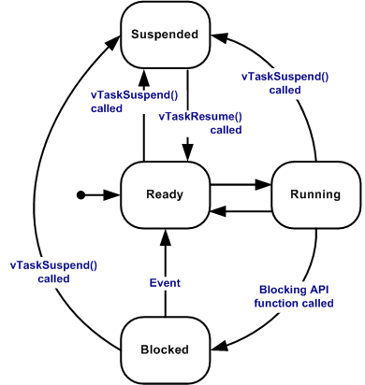
Task states
Running
Ready
Blocked
Suspended

Slide 16
Blocked Task
Blocked
Suspended

Slide 17
Deleted Task
Blocked
Suspended

Slide 18
Task template
void vATaskFunction( void *pvParameters )
{
for( ;; )
{
-- Task application code here. --
}
vTaskDelete( NULL );
}

Slide 19
Task template
void vATaskFunction( void *pvParameters )
{
for( ;; )
{
-- Task application code here. --
}
vTaskDelete( NULL );
}
SETUP
LOOP
Nunca chega aqui

Slide 20
Task template
Parâmetros
void vATaskFunction( void *pvParameters )
{
for( ;; )
{
-- Task application code here. --
}
vTaskDelete( NULL );
}

Slide 21
Task priority
De 0 até configMAX_PRIORITIES - 1.
Rodam as que têm mais prioridade, as de prioridade igual se alternam a cada tick (round-robin).
Se a de alta prioridade nunca chamar Delay as de menor prioridade não rodam.

Slide 22
Delay
Não trava o funcionamento, permite que outra coisa rode no tempo de espera.
void vTaskDelay( const TickType_t xTicksToDelay );

Slide 23
Heap types
Fragmentação por malloc
A
B
C
A
C
C
A
C
C

Slide 24
Heap types
Fragmentação por malloc
A
B
C
A
C
C
A
C
C

Slide 25
Heap types
Fragmentação por malloc
A
B
C
C
C

Slide 26
Heap types
A
#4
Fragmentação por malloc
A
B
C
C
C
C
A
C
#1
#2
#3

Slide 27
Heap types
A
Fragmentação por malloc
A
B
C
C
C
C
A
C

Slide 28
Heap types
heap_1 - A mais simples, faz pvPortMalloc, mas não faz pvPortFree.
heap_2 - Faz pvPortMalloc e pvPortFree mas não junta blocos de memória livre (fragmentação).
heap_3 - Implementa o malloc e free para serem thread-safe.
heap_4 - Faz pvPortMalloc e pvPortFree, além de juntar blocos de memória livre.
heap_5 - É como o heap 4, mas pode ter vários espaços de memória, não contíguos.

Slide 29
Task intercommunication
Queue
Task Notifications
Stream Buffer
Message Buffer

Slide 30
Queue
Deposita pacotes de dados de forma que, muitos possam depositar e muitos possam retirar.
Type A
Type A
Type A
Type A
Type A
Type A

Slide 31
Queue
QueueHandle_t xQueueCreate( UBaseType_t uxQueueLength, UBaseType_t uxItemSize );
xQueueSend( QueueHandle_t xQueue, const void * pvItemToQueue, TickType_t xTicksToWait );
xQueueReceive( QueueHandle_t xQueue, void *pvBuffer, TickType_t xTicksToWait );

Slide 32
Task sync
Binary Semaphores
Counting Semaphores
Mutex
Recursive Mutex

Slide 33
Semaphores
SemaphoreHandle_t xSemaphoreCreateBinary( void );
xSemaphoreTake( SemaphoreHandle_t xSemaphore, TickType_t xTicksToWait );
xSemaphoreGive( SemaphoreHandle_t xSemaphore );

Slide 34
Semaphores
Take
SemaphoreHandle_t xSemaphoreCreateBinary( void );
xSemaphoreTake( SemaphoreHandle_t xSemaphore, TickType_t xTicksToWait );
xSemaphoreGive( SemaphoreHandle_t xSemaphore );
Give

Slide 35

Counting Semaphores
SemaphoreHandle_t xSemaphoreCreateCounting( UBaseType_t uxMaxCount, UBaseType_t uxInitialCount);
uxSemaphoreGetCount( SemaphoreHandle_t xSemaphore );
SemaphoreHandle_t xSemaphoreTake( SemaphoreHandle_t xSemaphore, TickType_t xTicksToWait );
SemaphoreHandle_t xSemaphoreGive( SemaphoreHandle_t xSemaphore );

Slide 36
Counting Semaphores
SemaphoreHandle_t xSemaphoreCreateCounting( UBaseType_t uxMaxCount, UBaseType_t uxInitialCount);
uxSemaphoreGetCount( SemaphoreHandle_t xSemaphore );
SemaphoreHandle_t xSemaphoreTake( SemaphoreHandle_t xSemaphore, TickType_t xTicksToWait );
SemaphoreHandle_t xSemaphoreGive( SemaphoreHandle_t xSemaphore );
take

Slide 37
Counting Semaphores
SemaphoreHandle_t xSemaphoreCreateCounting( UBaseType_t uxMaxCount, UBaseType_t uxInitialCount);
uxSemaphoreGetCount( SemaphoreHandle_t xSemaphore );
SemaphoreHandle_t xSemaphoreTake( SemaphoreHandle_t xSemaphore, TickType_t xTicksToWait );
SemaphoreHandle_t xSemaphoreGive( SemaphoreHandle_t xSemaphore );
uxSemaphoreGetCount()
2

Slide 38
Counting Semaphores
SemaphoreHandle_t xSemaphoreCreateCounting( UBaseType_t uxMaxCount, UBaseType_t uxInitialCount);
uxSemaphoreGetCount( SemaphoreHandle_t xSemaphore );
SemaphoreHandle_t xSemaphoreTake( SemaphoreHandle_t xSemaphore, TickType_t xTicksToWait );
SemaphoreHandle_t xSemaphoreGive( SemaphoreHandle_t xSemaphore );
give

Slide 39
Mutexes
Como um semáforo binário, mas a task sendo bloqueada (em espera pelo recurso) pode “emprestar” a task quem está com o recurso a sua prioridade.

Slide 40




Mutexes

Slide 41
Mutexes
take

Slide 42
Mutexes
Tenta um take
X
Espera por

Slide 43
Mutexes
Esperando
Ganha a prioridade dos que esperam

Slide 44
Mutexes
Depois de usar o recurso, devolve e quem esperava obtém

Slide 45
Mutexes

Slide 46
Mutexes
SemaphoreHandle_t xSemaphoreCreateMutex( void )
xSemaphoreTake( SemaphoreHandle_t xSemaphore, TickType_t xTicksToWait );
xSemaphoreGive( SemaphoreHandle_t xSemaphore );

Slide 47
Recursive Mutexes
SemaphoreHandle_t xSemaphoreCreateRecursiveMutex( void );
xSemaphoreTakeRecursive( SemaphoreHandle_t xMutex, TickType_t xTicksToWait );
xSemaphoreGiveRecursive( SemaphoreHandle_t xMutex );

Slide 48
Task Notifications
Comunicação entre task, com baixa latência/overhead.
xTaskNotify( TaskHandle_t xTaskToNotify, uint32_t ulValue, eNotifyAction eAction )
xTaskNotifyGive( TaskHandle_t xTaskToNotify );
xTaskNotifyWait( uint32_t ulBitsToClearOnEntry, uint32_t ulBitsToClearOnExit, uint32_t *pulNotificationValue, TickType_t xTicksToWait );
ulTaskNotifyTake( BaseType_t xClearCountOnExit, TickType_t xTicksToWait );
eNotifyAction: eNoAction, eSetBits, eIncrement, eSetValueWithOverwrite, eSetValueWithoutOverwrite

Slide 49
Stream Buffer
Manda um stream, byte por byte.
Reader
Writer
Byte
Byte
Byte
Byte

Slide 50
Message Buffers
Manda uma mensagem, conjunto de bytes de tamanho fixo.
Reader
Writer
Package
Package
Package
Byte
Byte
Byte
Byte
Byte
Byte
Byte
Byte
Byte

Slide 51
Software timers
Após um número de ticks é feita uma chamada para uma função, podendo ser um timer
one-shot,
auto-reload.

Slide 52
Software timers
TimerHandle_t my_timer = xTimerCreate( "NOME", NUMERO_TICKS, RELOAD, COUNT, *f(void) );
RELOAD é um pdTRUE/FALSE
xTimerStart( TimerHandle_t xTimer, TickType_t xBlockTime );
xTimerStop( TimerHandle_t xTimer, TickType_t xBlockTime );

Slide 53
Hook Functions
Idle task hook: should be non blocking, must return if tasks are deleted
Tick hook: is inside a ISR
Stack overflow hook
Malloc failed hook

Slide 54
Hook Functions
void vApplicationIdleHook(void);
void vApplicationTickHook(void);
void vApplicationMallocFailedHook(void);
void vApplicationStackOverflowHook(TaskHandle_t xTask, signed char *pcTaskName);

Slide 55
Prática

Slide 56
ESP8266
esptool
make
all
app
flash
monitor

Slide 57
Semáforo e Queue
Obter recurso
LED
LED
LED
T = 1s
T = 2s
T = 4s
n = 2
T = 8s
T = 16s
Devolver recurso

Slide 58
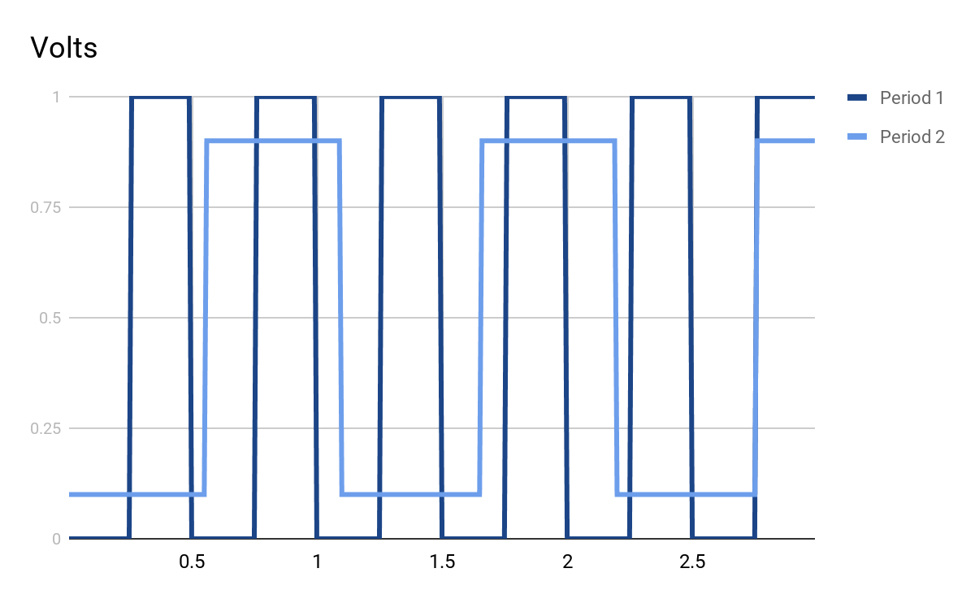
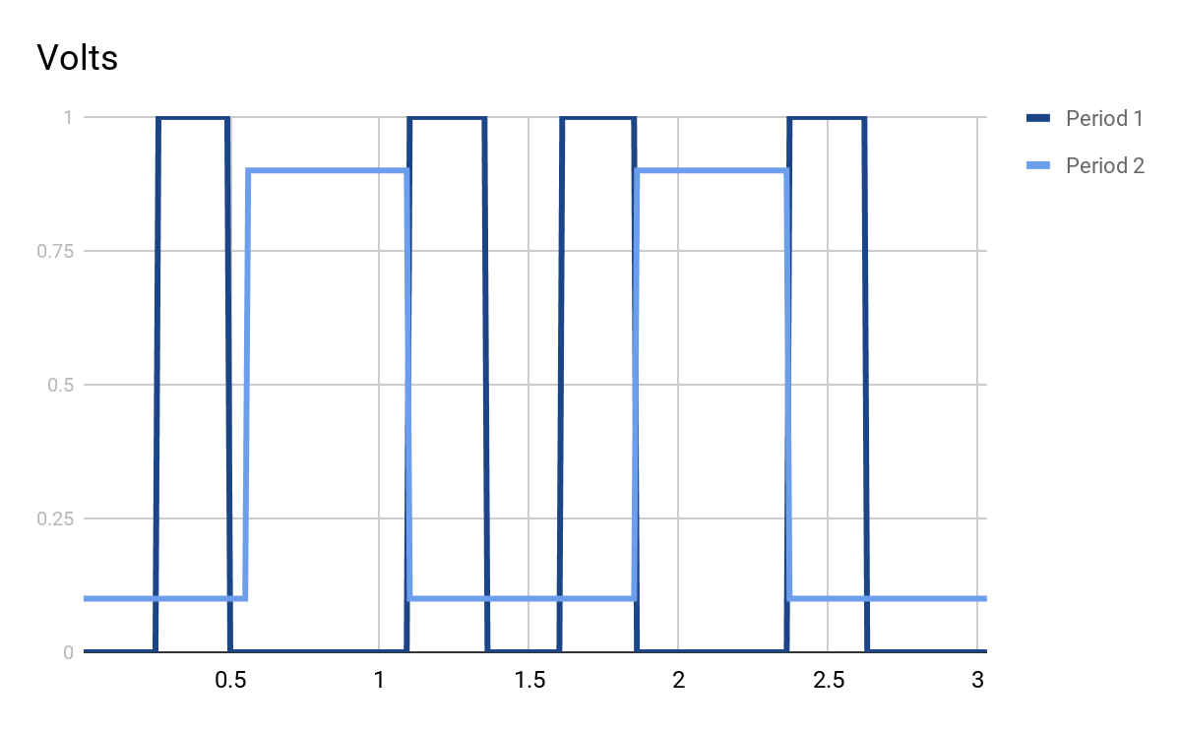
Semáforo Binário
Obter recurso
T = 1100 ms
T = 500 ms
Devolver recurso
Sem semáforo
Com semáforo

Slide 59
Semáforo Binário
Com semáforo
Sem semáforo

Slide 60
Software Timer
Auto Reload
T = 1s
Liga/Desliga
LED
Botão Boot
One Shot
T = 5s
Liga
Inicia
Desliga
LED

Slide 61
Task Notify
Botão Boot
Pressionado por
t segundos
Mensagem
Pisca o LED
Por 10t
Liga/Desliga
LED

Slide 62
Queue Delay
Três tasks enviam mensagens por uma fila com frequências diferentes. Duas tasks consomem elas e jogam na serial os resultados.
Gerador #1
T = 10s
Consumidor #1
T = 12s
Gerador #2
T = 11s
#1
#2
#1
#3
Consumidor #2
T = 6s
Gerador #3
T = 20s

Slide 63
Stream Buffer
stream
Letras aleatórias ou
mensagem
UART TX
A
B
F

