Slide 1
Music about Politics

Slide 2
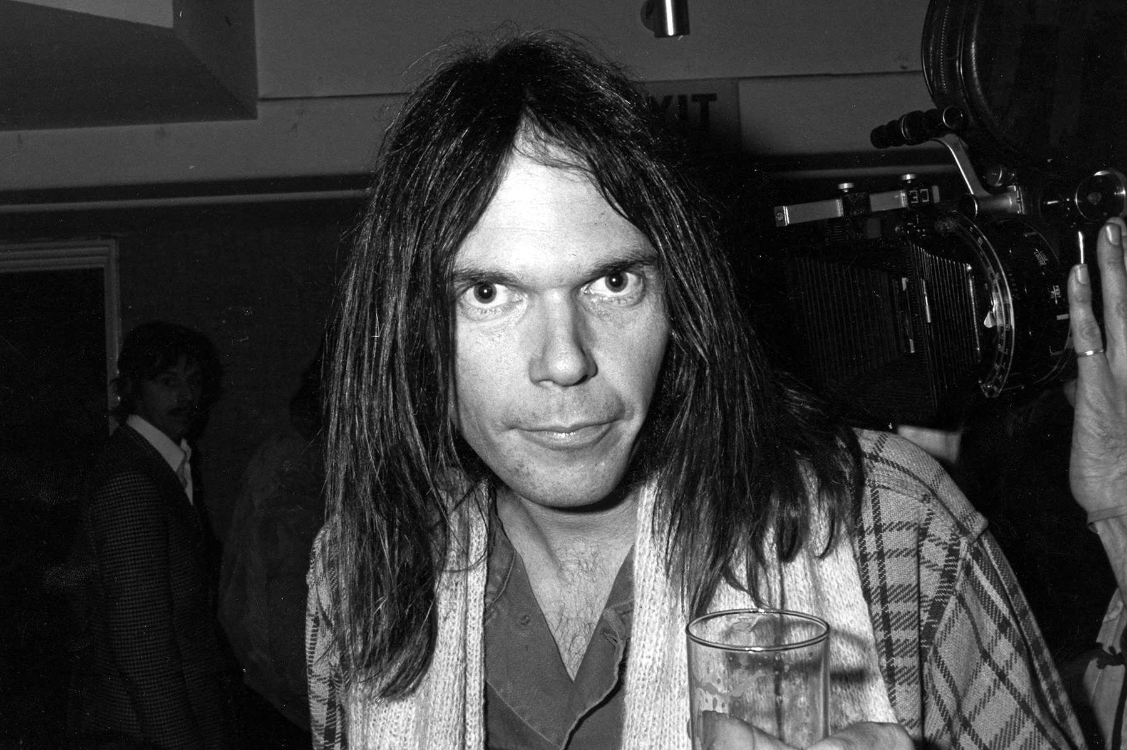
NEIL YOUNG | “Southern Man” This song is about racism in the American South, with references to slavery and the American white supremacist terrorist and hate group Ku Klux Klan or KKK. Young clarified that the song was more about the civil rights movement than the South in particular because many Southern people didn’t appreciate the generalization.
“I saw cotton and I saw black Tall white mansions and little shacks Southern man, when will you pay them back? I heard screaming and bullwhips cracking How long? How long? (Ah)”

Slide 3

TAYLOR SWIFT – ANTI-HERO
“Did you hear my covert narcissism I disguise as altruism Like some kind of congressman? (Tale as old as time)”

Slide 4
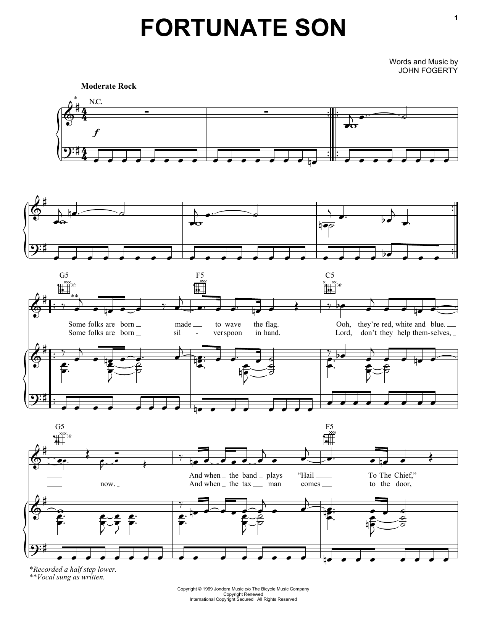

Slide 5

EMINEM | You Gon’ Learn
Make a bigot racist uncomfortable If y'all against talkin' reparation then I'm not against the thought of separation While the politicians that are white and privileged Ask how is this different from segregation, that's funny bro Segregation is bein' told where I'm gonna go Separation is bein' woke and goin' wherever I wanna go

Slide 6
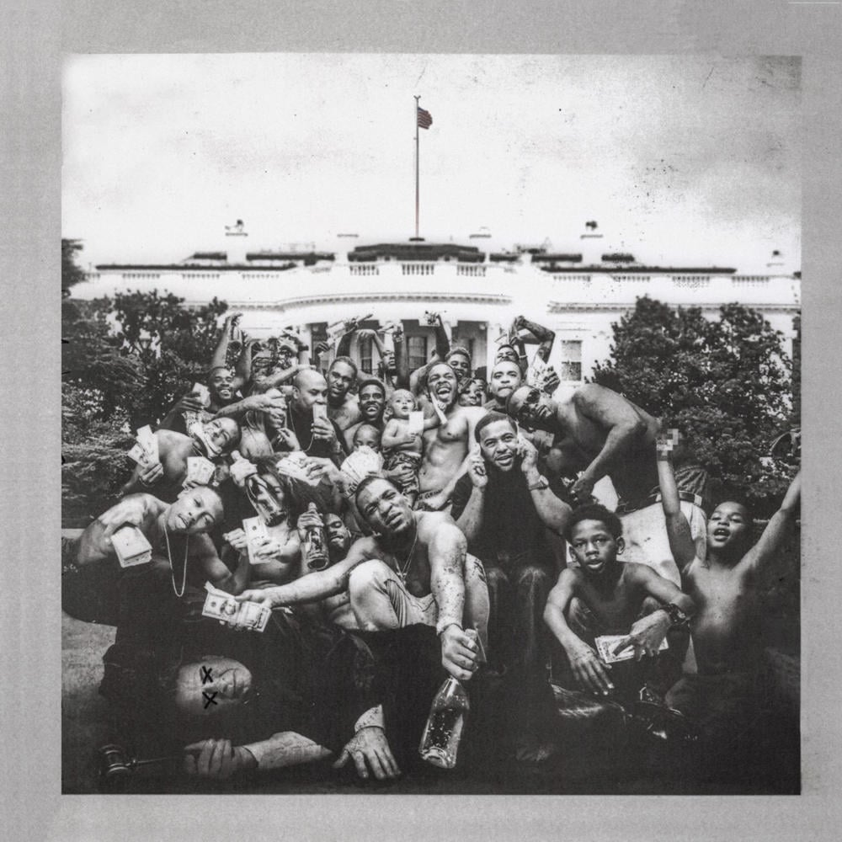
I remember you was conflicted Misusing your influence Sometimes I did the same Abusing my power full of resentment Resentment that turned into a deep depression

