Slide 1



Git & Github Introduction
Prepared by:
John Clement S. Escobanez, MIT
IT Faculty
College of Computing and Information Technologies

Slide 2
Objectives
Version Control
Git , Git repository
Git vs Github
Setup git environment
Create a git repository ( adding file, adding folder)
Checkout different version/ignore files…
Git tools

Slide 3
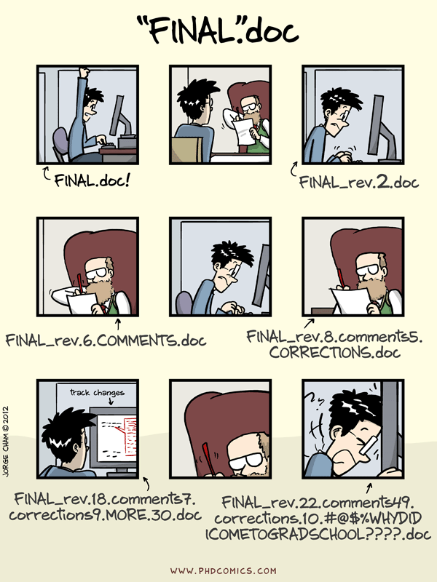

Slide 4
Why Version Control?
Collaboration Versioning Rolling Back Understanding
Scenario : Multiple students are doing a project together
Question: Why not Google drive & One drive ????
source code management vs file storage management

Slide 5
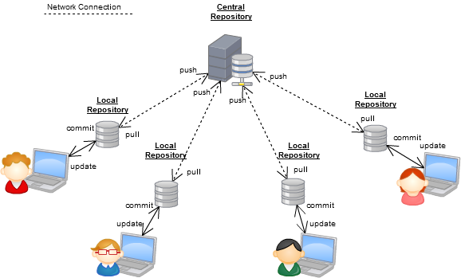
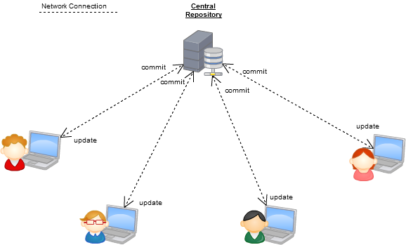
Version Control Systems
Some well-known version control systems are CVS, Subversion, Mercurial, and Git

Slide 6
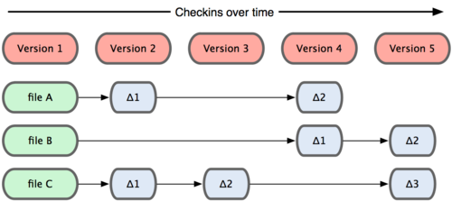
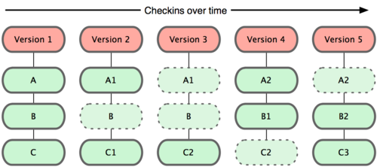
Why Git?
Git :most commonly used software for tracking changes in any set of files, usually used for coordinating work among programmers collaboratively developing source code during software development.
Git has many advantages over earlier systems such as CVS and Subversion
Subversion
Git

Slide 7

Git History
Came out of Linux development community
Linus Torvalds, 2005
Initial goals:
  Speed
  Support for non-linear development (thousands of parallel branches)
  Fully distributed
  Able to handle large projects like Linux efficiently
  Global Information Tracker (acronym name)

Slide 8

What is Github?
GitHub was developed by Chris Wanstrath, P. J. Hyett, Tom Preston-Werner and Scott Chacon using Ruby on Rails, and started in February 2008
It is a subsidiary of Microsoft, which acquired the company in 2018 for $7.5 billion
GitHub.com is a site for online storage of Git repositories.
You can get free space for open source projects or you can pay for private projects.
Question: Do I have to use Github in order to use Git?
Answer: No!
you can use Git completely locally for your own purposes, or
you or someone else could set up a server to share files, or
you could share a repo with users on the same file system.

Slide 9
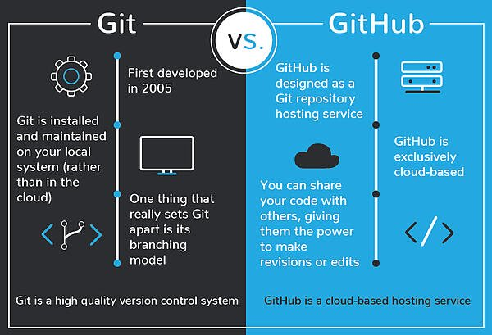
Git vs GitHub

Slide 10
Download and install Git
Here’s the standard one:
http://git-scm.com/downloads
Git Repository is a place where Git can store versions of our files
  $ cd ~/gitclass
  $ mkdir demo
  $ cd demo
  $ git init
  $ dir /ah or $ ls -a (* .git directory to store all the tracing info)

Slide 11
Introduce yourself to Git
Enter these lines (with appropriate changes):
  git config user.name "John Smith"
  git config user.email jsmith@gmu.edu
--global param

Slide 12
Git Command
command | description
git clone url [dir] | copy a git repository so you can add to it
git add files | adds file contents to the staging area
git commit | records a snapshot of the staging area
git status | view the status of your files in the working directory and staging area
git diff | shows diff of what is staged and what is modified but unstaged
git help [command] | get help info about a particular command
git pull | fetch from a remote repo and try to merge into the current branch
git push | push your new branches and data to a remote repository
others: init, reset, branch, checkout, merge, log, tag

Slide 13
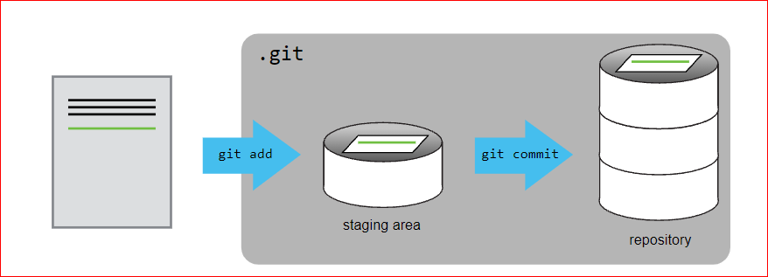
Adding a file to git repository

Slide 14
Adding a file to git repository
Create a rose.txt file ,copy rose.txt to demo folder
$git checkout -b main
Git status $git status
$ git add rose.txt
$ git status
$ git commit -m “my first file checked in “
$ git log

Slide 15
Continue…
Change rose.txt file
$git status
$git diff
$git commit -a –m “new message….”

Slide 16
Adding new folder
git diff HEAD~1 mars.txt
$mkdir poem
copy two text files to that poem folder
$git add poem

Slide 17
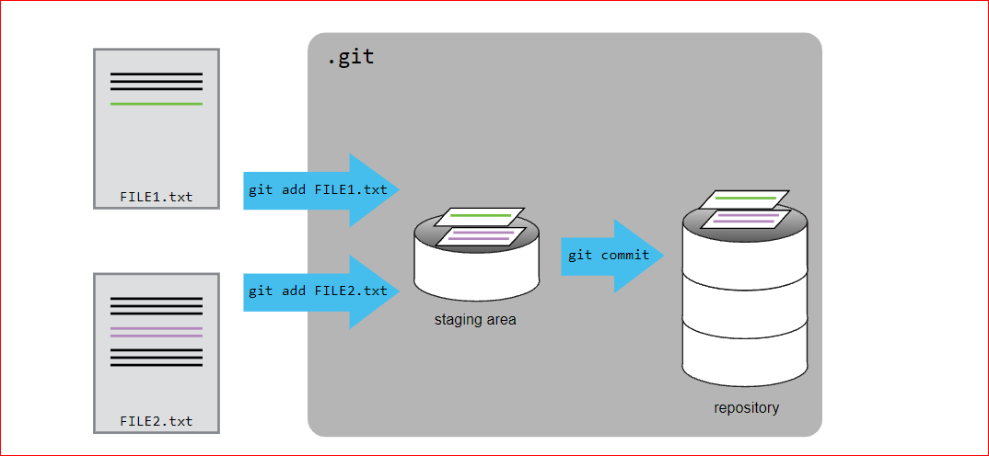
Adding Multimpule files…

Slide 18
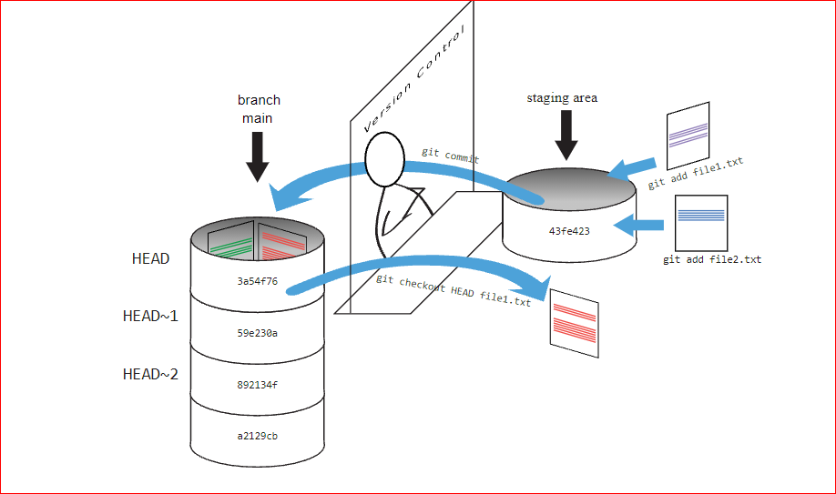

Slide 19
Checking previous version
$ git diff HEAD~1 rose.txt
$git checkout HEAD~1 rose.txt
$git checkout HEAD rose.txt

Slide 20
Ignoring Things
Configure Git to ignore specific files.
Explain why ignoring files can be useful.
Copy results folder with files
Create .gitignore file
Add
    *.dat
    results/

Slide 21


Git Tools
Windows Git Clients:
Sourcetree
GitHub for Windows .
Tortoise Git
Mac Git Clients:
GitUp
GitBox
Git-Xdev

Slide 22
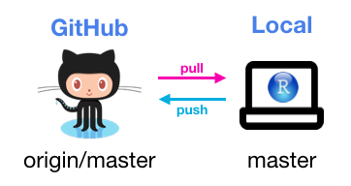
Thank You

