Slide 1


Robust Vibration Localization with Swarm-Intelligent Systems
Swarm Intelligence
Final Presentation
Fall 2006
Nathan Evans
Jean-Christophe Fillion-Robin
{firstname.lastname}@epfl.ch

Slide 2
Talk Outline
  Project Background
    Seismography + Swarm-Intelligent Systems
  Schematic Overview
  Multilateration
  Time Synchronization
  Data Acquisition / Processing
  Technical Limitations
  Results
  Future Research

Slide 3
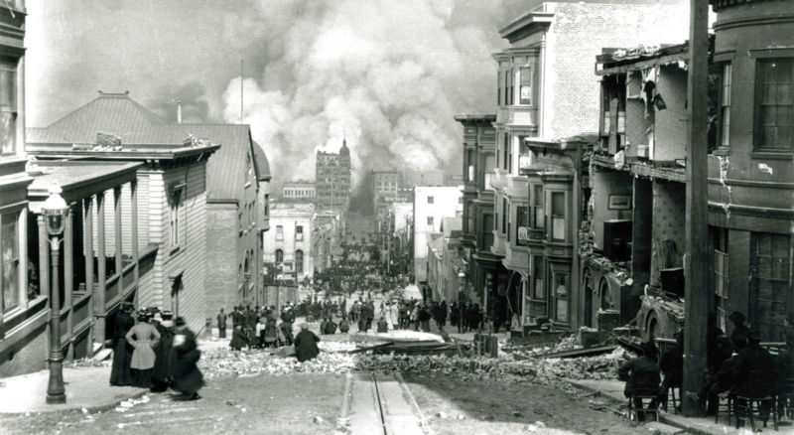
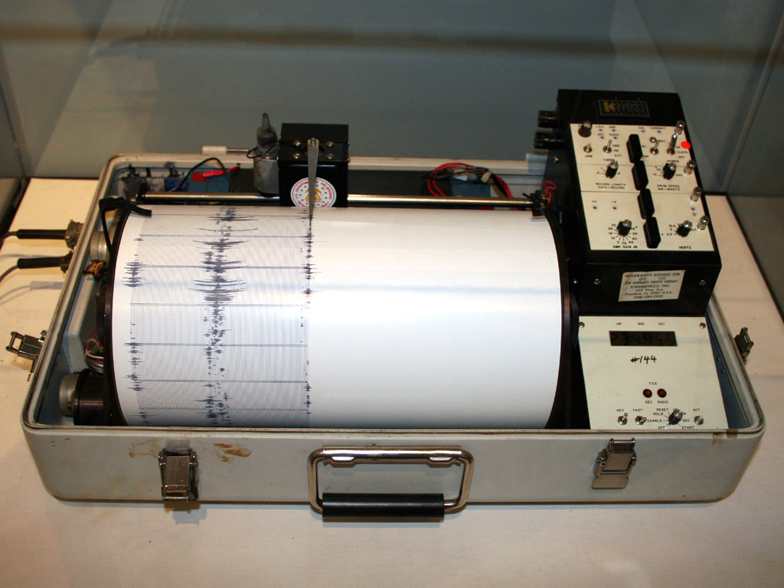
Project Background (I)
Seismography
  Science of shock wave detection
  Seismographs
[1]
[1]
Notes:
Talk about how the early seismographs worked and briefly mention how modern day ones work

Slide 4
Project Background (II)
Unique Seismographic Approach: Swarm-Intelligent Systems
Advantages
  Inexpensive individual units
  Distributed nature
    Improved accuracy
    Robustness
Obstacles
  Communication / synchronization
  Weak Computation

Slide 5
Talk Outline
  Project Background
  Schematic Overview
    Experimental Setup
    Project Outline
  Multilateration
  Time Synchronization
  Data Acquisition / Processing
  Technical Limitations
  Results
  Future Research

Slide 6
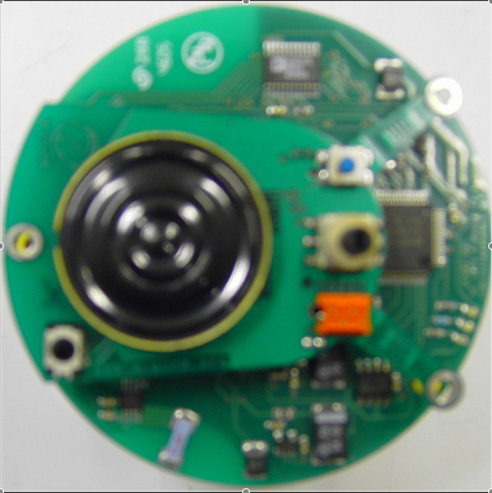
Experimental Setup
E-Puck
45.6cm
68.2cm
Epicenter
X
50.7cm

Slide 7
System Schematic
Light Detection
( Swarm Synchronization)
Vibration Detection
(Listening)
Centralized Computation
(Multilateration)
Data Pre-processing
(Send Data)

Slide 8
Talk Outline
  Project Background
  Schematic Overview
  Multilateration
    Formalisms
    Simplifications
    Finding solutions
  Time Synchronization
  Data Acquisition / Processing
  Technical Limitations
  Results
  Future Research

Slide 9
Multilateration (I)
Basic Principle:
  Given various receivers and their geographic coordinates, isolate signal origin using time difference of arrival (TDOA).
Formalism
  Robots:
  Medium velocity:
  Time of arrival (TOA)
  TDOA
$R_{i}$
$T_{R1}=\frac{1}{v_{m}}\sqrt{{\left(x−x_{R1}\right)}^{2}+{\left(y−y_{R1}\right)}^{2}}$
$v_{m}$
$T_{R2}=\frac{1}{v_{m}}\sqrt{x^{2}+y^{2}}$
$T_{R3}=\frac{1}{v_{m}}\sqrt{{\left(x−x_{R3}\right)}^{2}+{\left(y−y_{R3}\right)}^{2}}$
$T_{R12}=T_{R1}−T_{R2}$
$T_{R32}=T_{R3}−T_{R2}$

Slide 10
Multilateration (II)
Assumptions
  Stationary robots
  Predetermined geographic locations
  Homogeneous medium (constant )
Finding Solutions
  Graphical
  Bucher Method
  Approximations
$v_{m}$
$T_{R12}=T_{R1}−T_{R2}$
$T_{R32}=T_{R3}−T_{R2}$
${\%T}_{R12}=\frac{1}{v_{m}}\left[\sqrt{{\left(x−x_{R1}\right)}^{2}+{\left(y−y_{R1}\right)}^{2}}−\sqrt{x^{2}+y^{2}}\right]$
${\%T}_{R32}=\frac{1}{v_{m}}\left[\sqrt{{\left(x−x_{R3}\right)}^{2}+{\left(y−y_{R3}\right)}^{2}}−\sqrt{x^{2}+y^{2}}\right]$

Slide 11
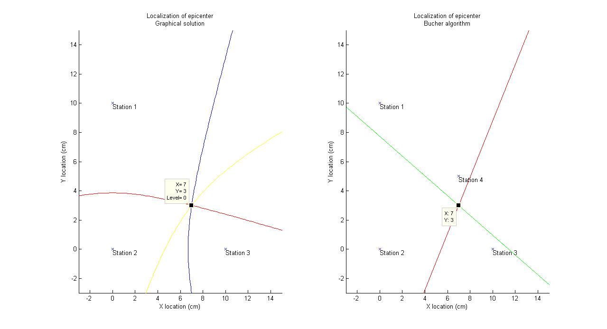
Multilateration (III)

Slide 12
Talk Outline
  Project Background
  Schematic Overview
  Multilateration
  Time Synchronization
    Necessity and Method
    Assumptions and Guarantee
  Data Acquisition / Processing
  Technical Limitations
  Results
  Future Research

Slide 13
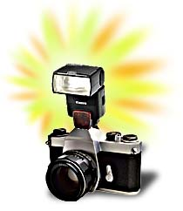
Time Synchronization (I)
Why synchronize?
  Multilateration requires it!
Method
  Robots “listen” on IR port for significant change
  Flash robots with an intense flash of light
  Disable interrupts
  Change listening mode to “vibration detection”
  Start counter
  Re-enable interrupts
  Acquire “significant” values, disable interrupts

Slide 14
Time Synchronization (II)
Implicit Assumption
  Light reaches each E-Puck at
  the “same time”
  300 km/s for distances less than 0.5m
Time Synchrony Guarantees
  Via PIC register manipulation, we sample IR channel at same frequency on each E-Puck
  Combination of same controller and disabling of interrupts guarantees same code execution

Slide 15
Talk Outline
  Project Background
  Schematic Overview
  Multilateration
  Time Synchronization
  Data Acquisition / Processing
    Pre-processing criteria
    Communication to central unit
    Centralized processing
  Technical Limitations
  Results
  Future Research

Slide 16
Data Acquisition (I)
What constitutes data as being “significant”?
  Empirically-defined threshold
    Not robust
  Adaptive thresholding
    Computationally expensive (floating point arithmetic)
    Time Synchronization fails
  Empirically-defined threshold + signal signature
    Simple and sure to capture all important wave characteristics

Slide 17
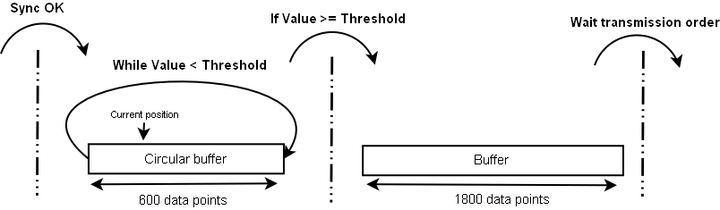
Data Acquisition (II)
E-Puck on board process:
Pre-window
buffer
Post-window
buffer

Slide 18
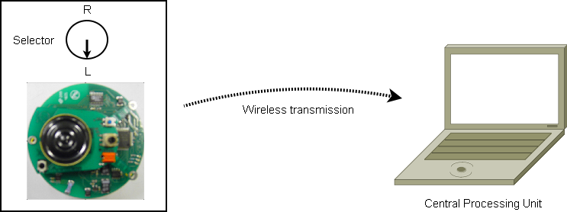
Data Acquisition (III)
Communication transmission order:
  Turn E-Puck selector to “left”
Pre/Post window buffer transmitted to CPU

Slide 19
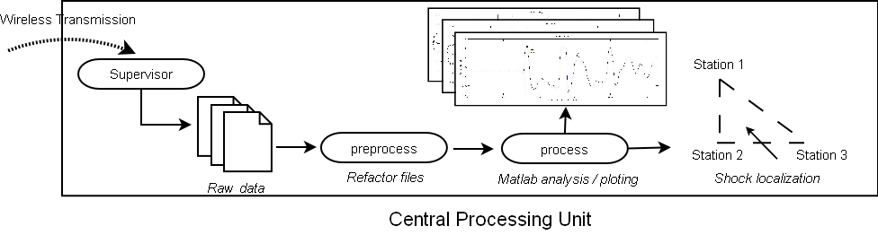
Data Processing
Central processing schema

Slide 20
Talk Outline
  Project Background
  Schematic Overview
  Multilateration
  Time Synchronization
  Data Acquisition / Processing
  Technical Limitations
    Accelerometer woes...
  Results
  Future Research

Slide 21
Technical Limitations
  Micro controller
    Emulated floating-point computation
  Autonomy
    High power consumption
  Accelerometer bandwidth response !!!
    f_{-3db} = 150Hz
    Low-pass filter cuts out important frequency information
    Timing information is inaccurate!

Slide 22
Talk Outline
  Project Background
  Schematic Overview
  Multilateration
  Time Synchronization
  Data Acquisition / Processing
  Technical Limitations
  Results
    Medium velocity
    Triangular setup
  Future Research

Slide 23
Results: Medium Velocity (I)
Shock wave velocity measurement
  Material: wood composite
Experimental Setup
X
29.7cm

Slide 24
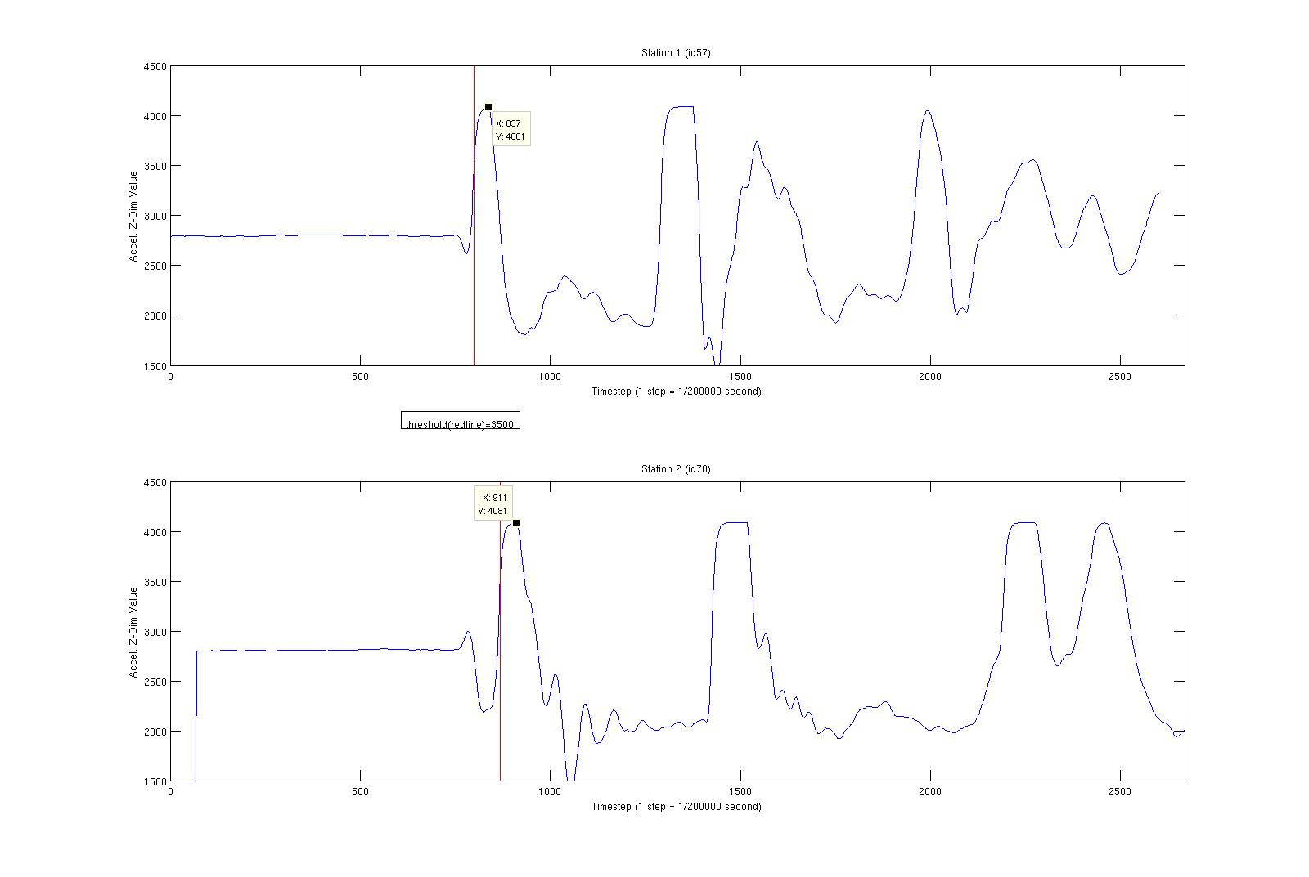
Results: Medium Velocity (II)

Slide 25
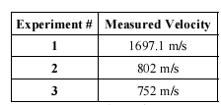
Results: Medium Velocity (III)
Three experimental results
Clearly timing information is skewed!
Wave alignment done manually because of improper timing.

Slide 26
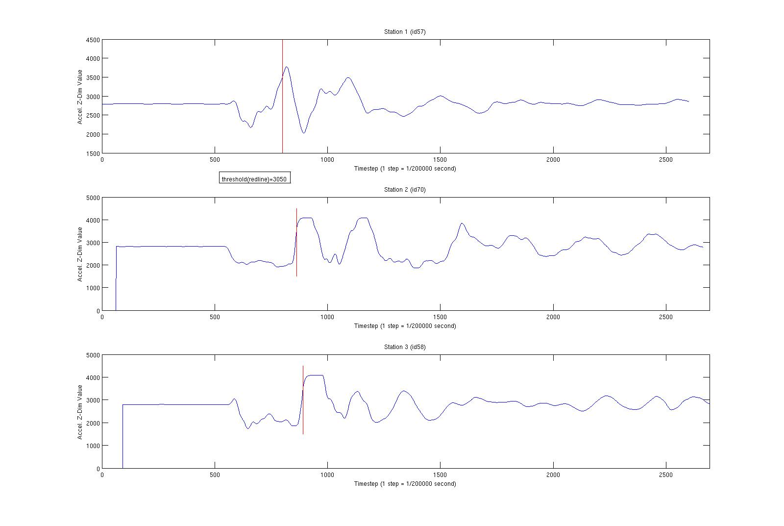
Results: Multilateration (I)
Finding the epicenter

Slide 27
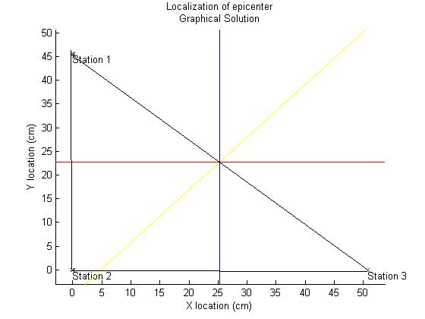
Results: Multilateration (II)
Again, improper timing information (due to accelerometer readings) distorts multilateration results

Slide 28
Talk Outline
  Project Background
  Schematic Overview
  Multilateration
  Time Synchronization
  Data Acquisition / Processing
  Technical Limitations
  Results
  Future Research

Slide 29
Future Research
Hardware Changes
  Appropriate signal capturing device
Robot mobility
  Honing in on “hot” epicenter zones
Larger swarm size
  Improved accuracy + analytical solution
  Correlative models – heterogeneous environments

Slide 30
Questions
?

Slide 31
References + Credits
References
  [1] Seismography. http://en.wikipedia.org/wiki/Seismograph
  [2] Multilateration. http://en.wikipedia.org/wiki/Multilateration
  [3] Bucher, Ralph. Exact Solution for Three Dimensional Hyperbolic Positioning Algorithm and Synthesizable VHDL Model for Hardware Implementation. New Jersey Center for Wireless and Telecommunication. http://ralph.bucher.home.att.net/project.html
  [4] B.T. Fang. Simple solutions for a hyperbolic and related position fixes. IEEE Trans. on Aerosp. and Elect. Systems, vol. 26, no. 5, pp. 748-753. Sept 1990.
  [5] Microchip: dsPIC30F6011/6012/6013/6014 Data Sheet.
  [6] Finwall, Bruce. Properties of Wood. Derby Tech. February, 1984. http://207.242.75.40/derbtech/wood.htm
  [7] Freescale Semiconductor: Accelerometer MMA7260Q-rev1 Data Sheet.
  [8] D T Pham. Tangible Acoustic Interface Approaches. Manufacturing Engineering Centre, Cardiff University, UK and Laboratoire Ondes et Acoustique, ESPCI, Paris, France.
Photos
  [1] - http://www.wikipedia.org

