Slide 1


Robust Vibration Localization with Swarm-Intelligent Systems
Swarm Intelligence
Final Presentation
Fall 2006
Nathan Evans
Jean-Christophe Fillion-Robin
{firstname.lastname}@epfl.ch
WE ARE BACK !

Slide 2
Talk Outline
  Beyond limitations
  Experiment 1
    Wave signals
    Cross-correlation
    Graphical solution
  Experiment 2
    Wave signals
    Cross-correlation
    Graphical solution
  Questions

Slide 3
Beyond Limitations
Microphone instead of accelerometer
Overpass the 150Hz bandwidth response

Slide 4
Talk Outline
  Using Microphone
  Experiment 1
    Wave signals
    Cross-correlation
    Graphical solution
  Experiment 2
    Wave signals
    Cross-correlation
    Graphical solution
  Questions

Slide 5
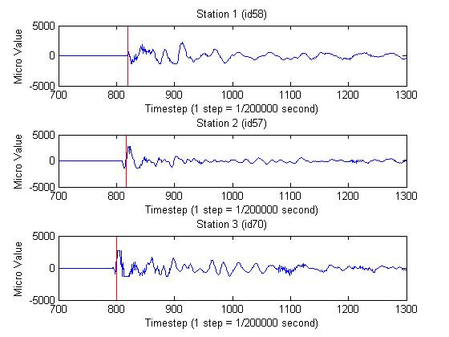
Wave signals (1)

Slide 6
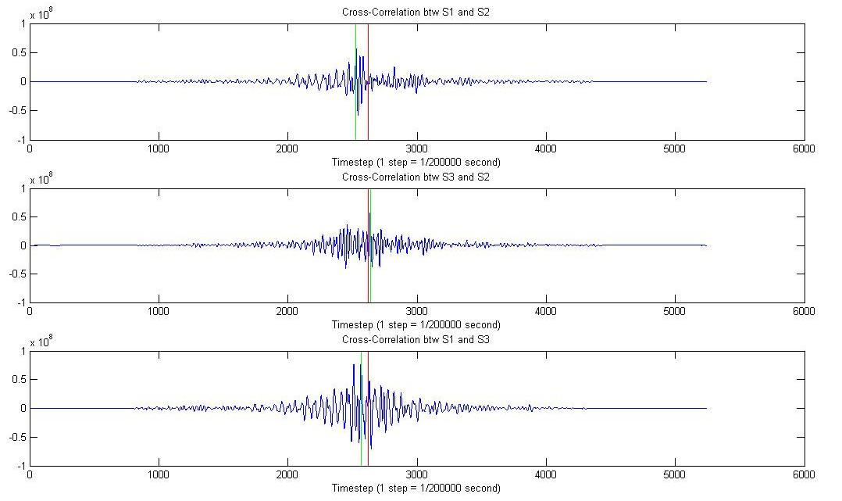
Cross-Correlation (1)

Slide 7
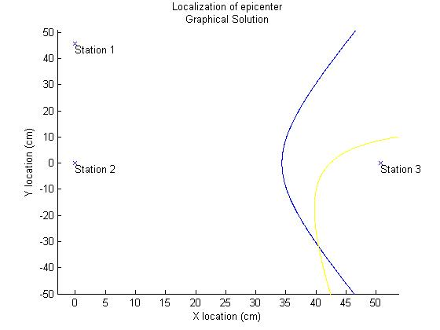
Graphical solution (1)

Slide 8
Talk Outline
  Using Microphone
  Experiment 1
    Wave signals
    Cross-correlation
    Graphical solution
  Experiment 2
    Wave signals
    Cross-correlation
    Graphical solution
  Questions

Slide 9
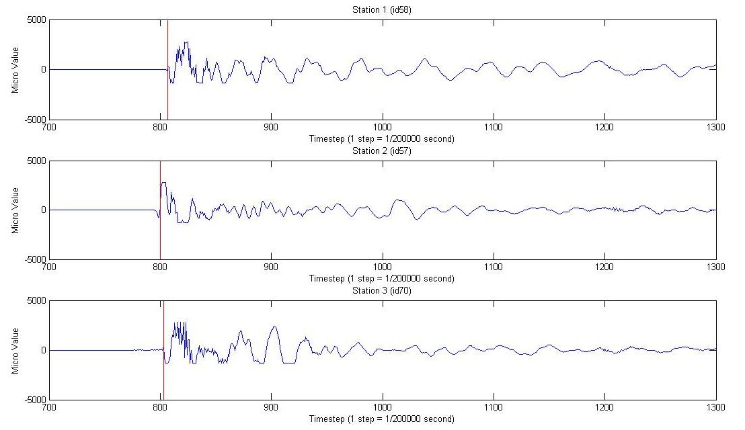
Wave signals (2)

Slide 10
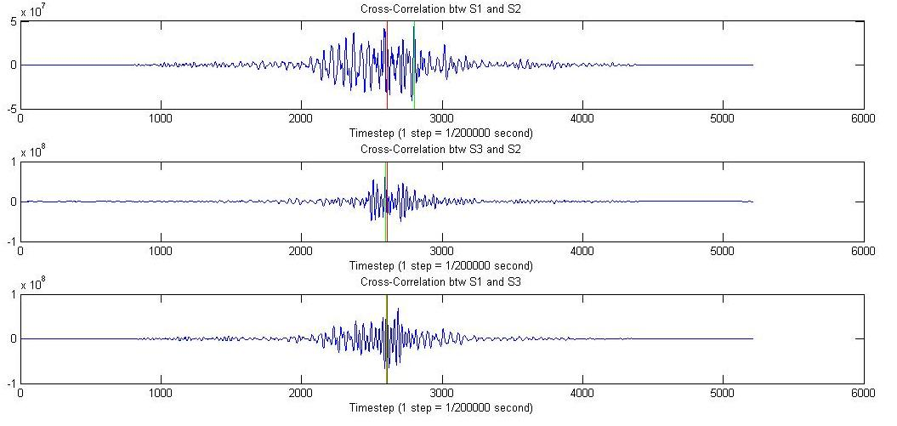
Cross-Correlation (2)

Slide 11
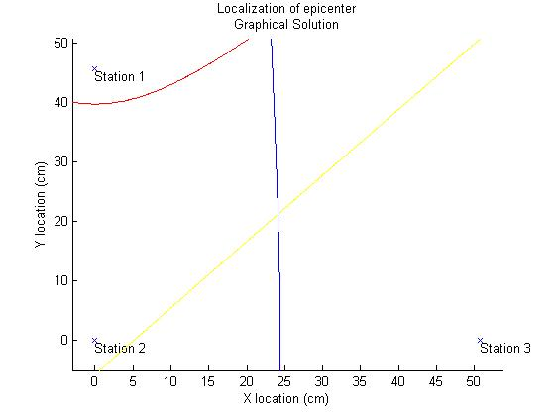
Graphical solution (2)

Slide 12
Talk Outline
  Using Microphone
  Experiment 1
    Wave signals
    Cross-correlation
    Graphical solution
  Experiment 2
    Wave signals
    Cross-correlation
    Graphical solution
  Questions

Slide 13
Questions
?

