Slide 1
PHEMTO: MEGAlib Simulations
José Sousa
12-11-2025
v1.1

Slide 2
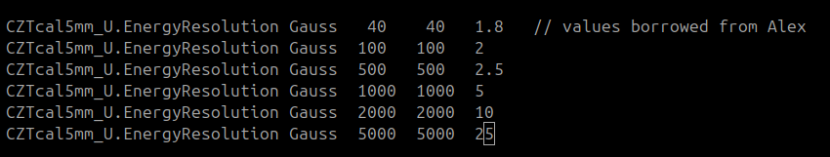
Overall Assumptions: detectors
CZT/CdTe Detectors performance:
density = 5.79 g/cm3
threshold = 4 keV
noise = 0.5 keV
dx dy = 0.25mm
Energy resolution:

Slide 3
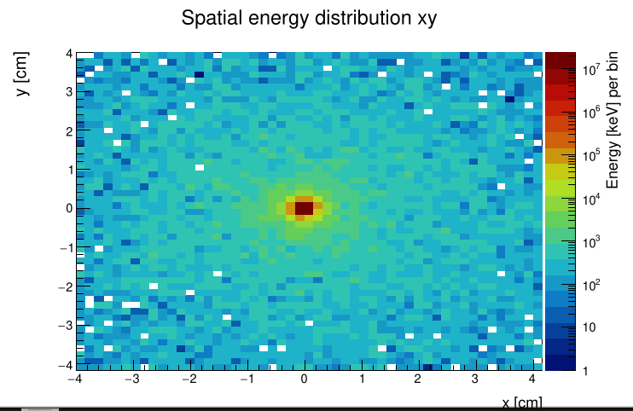
Overall Assumptions: sources
Example Source:
- Laue Lenses
- 1.5mm diameter focus [1,2]
- monochromatic 104keV
This simulations only for energies where laue lenses operates, [50, 700]keV
For E<50keV, used detector eff data on Laurent excel

Slide 4
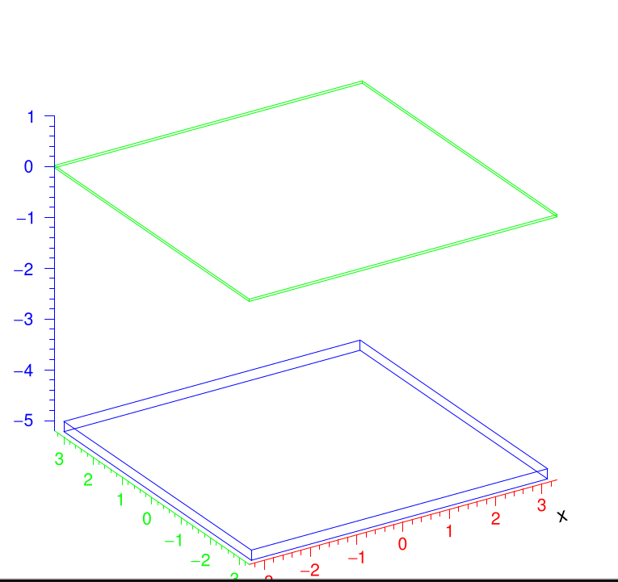
CONFIG 1
Si (green):
6.65x6.65cm2, 450um thick
CdTe (blue):
6.4x6.4cm2, 2mm thick
5cm spacing

Slide 5
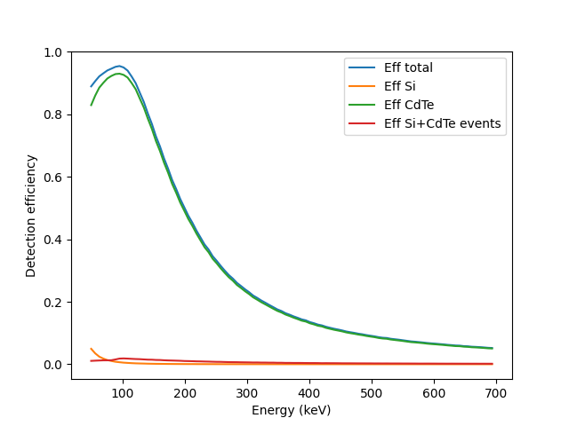
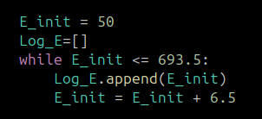
CONFIG 1
Simulated efficiency for Energies:
To be compliant with Laurent Excel

Slide 6
CONFIG 1
Sensitivity Comparison:
- Red, Laurent det eff Assumption (used 6.06 CdTe ro)
- Black, MEGAlib simulated eff from 50kev to 700kev

Slide 7
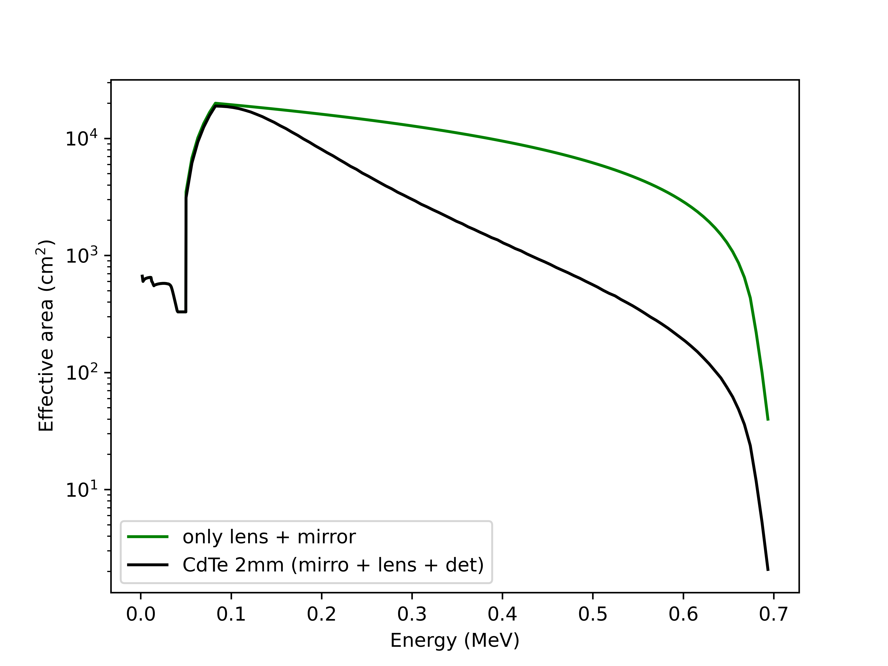
CONFIG 1
Effective Area using:
- Area lenses from Laurent excel
- multiply det_Eff x area

Slide 8
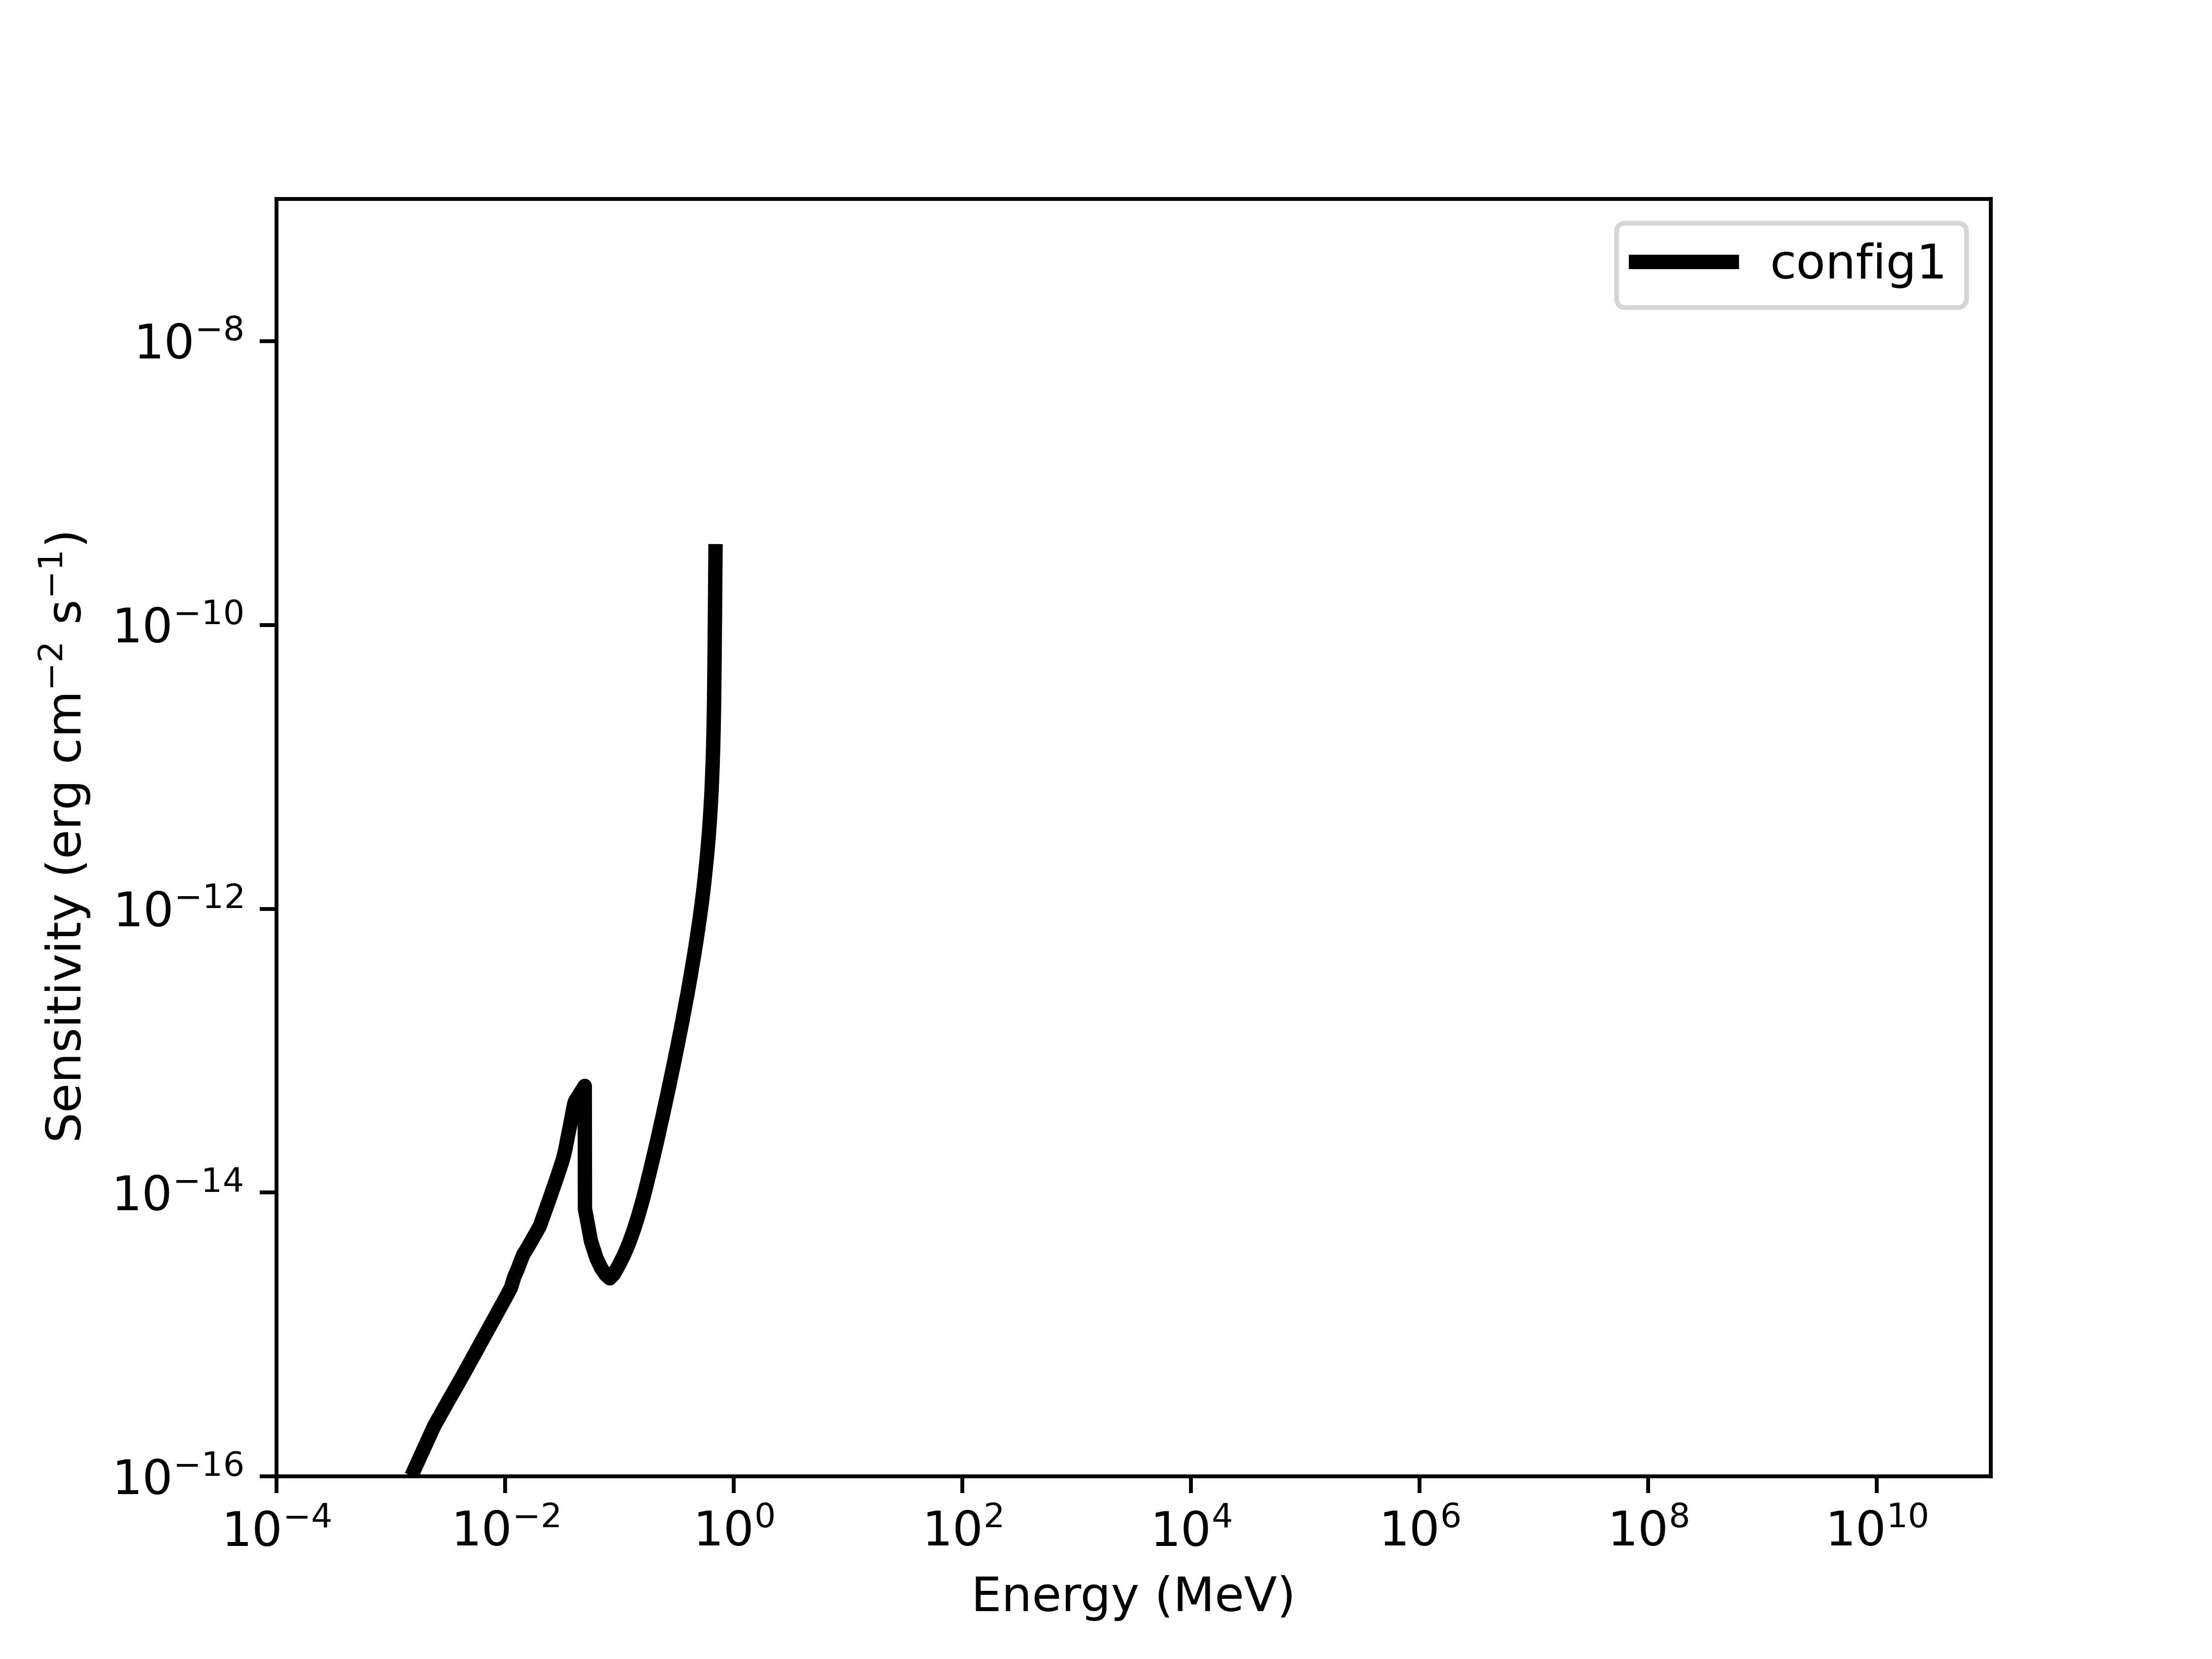
CONFIG 1
Sensitivity using:
- simulated det effs (Si + CdTe)
- used Laurent excel for lenses eff

Slide 9
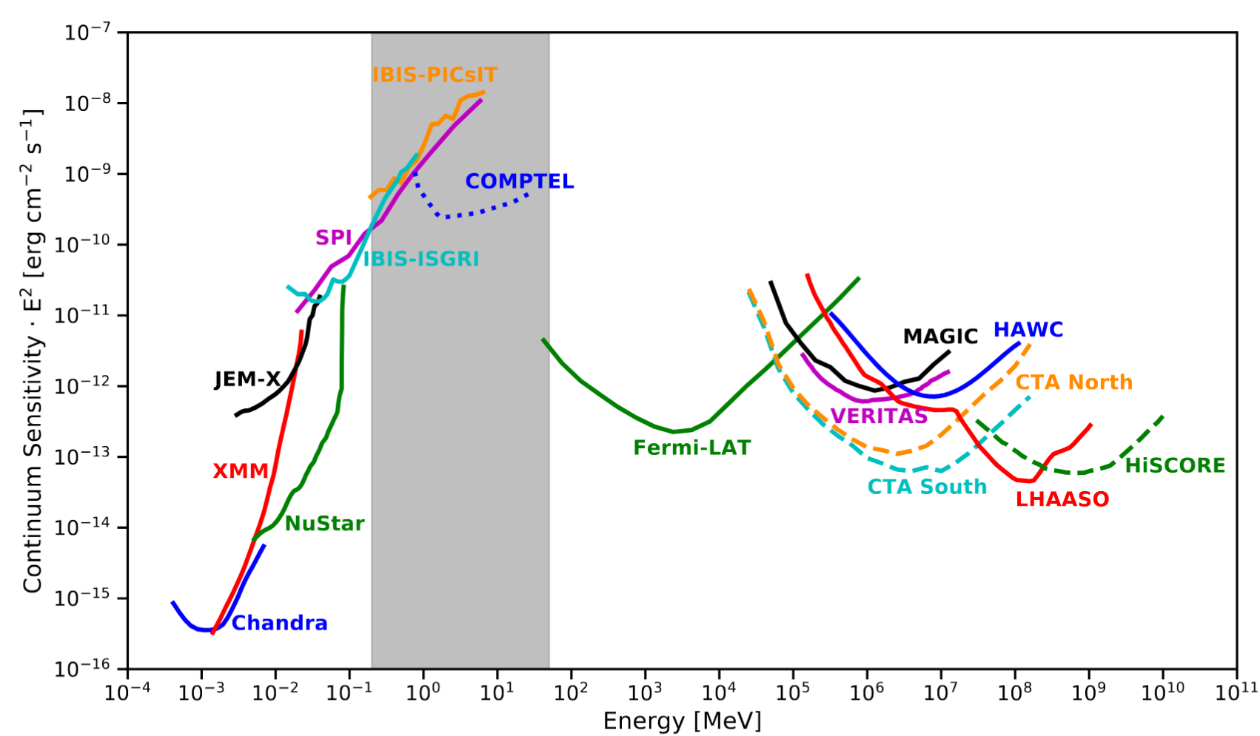

Adapted from Ref [3]
PHEMTO
2mm CdTe
NuSTAR
CHANDRA

Slide 10
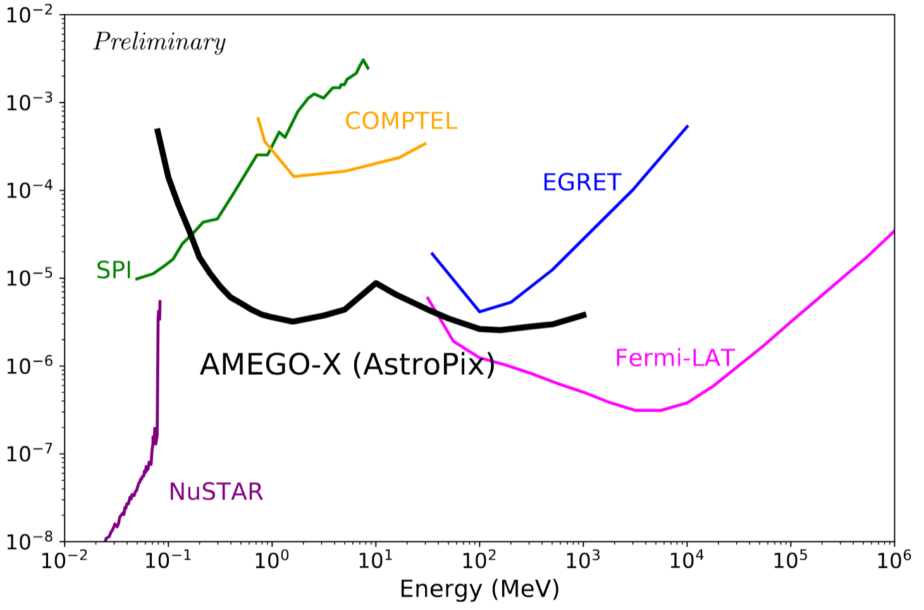

Adapted from Ref [3]
Amego is from Ref [4]
PHEMTO
2mm CdTe
NuSTAR
CHANDRA

Slide 11
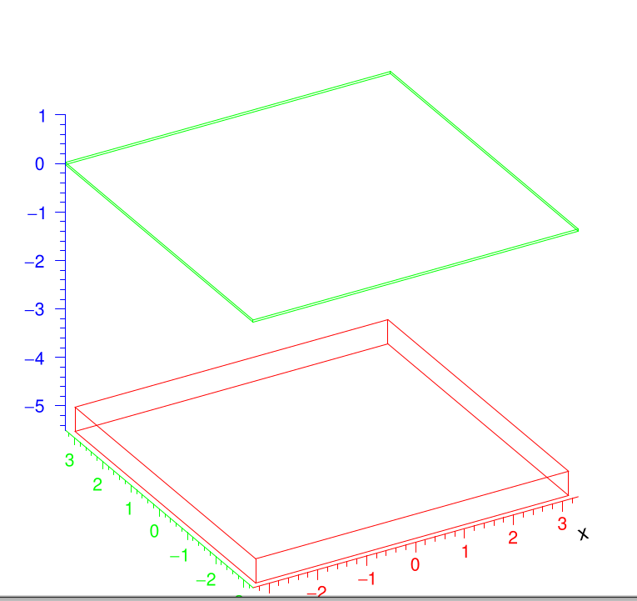
CONFIG 2
Si (green):
6.65x6.65cm2, 450um thick
CdTe (red):
6.4x6.4cm2, 5mm thick
5cm spacing

Slide 12
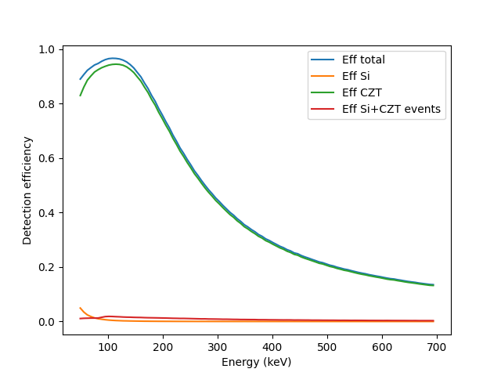
CONFIG 2
Simulated efficiency for Energies:
To be compliant with Laurent Excel

Slide 13
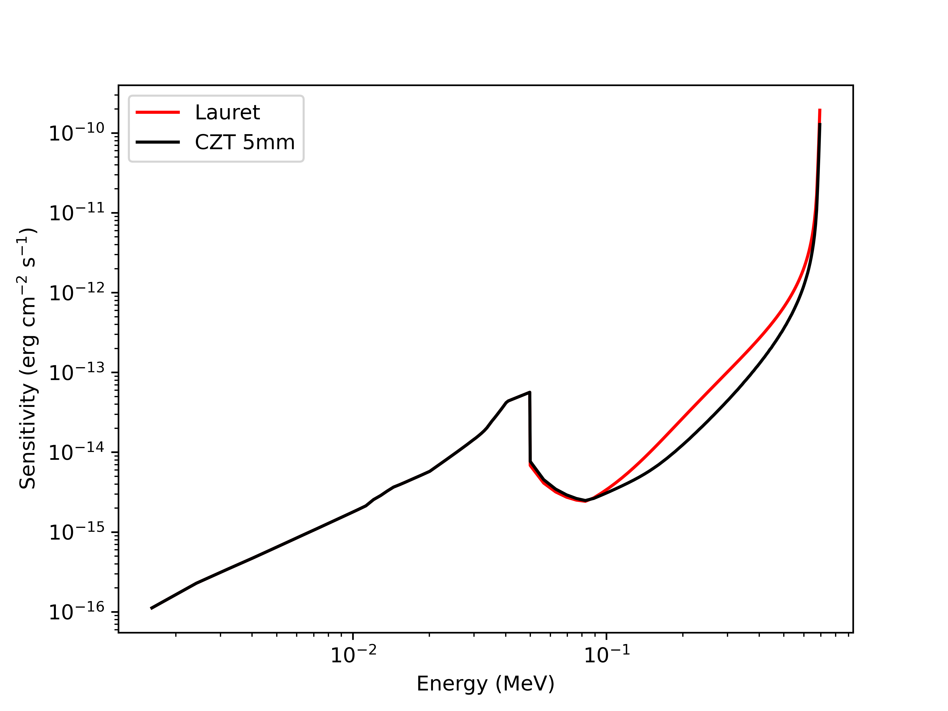
CONFIG 2
Sensitivity Comparison:
- Red, Laurent det eff Assumption (used 6.06 CdTe ro)
- Black, MEGAlib simulated eff from 50kev to 700kev

Slide 14
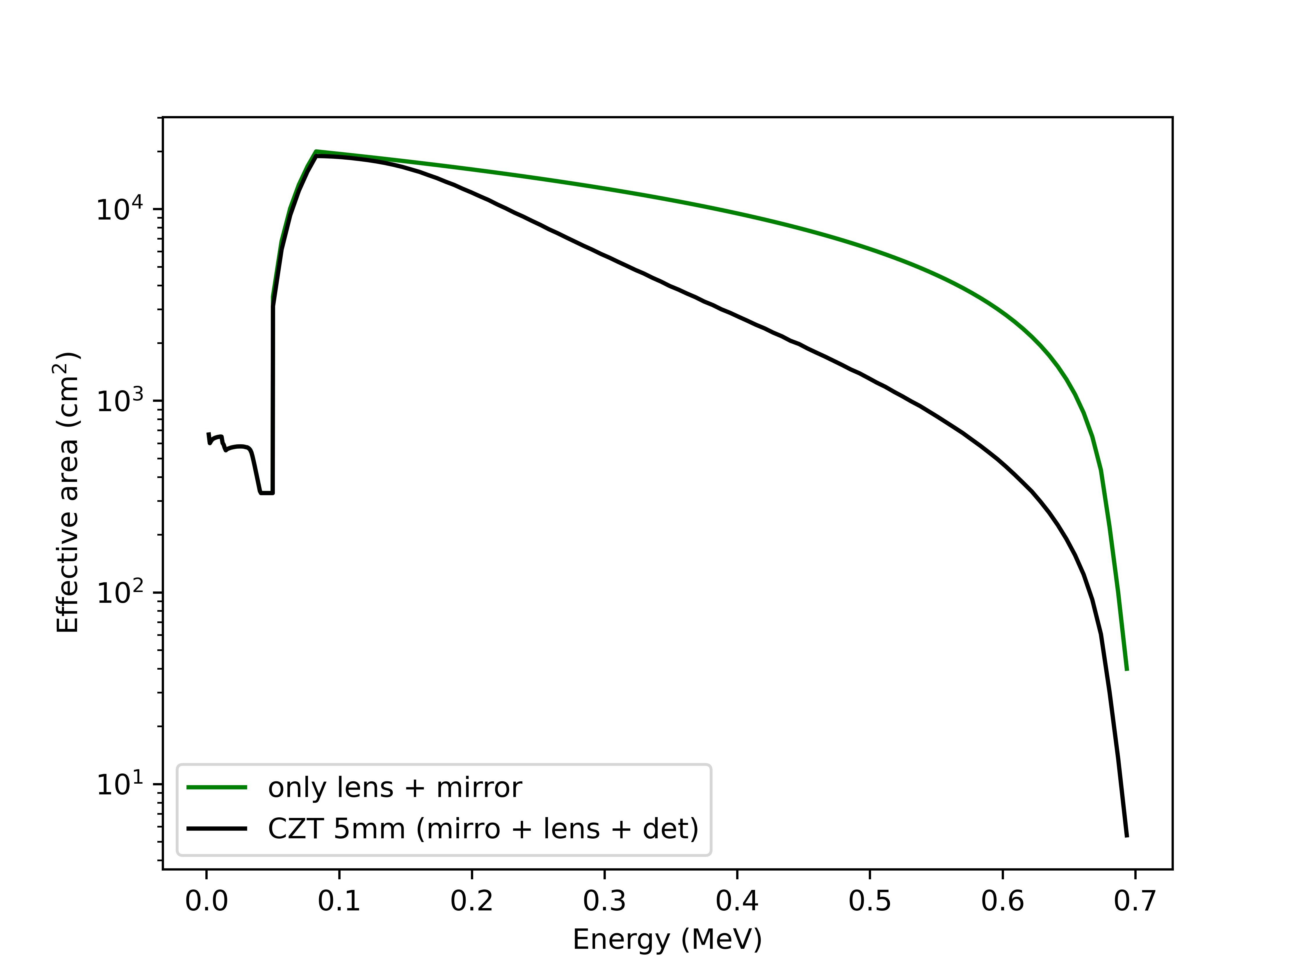
CONFIG 2
Effective Area using:
- Area lenses from Laurent excel
- multiply det_Eff x area

Slide 15
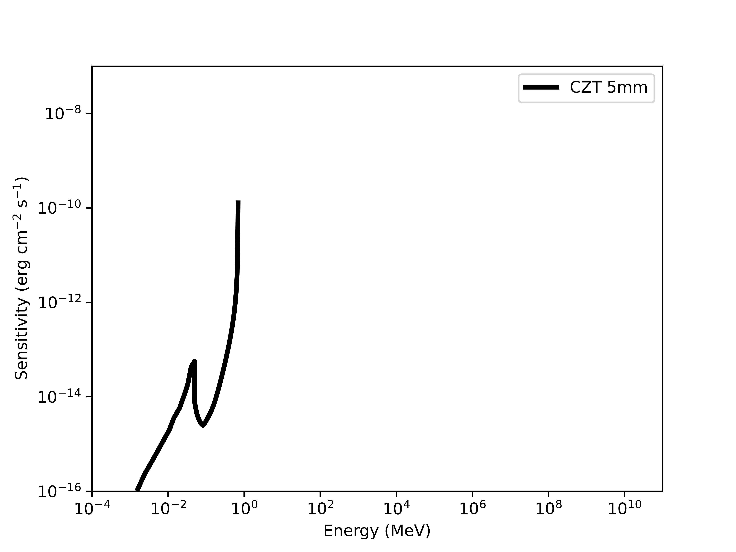
CONFIG 2
Sensitivity using:
- simulated det effs (Si + CdTe)
- used Laurent excel for lenses eff

Slide 16
Adapted from Ref [3]
PHEMTO
5mm CZT
NuSTAR
CHANDRA

Slide 17
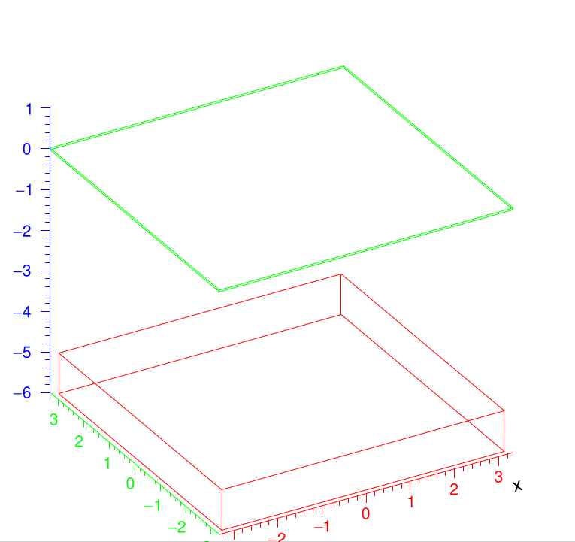
CONFIG 3
Si (green):
6.65x6.65cm2, 450um thick
CdTe (red):
6.4x6.4cm2, 10mm thick
5cm spacing

Slide 18
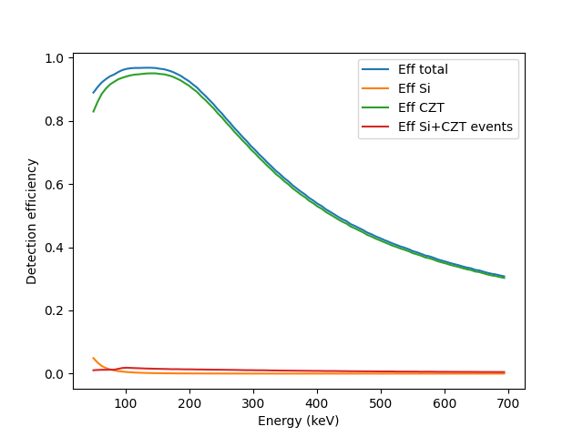
CONFIG 3
Simulated efficiency for Energies:
To be compliant with Laurent Excel

Slide 19
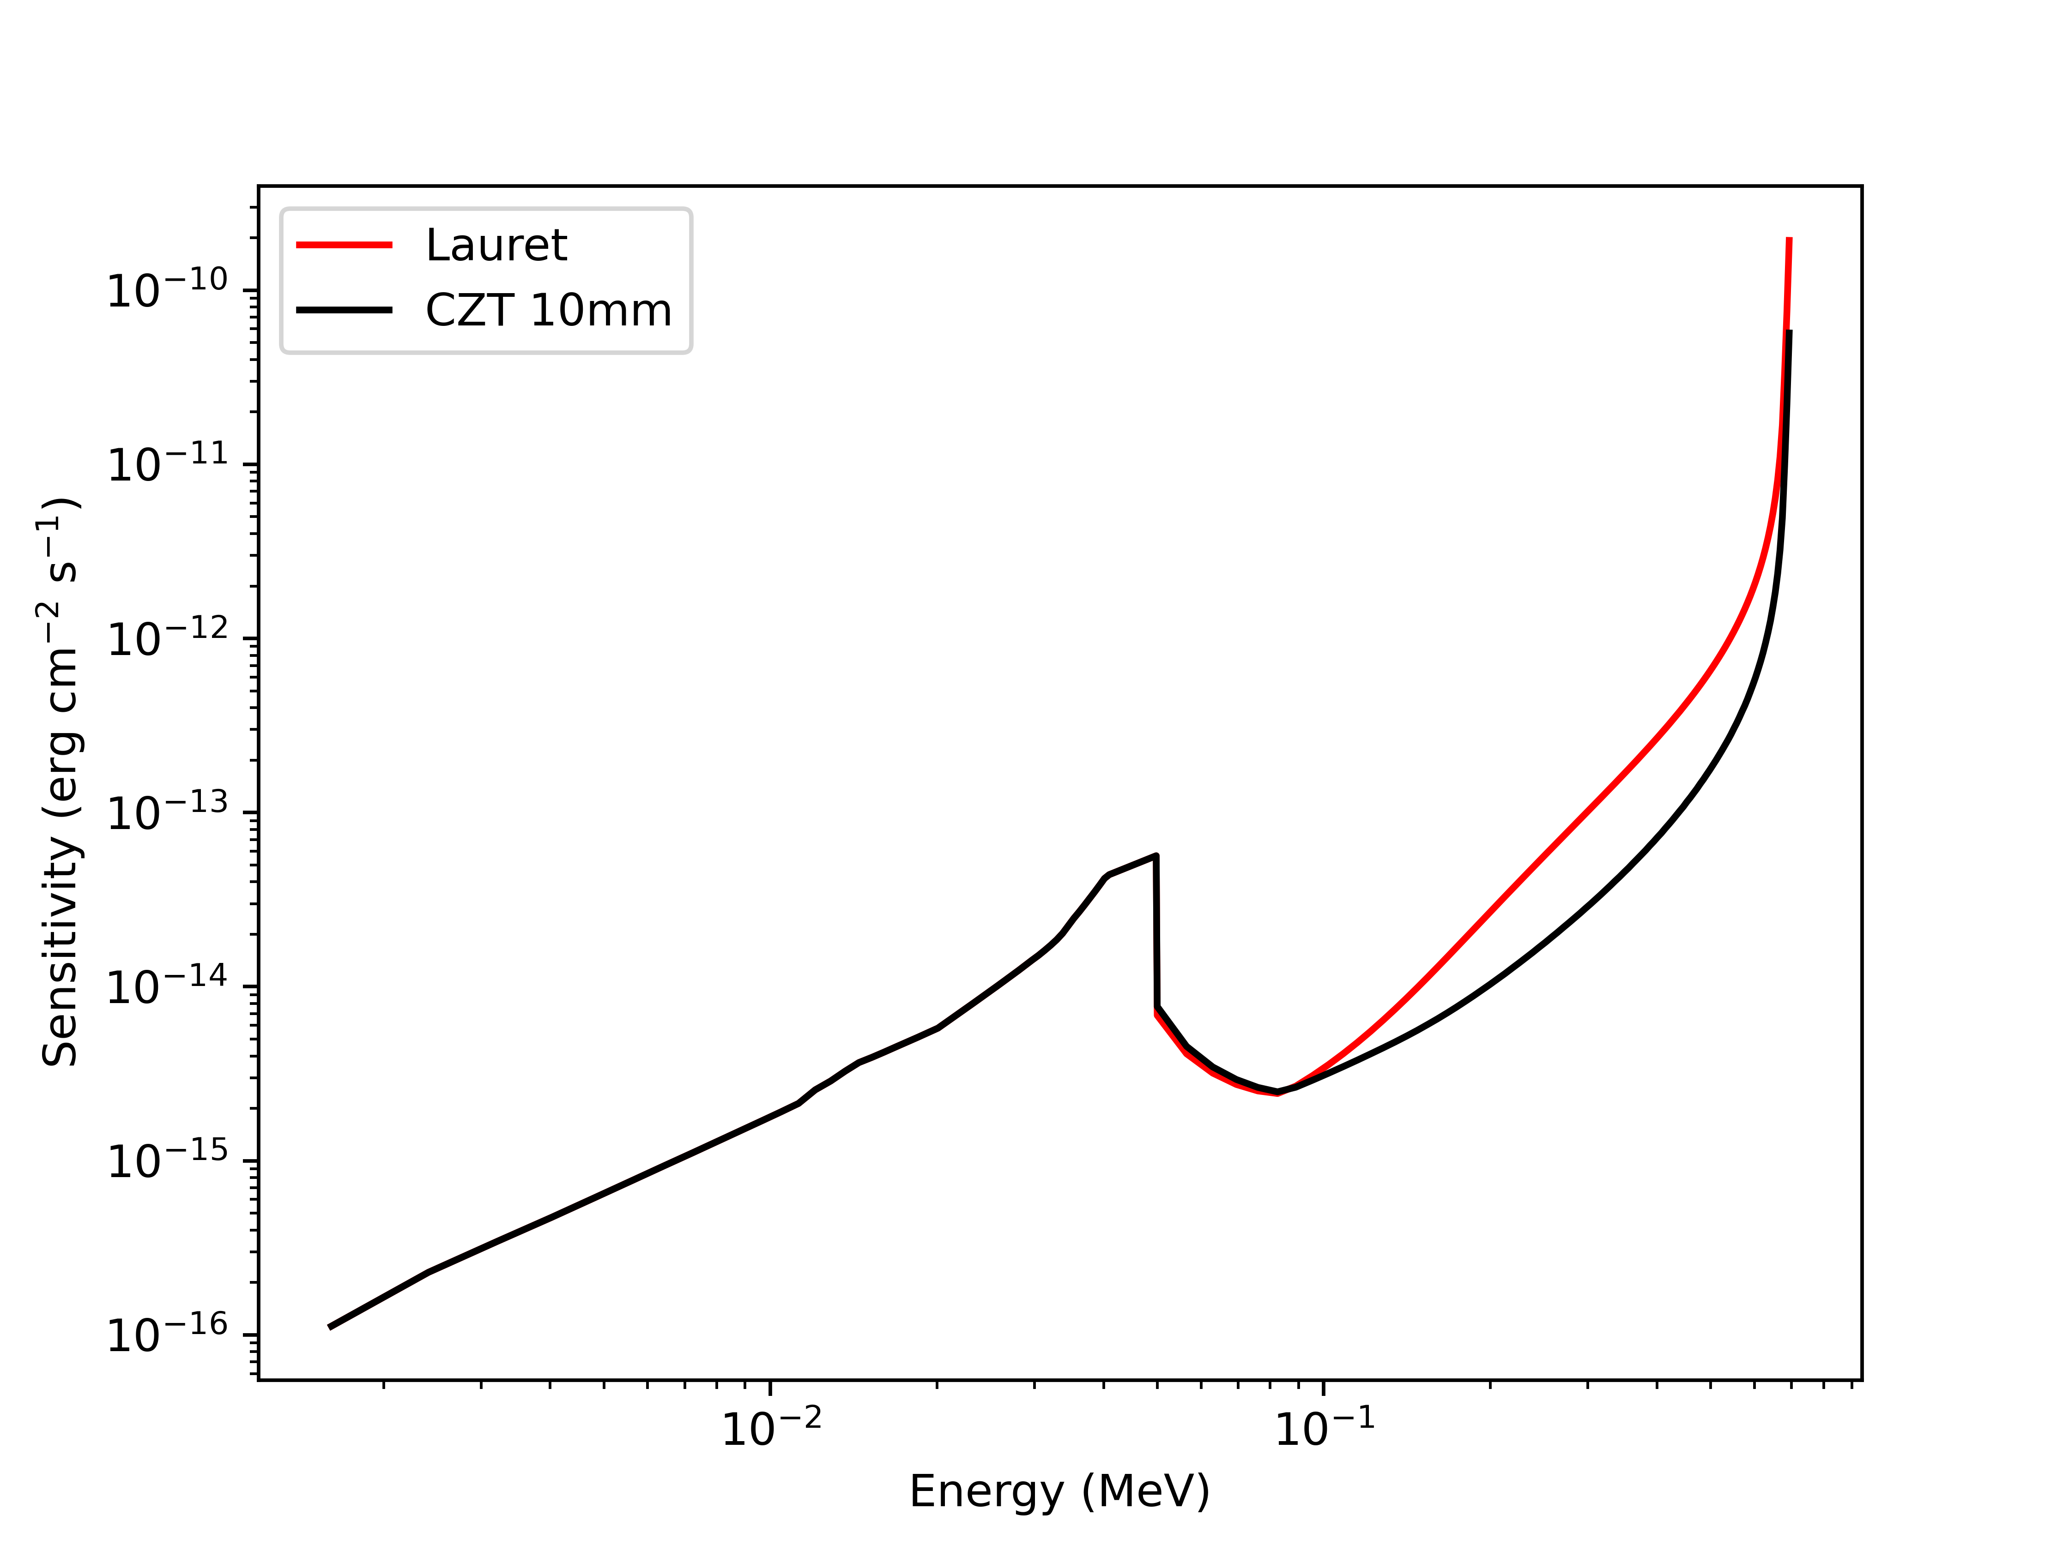
CONFIG 3
Sensitivity Comparison:
- Red, Laurent det eff Assumption (used 6.06 CdTe ro)
- Black, MEGAlib simmulated eff from 50kev to 700kev

Slide 20
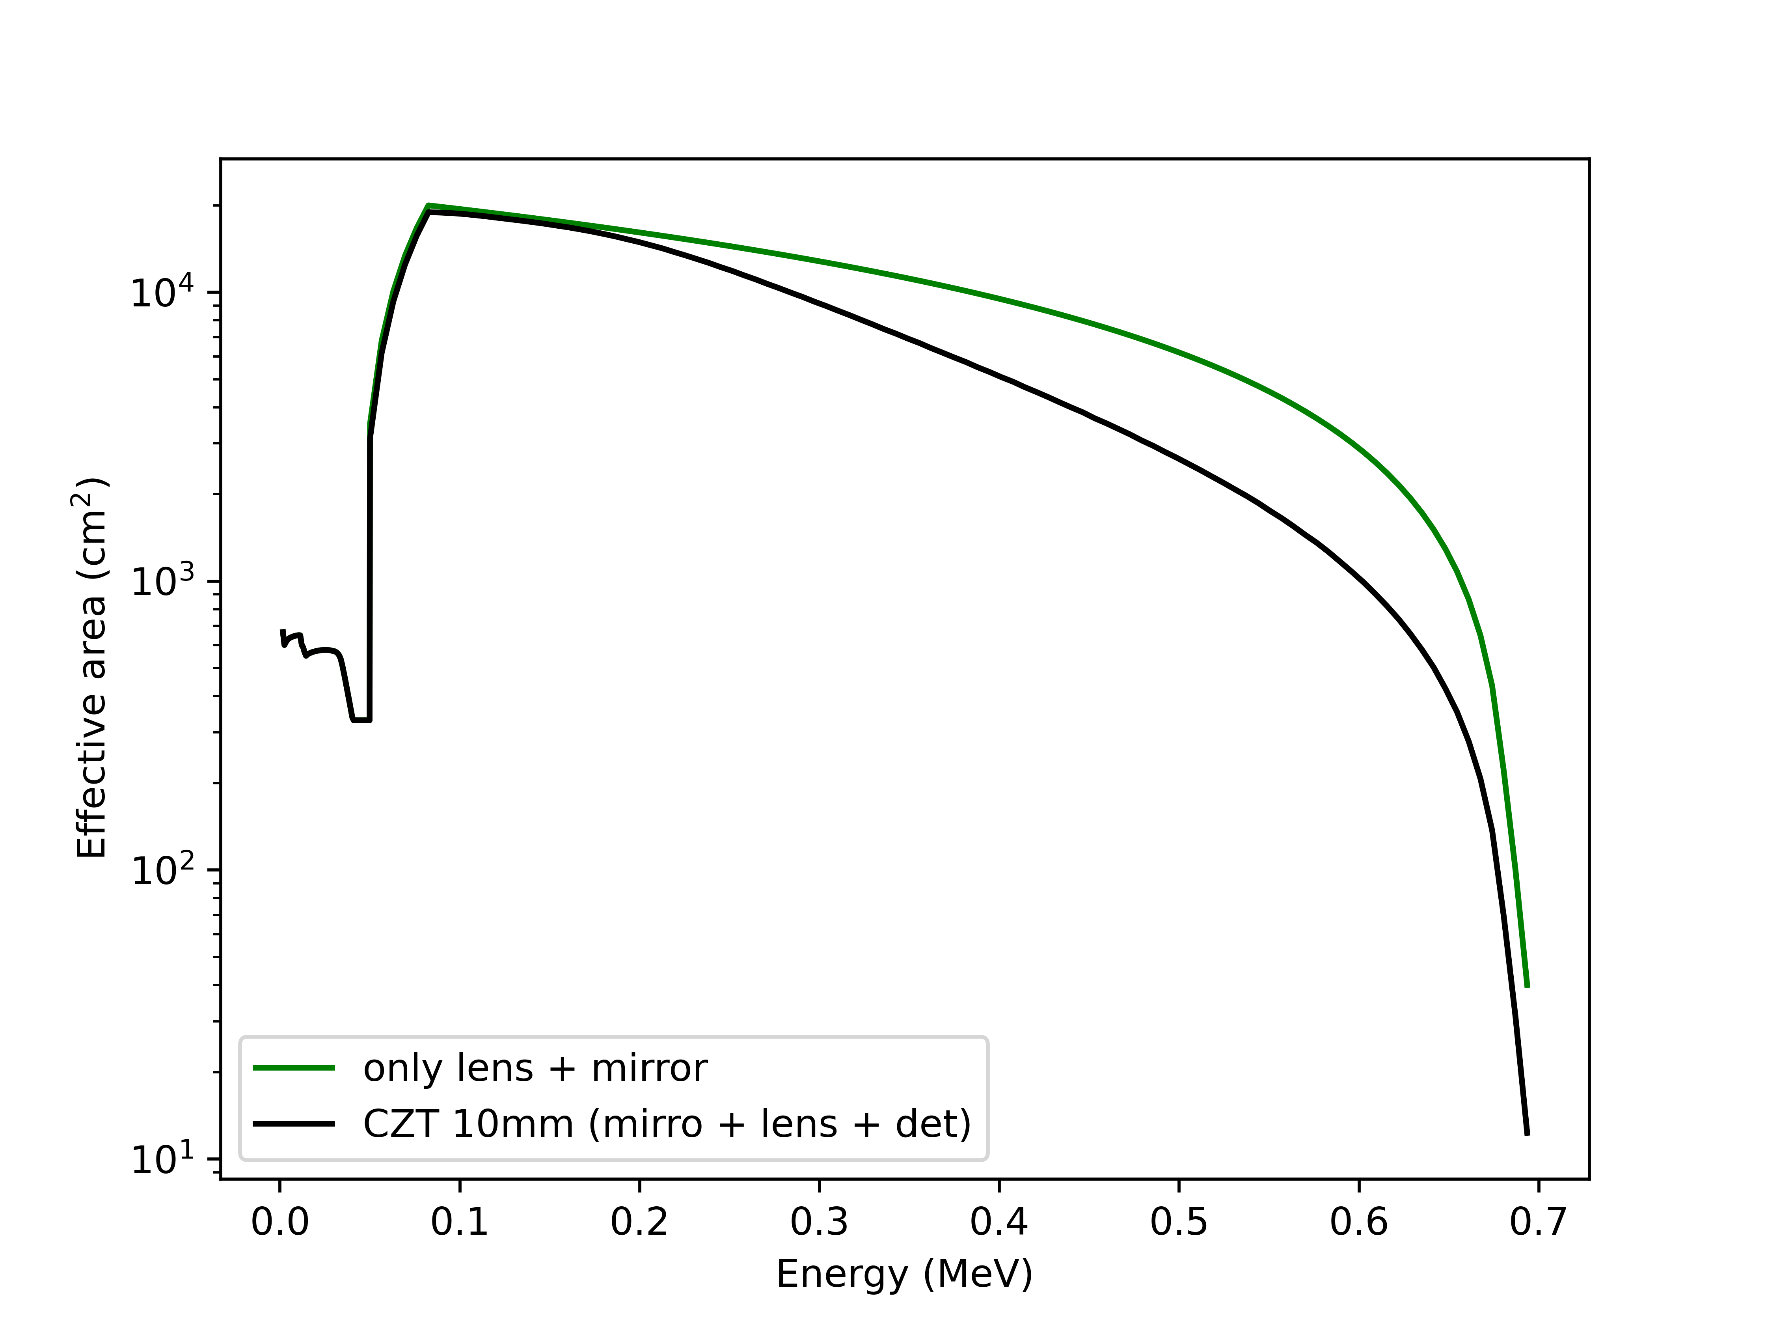
CONFIG 3
Effective Area using:
- Area lenses from Laurent excel
- multiply det_Eff x area

Slide 21
CONFIG 3
Sensitivity using:
- simulated det effs (Si + CdTe)
- used Laurent excel for lenses eff

Slide 22
Adapted from Ref [3]
PHEMTO
10mm CZT
NuSTAR
CHANDRA

Slide 23
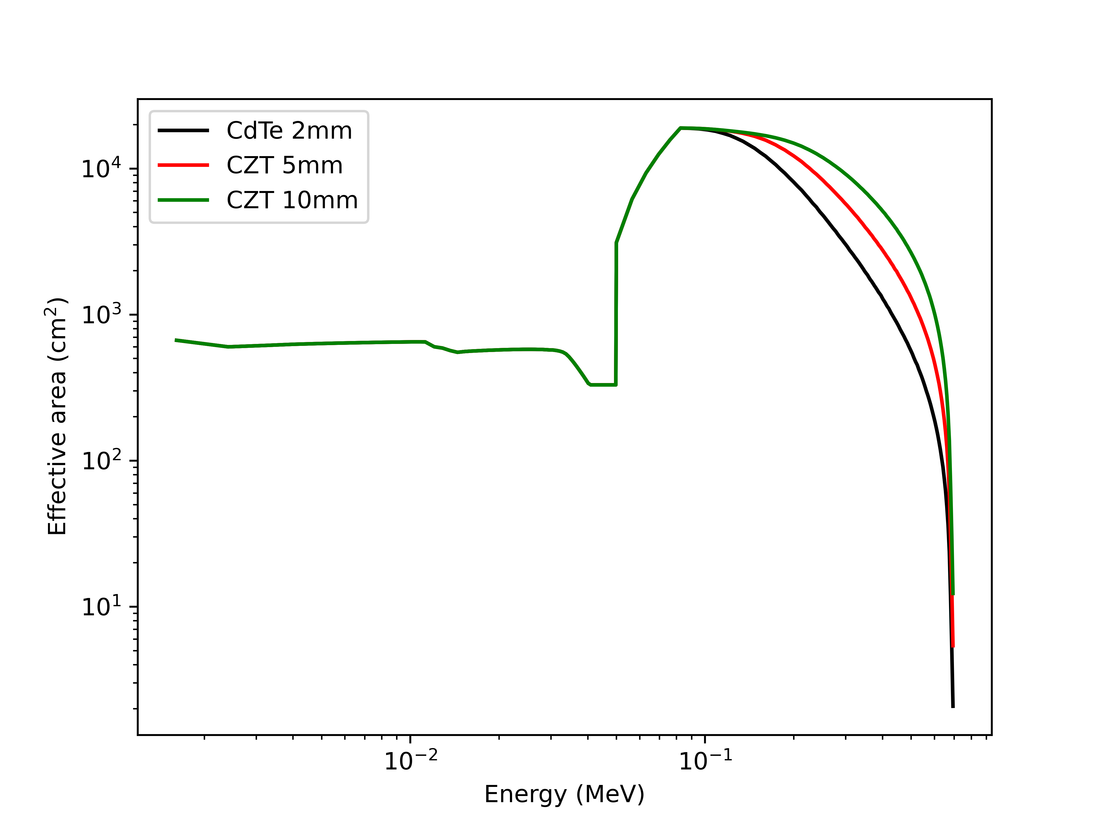
Comparison between configs
Sensitivity
Effective Area

Slide 24
Future Work
Detectors:
- get more realistic CZT and CdTe energy resolution (simulations from Jose or use MC2 values from Hugo Allaire/Alline)
- get more realistic Si energy resolution (see newAthena WFI instrument)
Alternative Configurations:
- check how the PSF of Laue/mirror is on side detector of config4 and config5 (see last slide for figure of config4 and config5)
New Instrument Geometry:
- Add Pb (0.13 cm thick) collimator
- Add anti-coincidence detector (for particle rejection, in case particles are simulated on the background model)
- Understand the impact of the Collimator on config4 and config5
Sources:
- get x-ray optics point spread functions (can be an approximation)
- update Laue source for collimated source with double Gaussian.
- use [5] for background simulations

Slide 25
Future Work
Polarimetry:
- analysis for inter-plane compton (high energy polarimetry)
- analysis for on side CZT plane polarimetry (config4, config5), 20keV goal (low energy polarimetry

Slide 26
References
[1] Ferrari, E., Ferrari, C., Virgilli, E., Caroli, E., Auricchio, N., Stephen, J. B., Ferro, L., da Silva, R. C., and Moita, M. (2025). Correction: Imaging performance of laue lenses made of ge and si bent crystals for future gamma-ray astrophysics telescopes. Aerotecnica Missili amp; Spazio.
[2] Frontera, F. (2025). Hard x-ray/soft gamma-ray laue lenses for high energy astrophysics.
[3] Lucchetta, G. et. al. (2022). Introducing the MeVCube concept: a CubeSat for MeV observations. doi:10.1088/1475-7516/2022/08/013
[4] https://doi.org/10.48550/arXiv.2108.02860
[5] Cumani, P., Hernanz, M., Kiener, J. et al. Background for a gamma-ray satellite on a low-Earth orbit. Exp Astron 47, 273–302 (2019). https://doi.org/10.1007/s10686-019-09624-0

Slide 27
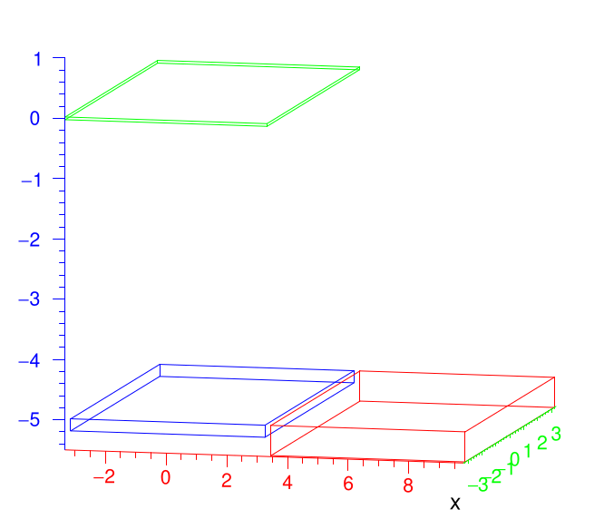
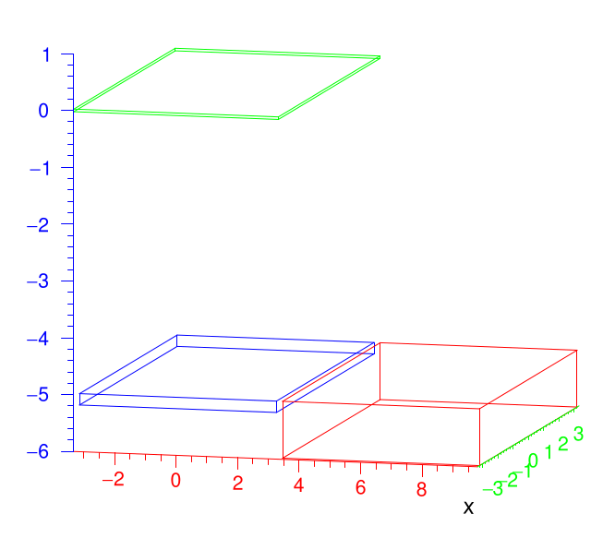
Extra Configs
(moving optics to focus on Red detector)
Config4:
green Si
Blue 2mm CdTe
Red 5mm CZT
Config5:
green Si
Blue 2mm CdTe
Red 10mm CZT

