Slide 1
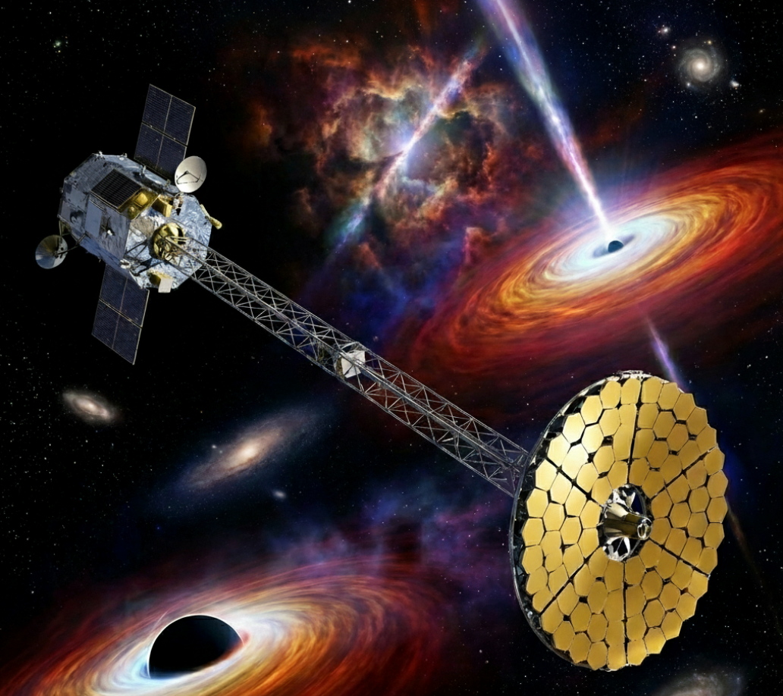
PHEMTO: MEGAlib Simulations
José Sousa - CEA/Dap
22-01-2026
V2
https://github.com/jcfsousa/phemto_simulations

Slide 2
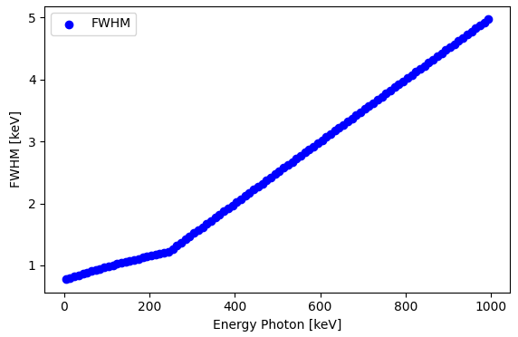
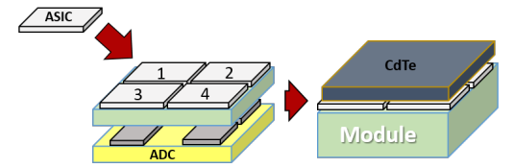
Overall Assumptions
Detectors
https://github.com/jcfsousa/phemto_simulations
CdTe Detector performance:
density = 5.79 g/cm3
thickness = 2mm
threshold = 4 keV
dx dy = 0.25mm
Energy resolution: 74e rms
Fixed at 0.5%
(charge loss, charge sharing)
PHEMTO config:
4x4 modules (6.4 x 6.4 cm2)
256 x 256 pix
1 module: 1.4cm, 64x64 pix

Slide 3
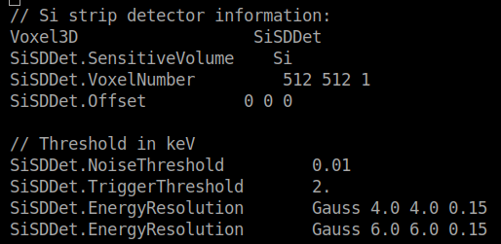
Overall Assumptions
Detectors
https://github.com/jcfsousa/phemto_simulations
Si Detector performance:
density = 5.79 g/cm3
thickness = 450um
threshold = 2 keV
dx dy = 0.13mm
Energy resolution: 0.35keV FWHM
PHEMTO config:
6.65 x 6.65 cm2
512 x 512 pix

Slide 4
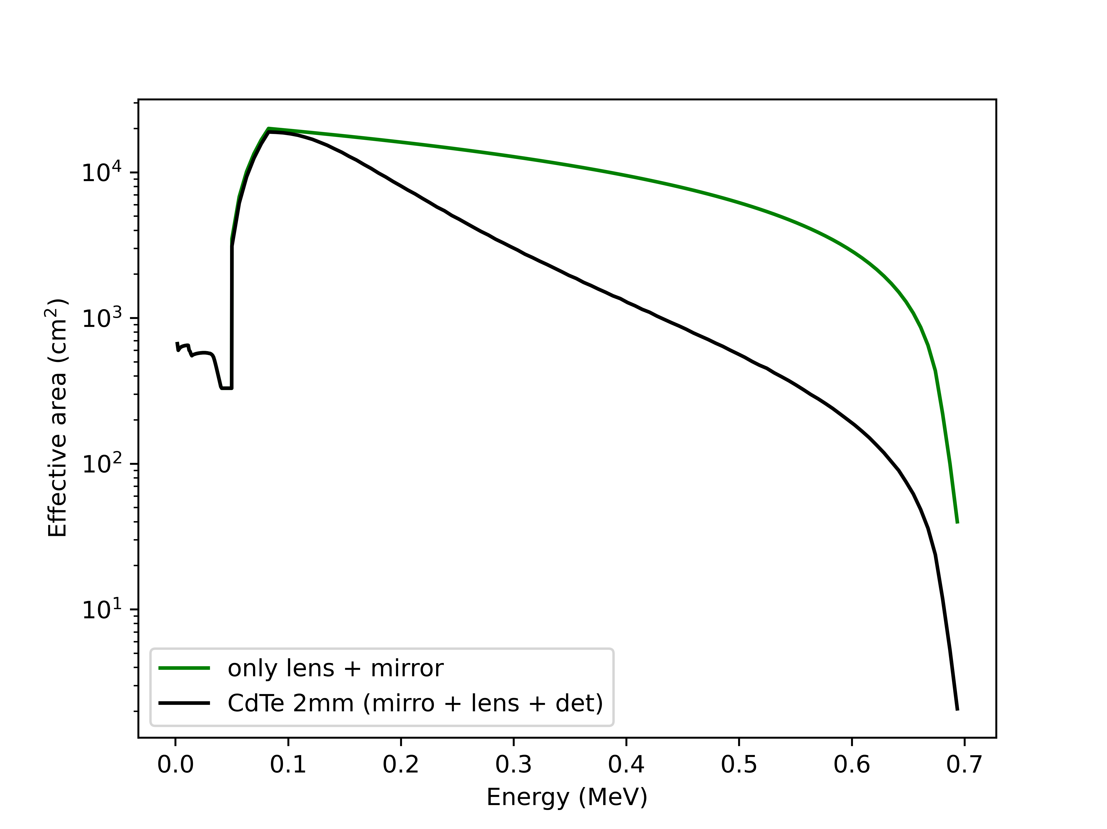
Overall Assumptions
Mirror Lenses
https://github.com/jcfsousa/phemto_simulations

Slide 5
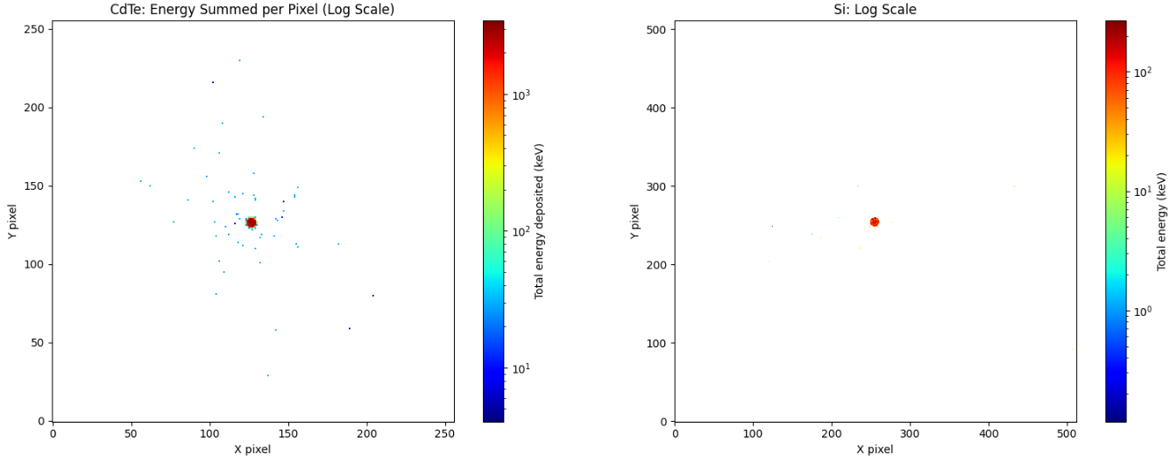
Overall Assumptions
PSF
https://github.com/jcfsousa/phemto_simulations
Laue Lense approximation:
- Homogeneous
- 1.5mm diameter focus [1,2]
*Used this approximation also for x-ray mirror PSF, [1, 400]keV*
CdTe - HED
Si - LED

Slide 6
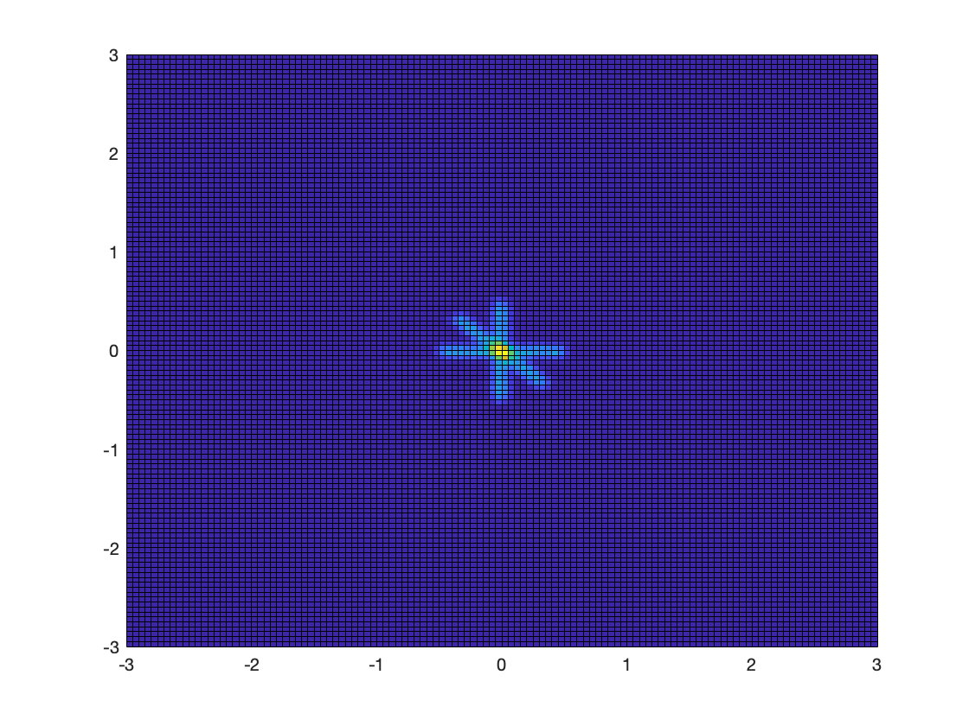
Overall Assumptions
PSF
https://github.com/jcfsousa/phemto_simulations
Laue Lense approximation:
- Homogeneous
- 1.5mm diameter focus [1,2]
*Used this approximation also for x-ray mirror PSF, [1, 400]keV*
Laue Lenses Future MEGAlib source:
X-ray mirror Future MEGAlib source:
?
Miguel Moite + Lisa Ferro

Slide 7
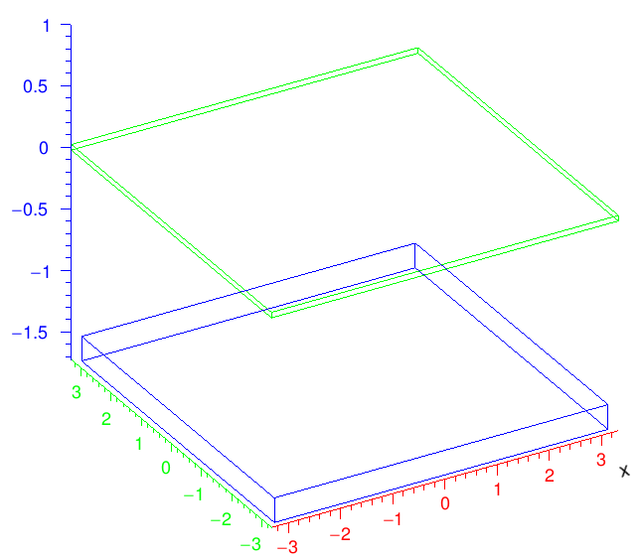
Instrument Configuration
MEGAlib Model
https://github.com/jcfsousa/phemto_simulations
Si (green):
6.65x6.65cm2, 450um thick
CdTe (blue):
6.4x6.4cm2, 2mm thick
1.5cm spacing - Instrument team worried about mechanical spacing
1.5cm

Slide 8
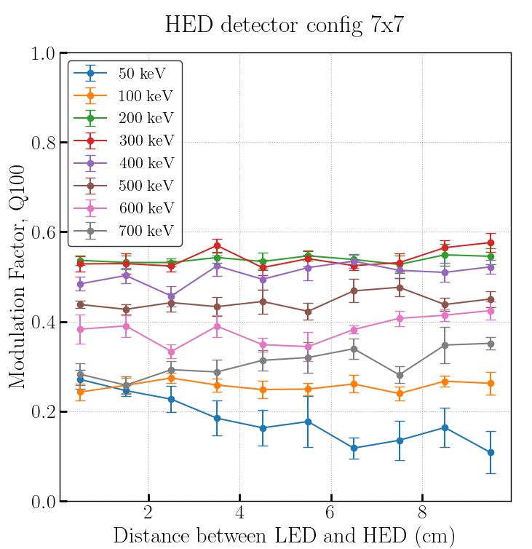
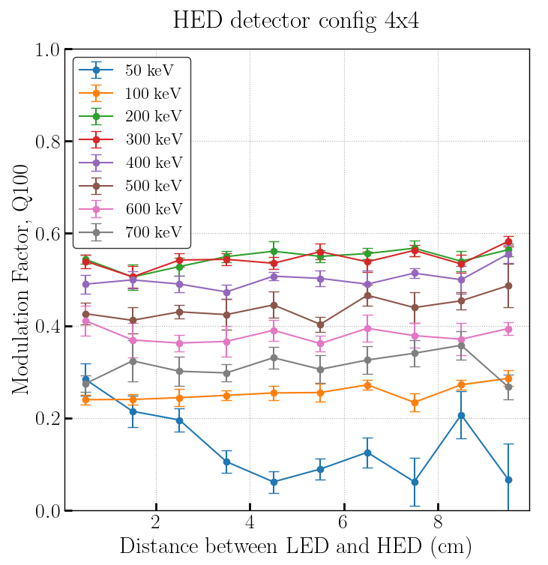
Instrument Configuration
Larger HED?
https://github.com/jcfsousa/phemto_simulations

Slide 9
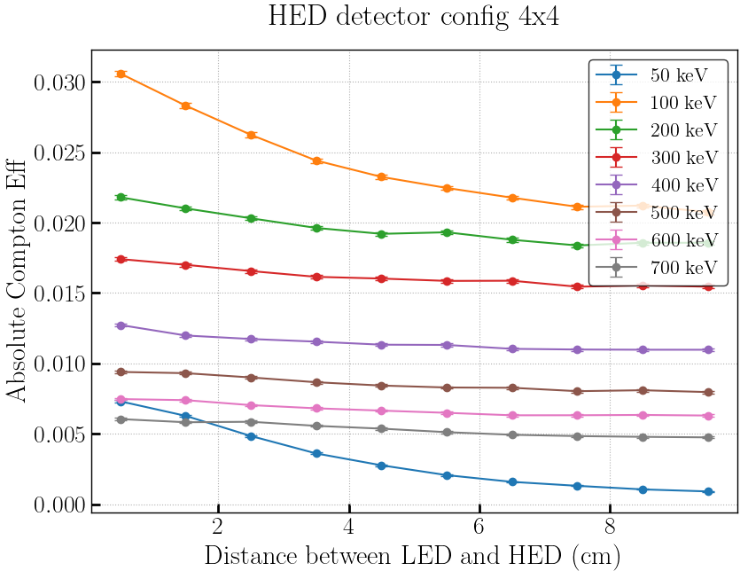
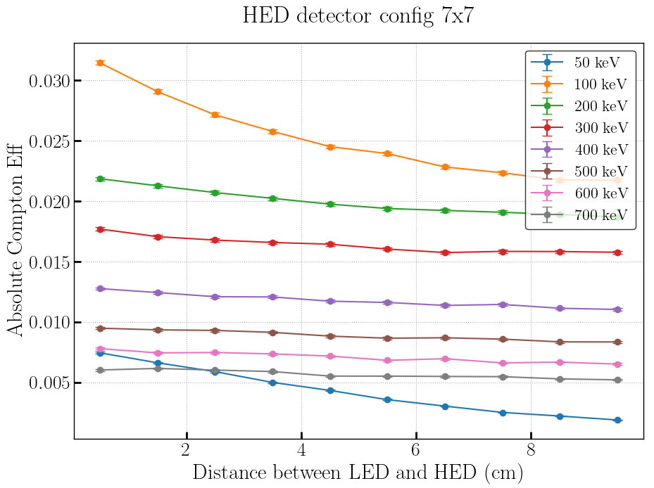
Instrument Configuration
Larger HED?
https://github.com/jcfsousa/phemto_simulations
*No Significant Impact on Compton Eff or Q with larger HED, 7x7*

Slide 10
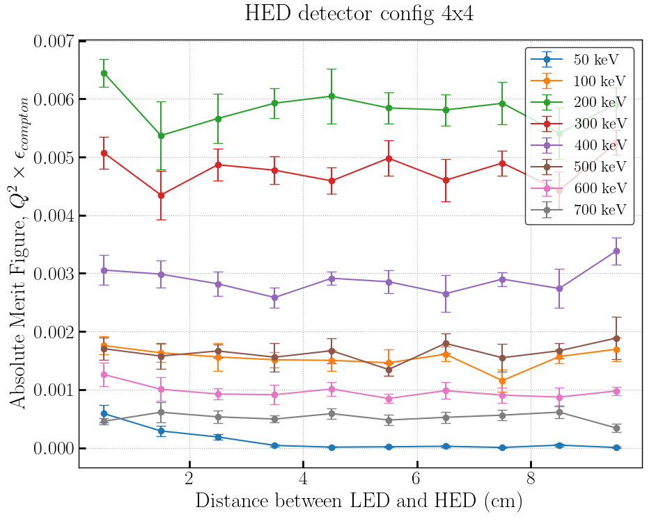
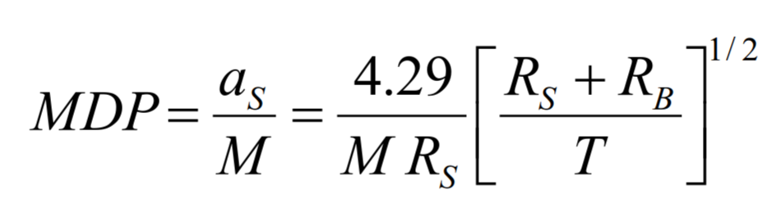
Instrument Configuration
Distance between LED - HED?
https://github.com/jcfsousa/phemto_simulations
Q
Q
Q
Q
Rs = Compteff . Ns
RB = Compteff . NB
Merit Figure = Q² . Compteff

Slide 11
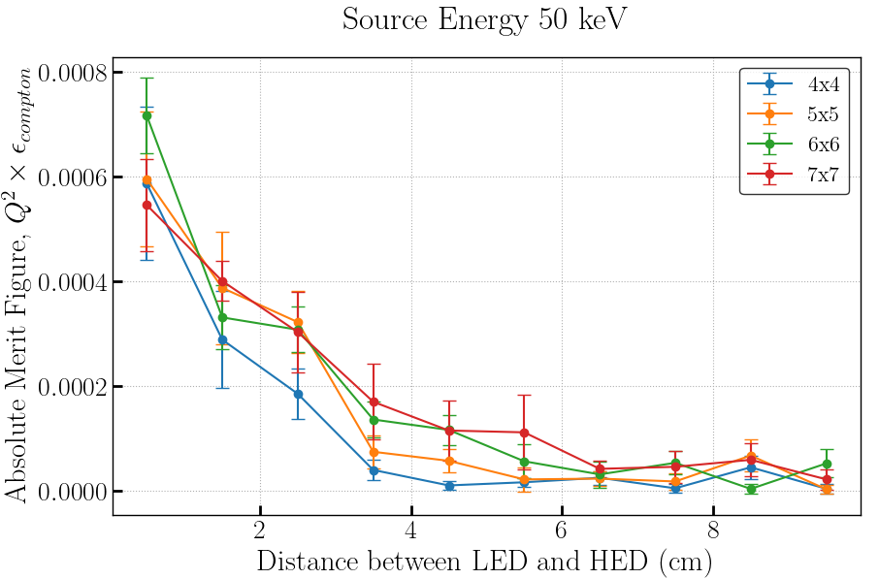
Instrument Configuration
Distance between LED - HED?
https://github.com/jcfsousa/phemto_simulations
Q
Q
Q
Q
Rs = Compteff . Ns
RB = Compteff . NB
Merit Figure = Q² . Compteff

Slide 12
Instrument Configuration
MEGAlib model
https://github.com/jcfsousa/phemto_simulations
Si (green):
6.65x6.65cm2, 450um thick
CdTe (blue):
6.4x6.4cm2, 2mm thick
1.5cm spacing - Instrument team worried about mechanical spacing
1.5cm

Slide 13
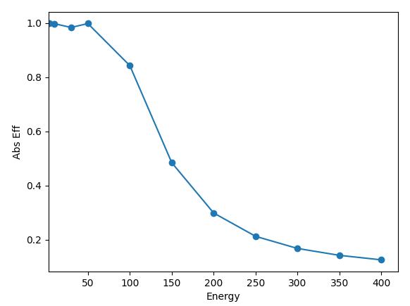
Efficiency and Sensitivity
PHEMTO
https://github.com/jcfsousa/phemto_simulations
Efficiency
Simulated in MEGAlib instrument Efficiency
Didnt have time to simulate Background on MEGAlib.
Ignoring Particle background (Anti-coincidence)
Used Phillipe Laurent background approximation (seems to be close to reality for photons)
Assuming background only on PSF area
MEGAlib REVAN reconstruction problem
(configuration problem)

Slide 14
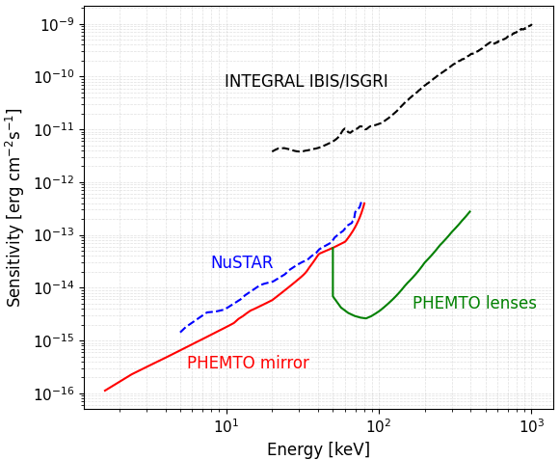
Efficiency and Sensitivity
PHEMTO
https://github.com/jcfsousa/phemto_simulations
Sensitivity
Simulated in MEGAlib instrument Efficiency
Didnt have time to simulate Background on MEGAlib.
Ignoring Particle background (Anti-coincidence)
Used Phillipe Laurent background approximation (seems to be close to reality for photons)
Assuming background only on PSF area

Slide 15

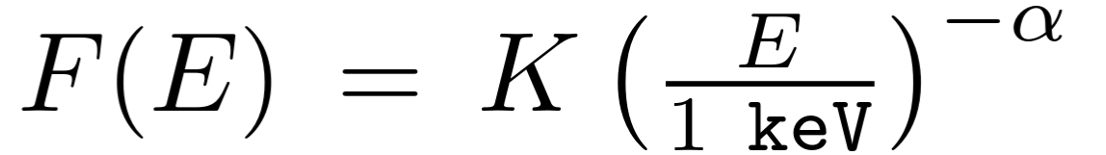


Polarization
PHEMTO MDP
https://github.com/jcfsousa/phemto_simulations
Crab Flux [8]:
MEGAlib Cosima
(Geant4)
100% polarized .source
Random polarized .source
MEGAlib
Event reconstruction
(Compton Chi2 via energies)
Collimated beam, 1.5mm diameter (PSF)
Azimuthal double Compton distribution
Bin Energy
(ie: [50,400]keV or [50,150]keV)
Parse .tra files + apply Dets pixelization
Q100, Compt_eff

Slide 16
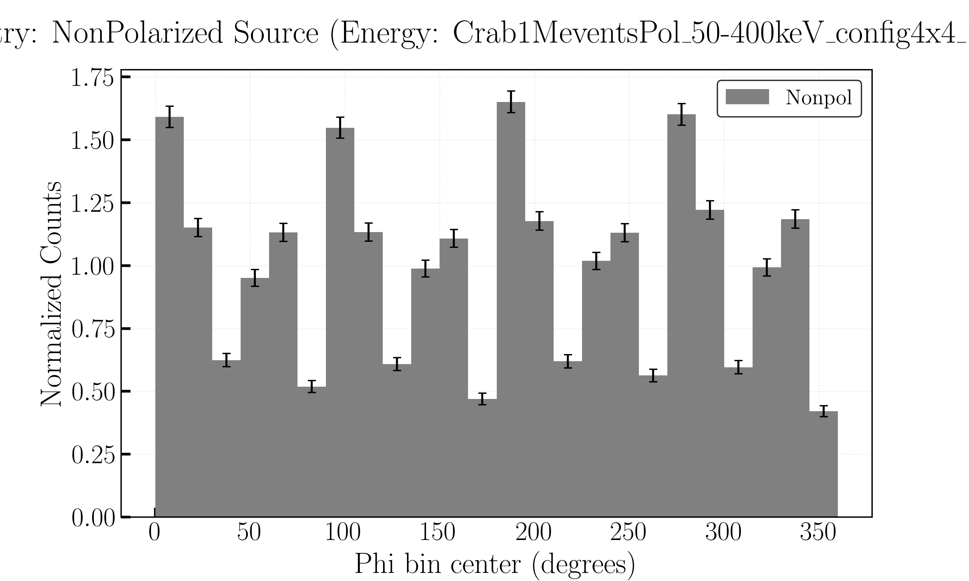
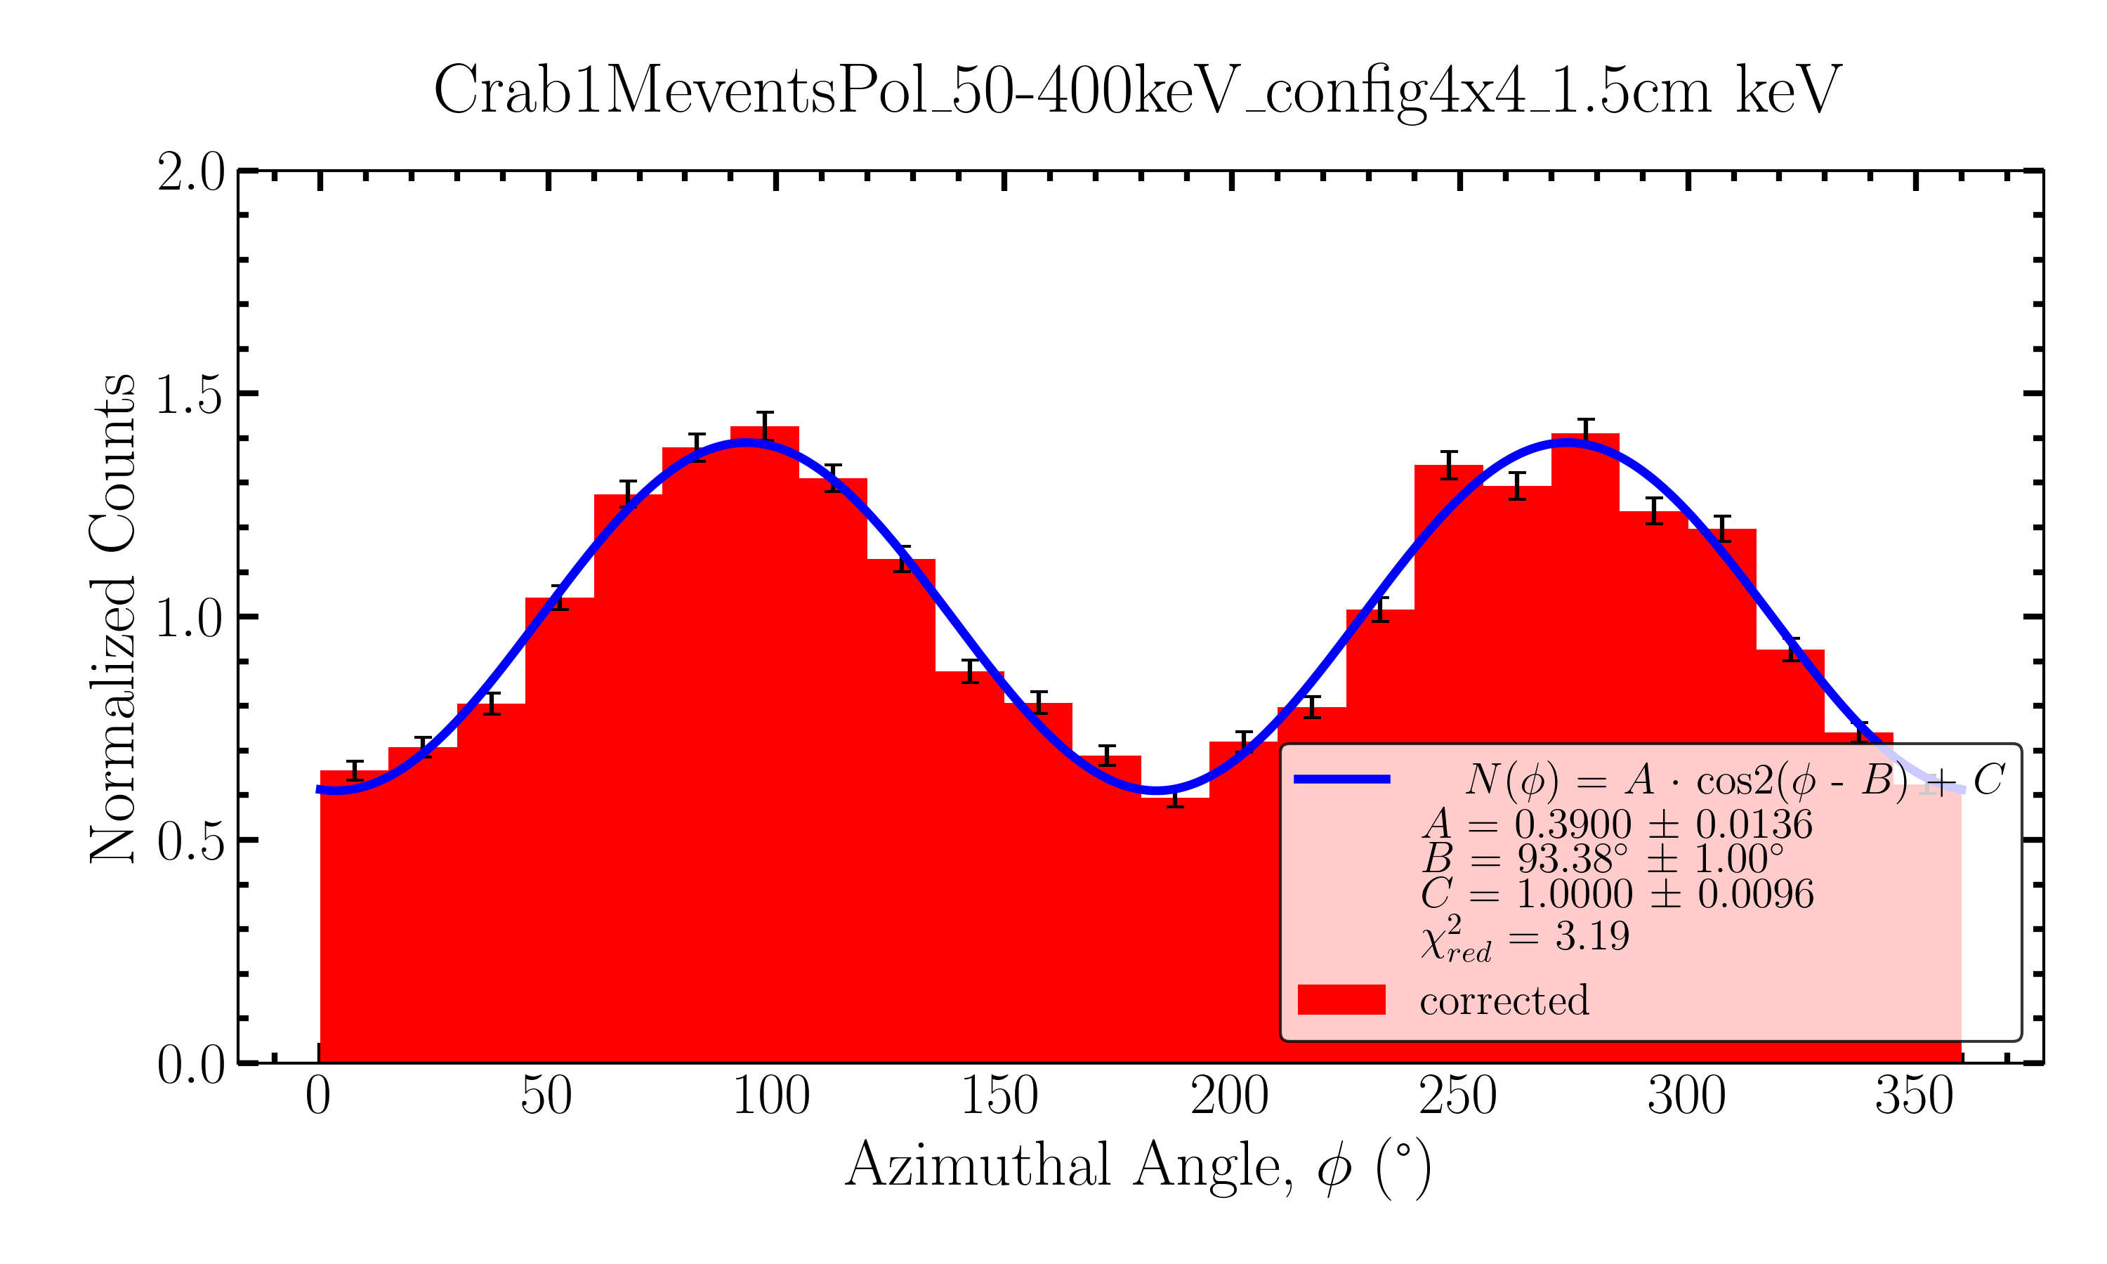
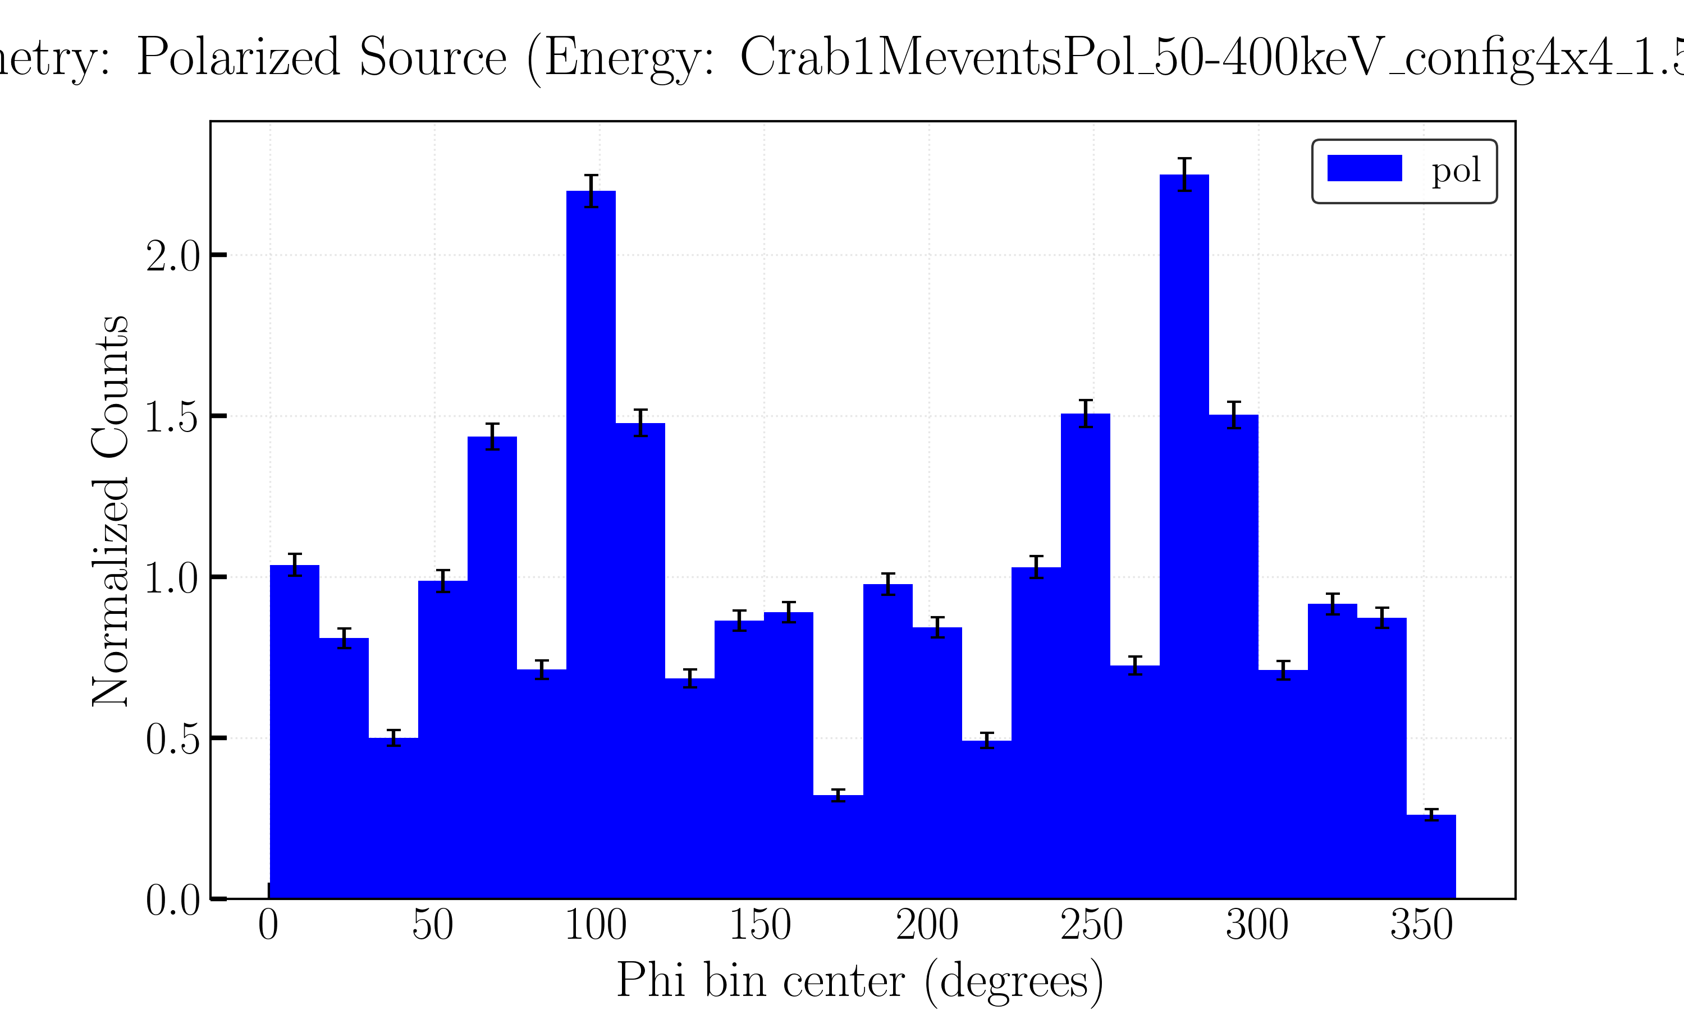
Polarization
PHEMTO MDP
Crab Source, Ebin [50,400]keV
*Non-Polarized*
*Corrected*
*Polarized*

Slide 17
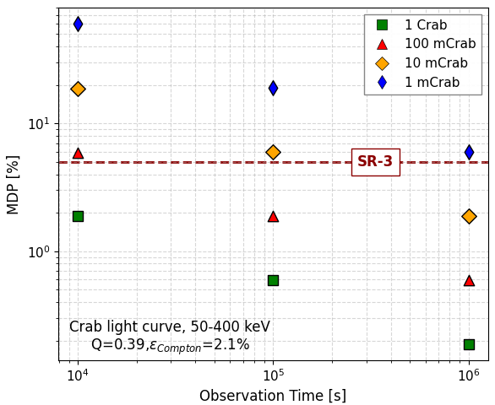
Polarization
PHEMTO MDP
https://github.com/jcfsousa/phemto_simulations
Crab Source
Ebin [50,400]keV

Slide 18
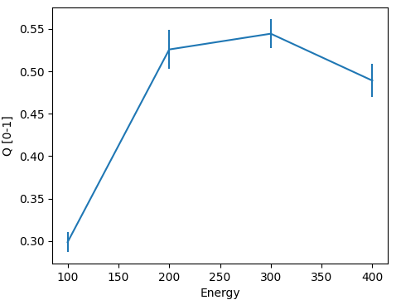
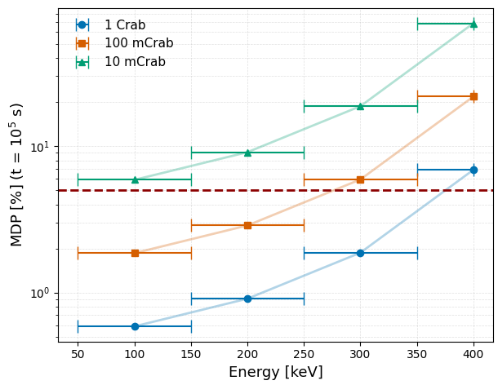
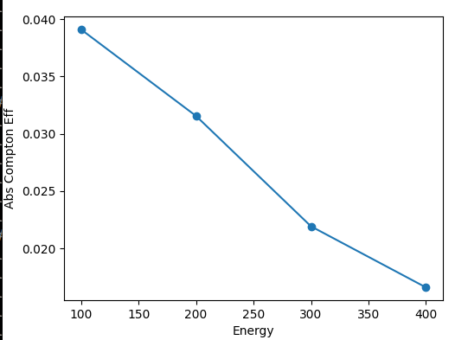
Polarization
PHEMTO MDP
https://github.com/jcfsousa/phemto_simulations
Crab Source
Ebin 100 keV
Monochromatic Q
Monochromatic
Compton Eff
*Used center bin monochromatic Q and Compton Eff*

Slide 19
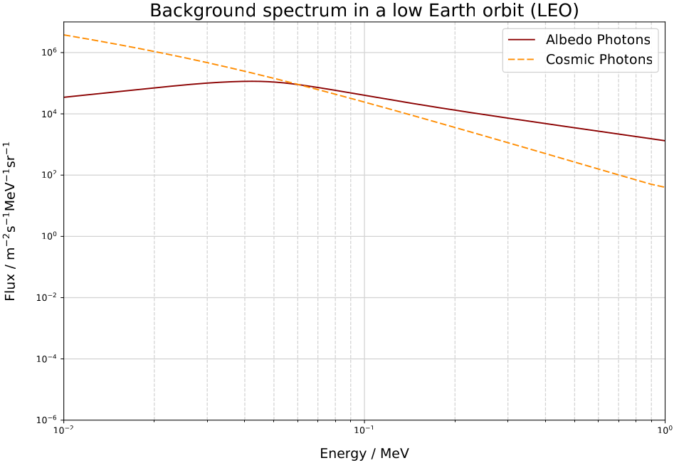
Polarization
PHEMTO MDP - Background
https://github.com/jcfsousa/phemto_simulations
Considered:
Cosmic Photons
Photoelectric on PSF
Compton with at least 1 event in PSF
[Background for a gamma-ray satellite on a low-Earth orbit, P.Cumani et al. 2019]

Slide 20
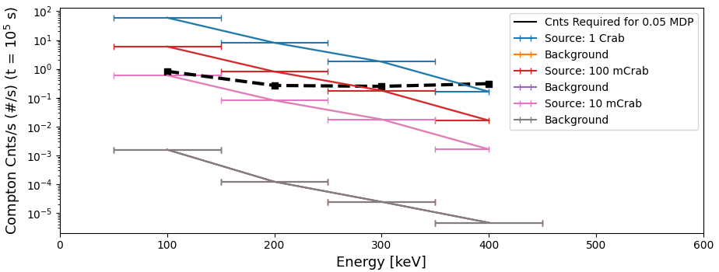
Polarization
PHEMTO MDP - Background
https://github.com/jcfsousa/phemto_simulations

Slide 21
Future Work
https://github.com/jcfsousa/phemto_simulations
Detectors
- Better energy resolution information detectors
- Can we do Polarimetry with Si?
Improve MEGAlib geometry:
- Anti-Coincidence detector
- Shielding (collimator + space craft backside detectors
- Collimator
Background:
- Run Cosmic Background with collimator (urgent for Phase 0 sensitivity)
- Define orbit
- Add particle background, Cumani paper
- Activation
Optics:
- Laue lenses PSF and updated Effective Area
- X-ray mirror PSF and updated Effective Area

Slide 22
PHEMTO: MEGAlib Simulations
José Sousa - CEA/Dap
22-01-2026
V2
https://github.com/jcfsousa/phemto_simulations

Slide 23
References
https://github.com/jcfsousa/phemto_simulations
[1] Ferrari, E., Ferrari, C., Virgilli, E., Caroli, E., Auricchio, N., Stephen, J. B., Ferro, L., da Silva, R. C., and Moita, M. (2025). Correction: Imaging performance of laue lenses made of ge and si bent crystals for future gamma-ray astrophysics telescopes. Aerotecnica Missili amp; Spazio.
[2] Frontera, F. (2025). Hard x-ray/soft gamma-ray laue lenses for high energy astrophysics.
[3] Lucchetta, G. et. al. (2022). Introducing the MeVCube concept: a CubeSat for MeV observations. doi:10.1088/1475-7516/2022/08/013
[4] https://doi.org/10.48550/arXiv.2108.02860
[5] Cumani, P., Hernanz, M., Kiener, J. et al. Background for a gamma-ray satellite on a low-Earth orbit. Exp Astron 47, 273–302 (2019). https://doi.org/10.1007/s10686-019-09624-0

Slide 24
References
https://github.com/jcfsousa/phemto_simulations
[6] https://doi.org/10.1051/0004-6361/202245205
[7] On understanding the figures of merit for detection and measurement of x-ray polarization
Martin C. Weisskopf, Ronald F. Elsner, Stephen L. O'Dell https://arxiv.org/abs/1006.3711
[8] THE INTEGRAL/SPI RESPONSE AND THE CRAB OBSERVATIONS arXiv:astro-ph/0406058v1 2 Jun 2004
[9]Andreas Zoglauer et al., "MEGAlib - Medium Energy Gamma-ray Astronomy Library", NewAR 50 (7-8), 2006

