Slide 1
AI Writer
- artificial assisted writing -

Slide 2
Purpose
Help facilitate writing
Give small generated text help as you write
Ask for larger generated text helps from an AI base on the type of story being written

Slide 3
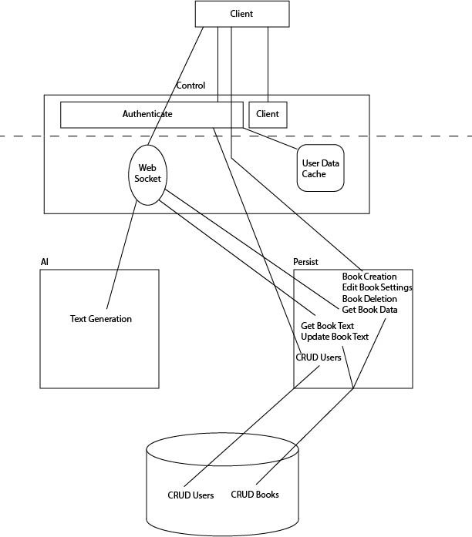
App Structure
Control - Auth - Serves Client - Proxy for Internal Services - WebSocket
AI - Text Generation
Persist - Handles Connection to Database

