Slide 1
ALPASPINAS · DRAGON BOAT TEAM · MALAYSIA
Onboarding Process / Website Demo
A walkthrough of the six core journeys — three for members, three for the team admins.
MEMBERS
ADMIN
Registration · Training sign-ups · Merch
Sign-up tracking · Boat assignments · Merch management
Notes:
Overview of the six core AlpasPinas processes, split between member-facing and admin-facing flows.

Slide 2
THE SIX JOURNEYS
What we'll walk through
MEMBERS
ADMIN
For Members
For Admins
What paddlers do on the site
How the team runs it behind the scenes
1
Onboarding & registration
1
Training sign-up tracking
2
Training sign-ups
2
Boat assignments
3
Merchandise purchase
3
Merchandise management
Notes:
Roadmap slide. Three member journeys on the left, three admin journeys on the right.

Slide 3
01
PART ONE — THE PADDLER'S SIDE
For Members

Slide 4
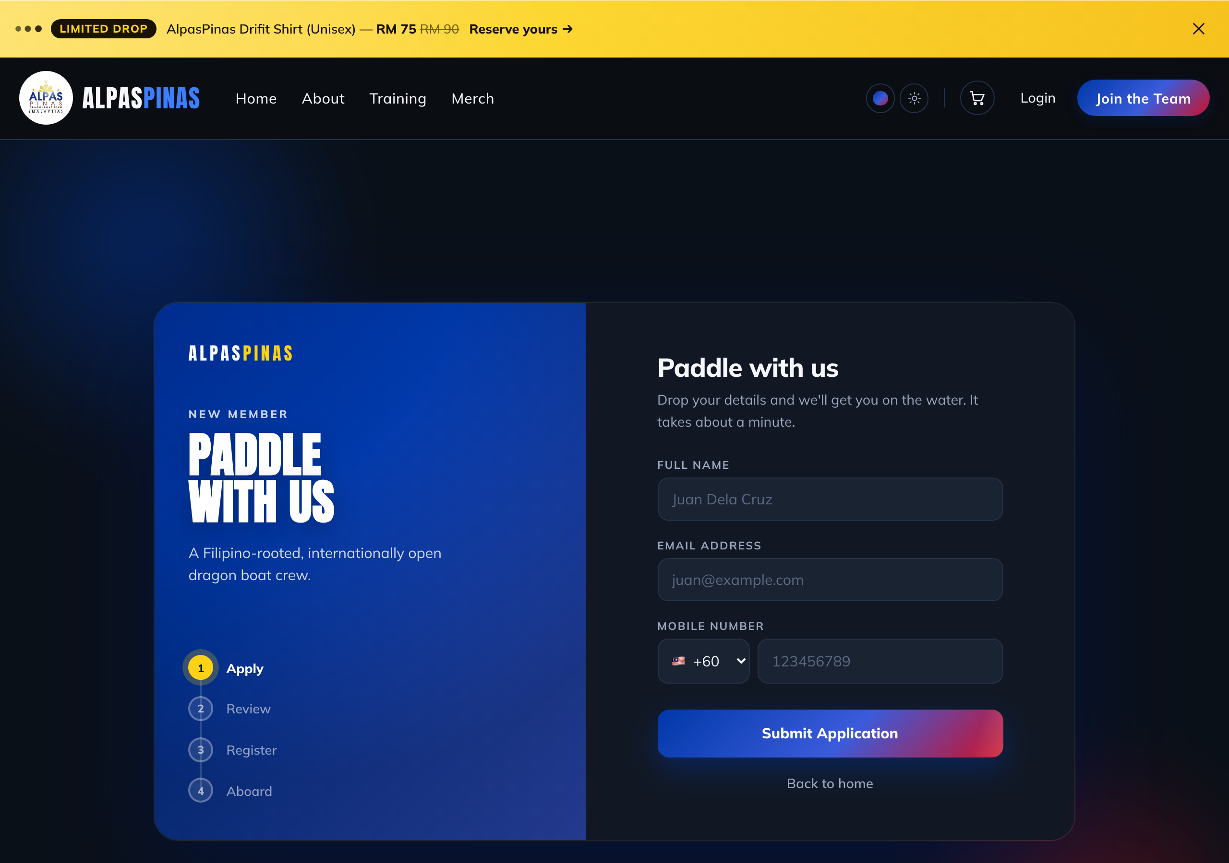
MEMBERS
PROCESS 1
Onboarding & Registration
From "I'm curious" to a full crew account — a guided four-step path.
1
Apply
Prospective paddler drops name, email and mobile on the “Paddle with us” form.
2
Review & approval
The team reviews the application; approval generates a secure registration link (valid 7 days).
3
Register
Applicant opens the emailed link and sets a password, then their boat details — gender, birthday, paddling side & weight.
Step 1 · the application form with its 4-step rail
4
Aboard
An optional emergency contact, and they're welcomed in with a full member account.
Notes:
Registration is invite-gated: apply, get approved, receive a tokenized link, set password + boat profile. Emergency contact is optional.

Slide 5
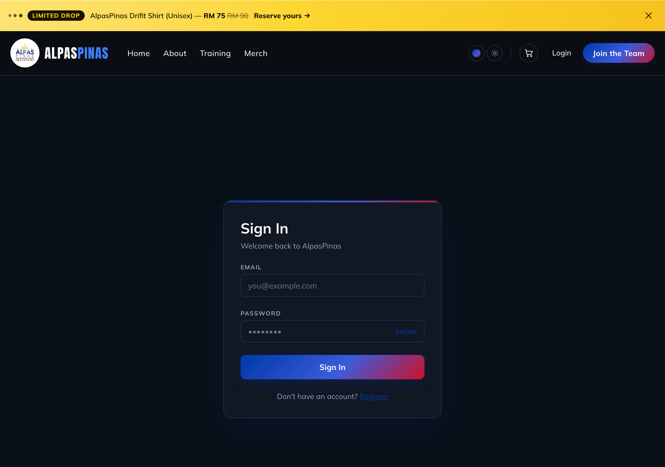
MEMBERS
PROCESS 2
Training Sign-ups
Members reserve a seat for lake or land sessions in a few taps.
1
Sign in
Members log in with the email & password created at registration.
2
Open a session
The Training page lists upcoming sessions with live seat counts; tap one to sign up.
3
Fill the booking form
Name, side/role & weight prefill from the profile. Lake sessions also ask PFD/paddle needs and which day(s) — Sat, Sun or both.
Members sign in before booking a session
4
Confirmed or waitlisted
If the boat has room the seat is confirmed; if full, they join the waitlist automatically.
Notes:
Training sign-up: authenticated members book seats. Land vs lake sessions differ. Overflow goes to a waitlist.

Slide 6
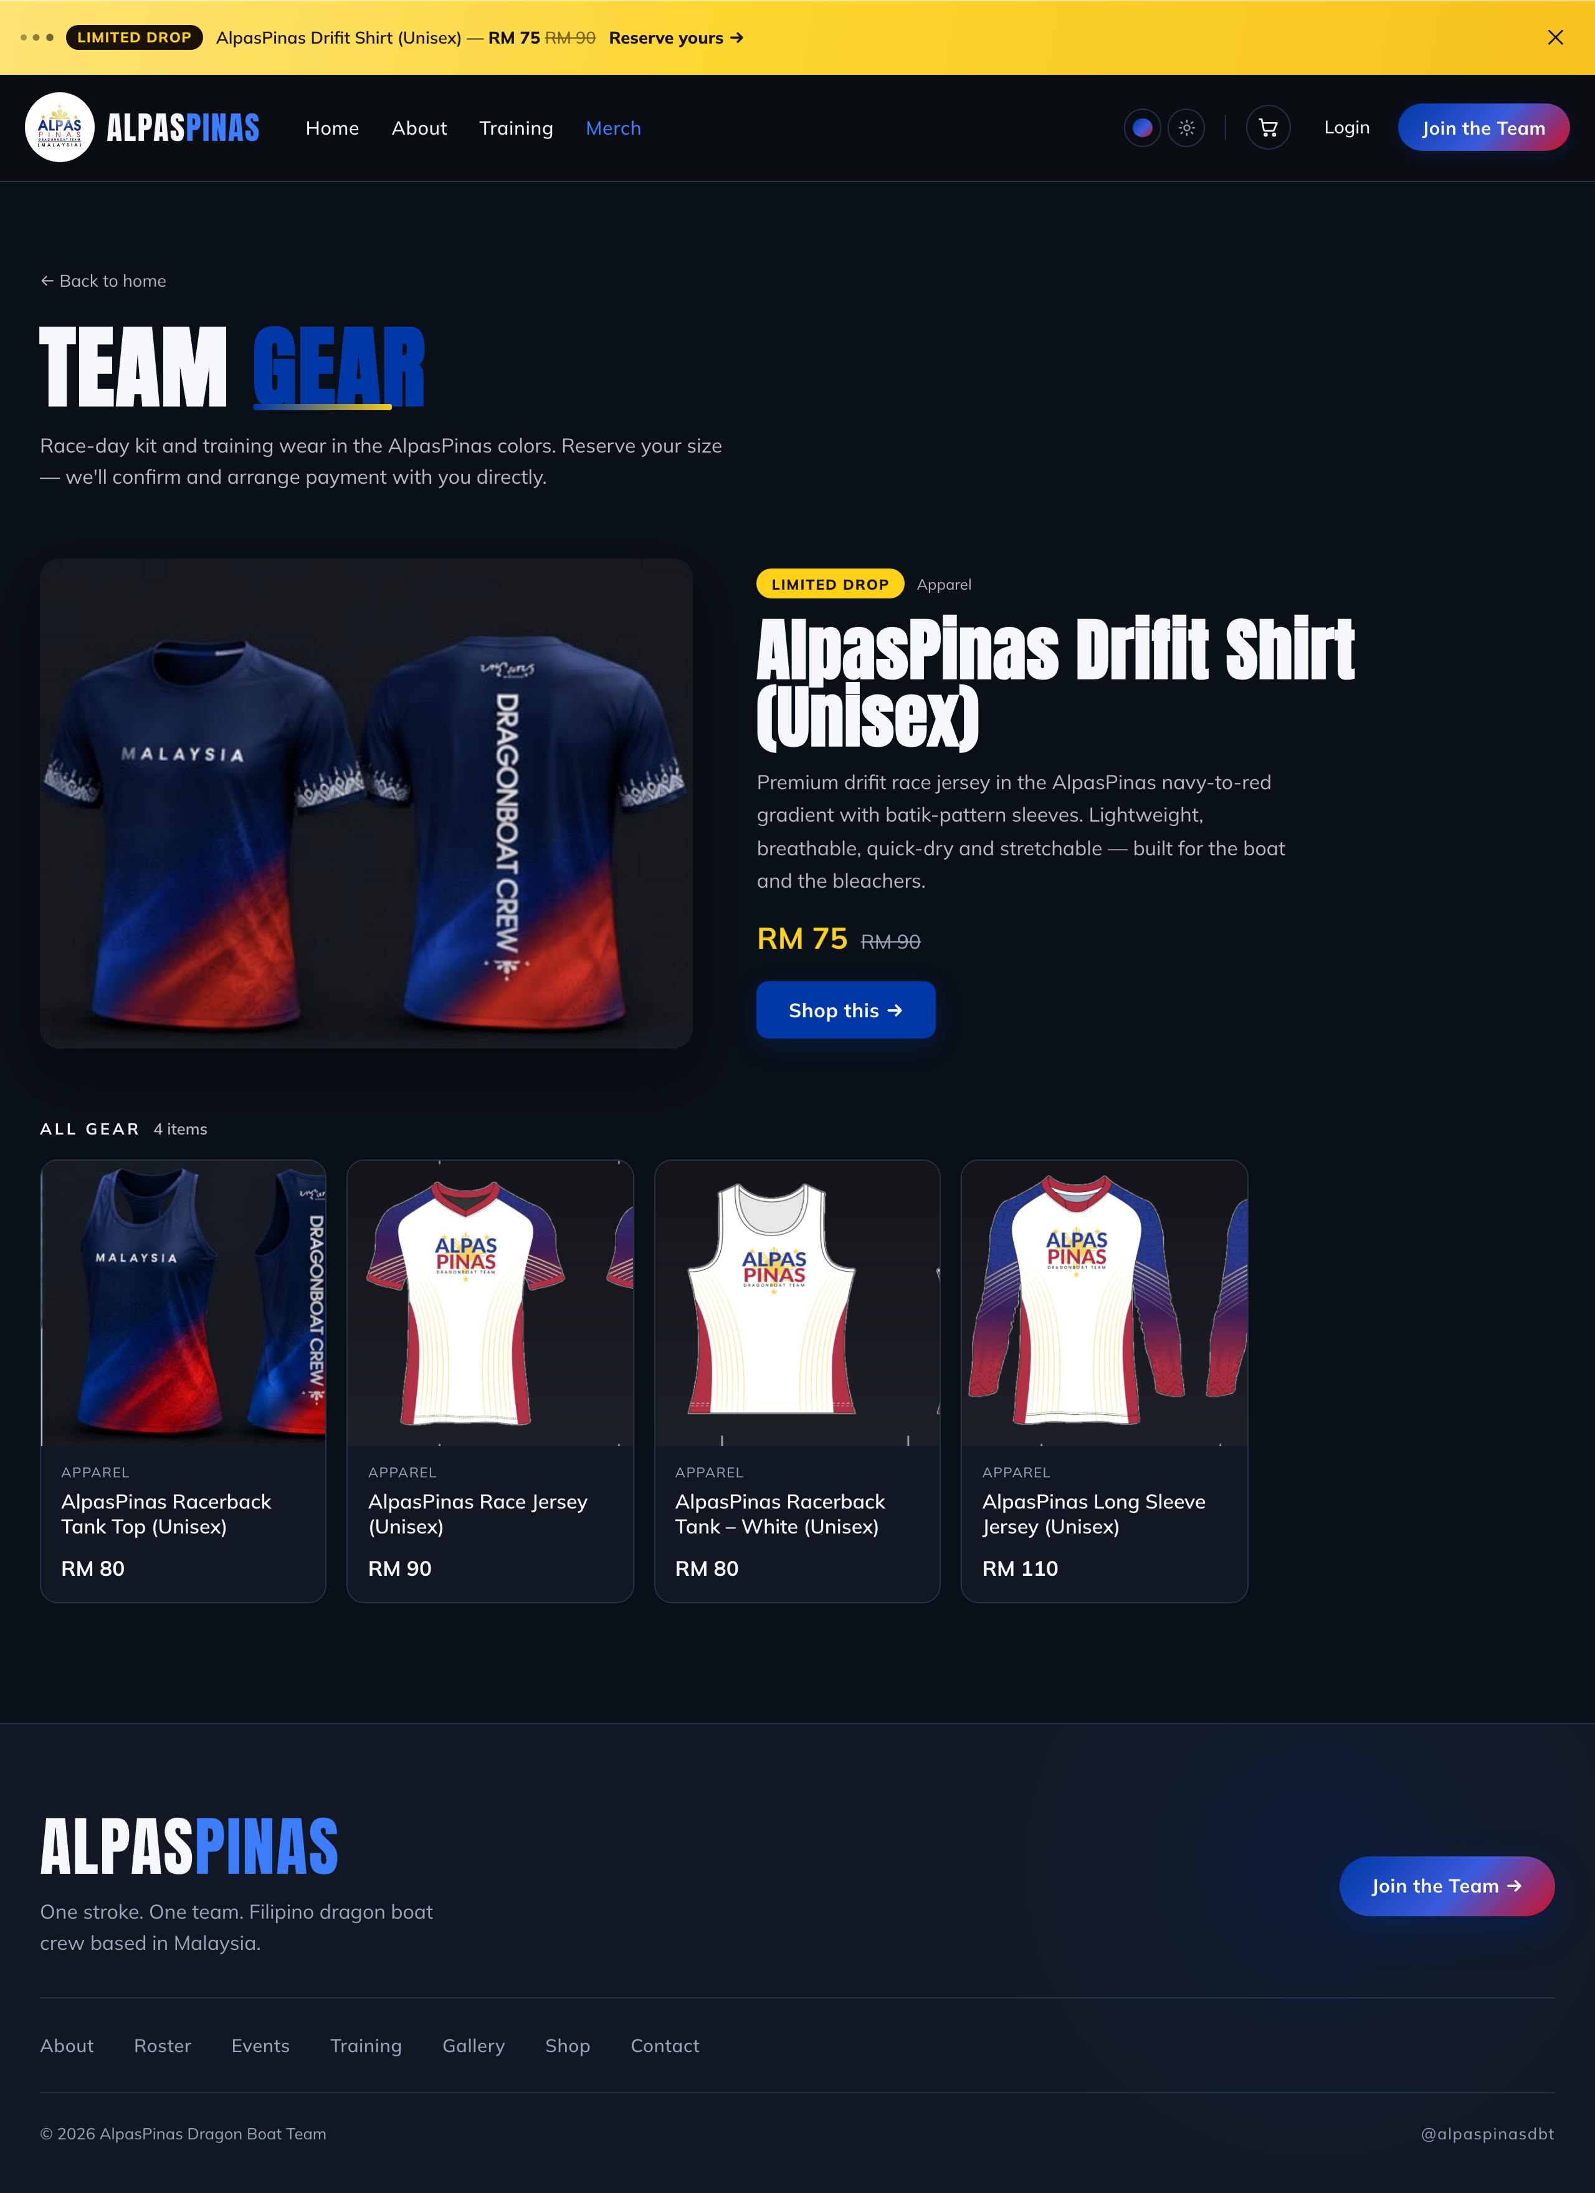
MEMBERS
PROCESS 3
Merchandise Purchase
A low-friction “reserve” flow — payment is arranged directly, not online.
1
Browse the shop
Team gear is shown with a featured “limited drop” up top and the full range below.
2
Pick size & quantity
On the product page the visitor chooses a size and quantity, then adds to cart.
3
Reserve details
In the cart they enter name, email, phone and choose pickup or delivery (address for delivery).
4
Order placed
The reservation is recorded and a confirmation email goes out; the team follows up to arrange payment.
The Team Gear shop — featured item + full range
Notes:
Merch is reserve-only: no online payment. Browse -> size/qty -> cart details (pickup/delivery) -> order recorded + email; team arranges payment manually.

Slide 7
02
PART TWO — RUNNING THE TEAM
For Admins

Slide 8
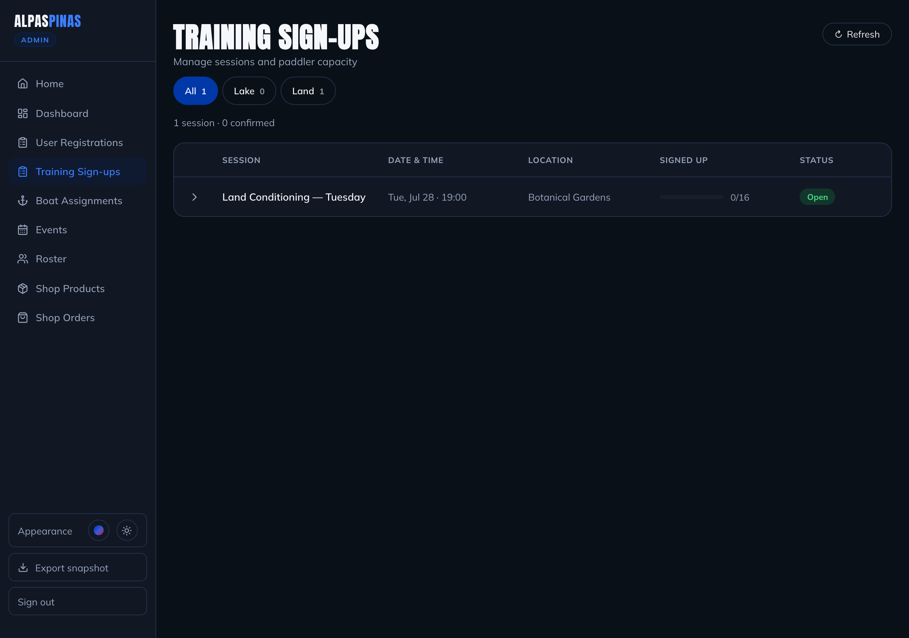
ADMIN
ADMIN 1
Training Sign-up Tracking
A live view of every session and who's on it.
1
See every session
Sessions list with date, time, location and a signed-up / capacity count.
2
Filter by venue
Toggle All / Lake / Land to focus on the right kind of session.
3
Expand for the roster
Open a session to see confirmed paddlers and the waitlist.
4
Approve & manage
Approve waitlisted paddlers or cancel a sign-up; status pills show open / full at a glance.
Admin · Training Sign-ups dashboard
Notes:
Admins track sessions with live capacity, filter by venue, expand rosters, and approve/cancel sign-ups.

Slide 9
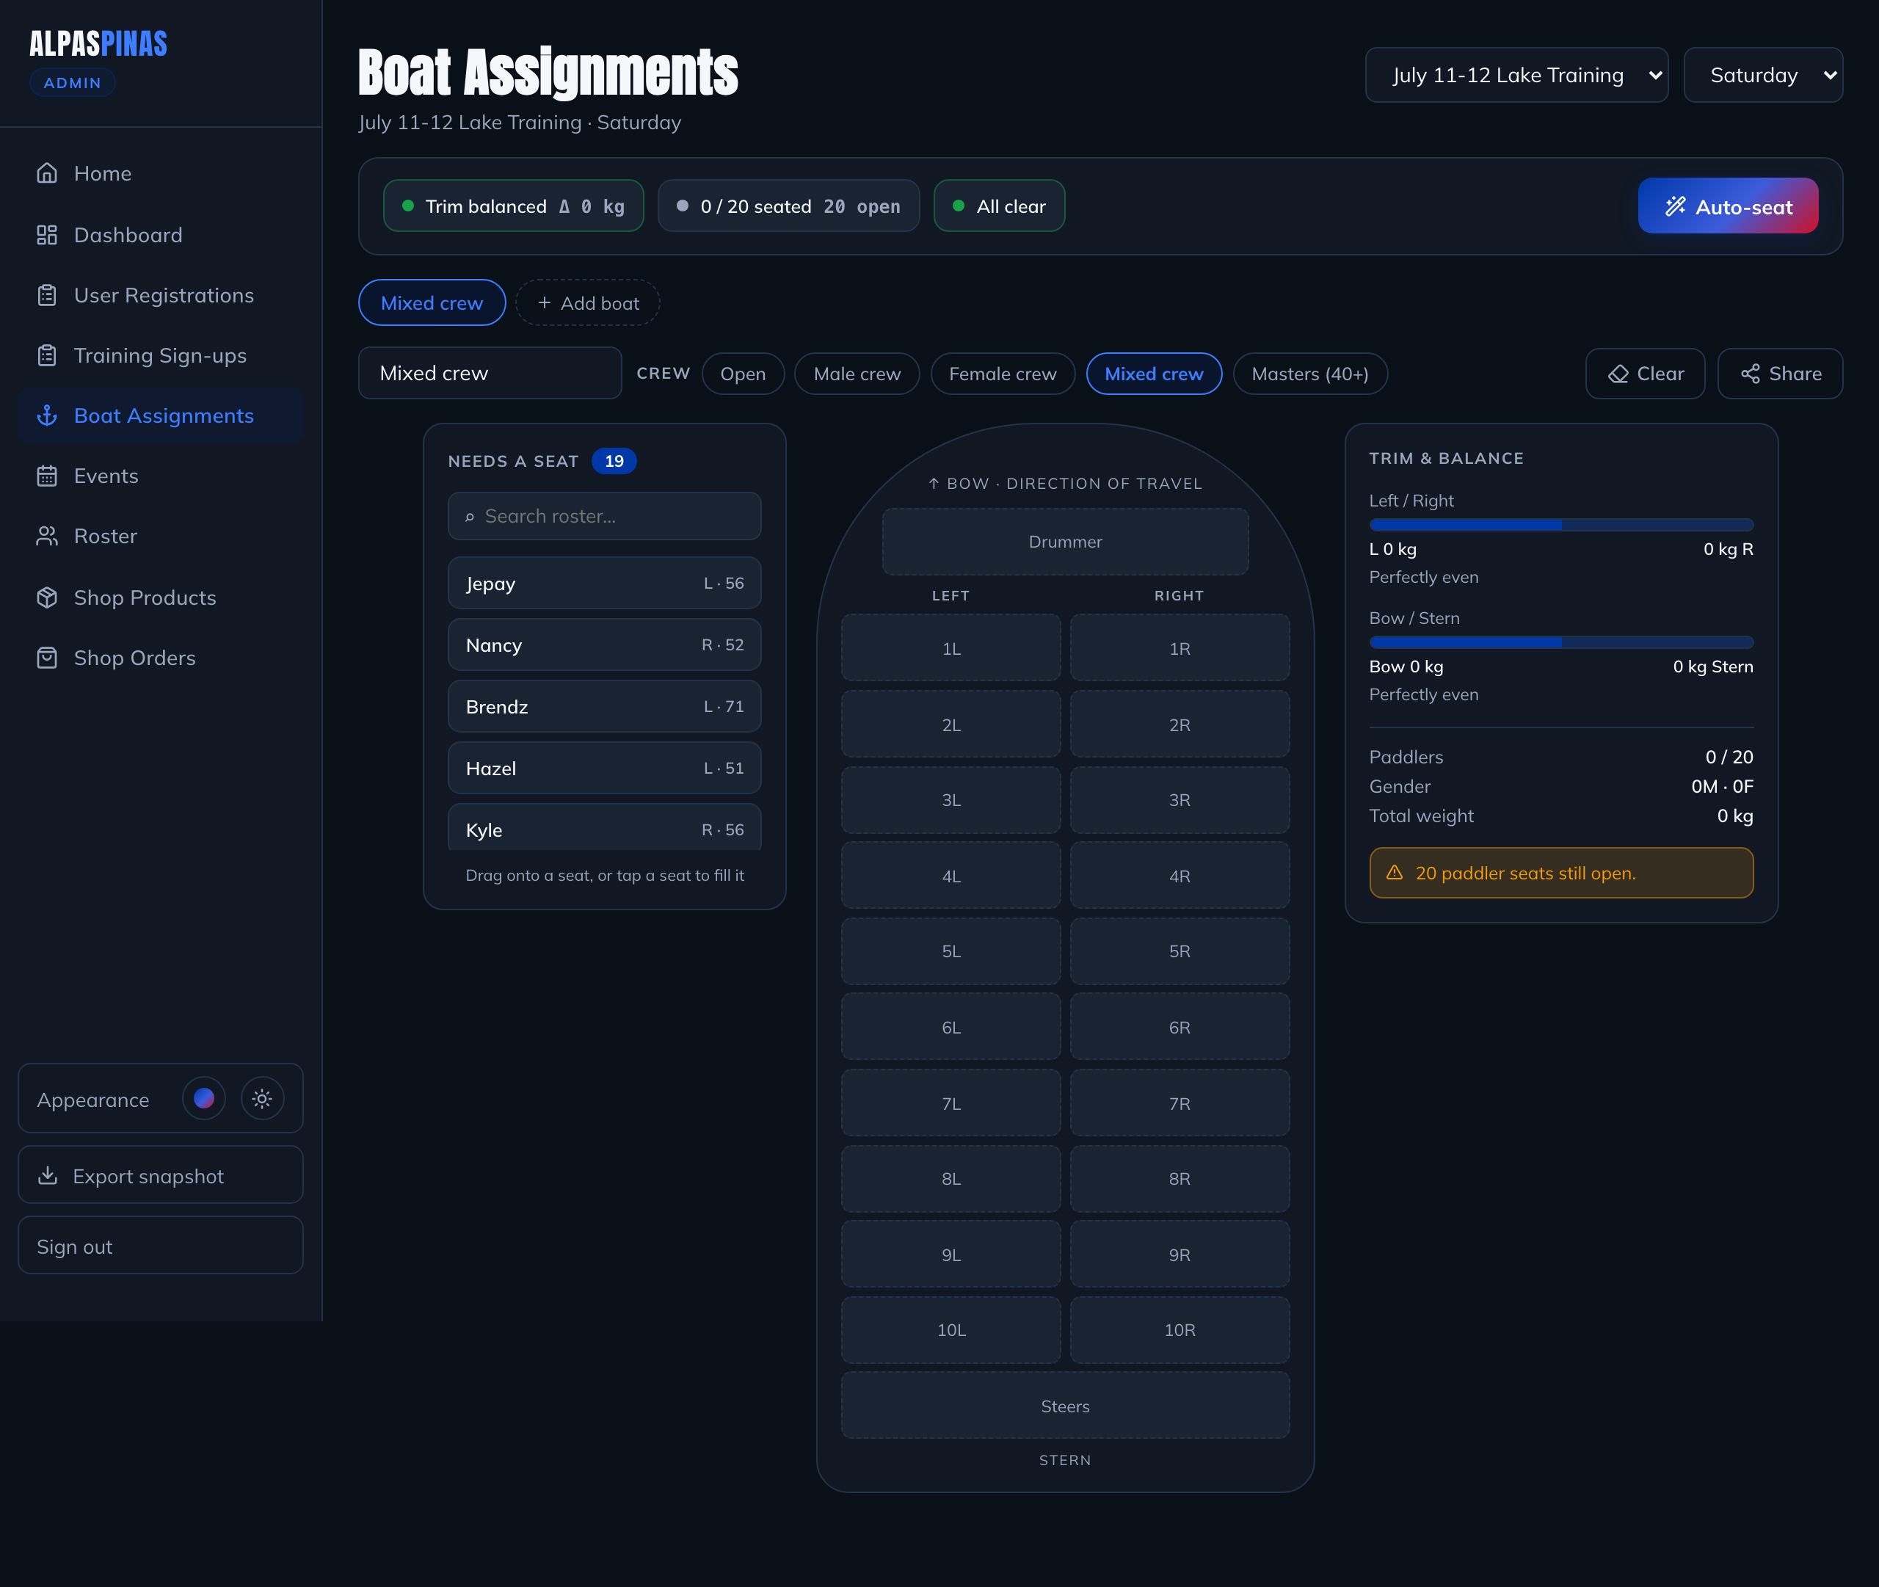
ADMIN
ADMIN 2
Boat Assignments
Seat the crew with balance and side-matching built in.
1
Pick session & day
Choose a training session and day; signed-up paddlers appear in “Needs a seat”.
2
Seat the paddlers
Drag paddlers onto left/right seats, drummer and steers — or tap a seat to fill it.
3
Watch trim & balance
Live left/right and bow/stern weight balance, gender mix and seat counts update as you go.
4
Auto-seat, presets & share
One-tap auto-seat, crew presets (mixed, masters…), then share or print the line-up.
Admin · the drag-and-drop boat planner
Notes:
Boat planner: assign seats via drag/drop, live trim & balance, auto-seat and crew presets, share/print the final line-up.

Slide 10
ADMIN
ADMIN 3
Merchandise Management
Two connected halves: the catalogue, and the orders it generates.
P
Shop Products
O
Shop Orders
Create, edit and remove products
See every reserve/inquiry order come in
Set price, promo price & “limited drop” label
Move each through Reserved → Paid → Fulfilled
Manage sizes, stock, images & category
Record an estimated delivery date
Flag the one featured item for the homepage
Old orders auto-archive after 30 days
Reserve orders from the member shop land directly in Shop Orders for the team to fulfil.
Notes:
Merch management has two parts: Shop Products (catalogue, pricing, featured item, stock) and Shop Orders (status flow Reserved->Paid->Fulfilled, auto-archive).

Slide 11
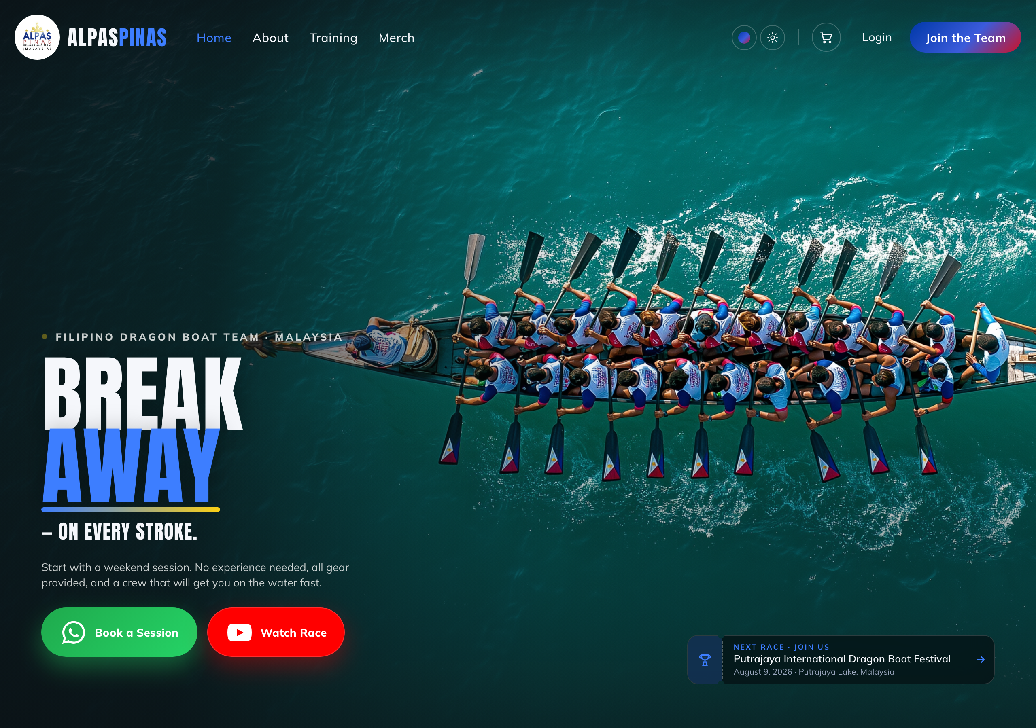
One portal, six journeys, one crew.
Members join, train and gear up · Admins track, seat and fulfil.
ALPASPINAS · MALAYSIA
Notes:
Closing. The portal ties member journeys and admin operations into one system.

