Slide 1
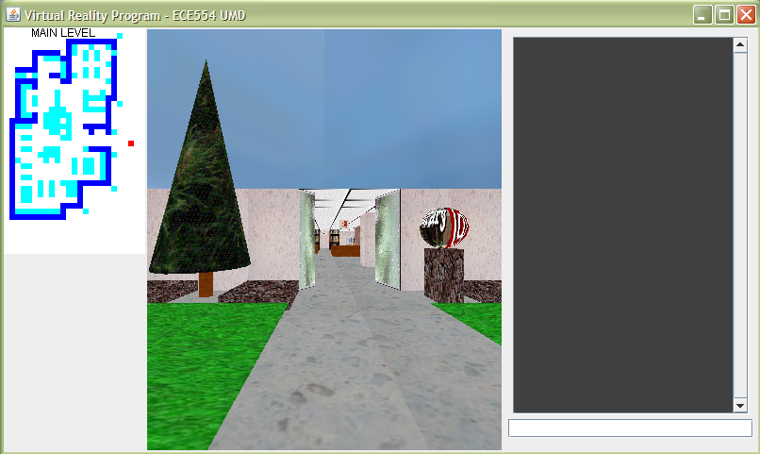
Presented by Juan C Garcia
Real Time Systems

Slide 2
Outline
Introduction - RT
Task Scheduling
Task Dispatching
Java 3D
Virtual Reality Example

Slide 3
What is Real Time
A real-time system is one that must process information and produce a response within a specified time, else risk severe consequences, including failure.
soft real-time systems → uncomfortably’ long response times are a nuisance but the system still functions even if deadlines are sometimes not met are called.
hard real-time systems → Systems where failure to meet response time constraints leads to catastrophic system failure (aircraft crashing, car skidding, patient dying before corrective action is performed).

Slide 4
Real Time System
In general, an RT Systems should provide at least 3 specific functions
  Task Scheduling (what tasks should run when)
  Task Dispatching (performs bookkeeping to start a task /status)
  Inter-task Communication

Slide 5
RT Systems Implementation
Polled Loop
Phase/State-Driven
Coroutines
Interrupt-Driven

Slide 6
Polled Loop
Simplest RT System
It is simply an infinite loop that constantly checks a flag until an event occurs
  It then executes some process & loops again
Handles one event, or several non-overlapping events

Slide 7
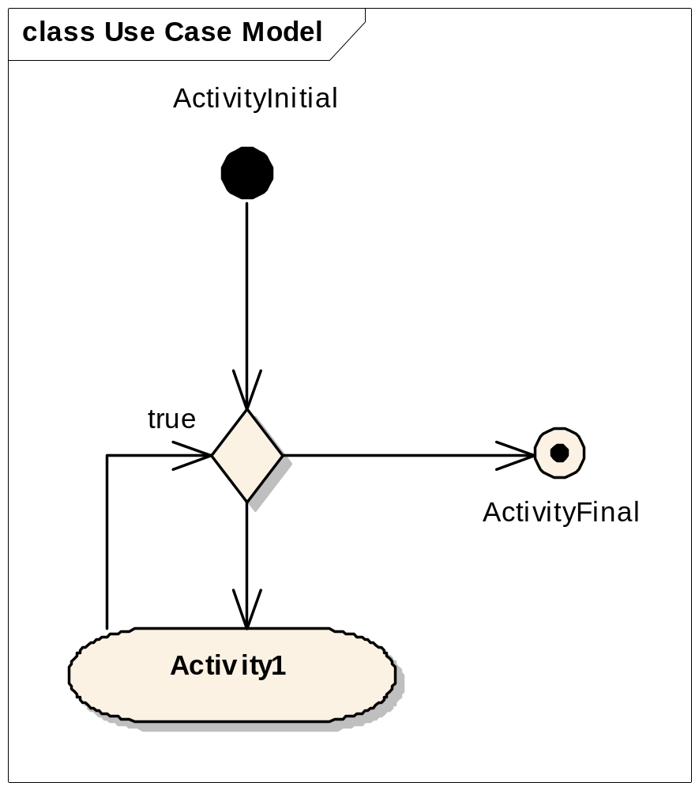
Polled Loop Systems
Example I - With Interrupts
public void run()
{
while(true)
{
if (flag)
processEvent();
sleep();
}
}

Slide 8
Phase/State-Driven Code
Facilitates basic multi-tasking system
Each task is divided into some number of segments
Each segment executes w/o interruption
A task can be temporarily suspended after any of its segment complete execution

Slide 9
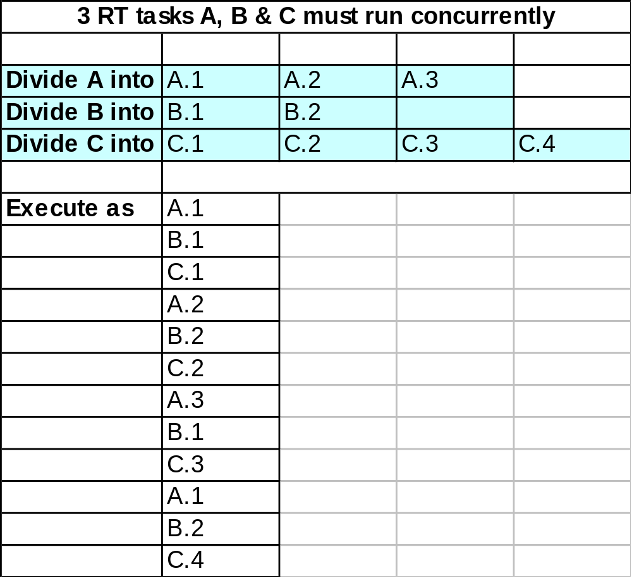
Phase/State-Driven Code
Example I

Slide 10
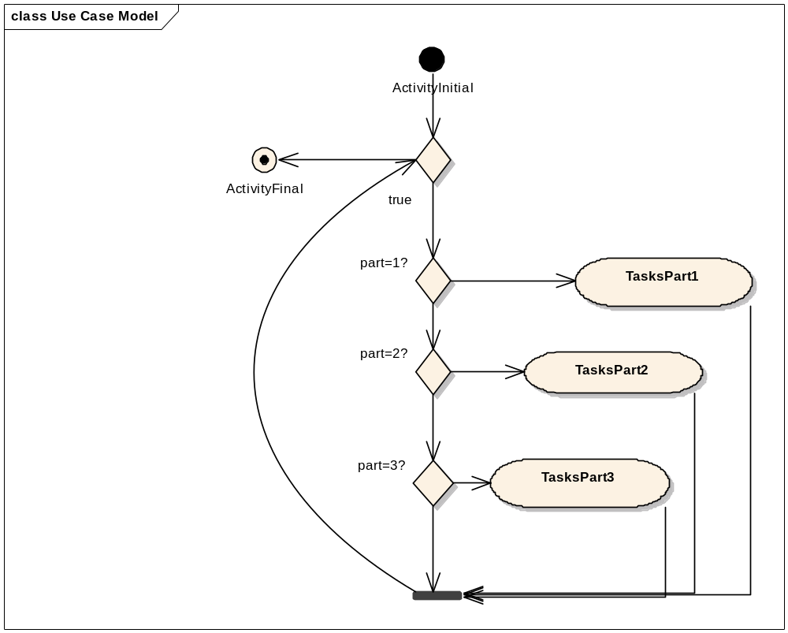
Phase/State-Driven

Slide 11
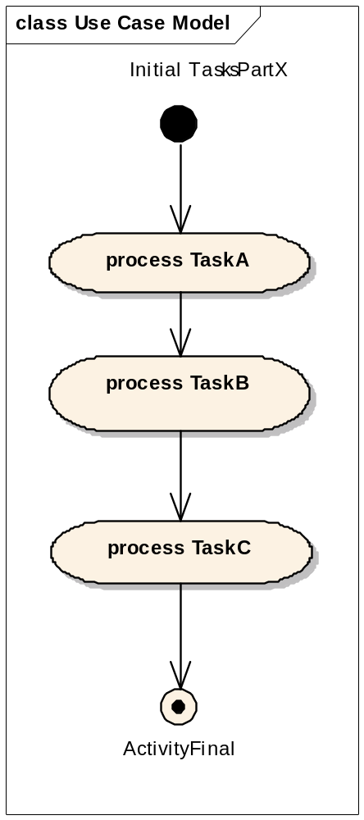
Phase/State-Driven

Slide 12
Phase/State-Driven Code
Example II
public void tastksPart1()
{
processTaskA1();
processTaskB1();
processTaskC1();
}
public void processTask(int flag)
{
switch (flag)
{
case 1: tasksPart1;break;
case 2: tasksPart2;break;
case 3: tasksPart3;break;
default: break;
}
}

Slide 13
Coroutines
This is the implementation of state-driven code into a multi-tasking system
i.e.: Any single task can be state-driven
two or more tasks, executing simultaneously where each task is state-driven

Slide 14
Methods of Implementation
Round-Robin
Preemptive Priority

Slide 15
Interrupt-Driven System
Round-Robin
Interrupt comes in at a fixed rate
When the interrupt comes in
  Current task suspended & sent to back of queue
  Context saved to a non-LIFO data structure
    (not a stack)
  Context of next task in queue is loaded
  Next task executes until interrupted

Slide 16
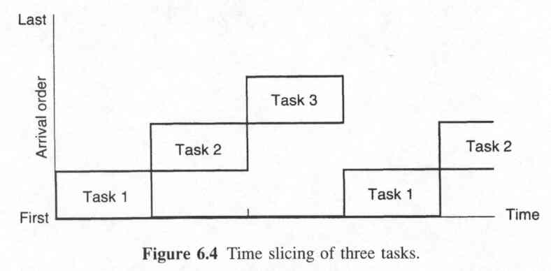
Interrupt-Driven System
Example II - Round-Robin

Slide 17
Coroutines
Example II
Main Method
public void processPhaseN (int phase)
{
while (true)
{
switch (flag)
{
case 1: taskPhase1;
break;
case 2: taskPhase2; break;
case 3: taskPhase3; break;
default: break;
}
}
}
Public void taskN()
{
int flag =1;
while (true)
{
switch (flag)
{
case 1: taskPhase1;
flag = 2; break;
case 2: taskPhase1;
flag = 3; break;
case 3: taskPhase1;
flag = 1; break;
default: break;
}
}
}

Slide 18
Interrupt-Driven System
Preemptive Priority
A higher priority task can interrupt & preempt a lower priority task
  Can be a system w/ 2 or more fixed-rate interrupts operating at different rates
    e.g.: 1ms, 10ms, 100ms
  Can be multiple sporadic event-driven interrupts
  Interrupt priorities can be fixed or dynamic
    Ex: A threat mgmt system on military aircraft

Slide 19
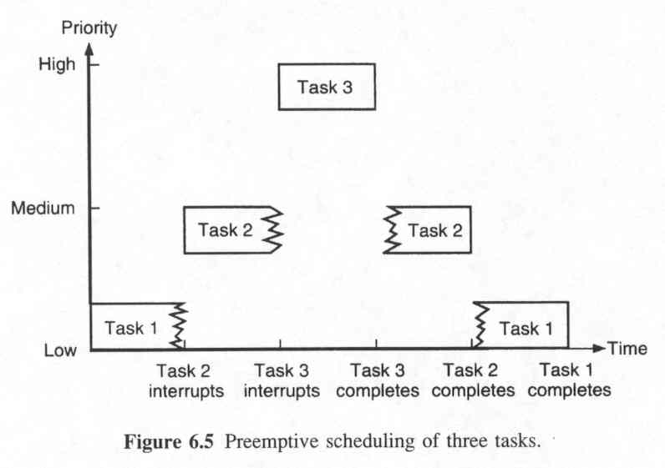
Interrupt-Driven System
Example III - Preemptive Priority

Slide 20
Example Using Java 3D
Virtual reality program of the Public Library
  User can navigate through the different sections of the library
  User can access information of the different sections by using mouse operations
  User will receive a help message with different choices after 5 minutes of inactivity
  User will be notified of the daily and weekly events
  User can get additional information by using the keyboard and message window of the system
  System will respond to user interaction in 400 milliseconds

Slide 21
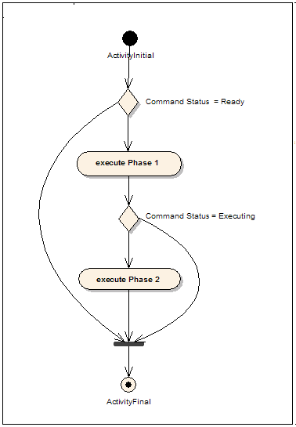
Task Segmentation

Slide 22
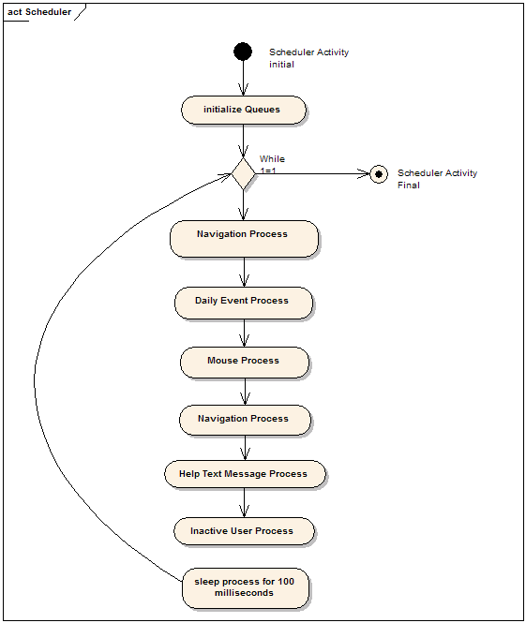
Scheduling System

Slide 23
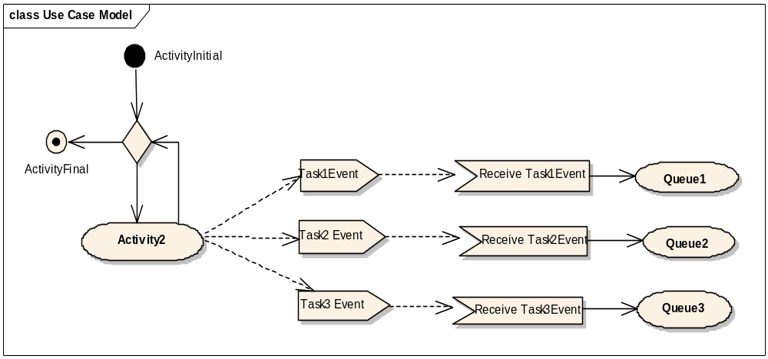
Task Dispatching

Slide 24
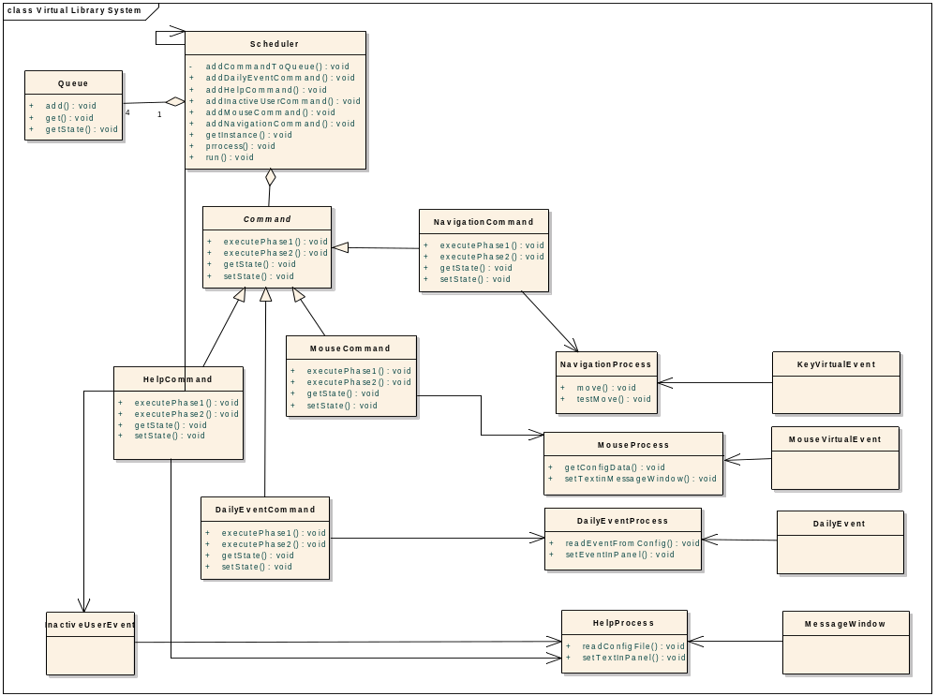

Slide 25
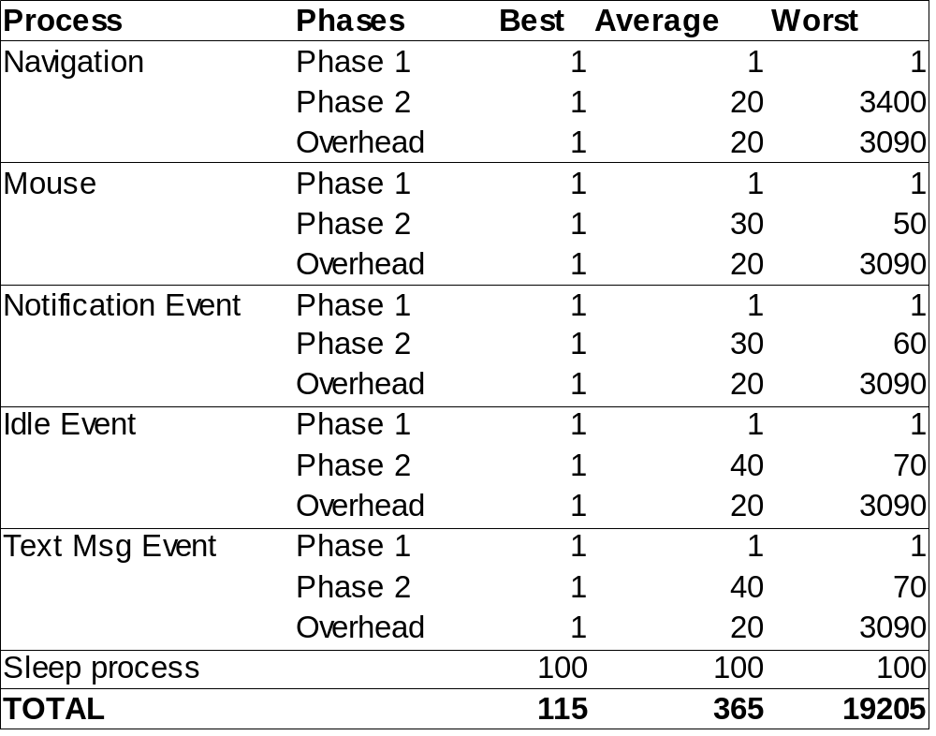
Test Results Scheduling/Multitasking

Slide 26
JAVA 3D

Slide 27
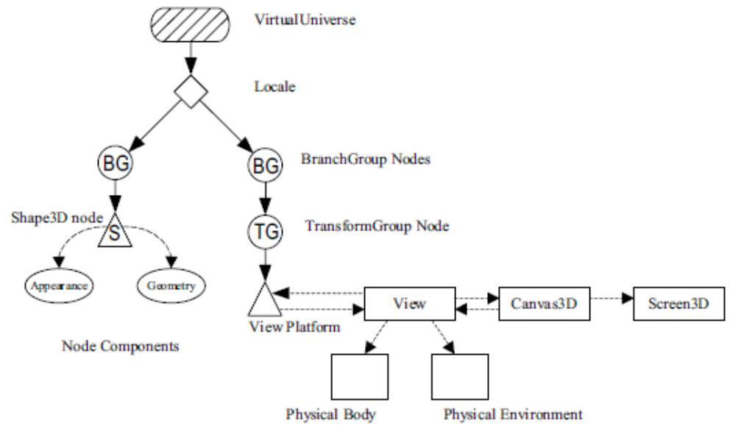
Java 3D - Scene Graph

Slide 28
Java Code to create 3D Objects – Simple Example
private TransformGroup targetTG;
private Transform3D rotation = new Transform3D();
private double angle = 0.0;
// create SimpleBehavior - set TG object of change
SimpleBehavior(TransformGroup targetTG){
this.targetTG = targetTG;
}
// initialize the Behavior
// set initial wakeup condition
// called when behavior becomes live
public void initialize(){
// set initial wakeup condition
this.wakeupOn(new WakeupOnAWTEvent(KeyEvent.KEY_PRESSED));
}
// called by Java 3D when appropriate stimulus occurs
public void processStimulus(Enumeration criteria){
// do what is necessary in response to stimulus
angle += 0.1;
rotation.rotY(angle);
targetTG.setTransform(rotation);
this.wakeupOn(new WakeupOnAWTEvent(KeyEvent.KEY_PRESSED));
}

Slide 29
Java Code to create 3D Objects
Create a simple universe
GraphicsConfiguration config = SimpleUniverse.getPreferredConfiguration();
canvas3D = new Canvas3D(config);
add(BorderLayout.CENTER, canvas3D);
su = new SimpleUniverse(canvas3D);
Creates scene
BranchGroup sceneBG = new BranchGroup();
Create Lights
AmbientLight ambientLight = new AmbientLight(params.color);
ambientLight.setInfluencingBounds(params.bounds);
Add lights to scene
ParamsLight params = new ParamsLight();
params.bounds = bounds;
params.color = ColorFactory.getWhite();
sceneBG.addChild((AmbientLight)ObjectFactory.getInstance().createLigth(ObjectFactory.AMBIENT_LIGHT, params));

Slide 30
Java Code to create 3D Objects
Add background
sceneBG.addChild(addBackground());
Background
TextureLoader texture = new TextureLoader(Config.getInstance().getStringVal("FILE_NAME_SKY"), null);
Sphere sphere = new Sphere(1.0f, Sphere.GENERATE_NORMALS | Sphere.GENERATE_NORMALS_INWARD|Sphere.GENERATE_TEXTURE_COORDS, 4);
Appearance ap = sphere.getAppearance();
ap.setTexture(texture.getTexture());
BranchGroup bg = new BranchGroup();
bg.addChild(sphere);
Background back = new Background();
back.setApplicationBounds(bounds);
ack.setGeometry(bg);

Slide 31
Java Code to create 3D Objects
Create Object
TransformGroup tg1;
Primitive obs = new Box(params.widthX1, params.heightY1, params.widthZ1,
Primitive.GENERATE_TEXTURE_COORDS |Primitive.GENERATE_NORMALS, (Appearance)params.listAppearances.get(1) );
if (params.action != null) obs.setUserData(params.action);
tg1 = new TransformGroup();
Transform3D trans1 = new Transform3D();
trans1.setTranslation( new Vector3d(params.x1, params.y1+params.height, params.z1) );
tg1.setTransform(trans1);
tg1.addChild(obs);
Move Object
//commits values set in testMove
targetTG.setTransform(t3dPossibleMove);
if (isVerticalMoveOk())
targetTG.setTransform(t3dPossibleMove);
gMap.setMove(dir, isFirstFloor);

Slide 32
Configuration Virtual Program ASCII Map
wwwwwwwwwwwwwwwwwwww
wbbbbbbbbbbbbbbbbbbwwwwwwwwww
wbd 5 Cbbbbbbbbebw
wbk fmg s s s s Cbzzzzzzbebw
wbd fmg s s s s Cbz P zb bwwww
wbd N O bb fm bbebbbbw
wbd sssL y H 3bw
wbk ooo BBB zbw
wbd sssM Sho lbbbb1 b Qzbw
wbd3 ooo lbpbbfmg b zbw
wbbb y o hTofmg b66 bwwww
wwwb AAA ooooo bbbbbbbbw
wb uuu fmg n oFbw
wbbbbb H 2 bw
twwwwbUDDDUv b bbba cc cc bw
wb fmg b bb I b R abw
wb 1b 1b b b cc cc bw
wbiiiiib 3b b ba H bw
wbbbbbbb bbbbbbb q q abw
twwwwwtwxZJwwwwwbbbbbbbbebbw
99999999 99999twwwwwwwwwwwt
99999999 99999999999999999

Slide 33
Virtual Program - Screen shots

Slide 34
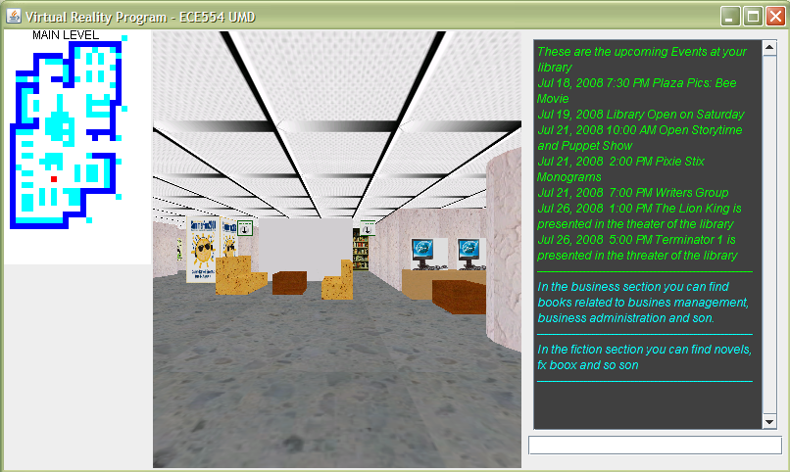
Virtual Program - Screen shots

Slide 35
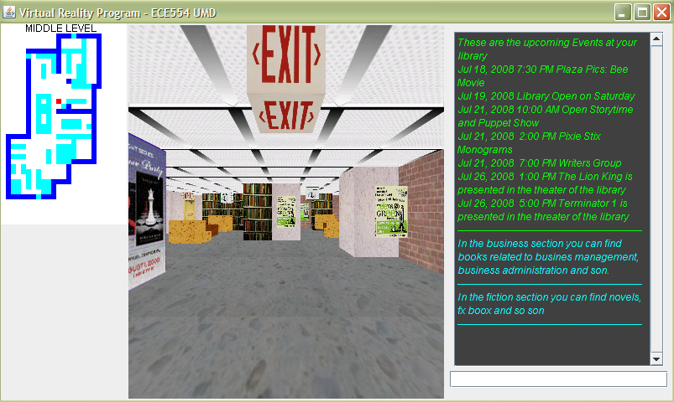
Virtual Program - Screen shots

Slide 36
Q&A

