Slide 1
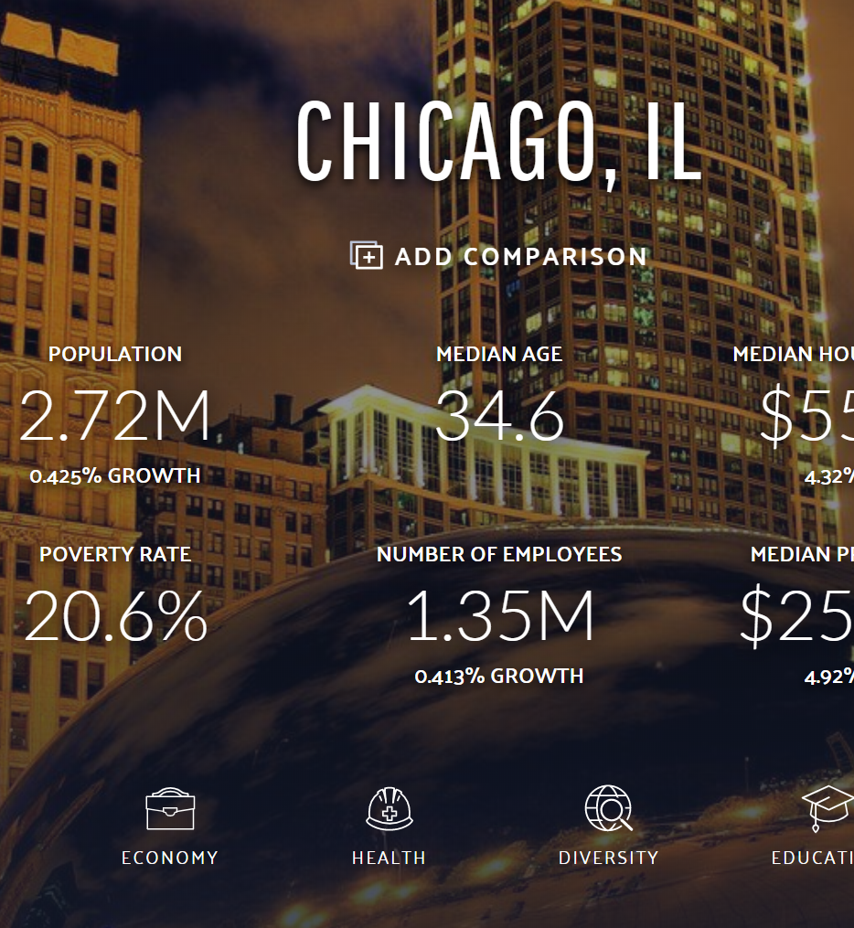
Visualizing the Crime Clusters 2017-2019
Adding income layer to Leaflet
Boundaries- Census tracts -2010.geojson (https://data.cityofchicago.org)
2017 Income per Location (https://datausa.io/profile/geo/chicago-il/)
QGIS: a free and open-source cross-platform desktop geographic information system application that supports viewing, editing, and analysis of geospatial data https://qgis.org/en/site/

Slide 2
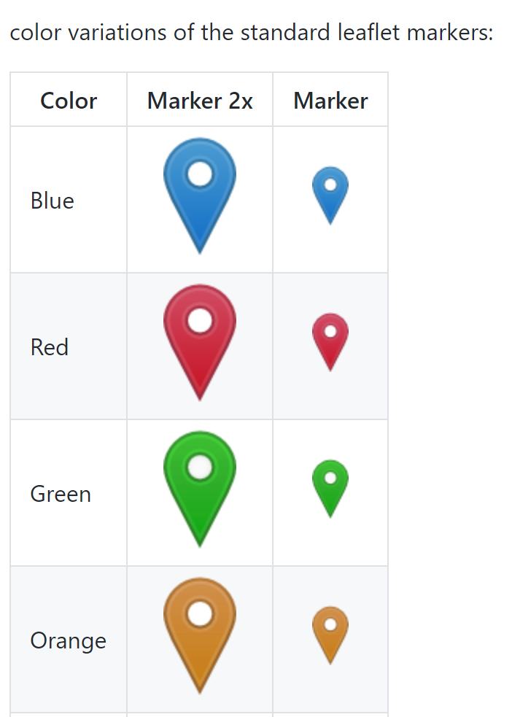
Visualizing the Crime Clusters 2017-2019
Adding colored markers using third party source
Credit: https://github.com/pointhi/leaflet-color-markers

