Slide 1
Threading is not a model
Joe Gregorio
Developer Relations, Google Wave

Slide 2
Scope
My Opinion

Slide 3
Goal
I want to annoy you.

Slide 4
The path
A short story, a book, design patterns, and Djikstra

Slide 5
The Principle of Sufficient Irritation
"The Short Happy Life
of the Brown Oxford"
Philip K. Dick
The short story

Slide 6
The Principle of Sufficient Irritation in action
Determining the radioactive irritant is left as an exercise for the reader.

Slide 7
The path
A short story, a book, design patterns, and Djikstra

Slide 8
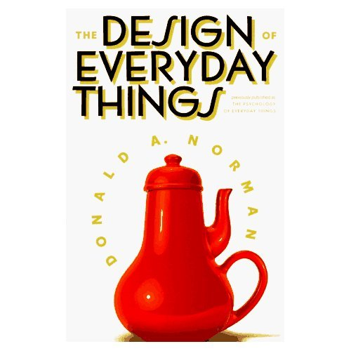
The Design of Everyday Things
The book

Slide 9
The path
A short story, a book, design patterns, and Djikstra

Slide 10
Setting the record straight
Let's talk about Design Patterns
I did not say that patterns are bad.
I did say that using them may be a sign of weakness in a language.

Slide 11
A Blog Post
Python isn't Java without the compile
Design Patterns in Dynamic Programming – Peter Norvig
Beyond Java – Bruce Tate

Slide 12
Language
Not talking just about Python

Slide 13
Language
Aren't patterns good?
Yes, but also a sign of weakness

Slide 14
There is a lack of patterns in Python
1. Define 'lack of patterns'
2. Demonstrate that lack
3. Explain why

Slide 15
Hard numbers
comp.lang.python
100,000+ messages

Slide 16
Hard numbers
“factory method pattern” - 0
“abstract-factory pattern” - 0
“flyweight pattern” - 3
“state pattern” - 10
“strategy pattern” - 25
“flyweight” - 36
“visitor pattern” - 60

Slide 17
For your comparison
“dark matter” - 2

Slide 18
For your comparison
“dark matter” - 2
“the pope” - 16

Slide 19
For your comparison
“dark matter” - 2
“the pope” - 16
“sausage” - 66
Presuming there is no overlap among these messages

Slide 20
There is a lack of patterns in Python
1. Define 'lack of patterns'
2. Demonstrate that lack
3. Explain why

Slide 21
Explain Why
The patterns are built in.
No one talks about the 'structured programming' pattern or the 'object-oriented' pattern any more.

Slide 22
Strategy Pattern on comp.lang.python
class Bisection (FindMinima):
def algorithm(self,line):
return (5.5,6.6)
class ConjugateGradient (FindMinima):
def algorithm(self,line):
return (3.3,4.4)
class MinimaSolver: # context class
strategy=''
def __init__ (self,strategy):
self.strategy=strategy
def minima(self,line):
return self.strategy.algorithm(line)
def changeAlgorithm(self,newAlgorithm):
self.strategy = newAlgorithm
solver=MinimaSolver(ConjugateGradient())
print solver.minima((5.5,5.5))
solver.changeAlgorithm(Bisection())
print solver.minima((5.5,5.5))

Slide 23
Strategy Pattern
“When most of your code does nothing in a pompous way that is a sure sign that you are heading in the wrong direction. Here's a translation into python”
- Peter Otten

Slide 24
Strategy Pattern on comp.lang.python
def bisection(line):
return 5.5, 6.6
def conjugate_gradient(line):
return 3.3, 4.4
solver = conjugate_gradient
print solver((5.5,5.5))
solver = bisection
print solver((5.5,5.5))

Slide 25
Proof by Wikipedia
“This pattern is invisible in languages with first-class functions.”
http://en.wikipedia.org/wiki/Strategy_pattern
What other language features are there, and what patterns do they make invisible?

Slide 26
Catalog of Language Features
First-class functions
Meta-programming
Iterators
Closures

Slide 27
Proof by Wikipedia
In object-oriented programming, the Iterator pattern is a design pattern in which iterators are
used to access the elements of an aggregate object sequentially without exposing its underlying representation.
http://en.wikipedia.org/wiki/Iterator_pattern
The definition of low-hanging fruit.

Slide 28
Iterators
for element in [1, 2, 3]:
print element
for element in (1, 2, 3):
print element
for key in {'one':1, 'two':2}:
print key
for char in "123":
print char
for line in open("myfile.txt"):
print line

Slide 29
There is a lack of patterns in Python
1. Define 'lack of patterns'
2. Demonstrate that lack
3. Explain why

Slide 30
The path
A short story, a book, design patterns, and Djikstra

Slide 31
Structured Programming
"Go to statement considered harmful”
Edsger W. Dijkstra,1968
Letter to the editor, Communications of the ACM , Volume 11, Issue 3 (March 1968)

Slide 32
Structured Programming
We are talking about Routines! (or procedures, or functions, or methods) being controversial.
Along with 'if', 'while', and 'switch' statements

Slide 33
The controversy went on for a while
"GOTO Considered Harmful" Considered Harmful
Frank Rubin, 1987
Communications of the ACM, Vol. 30, No. 3. (March 1987), pp. 195-196.

Slide 34
With Structured Programming
def hyp(x, y):
return math.sqrt(x**2 + y**2)
>> hyp(3, 4)
5

Slide 35
What if Structured Programming wasn't built in?
def hyp:
push(pop()**2 + pop()**2)
call math.sqrt
return
>> push(3)
>> push(4)
>> call hyp
>> pop()
5
You can do Structure Programming with our built in stack and 'call' primitives!

Slide 36
Patterns and Primitives
Pattern
Primitives
Language Feature
Model

Slide 37
Some Concurrency Patterns listed on Wikipedia
Lock
Monitor Object
Reactor
Thread pool
Thread-specific storage
These you will see on comp.lang.python

Slide 38
Some Concurrency Patterns listed on Wikipedia
Lock
Monitor Object
Reactor
Thread pool
Thread-specific storage
These you will see on comp.lang.python

Slide 39
Patterns and Primitives
Threadpool (Pattern)
Threads + queue + lock (Primitives)
Language Feature
Concurrency
(Model)

Slide 40
“Just” use threads
Threading is not a model
Threading is a primitive, along with locks, transactional memory, etc.

Slide 41
What are the concurrency models?
Communicating Sequential Processes (CSP)
Actors
The difference is only in 'what' is concurrent

Slide 42
CSP Model
Based on CSP by C.A.R. Hoare.
An actual model for processes
All code is written single threaded
Communication via channels.

Slide 43
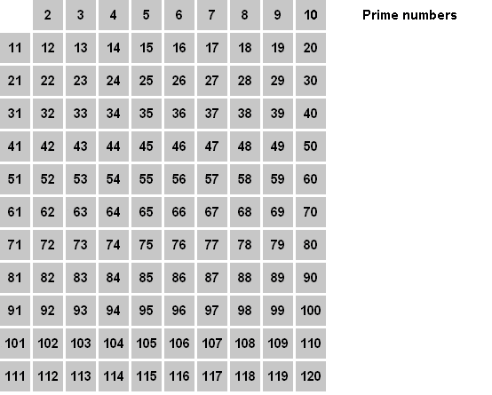
Sieve of Eratosthenes

Slide 44
Sieve of Eratosthenes
N
2
3
5
7
11
13

Slide 45
CSP – Stackless – Primes
import stackless
def generate(ch):
for i in range(2, 1000):
ch.send(i)
def pfilter(chin, chout, p):
for i in chin:
if i % p != 0:
chout.send(i)
def primes(chin):
while 1:
prime = chin.receive()
print prime
chout = stackless.channel()
stackless.tasklet(pfilter)(chin, chout, prime)
chin = chout
c = stackless.channel()
stackless.tasklet(generate)(c)
stackless.tasklet(primes)(c)
stackless.run()

Slide 46
CSP – Stackless – Primes
import stackless
def generate(ch):
for i in range(2, 1000):
ch.send(i)
def pfilter(chin, chout, p):
for i in chin:
if i % p != 0:
chout.send(i)
def primes(chin):
while 1:
prime = chin.receive()
print prime
chout = stackless.channel()
stackless.tasklet(pfilter)(chin, chout, prime)
chin = chout
c = stackless.channel()
stackless.tasklet(generate)(c)
stackless.tasklet(primes)(c)
stackless.run()
N
2
Pn
Pn+1

Slide 47
CSP – Go – Primes
N
func generate(ch chan int) {
for i := 2; ; i++ { ch <- i } // Send 'i' to channel 'ch'.
}
func filter(in, out chan int, prime int) {
for {
i := <-in // Receive 'i' from 'in'.
if i % prime != 0 { out <- i } // Send 'i' to 'out'.
}
}
func main() {
ch := make(chan int) // Create a new channel.
go generate(ch) // Start generate() as a goroutine.
for {
prime := <-ch
fmt.Println(prime)
ch1 := make(chan int)
go filter(ch, ch1, prime)
ch = ch1
}
}
2
Pn
Pn+1

Slide 48
CSP
An implementation could use:
Threads
Locks
Transactional Memory

Slide 49
Actor Model
Objects are concurrent
Objects send, and respond to messages
All code is written single threaded
Note that the 'channels' are implicit

Slide 50
Actors – IO – Primes
Filter := Object clone
Filter init := method(p,
self prime := p
self next := nil
self
)
Filter number := method(n,
r := n % prime;
if (r != 0,
if (self next == nil,
n println;
next = self clone init(n)
)
next @number(n); yield
)
)
Filter init(2)
for (i, 2, 1000,
Filter number(i); yield
)
2
Pn
Pn+1
N

Slide 51
The path
A short story, a book, design patterns, and Djikstra

Slide 52
Further Reading
http://golang.org
http://www.iolanguage.com/
http://www.stackless.com/
Things not mentioned
Futures
Deterministic vs Non-Deterministic
REST, MapReduce and other share-nothing
architectures

Slide 53
My Goal
Every time you use a concurrency pattern you remember the lack of affordances, and it proves sufficiently irritating.
The short story, the book, and design patterns.

