Slide 1
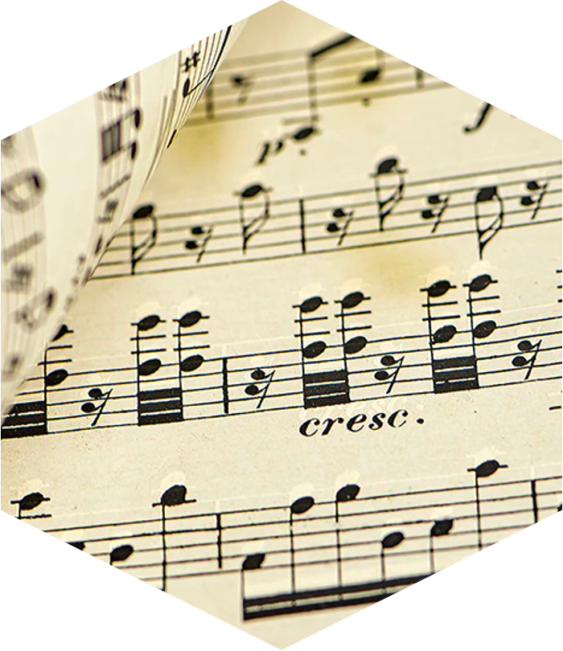
James “Collin” Guidry
Data Science Consultant

Slide 2
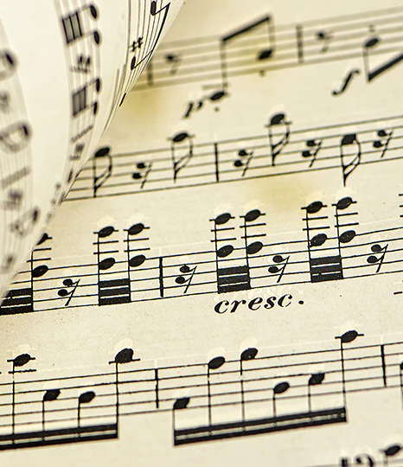
Composer Classification
Data Science Challenge

Slide 3
Overview
MIDI Composer Classification
Background & Objectives
Solution
Given a collection of musical pieces from four composers, develop a method to predict whether a composition is not written by any of the four composers.
System must predict given only 30 seconds of a composition.
Ingest compositions as MIDI files and process them as 30-second chunks.
Extract metadata from MIDI files to perform composer classification via a machine learning model.

Slide 4
Solution Methodology
Data Availability Influences Modeling Techniques
Primary Challenge
Approach
The desired class to be predicted is not present in the training data.
Model is unable to learn which musical components are unlike those of the four composers.
Train a multi-class classification model to distinguish between the four composers.
Compositions with low probability of belonging to all four composers are classified as such.
Cross validation methods are prioritized to increase performance on unseen data.
Notes:
“Medical study with no control group” Access to compositions which are not authored by the four composers would simplify the problem.

Slide 5
Solution Alternatives Considered
Balancing time, feasibility, and performance in approach selection
Approach | Classes | Final Prediction Based on | Pros | Cons
Single, multi-class classifier | 0, 1, 2, 3 | Maximum threshold of predicted class probabilities. "Unknown" if the maximum predicted probability is below the threshold. | Simplified model architecture. Greater flexibility for inclusion of other composers. Better for holistic learning of all classes via a single model. | Post-processing of predictions and threshold setting is separate from model training. Choice of threshold can significantly affect performance.
Separate, binary classifiers for each composer | 0,1; 0,1; 0,1; 0,1 | Comparison of independent model results. "Unknown" if all models predict below probability of 0.5. | Allows examination and tuning models by composer individually. Resulting predictions more closely reflect the probability of belonging to a composer. | More complex and time-consuming model architecture. Accumulation of errors when combining predictions and Bernoulli trial type effects. Class probabilities of each composer will not be normalized or sum to 1. Less explainable approach.
Single, unsupervised model or outlier detection | None | Samples with outlier scores above a certain threshold are classified as “unknown." | Does not require training on specific classes. Can detect anomalies that do not fit any known class. | Unproven method. Threshold selection may be difficult. Requires a well-defined notion of what constitutes an outlier and which features have out-of-sample variance.
L
Notes:
Arbitrary threshold of 0.65

Slide 6
Key Requirement: Audio Sample Duration
30-second chunk requirement highlights tradeoff between prediction accuracy and practicality
Tradeoffs Encountered
Shorter sample durations make the solution more convenient and useful for users but may result in a lower accuracy rate.
Longer sample durations (e.g., recording the entire song) results in more accurate classification but are less convenient for users.
Striking a balance between sample duration and accuracy/value is crucial to ensure that the solution is both accurate and convenient for users.*
Prediction
Accuracy
User
Value & Adoption
Duration of Audio Provided to Model
* Easily parameterized pipeline enables experimentation
Notes:
Pipeline and modelling notebooks and parameterized to do this
Experimentation enabled by a parameterized preprocessing pipeline and modeling notebooks.

Slide 7
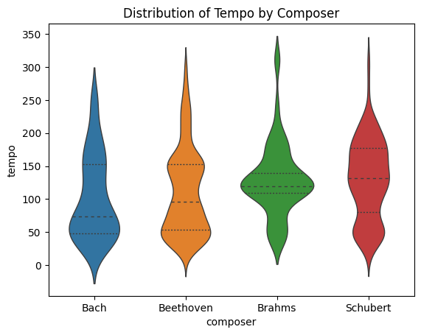
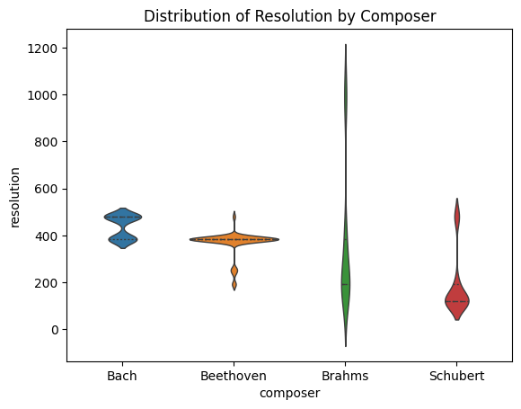
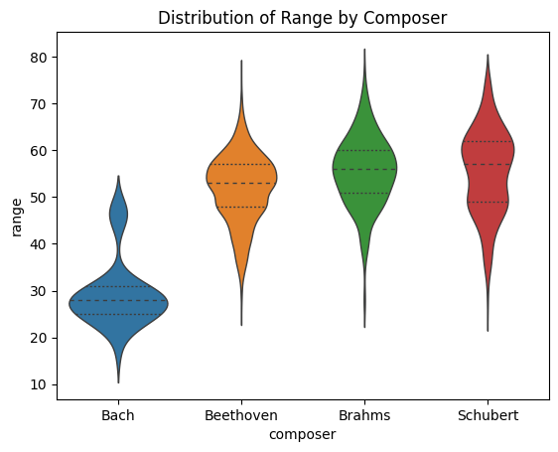
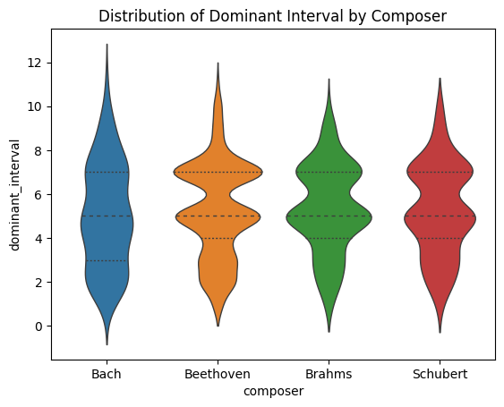
Exploratory Data Analysis
Musical Characteristics with Visible Variance Among Composers
Features Analyzed
Tempo
Beats per minute.
Resolution
Number of ticks per quarter note.
Indicative of the smallest duration between notes.
Range
Span of notes, from lowest to highest.
Dominant Interval
Distance between the fifth note and the first note of a major or minor scale.
Used to measure tension or instability between chord progressions.

Slide 8
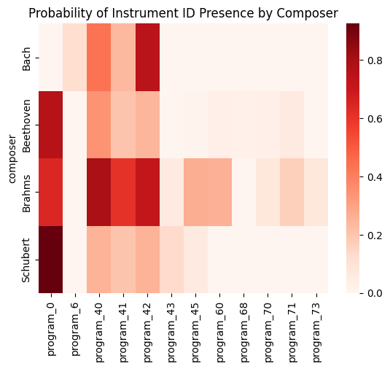
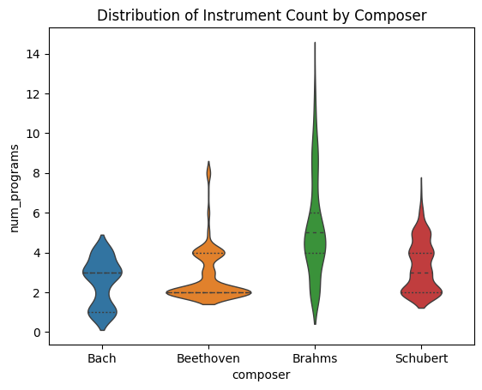
Exploratory Data Analysis
Instrument Usage Varies Among Composers
Some composers use specific instruments which other composers do not.
Certain composers consistently use fewer total instruments than others.

Slide 9
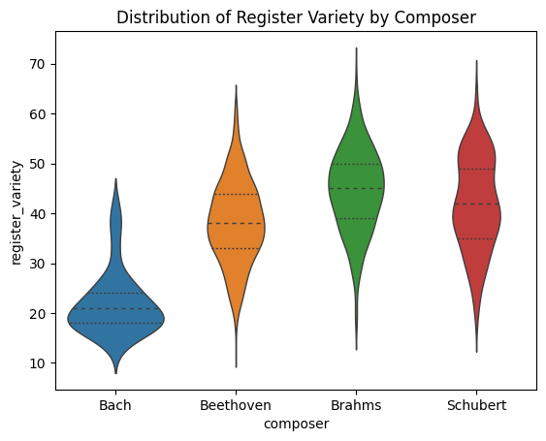
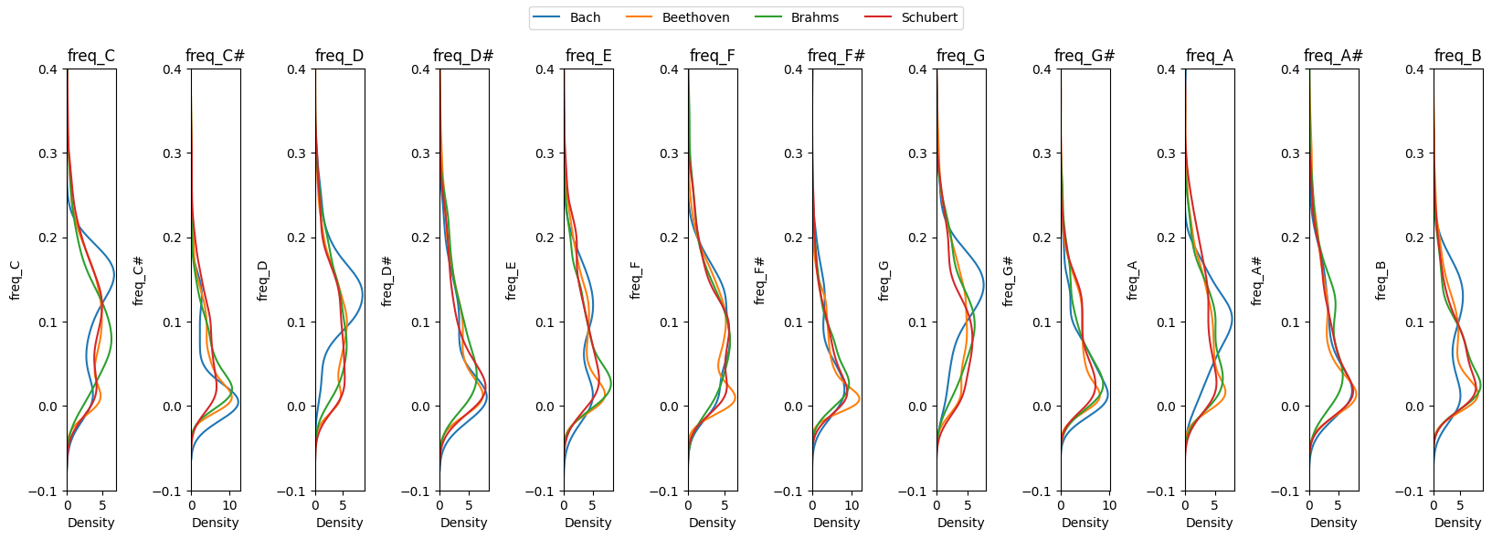
Exploratory Data Analysis
Pitch variety and frequency vary between composers, especially for Bach
Features Analyzed
Register Variety
The number of pitches played at least once in a piece.
Pitch Frequency
The percentage of notes in a sample belonging to a specific pitch.

Slide 10
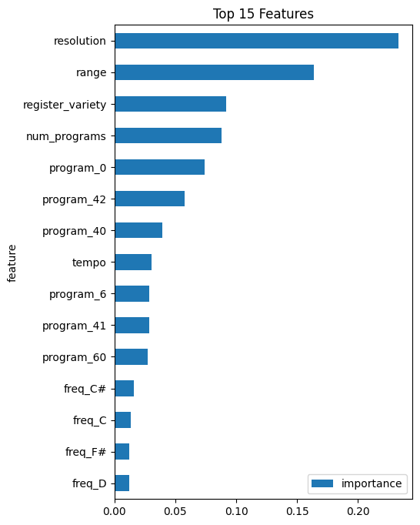
Feature Selection
Feature set informed by EDA and Predictive Power Scores
Features Chosen
Tempo
Resolution
Range
Presence of 11 distinct instruments
Number of instruments
Register (pitch) variety
Pitch frequencies
C, C#, D, D#, E, F, F#, G, G#, A, A#, B
Dominant interval
Selection Based on:
Features with highest predictive power scores
Exploratory Data Analysis
Model cross validation accuracy via experimentation
Multicollinearity checking

Slide 11
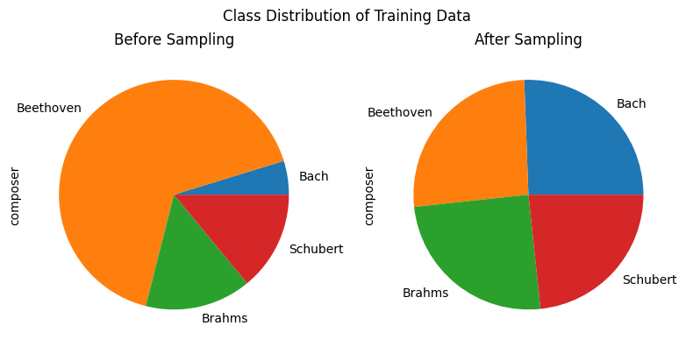
Pre-modeling Considerations
Training model with 30-second samples exacerbates class imbalance and risk of data leakage
Actions taken
Class Imbalance Observed and Corrected
Stratified re-sampling implemented to correct for class imbalance.
Normalizes the training data to equal proportions of each class, to improve performance. Test data unaffected.
Cross validation strategy prohibits samples of the same composition to be split across train, eval, and test sets.

Slide 12
Model Selection and Tuning
Broad search of models and parameters tested
6 types of machine learning models were fit, tuned, and evaluated on training data, using grid search cross validation.
Five random 80-20 splits used in each search, averaging results to select best hyperparameters.
Random forest classifier yields highest accuracy.
Final best parameters used to re-fit on entire training data.
Model | Accuracy (Training) | Hyperparameters Tested
RandomForest | 67%* | n_estimators: [100, 200, 500], max_depth: [None, 5, 10, 15, 20]
GradientBoosting | 66% | n_estimators: [100, 200, 500], max_depth: [3, 5, 7, 9]
LightGBM | 65% | n_estimators: [100, 200, 500], 'max_depth: [3, 5, 7], 'learning_rate: [0.01, 0.1, 1]
AdaBoost | 55% | n_estimators': [50, 100, 200], 'learning_rate': [0.01, 0.1, 1]
SVM | 54% | C': [0.1, 1, 10], 'gamma': [0.1, 1, 10], 'kernel': ['rbf', 'linear']
KNN | 41% | n_neighbors': [3, 5, 7], 'weights': ['uniform', 'distance'], 'algorithm': ['auto', 'ball_tree', 'kd_tree', 'brute']
* Training data is stratified – not representative of true accuracy

Slide 13
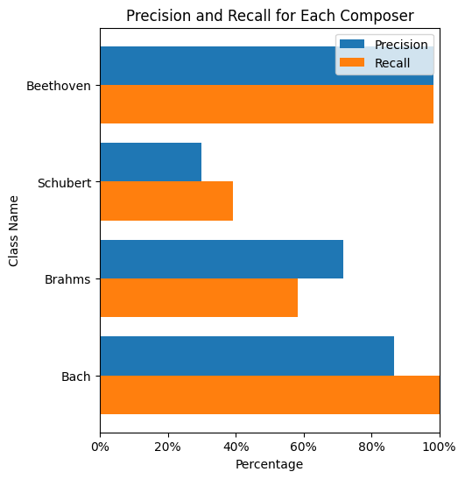
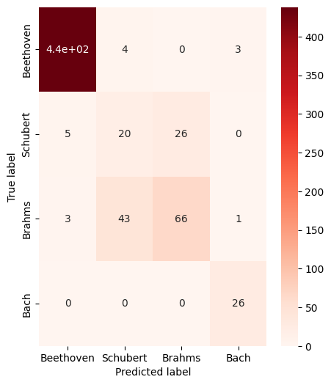
Model Validation & Results
Performance on test set exceeds baseline
Test/Holdout Set Performance
Classifier predicts composers with 85% accuracy on unseen test data.
Baseline accuracy of 70%, based on most common class
The model has high recall for Beethoven and Bach (98% and 100%, respectively), but lower recall for Schubert and Brahms (39% and 58% respectively).
Meaning, samples belonging to Beethoven and Bach classes were correctly identified more-so than that of Schubert and Brahms.
Notes:
Baseline of 70%, since Beethoven is the most common class

Slide 14
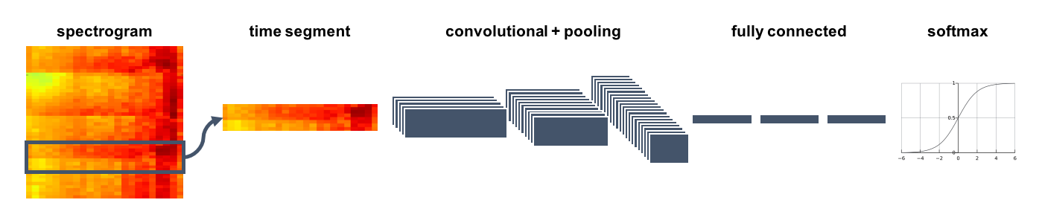
Recommendations / Areas of Maturity
MIDI Composer Classification
Immediate Enhancements
More advanced feature creation
Additional EDA
ML Improvements
PCA implementation
Categorical embeddings
Near-term Enhancements
Add subsequent training layer for probability calibration
Secondary logistic regression meta-model can estimate empirical probabilities more accurately.
Reduces need for use of arbitrary threshold.
Creation of separate binary classifiers
Long term “ground-up” solution
Convolutional Neural Network (CNN) and spectrogram-based features are state-of-the art approach for audio classification
More advanced technology stack and preprocessing efforts required, leading to more performant results.
Source

Slide 15
Conclusion
MIDI Composer Classification
Developed an end-to-end solution for composer classification of 30-second audio samples, with 85% prediction accuracy on unseen compositions.
Improvement opportunities identified to enhance real-world capabilities.

