Slide 1

predictive accuracy of default of credit card clients
Collin Guidry
Notes:
Liana

Slide 2
Executive Summary: predict default of payments
Payment Default Data
Dataset of interest: credit card payment defaulters
KNN
K-means Clustering
Neural Network
Models Tested
Best Model
Neural Network
Has highest accuracy
Notes:
Liana

Slide 3
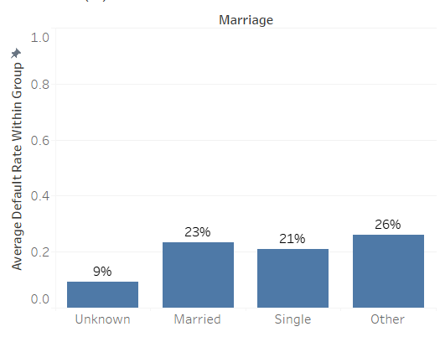
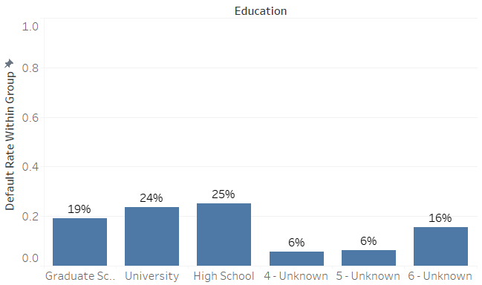
Data exploration
This data includes a series of historical credit card payments for bank customers and whether each customer defaulted on his/her most recent payment.
The amounts due and amount paid for previous months is shown, as well as demographic information such as age, gender, marital status, and education
Average Default Rate by Demographics
Marital Status
No particular marital status type indicates a higher rate of payment default.
Education Level
Higher education individuals are generally less likely to default on payments
There are two unknown education types which have very low default rates
Notes:
Collin

Slide 4




Sample data breakdown
Mostly female defaulters
30,000 Customers
4 distinct marriage values
Mostly female
Notes:
MK

Slide 5
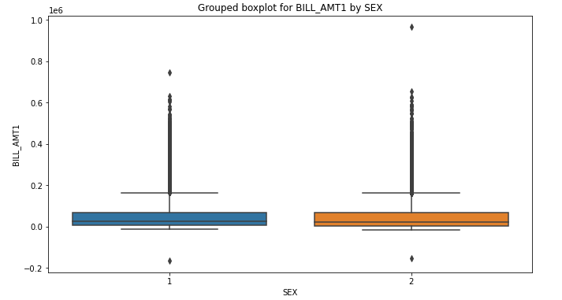
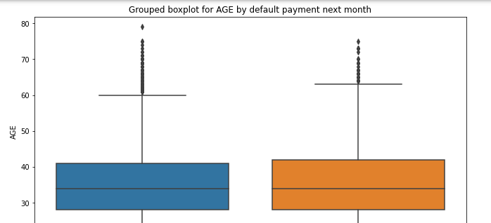
Data Distributions
Distribution of the amount due per month is relatively equal among males and females
The bulk of customers are between approximately 30-40 years of age regardless of default status
Notes:
Liana

Slide 6
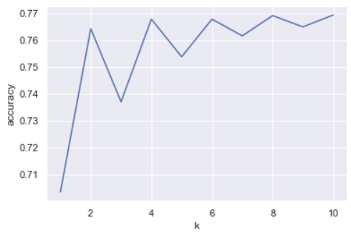
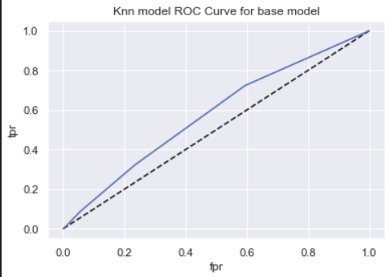
KNN model
Value of k chosen: 4
(Accuracy does not significantly increase after 4 see Appendix A for additional information)
Measure | Value
Accuracy | 77%
Misclassification | 23%
True Positive | 11%
False Positive | 4%
Specificity | 96%
Precision | 44%
Prevalence | 23%
Accuracy
Roc
Notes:
MK

Slide 7
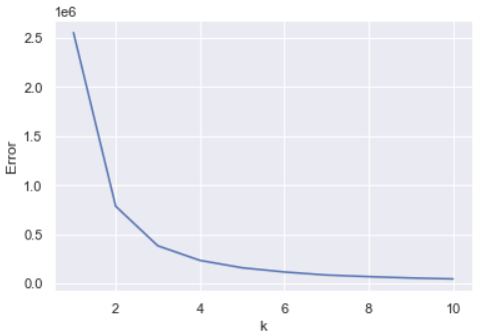
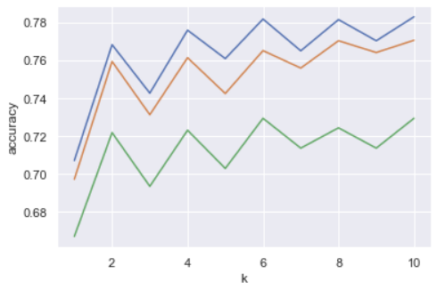
K-means clustering knn model
K-means Clustering
Variables used: Age and Default Payment
Number of segments chosen: 3
The last significant decrease in error occurs at k = 3
KNN Model
Value of k chosen: 4
Low value of k chosen without sacrificing accuracy
Weighted Average Accuracy of all models: 76%
Segment accuracy
Segment Knn
Segment Age | Accuracy | Misclassification | True Positive | False Positive | Specificity | Precision | Prevalence
21-32 | 76% | 24% | 9% | 4% | 96% | 37% | 23%
33-44 | 78% | 22% | 11% | 4% | 96% | 40% | 21%
45-79 | 72% | 28% | 9% | 6% | 94% | 35% | 26%
See Appendix A for all segments’ ROC curves
Notes:
Collin

Slide 8
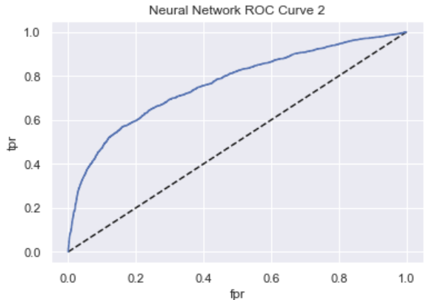
Neural network model
Layer 1: 12 Nodes
Layer 2: 8 Nodes
Layer 3: 1 Node
Measure | Value
Accuracy | 81%
Misclassification | 19%
True Positive | 35%
False Positive | 5%
Specificity | 95%
Precision | 65%
Prevalence | 23%
Roc
Notes:
MK

Slide 9
Model comparison
KNN model
Accuracy: 76%
KNN models of separate segments
Accuracy: 76%
Using a KNN model for each age group does not outperform a single model
Neural Network
Accuracy: 81%
Due to the pattern-based nature of the payment data, the neural network’s ability to “memorize” allows it the highest level of accuracy.
Cross validation used for all models such that over-fitting is not a concern
Notes:
Tanvi

Slide 10
conclusion
Best Model: Neural Network
Highest accuracy rate
Highest true positive
Highest area under ROC curve
Recognizes patterns
Notes:
Tanvi

Slide 11

Thank you
Notes:
Tanvi

Slide 12
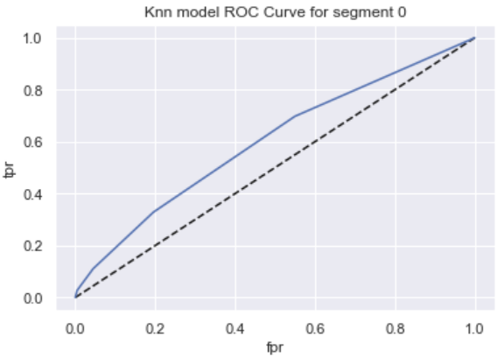
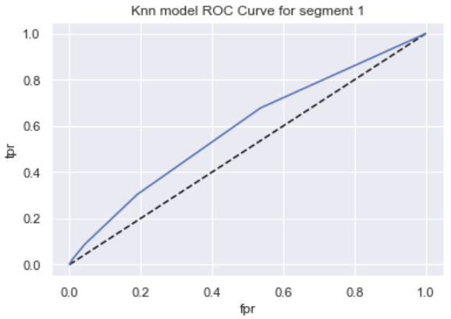

Appendix A
ROC for all 3 segments' KNN models

