Slide 1
Customer Salary Prediction
Collin Guidry
Notes:
Person 1

Slide 2
Objectives
Develop a process to decide which customers should be targeted for our marketing campaign.
Use census data to train a model that can predict whether an individual makes greater than $50,000 a year
Verify the model’s accuracy for predicting the income of potential new customers
Notes:
Person 2

Slide 3
Executive Summary
Salary can accurately be predicted based on our analysis
We chose to use a Random Forest Classifier as our tool for prediction
Highest accuracy rate
Least likely to produce costly predictions
Notes:
Person 2

Slide 4
Data Overview
How did we sample the data that was given?
Weight-based sampling was used to generate a dataset from census data.
Sampling enabled us to reduce the data to a feasible size
Removed outliers
Simplified variables such as education level and marital status
Notes:
Collin

Slide 5
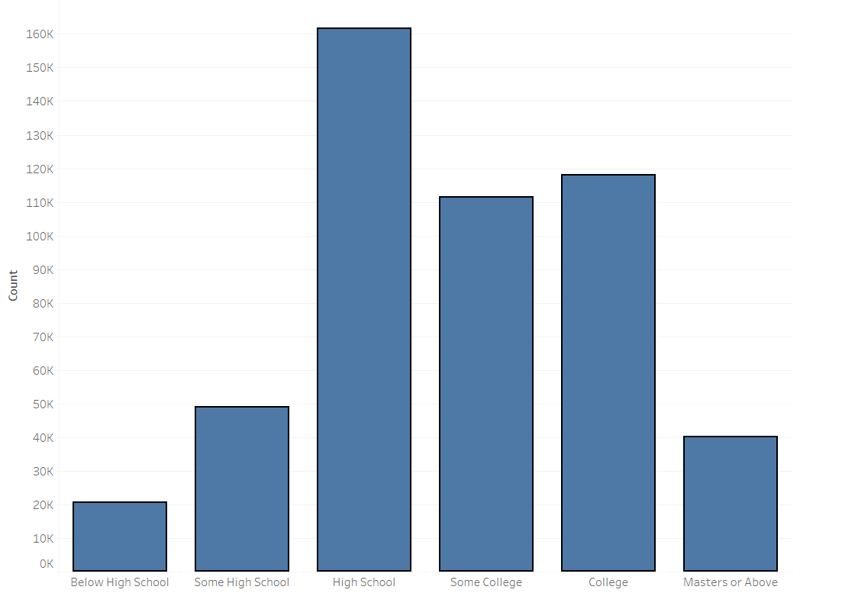
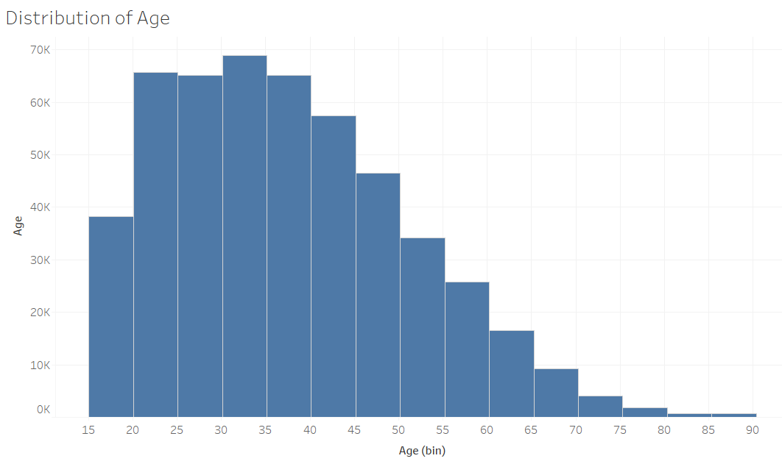
Data Overview (cont'd)
What does our sample data look like?
77% of people do not make over $50k
Approximately 55% of people have either a High School, Some College, or College Education

Slide 6
Model Development Process
Train Model
Sample of US Census Data used to capture relationship between various characteristics of a person and salary
Predict
Use the model to predict the salary level of people it has not yet been exposed to.
Measure Performance
Accuracy
True positive rate
False positive rate
ROC
Compare Models:
Notes:
Collin

Slide 7
Model Selection
Random Forest Classifier
Most accurate predictions (accuracy of 94%)
86% of all correct predictions were for high income individuals.
Of the correct predictions, most were in our target market of high-income individuals (86%)
This model is the least likely to classify a low-salary person as high salary. (Most costly error)
Notes:
Collin
True positive – we predicted over 50k and was actually over 50k
When making correct predictions, more likely to classify those of interest who make over 50k
False positive – we predicted over 50k but was actually under 50k
Low false positive rate means we are not likely to predict someone has a high salary when they actually hava a low salary

Slide 8
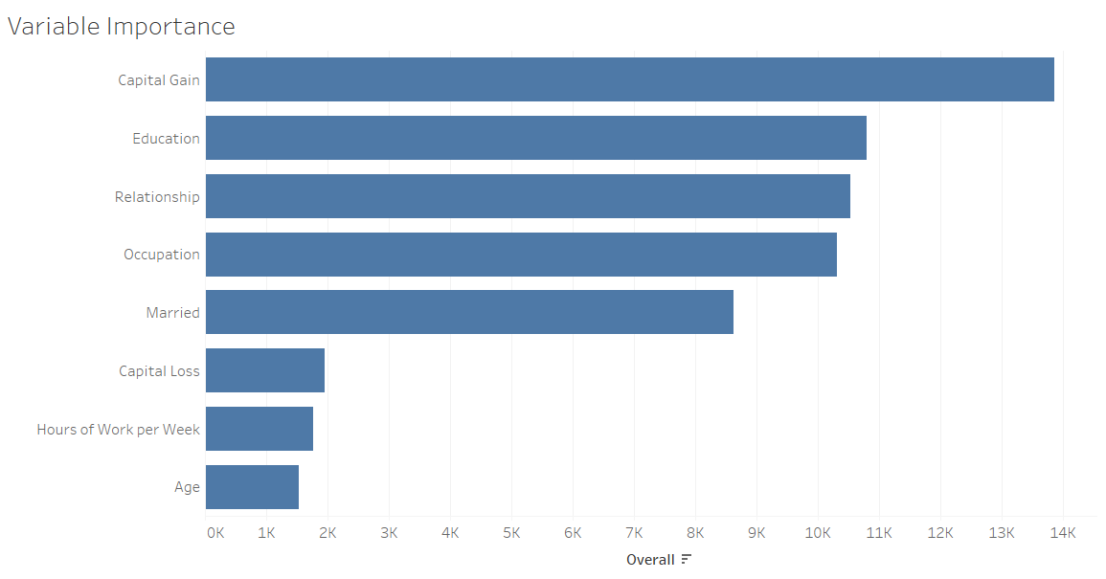
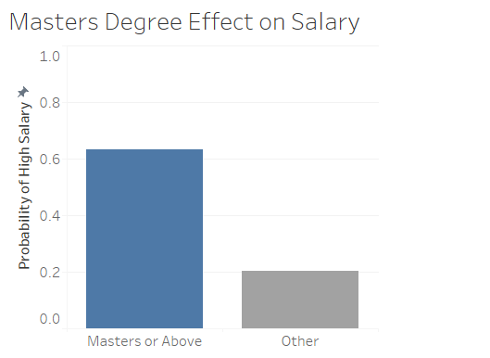
Best Indicators of High Salary
Capital Gain / Capital Loss
Those who invest have higher salaries are more likely to have disposable income to invest
Education
Those who reached graduate school or above are 43% more likely to make more than $50K
Figure 1
Figure 2
Notes:
Liana

Slide 9
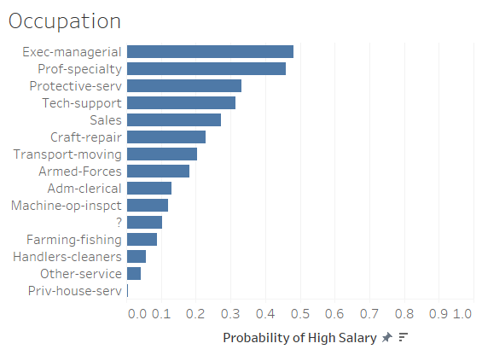
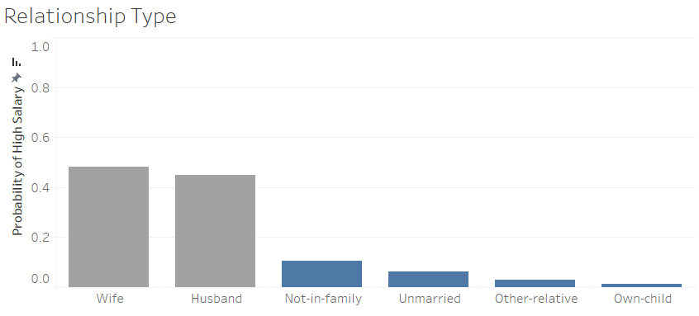
Best Indicators of High Salary (cont'd)
Figure 3
Figure 4
Occupation
High salary widely varies among job types.
Relationship / Marriage
Those who are a husband or wife have a 44% higher probability of making over $50k
Notes:
Liana

Slide 10
Recommendations
Which specific types of people should be targeted?
An ideal customer would be:
Invests in the stock market (gains preferred)
Highly educated with at least a master’s degree
Household role as a husband or wife
Occupation that is executive/managerial or specialty profession
Of those identified as ideal customers, spend more on individuals with the greatest probability of having a higher salary
Re-build the model by city or state, as outcomes could vary by region
Notes:
Liana

Slide 11
Conclusion Should the model be used?
Pros
Cons
Best accuracy of all tested models
Lowest chance of making a costly prediction out of all tested models
Provides the ability to rank customers by probability of having a high salary
Census data may not accurately represent bank's customer-base
Chance of over-fitting
Population across regions could have a different mix of characteristics than what was modeled
Notes:
After all the analysis we have come to the conclusion that there are certain benefits as well as limitations associated with the implementation of the Random Forest model to figure out whether household incomes greater than $50K can be predicted and whether that group can be targeted for the $25 million direct marketing campaign.
1.The limitations associated with the random forest model is that there is quite a possibility that census data doesn’t represents accurately the bank customer base. We might need some other demographics to do the further analysis.
2. limitation is chances of over fitting the model. Overfitting can substantially increase the errors in the model and can reduce the predictive power of the model.
3.There is also a possibility that population across regions could have a different mix of characteristics than what has been modeled. This can compromise the accuracy of the model
on the other hand if we consider the pros of all the models we have tested random forest has the best accuracy of 94% and around 86% of all the correct predictions were for high income group. Also if we use this model for predicting the chances of making a costly prediction is lowest out of all the tested models.
This model also provides the ability to rank customers by probability of having a high salary.
So on the basis of all the analysis which we have done so far we recommend that Bank should use Random Forest model to predict the households with income greater than $50k

Slide 12
Thank you
Notes:
Person 1

Slide 13
Appendix A - Model Comparisons
Naïve Bayes model has an accuracy rate of 83% and approximately 53% of the correct predictions were for high income individuals.
Logistic Regression model has an accuracy rate of 85% and around 60% of all the correct predictions were for high income group.
Cart model has an accuracy rate of 85% and around 50% of all the correct predictions were for high income group.
Random Forest model has an accuracy rate of 94% and around 86% of all the correct predictions were for high income group.

Slide 14
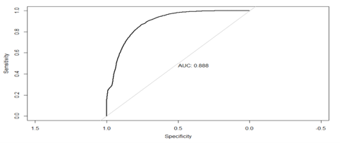
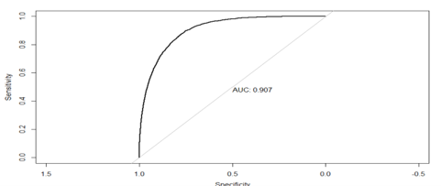
Appendix B - ROC Curves and AUC for all models
Naïve Bayes
Logistic Regression

Slide 15
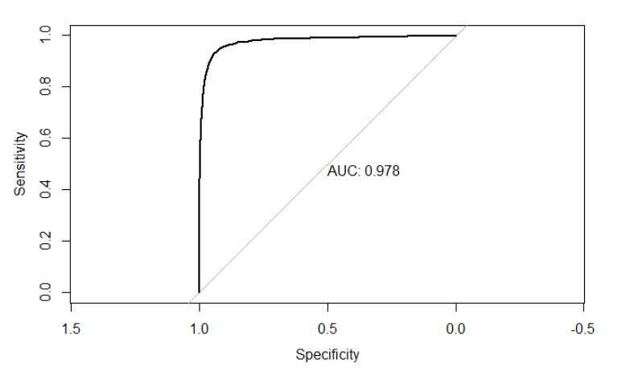
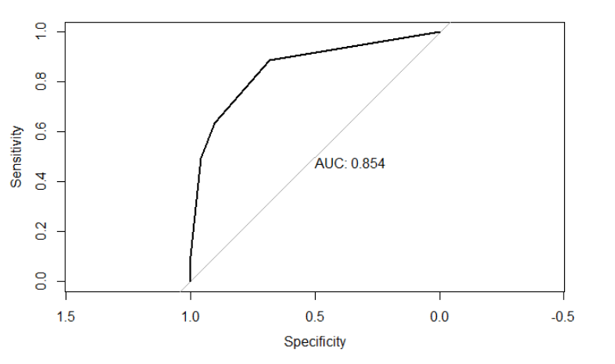
Appendix B (Cont'd)
Random Forest
Cart

