Slide 1
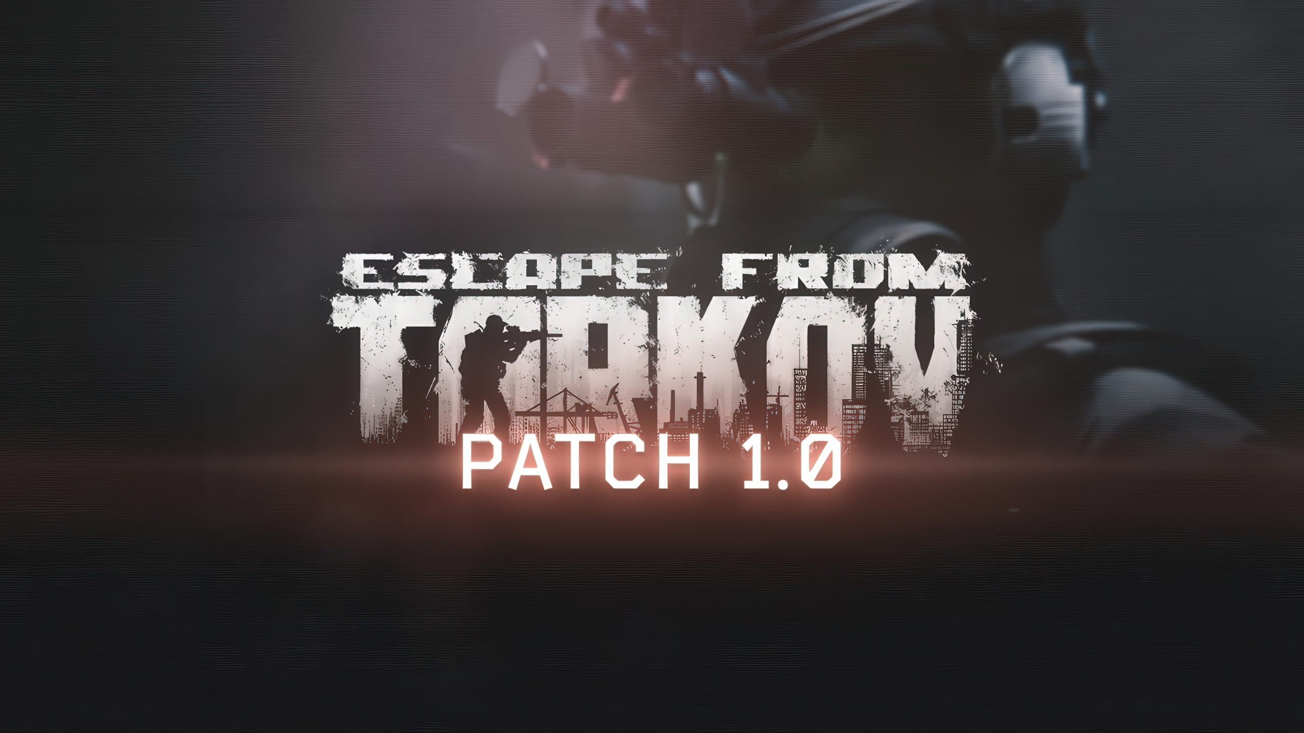
MDIA 438 · UNIT 12
BRANDED CONTENT & NARRATIVE
Escape from
Tarkov
Content Marketing Campaign
Success metrics and measurement tools for a six-month owned, paid, and earned media plan.
JULIO HERNANDEZ
INSTRUCTOR: MICHAEL DELONG · APRIL 2026
Notes:
Cover slide. Introduce the campaign: a six-month content marketing push for Battlestate Games' Escape from Tarkov built on integrated owned, paid, and earned media, with clear success metrics and measurement tools for each.

Slide 2
01 · OPPORTUNITY
A passionate community ready to activate
Escape from Tarkov sits in a rare position: a hardcore extraction shooter with one of the most engaged communities in gaming, now available on Steam following its November 15, 2025 release. The game already punches far above its paid weight through creator-driven storytelling, but its promotion has been reactive rather than orchestrated.
200K
Peak concurrent players (May 2020)
14M+
Twitch hours watched during drops events
The opportunity is to fuse owned, paid, and earned media around every major content beat — wipes, maps, and system updates — turning isolated messages into orchestrated waves of content and conversation that grow sales, viewership, and community membership.
1.3M
Subreddit members (r/EscapefromTarkov)
Source: IGN, PC Gamer, Battlestate Games
TARKOV · CONTENT MARKETING CAMPAIGN · JULIO HERNANDEZ
2 / 13
Notes:
The core argument: Tarkov has the audience and the content beats; what it lacks is coordinated promotion. Call out that the game's community scale and creator passion make it ideal for an integrated owned/paid/earned campaign.

Slide 3
02 · TARGET AUDIENCE
Who we are targeting and why
PRIMARY
WHY THIS AUDIENCE
Hardcore FPS and extraction shooter players
High lifetime value
Extraction-shooter fans historically spend 500+ hours in games they commit to and are highly likely to purchase edition upgrades.
AGE
18 – 34
GEOGRAPHY
North America and Europe
Content creators
This segment does not just watch Tarkov — they make guides, montages, and memes that fuel earned media at no cost to the studio.
PLATFORM
PC (Steam + Battlestate launcher)
BEHAVIOR
Active on Twitch, YouTube, Reddit, Discord
Community habit
INTERESTS
Tactical shooters, mil-sim, survival games
Daily touchpoints across Twitch, Reddit, Discord, and YouTube mean promotion can be timed to when the audience is already looking.
TARKOV · CONTENT MARKETING CAMPAIGN · JULIO HERNANDEZ
3 / 13
Notes:
Primary audience from Unit 8: 18–34 hardcore FPS and extraction shooter players in North America and Europe. Emphasize that this segment is both high-value (purchases) and high-leverage (content creation), which is why the campaign leans on earned media.

Slide 4
03 · OBJECTIVES
SMART goals for the six-month window
CONTENT MARKETING
PROMOTION
Boost engagement through platform-native content
Convert engagement into community and sales
Boost community engagement by 15% by developing short-form video, dev blogs, and creator spotlights across owned channels over the next six months.
Target 18–34 hardcore FPS players in NA and EU with an integrated mix of owned, earned, and paid media to highlight Tarkov's high-stakes realism, wipes, and new features, boosting game sales, Twitch viewership, and Discord membership by 15% over six months.
CORE KPIs
CORE KPIs
Engagement rate · Avg. watch time · Email CTR
Game sales · Peak Twitch CCV · Discord members
Source: Lovett & Staelin (2016), Marketing Science, Koob (2021), PLoS ONE
TARKOV · CONTENT MARKETING CAMPAIGN · JULIO HERNANDEZ
4 / 13
Notes:
Two SMART objectives. Content marketing targets engagement lift; promotion targets the three hard business metrics from Unit 8 — sales, Twitch viewership, and Discord membership — all with a 15% lift target over six months.

Slide 5

04 · CONTENT EXAMPLE
'Surviving the Wipe': a three-part video series
THE IDEA
A three-episode video series following three Tarkov creators — a new player, a returning veteran, and a top streamer — as they prep for and play through a major wipe. Long-form cuts live on YouTube; vertical clips seed TikTok, Reels, and Shorts; dev commentary ties it back to the official site.
WHY IT SUPPORTS THE OBJECTIVES
Addresses Tarkov's steep learning curve through a new-player lens, directly targeting lapsed and prospective buyers.
Creator-led storytelling anchors the campaign.
Built for repurposing: one shoot produces YouTube episodes, short-form verticals, dev blog posts, and email newsletter segments.
Leans on creators — the most credible voices in this genre — so the series doubles as earned-media fuel.
TARKOV · CONTENT MARKETING CAMPAIGN · JULIO HERNANDEZ
5 / 13
Notes:
This is the Unit 6 content example, refined. The 'Surviving the Wipe' series intentionally produces assets for every media type: long-form for owned, short vertical clips to boost with paid, and creator storylines that seed earned coverage.

Slide 6
05 · OWNED MEDIA
Tactics across Tarkov's permission-based channels
Official website hub
Segmented email program
Dedicated landing pages for each wipe and new map, with detailed patch notes, 'New to Tarkov' guides, and CTAs to purchase, upgrade editions, or join the Discord and newsletter.
Three streams — current players, lapsed players, and prospects — featuring wipe countdowns, mechanical change summaries, and curated creator roundups such as 'Top five wipe prep guides.'
Platform-native social
Dev streams on Twitch & YouTube
Vertical clips on TikTok and Instagram Reels, long-form breakdowns and dev diaries on YouTube, rapid updates and memes on X, and carousels that tease the content hub.
Scheduled developer streams, patch previews, and post-wipe Q&A sessions — then archived and chaptered on YouTube so players can rewatch and share specific segments.
TARKOV · CONTENT MARKETING CAMPAIGN · JULIO HERNANDEZ
6 / 13
Notes:
Owned media is where we control the message. Each major content beat (wipes, maps, events) gets a hub on the website and is sliced into snackable pieces for every channel — all pointing back to owned destinations where we can capture email, Discord, or purchase.

Slide 7
05 · OWNED MEDIA
Measurement tools and success metrics
TOOL
CHANNEL
KEY METRICS
Google Analytics 4
Website & landing pages
Sessions, wipe-hub pageviews, scroll depth, edition-upgrade conversions
Mailchimp / HubSpot
Email newsletter program
Open rate, click-through rate, list growth, segment performance
YouTube Studio
Dev diaries and episode series
Watch time, avg. view duration, subscriber lift, traffic sources
Twitch Insights
Official BattlestateGames channel
Avg. concurrent viewers, unique viewers, follows gained per stream
Sprout Social / Hootsuite
X, Instagram, TikTok, Facebook
Engagement rate, impressions, shares, best-time-to-post analytics
Discord Server Insights
Official community server
Members joined, messages sent, retention at 7 and 30 days
Source: Google Analytics Help, Taiminen & Karjaluoto (2015), Koob (2021)
TARKOV · CONTENT MARKETING CAMPAIGN · JULIO HERNANDEZ
7 / 13
Notes:
Owned measurement stack. GA4 is the backbone — every campaign URL uses UTM tagging so every click from email, social, or paid is traceable. Sprout Social or Hootsuite centralizes social reporting; YouTube Studio and Twitch Insights handle video/stream KPIs; Discord's built-in insights track community growth.

Slide 8
06 · PAID MEDIA
Tactics to extend reach beyond the core
Targeted Meta campaigns
Short-form vertical boosts
Facebook and Instagram auction campaigns targeting interests in tactical shooters, mil-sim, and survival games. Creative features intense raid footage with copy like 'Think you can survive Tarkov?' Optimized for video views and landing-page clicks.
Paid placements on Instagram Reels and TikTok that promote 30-second raid moments and 'extractions gone wrong' clips with interactive captions ('What would you do here?') to drive shares and duets.
Retargeting funnels
Defensive clarifying ads
Pixels on the wipe hub and trailer pages build audiences of engaged visitors, who then see follow-up ads for wipe-prep guides, 'what changed this patch' breakdowns, and edition-upgrade explainers over several weeks.
Around controversies like PvE pricing, paid placements point to honest FAQs and developer commentary rather than pure sales pages — ensuring accurate information is widely seen.
Source: de Vries, Gensler & Leeflang (2017), Journal of Marketing, Meta for Business
TARKOV · CONTENT MARKETING CAMPAIGN · JULIO HERNANDEZ
8 / 13
Notes:
Paid media is the push that extends reach beyond the core community. Not about generic brand ads — every dollar promotes a specific piece of content (trailer, guide, explainer) that pulls players deeper into the Tarkov ecosystem.

Slide 9
06 · PAID MEDIA
Measurement tools and success metrics
TOOL
PURPOSE
KEY METRICS
Meta Ads Manager
Facebook & Instagram campaigns
CPM, CPC, CTR, video views, cost per landing-page view
TikTok Ads Manager
Vertical short-form boosts
Views, engagement rate, cost per 1,000 impressions, follows
Google Ads + Analytics 4
YouTube pre-roll & display
View-through rate, CPV, conversions, post-click engagement
GA4 + Meta Cost Import
Cross-channel attribution
ROAS, cost per conversion, assisted conversions, journey paths
Meta Pixel
Retargeting audience building
Pixel events fired, audience size, retargeted conversion rate
Supermetrics / Looker Studio
Unified reporting dashboard
Weekly paid media scorecard across platforms in one view
Source: Meta for Business, TikTok for Business, de Vries, Gensler & Leeflang (2017), JBR
TARKOV · CONTENT MARKETING CAMPAIGN · JULIO HERNANDEZ
9 / 13
Notes:
Paid measurement stack. Meta Ads Manager and TikTok Ads Manager handle in-platform metrics; GA4 with Meta cost import (released October 2025) unifies spend and conversions. Supermetrics or Looker Studio builds the weekly scorecard that rolls everything up for the team.

Slide 10
07 · EARNED MEDIA
Tactics where creators do the storytelling
Twitch drops campaigns
UGC amplification loop
Drop events timed around wipes and major updates elevate selected Tarkov streamers, creating 'must-watch' viewership and pushing Tarkov to the top of Twitch categories for days at a time.
Systematic monitoring of YouTube, Twitch, Reddit, and X for standout videos, guides, montages, and memes — then resharing via official accounts and tagging creators to reinforce that the community is seen and valued.
Proactive press & creator outreach
Transparent response to coverage
Pitch stories like wipe analytics, player behavior insights, and anti-cheat progress to gaming outlets (PC Gamer, IGN, Kotaku) and mid-tier creators — turning internal data into newsworthy narratives.
When third-party coverage appears — positive or critical — share it openly through owned channels and address it in dev commentary. Turns controversy moments into trust-building moments.
Source: Stephen & Galak (2012), Journal of Marketing Research, Lovett & Staelin (2016), Marketing Science
TARKOV · CONTENT MARKETING CAMPAIGN · JULIO HERNANDEZ
10 / 13
Notes:
Earned media is where Tarkov punches above its paid weight. Creators serve as an always-on third-party storytelling engine; our job is to design campaigns that harness and reward UGC. Trust in this genre is earned — not bought.

Slide 11
07 · EARNED MEDIA
Measurement tools and success metrics
TOOL
PURPOSE
KEY METRICS
Meltwater
News, broadcast & social monitoring
Mentions volume, reach, sentiment, share of voice vs. competitors
Brandwatch
Social listening & trend analysis
Conversation volume, sentiment shift, influencer identification
Cision
PR outreach & press tracking
Pitches sent, placements landed, estimated media value (EMV)
Twitch Drops Dashboard
Drops event performance
Participating channels, hours watched, drops claimed, new viewers
CreatorIQ / GRIN
Influencer & creator relationships
Creator reach, engagement rate, cost per engagement, CPM
Reddit + TweetDeck / Pro
Community & X conversation
Thread volume, upvotes, subreddit growth, viral post tracking
Source: Stephen & Galak (2012), Journal of Marketing Research, Lovett & Staelin (2016), Marketing Science
TARKOV · CONTENT MARKETING CAMPAIGN · JULIO HERNANDEZ
11 / 13
Notes:
Earned measurement is harder than owned or paid because the conversations happen outside our platforms. Meltwater gives us news + broadcast coverage; Brandwatch handles social listening and sentiment; Cision tracks PR pitches and placements. CreatorIQ or GRIN manages Twitch drops and creator relationships at scale.

Slide 12
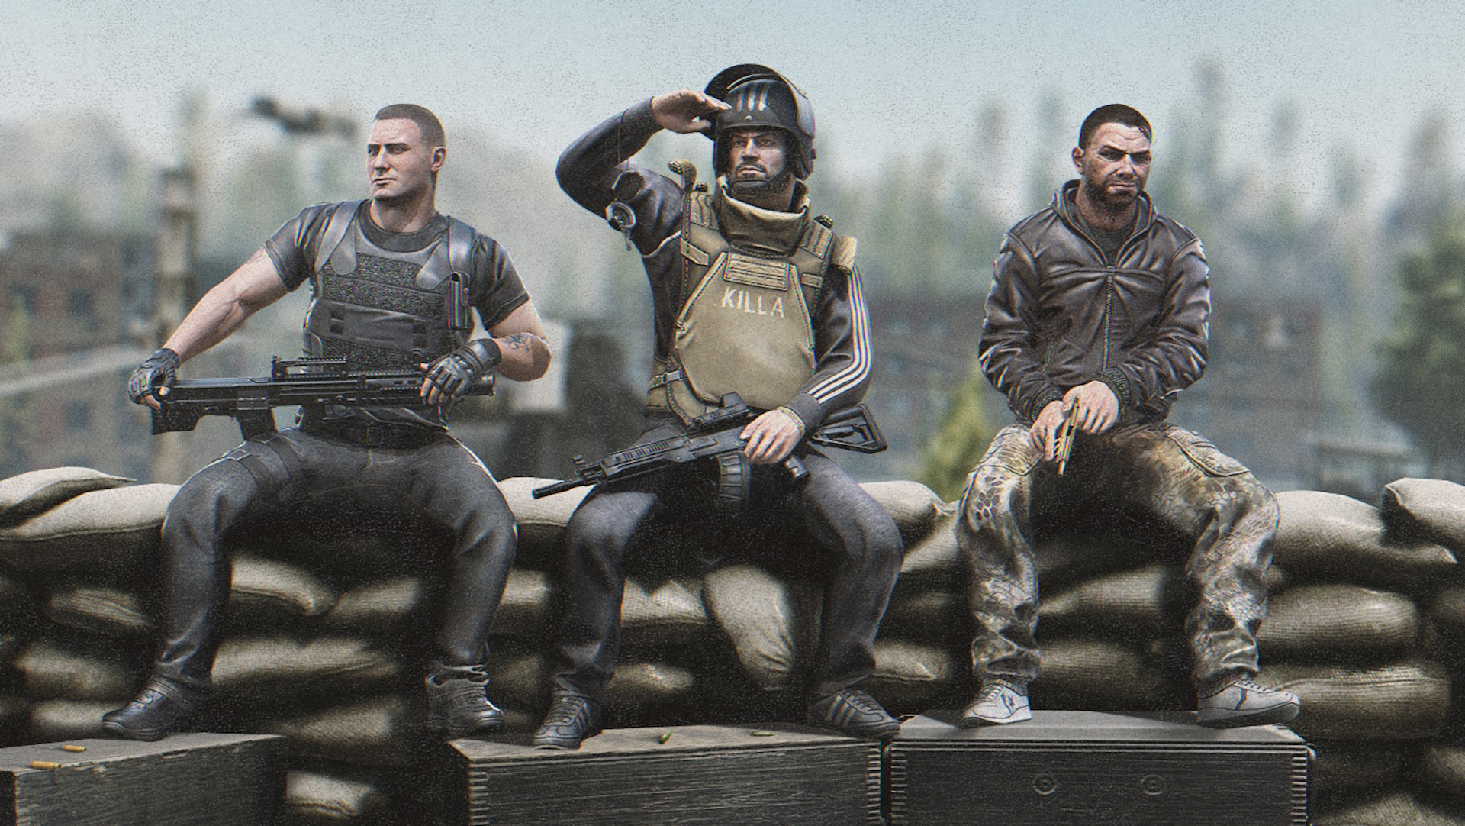
08 · THE CLOSE
Why this works for Battlestate
Respects the community's voice
We amplify creators rather than talk over them. In a genre where trust is earned, that is a structural advantage no paid budget can buy.
Every dollar is measurable
Each tactic is paired with a real tool — GA4, Meta Ads Manager, Meltwater, Cision — so we know what moved sales, viewership, and Discord growth, and what did not.
Built for the wipe cadence
The plan rides Tarkov's natural rhythm. Every update triggers an orchestrated owned-paid-earned wave instead of isolated announcements.
The 15% lift is earned, not hoped for
Owned media holds attention, paid extends reach, earned converts trust — together they compound across six months of campaign cycles.
Let's build the next wipe into a campaign that fans remember.
TARKOV · CONTENT MARKETING CAMPAIGN · JULIO HERNANDEZ
12 / 13
Notes:
Persuasive close. The four pillars: community trust, measurability, wipe-cadence fit, and compounding integration. The 15% lift isn't aspirational — it comes from tying every tactic to a measurable tool and iterating across every wipe cycle.

Slide 13
REFERENCES
Works cited (APA, 7th ed.)
Battlestate Games Limited. (n.d.). Battlestate Games — About. battlestategames.com
Battlestate Games Limited. (n.d.). Escape from Tarkov — Official website. escapefromtarkov.com
de Vries, L., Gensler, S., & Leeflang, P. S. H. (2017). Effects of traditional advertising and social messages on brand-building metrics. Journal of Marketing, 81(5), 1–15. doi.org/10.1509/jm.15.0178
Koob, C. (2021). Determinants of content marketing effectiveness. PLoS ONE, 16(4). pmc.ncbi.nlm.nih.gov/articles/PMC8016322
Lovett, M. J., & Staelin, R. (2016). The role of paid, earned, and owned media in building entertainment brands. Marketing Science, 35(1), 142–157. doi.org/10.1287/mksc.2015.0961
Park, J., & Kim, R. B. (2022). A scoping review of the effect of content marketing on online consumer behavior. SAGE Open, 12(2). doi.org/10.1177/21582440221093042
Stephen, A. T., & Galak, J. (2012). The effects of traditional and social earned media on sales. Journal of Marketing Research, 49(5), 624–639. doi.org/10.1509/jmr.10.0401
Taiminen, H. M., & Karjaluoto, H. (2015). The usage of digital marketing channels in SMEs. Journal of Small Business and Enterprise Development, 22(4), 633–651. doi.org/10.1108/JSBED-05-2013-0073
Phillips, R. (2025, August 22). Escape from Tarkov finally has a 1.0 release date. IGN. ign.com
Wilde, T. (2025, November 24). Tarkov director on 1.0 launch-week stress tests. PC Gamer. pcgamer.com
TARKOV · CONTENT MARKETING CAMPAIGN · JULIO HERNANDEZ
13 / 13
Notes:
APA 7th edition references. Built on the Unit 8 reference list and extended with measurement-tool sources for Unit 12.

