Slide 1
심리과학 연구방법 Orientation: Next Big Thing

Slide 3
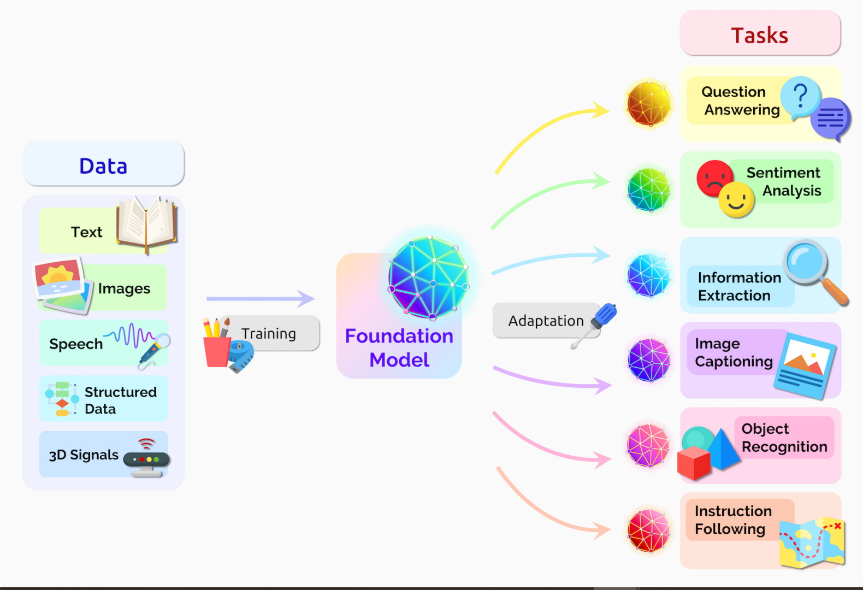
파운데이션 AI 모델의 시대
파운데이션 모델 (예, GPT)
대규모 unlabeled 데이터를 “빈칸채우기²"와 같이 자기지도학습하는 뉴럴넷.
수많은 테스크에 활용/적응 가능.
엄마가 “너 오늘 왜 이렇게 늦었어?“라고 물으셨다. 나는 ( )라고 대답했다.
• “길이 막혔어” (65%) ✅
• “시간 개념을 초월해 봤어” (25%) 😂
• “고양이” (10%) ❌
1. On the Opportunities and Risks of Foundation Models, arxiv, 2021; 2. BERT: Pre-training of Deep Bidirectional Transformers for Language Understanding 2019

Slide 4
파운데이션 AI 모델의 시대
파운데이션 모델 (예, GPT)
대규모 unlabeled 데이터를 “빈칸채우기²"와 같이 자기지도학습하는 뉴럴넷.
수많은 테스크에 활용/적응 가능.
원시 데이터(raw data)에서 특징(feature)·표상(representation)을 자동으로 학습하는 과정.
언어: 단어 임베딩(word embedding) → 문장 의미 이해.
뇌영상: fMRI or signal 데이터 → 인지 상태를 설명하는 저차원 패턴.
단백질 서열: 아미노산 문자열 → 3D 구조 예측.
심리학 실험: 인지실험 데이터 → 인간 인지행동 패턴 예측.
엄마가 “너 오늘 왜 이렇게 늦었어?“라고 물으셨다. 나는 ( )라고 대답했다.
• “길이 막혔어” (65%) ✅
• “시간 개념을 초월해 봤어” (25%) 😂
• “고양이” (10%) ❌
1. On the Opportunities and Risks of Foundation Models, arxiv, 2021; 2. BERT: Pre-training of Deep Bidirectional Transformers for Language Understanding 2019

Slide 5
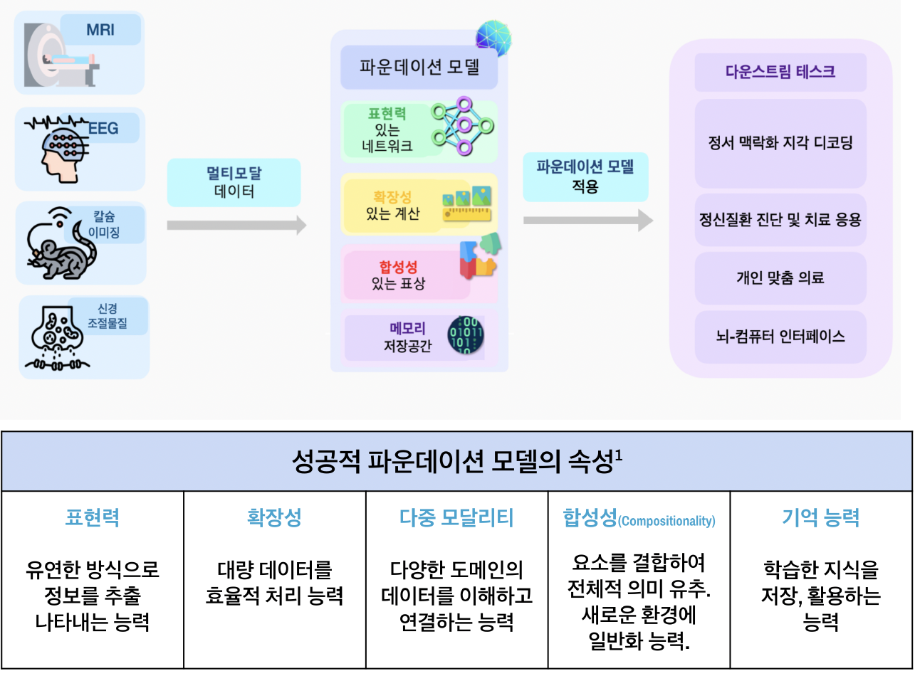
파운데이션 AI 모델의 시대
1. On the Opportunities and Risks of Foundation Models, arxiv, 2021; 2. BERT: Pre-training of Deep Bidirectional Transformers for Language Understanding 2019

Slide 6
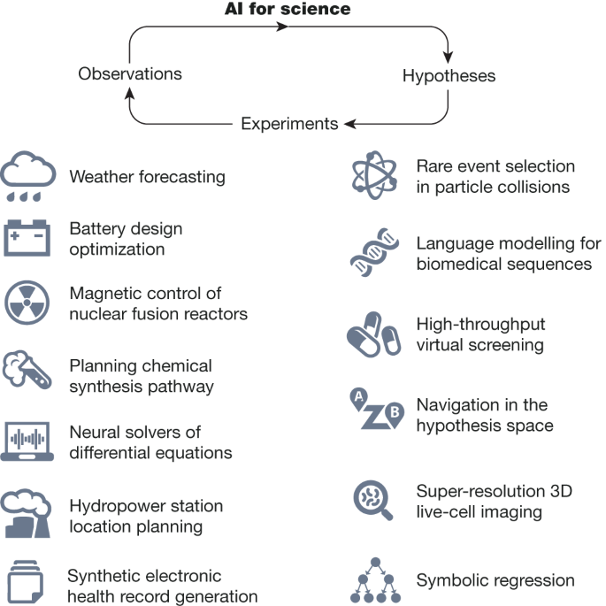
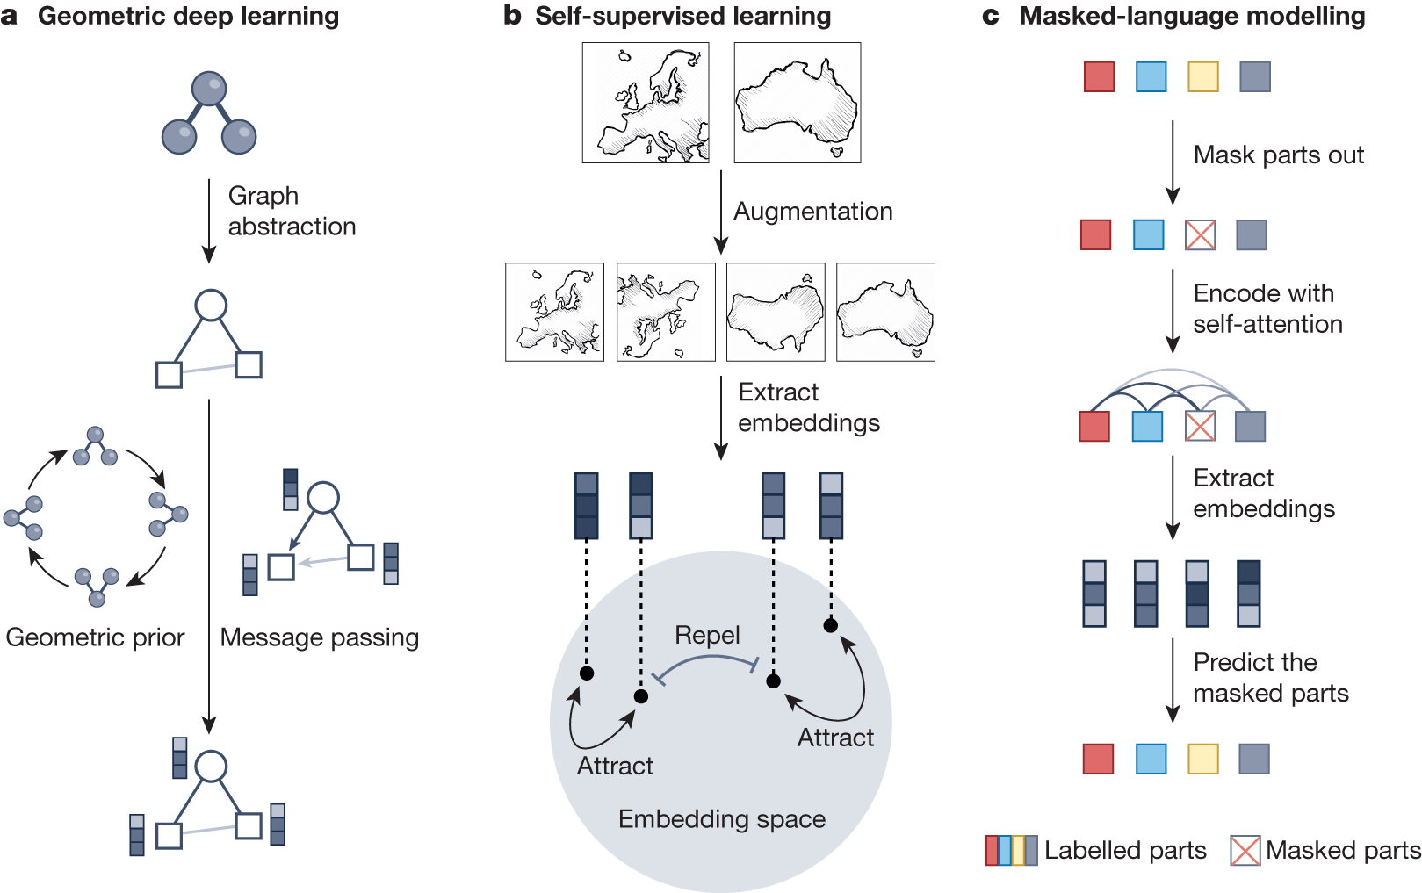
Scientific discovery in the age of artificial intelligence, nature, 2023 [paper] [link]
Fig. 1: Science in the age of artificial intelligence.
Fig. 2: Learning meaningful representations of scientific data.

Slide 7
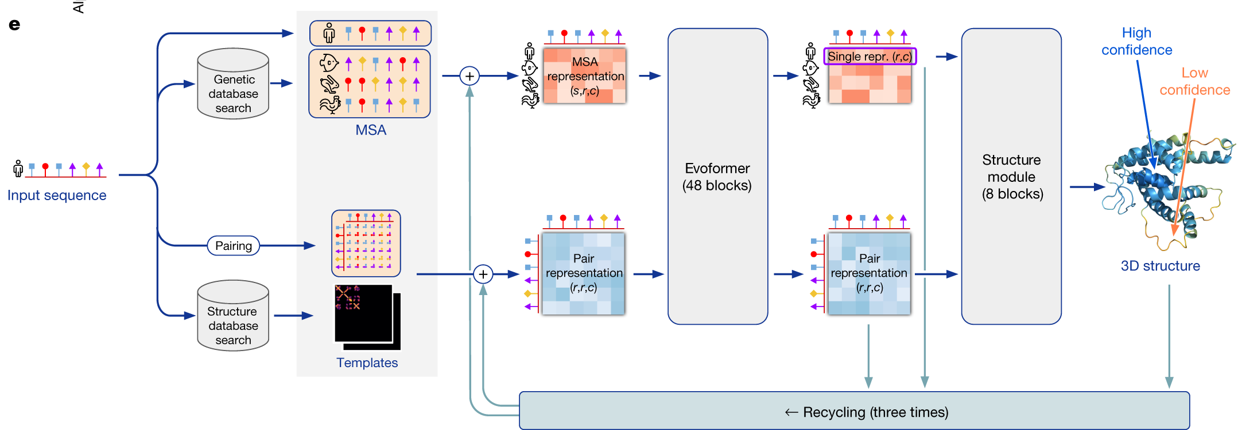
Foundation Model Drives AI Innovation : AlphaFold [website]
Impact:
Over 2 million researchers in over 190 countries

Slide 8
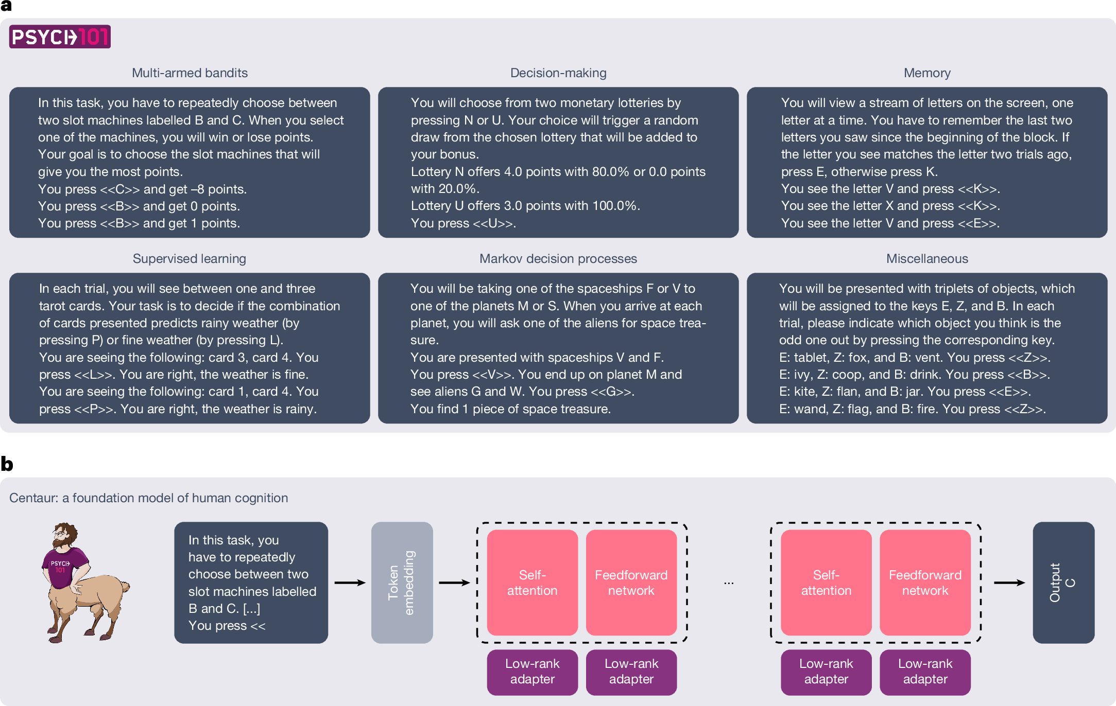
A foundation model predicting human behaviours and cognition

Slide 9
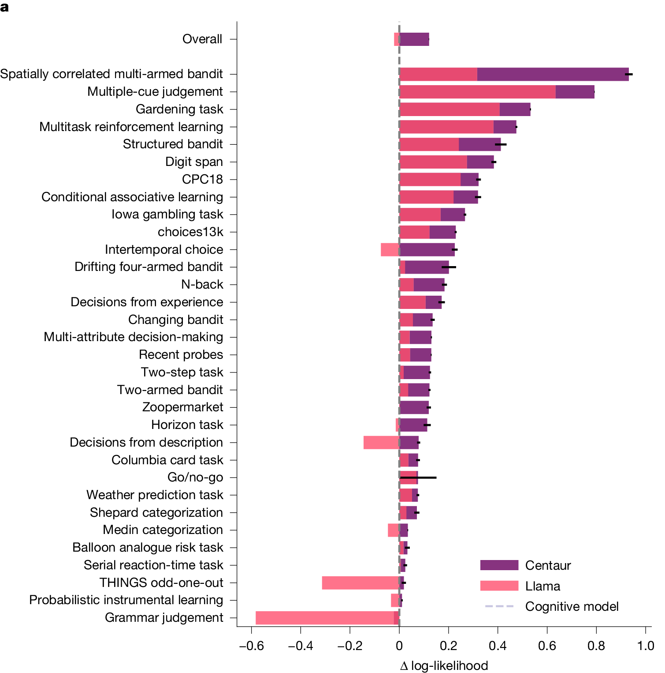
A foundation model predicting human behaviours and cognition
전통적 심리학 연구 | Centaur 기반 패러다임 | 예상되는 임팩트
과제별, 영역별로 국한된 이론 | 단일 파운데이션 모델이 160여 개 실험, 1천만 건 이상의 선택 데이터를 학습 | 단편적 이해 → 통합 인지 이론으로의 전환
작은 규모 데이터와 실험 중심 | 대규모 데이터셋 기반, 자연어로 모든 실험을 기술·학습 | 범용 행동 예측 및 새로운 상황 일반화
연구자가 수작업으로 가설·모델 제시 | AI가 대규모 데이터에서 가설적 패턴 발견 (예: 새로운 의사결정 전략) | 모델 기반 과학적 발견(model-guided discovery)
실험 설계는 비용·시간 요구 | 모델이 가상 실험 환경에서 조건·효과 크기 예측 가능 | 인실리코 실험 프로토타이핑 → 연구 효율성 극대화
연구자의 역할: 이론 창조자 | 연구자의 역할: 모델 해석자·큐레이터 | 과학자의 정체성 변화: 데이터→모델→이론 패러다임

Slide 10
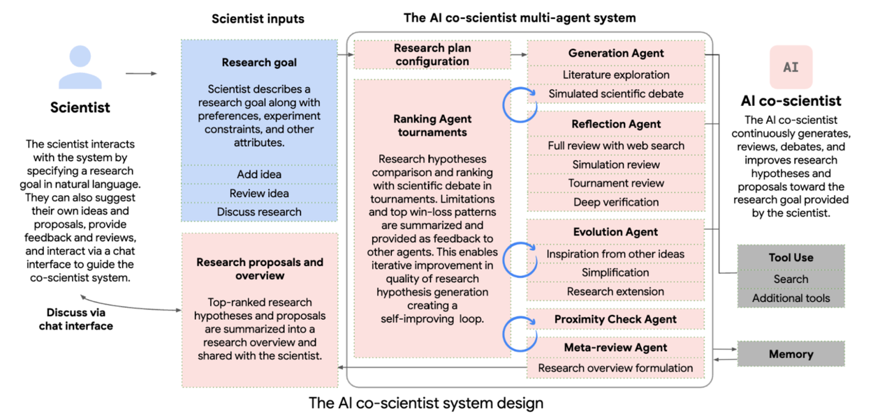
Agentic AI for Science: AI Co-Scientist
AI Co‑Scientist는 여러 전문 에이전트들이 협업하는 멀티 에이전트 구조
가설 생성 → 검토 → 랭킹 → 진화 과정을 반복하며 성능 개선.

Slide 11
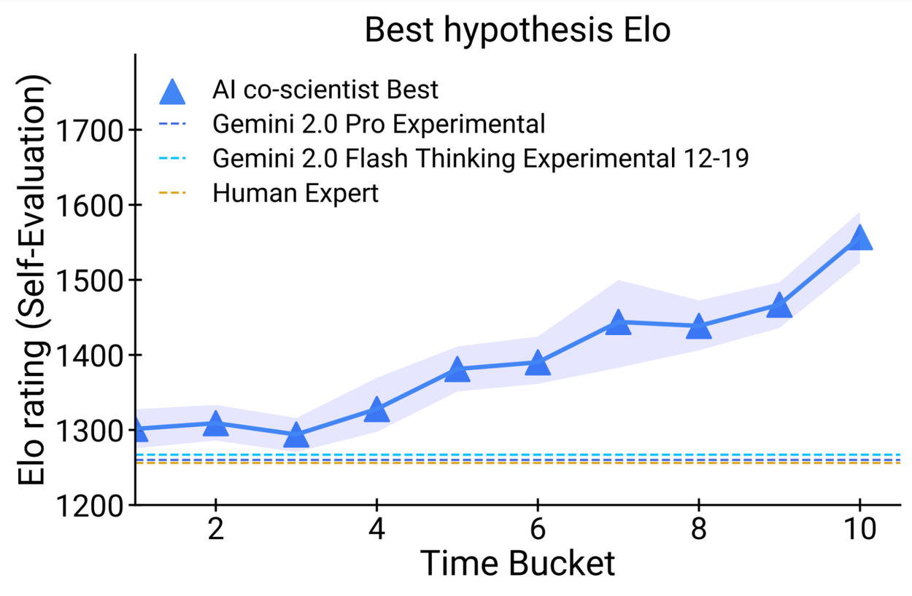
Agentic AI for Science: AI Co-Scientist
AI Co‑Scientist는 여러 전문 에이전트들이 협업하는 멀티 에이전트 구조
가설 생성 → 검토 → 랭킹 → 진화 과정을 반복하며 성능 개선.
test‑time compute scaling은 이러한 반복적 추론 과정을 가능하게 해주는 기반. 더 많은 계산 자원을 투입할수록 과학 가설과 최종 연구 결과의 퀄러티가 향상 → 어떤 의미?

Slide 13
Primer: 어떤 목표로 트레이닝 할 것인가?
“보이지 않는 연결 보기”
https://twitter.com/proffeynman/status/1141007291363102720?lang=en
”토네가와 교수님이 말하는 창의성”
https://www.youtube.com/watch?v=fnzNIferCzY
“창의성을 위한 지루한 기초 교육”
https://www.joongang.co.kr/article/23659580#home

Slide 14
Google DeepMind's CEO says undergraduates should spend their time "learning to learn."Change will be the only constant in the next decade, Demis Hassabis told students at the University of Cambridge. By the time they graduate, students should have knowledge of their passions and core fundamentals, he added. Cambridge students had a chance to submit questions to Google DeepMind CEO Demis Hassabis earlier this year. They wanted to know how they should focus their time in the age of AI.
His advice? Spend your time "learning to learn."
"I think really understanding — using the time you have as an undergraduate to understand yourself better, and how you learn best," Hassabis said in an interview at Queens' College, Cambridge. Adaptability is key, he added, "how to pick up new material really quickly and getting adept at that."
The AI executive said he believes that today's college students will be entering a world where the only predictable factor is "an incredible amount of disruption and change," all due to developing technologies. He also offered his view on which industries he expected to grow.
"I would say especially AI, but also VR, AR, you know, quantum computing," he said. "All of these things are sort of looking like they're gonna be promising in the next five to 10 years."
Anytime there is change, he added, there is also "huge" opportunity.
"I think we're about to enter a period like that, perhaps like in the nineties when we were graduating, you know, it was the internet, and mobile, and gaming," Hassabis said. "I think we're in another one of those eras. So they're very exciting, but you've gotta be very nimble and embrace the new technologies that are coming down the line."
Hassabis said students should focus on the fundamentals. Though there's always likely to be a new fad, it's better to avoid becoming distracted by things that could be "in fashion today, but out of fashion tomorrow."
"I remember my favorite topics were things like computation theory and information theory, you know, studying things like Turing machines," Hassabis said. "That stayed with me for my whole career, really. So, I like the kind of mathematical underpinnings and a lot of the traditional, foundational work."
Students shouldn't neglect their passions, either, he added. By the time they're done with school, Hassabis said graduates should be able to "combine" deep knowledge of their interests with the core skills they've developed.
"In your spare time, you should be probably experimenting with whatever your passionate area is," Hassabis said. "In my case, it would be AI. With all the tools that are coming out — and a lot of it's very accessible and open source and so on — so that you really are up to speed with the absolute latest when you graduate."
As for graduate students, Hassabis suggested they develop expertise across a variety of fields. If they're learning about AI, for instance, they should also know where best to apply it.
"I feel like multidisciplinary research 0is really gonna come to the fore in the next sort of decade," he said.
There's likely to be a lot of "low-hanging fruit" where artificial intelligence and STEM fields intersect, he added, so it's important to know enough about both your subject areas to understand what the "right questions" are — as asking them could lead to breakthroughs.
"Picking the question is about having this sort of taste or smell, if you like, of intuition, of, 'What is the right problem?' Is it the right time to tackle that problem, as well?" Hassabis said. "Because timing can be really difficult. You don't want to really be 50 years ahead of your time."
And though Hassabis said you can't really train that sixth sense, he says you can keep an open mind, and remain ready to jump at the opportunities when they do appear.
"They can come up from anywhere," he said. "So that kind of goes with being multidisciplinary, exposing yourself to a wide range of ideas."

Slide 15
새시대의 인재상
1. AI 상호작용 (AI Interaction): AI를 당신의 사고 파트너 로. 질문을 설계하고 AI 응답을 이해하며 반복 개선할 수 있는 능력.
2. 비판적 사고 & 평가 (Critical Thinking & Evaluation): AI가 생성한 응답이 맞는지, 정보 출처는 어떤지, 왜곡된 편향은 없는지를 판단하는 비판적 검토 능력. “10편의 AI-assisted 제안서 중 어떤 1개를 선택할 것인가?"
3. 창의성 & 협업 (Creativity & Collaboration): AI와 인간의 협력. 인간간의 협력. 서로 다른 영역의 전문가들과의 소통. 협력과 창의적 사고가 결합될 때, AI와 함께 새로운 가능성: 더 나은 해결책, 돌파구 등.
“창의적인 AI의 결과물을 이해하고 action plan으로 만드는 것은 사람의 영역”
토네가와 교수님의 조언
Curiosity
Persistence: Urge to address the question
Unique perspective: to combine seemingly disconnected fields.
4. 적응력 (평생 학습) Adaptability (Lifelong Learning)
기술 변화가 끝없이 이어지는 가운데, 배우고 적응하는 능력은 성장의 조건입니다 (딥러닝, LLM, Agentic AI, 양자정보과학…)

