Slide 1
Solution

Slide 2
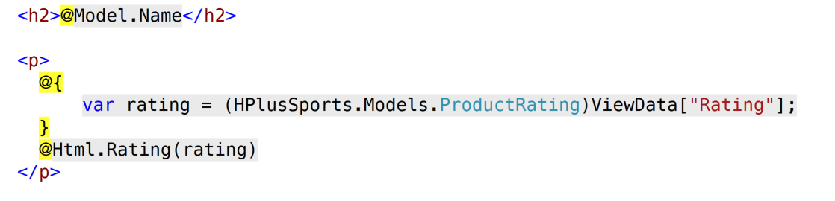
Views\Products\Product.cshtml

Slide 3
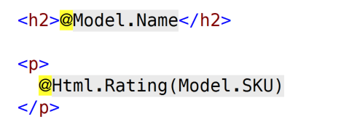
Views\Products\Product.cshtml

Slide 4
Challenge
Replace the call to @Html.Rating(rating) with @Html.Rating(Model.SKU)
Use a combination of a custom HTML Helper and a Child Action
Render the same exact markup

Slide 5
Tips
Move the database logic to retrieve the Rating object from the the ProductController to the new Child Action

Slide 6
Time
Estimated time: 10-15 minutes

