Slide 1
Understanding Feature Folders

Slide 2
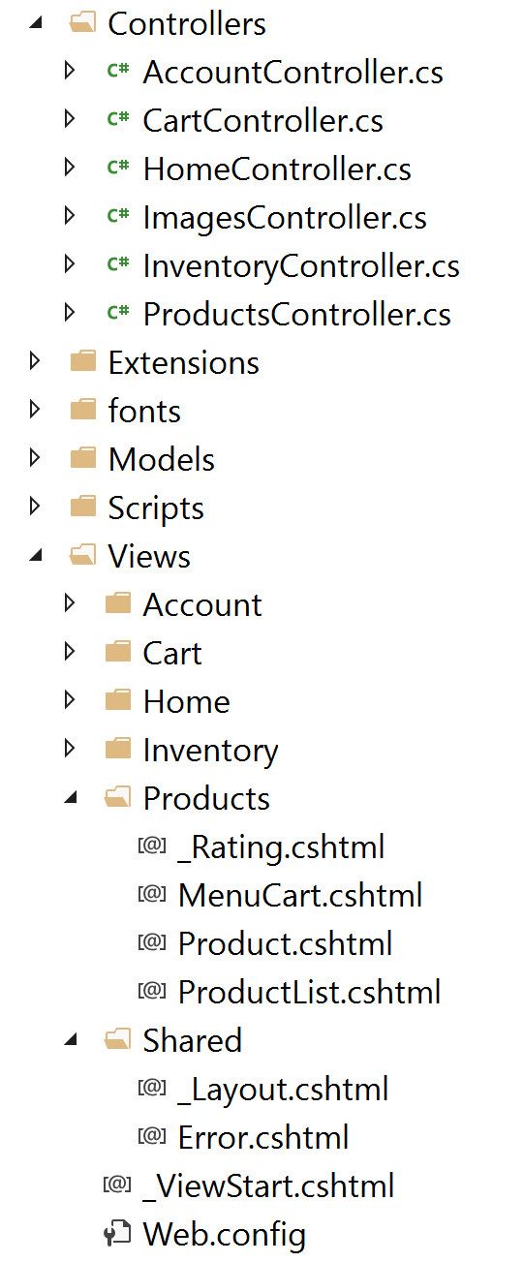
Standard ASP.NET MVC Folder Layout

Slide 3
Standard ASP.NET MVC Folder Layout
Technical relationships
rather than logical relationships

Slide 4
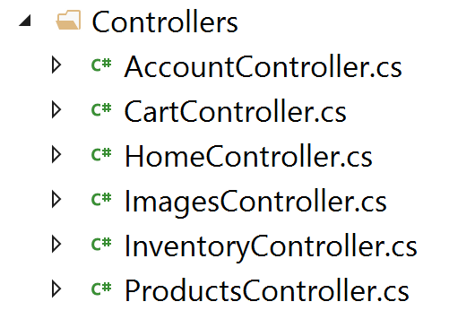
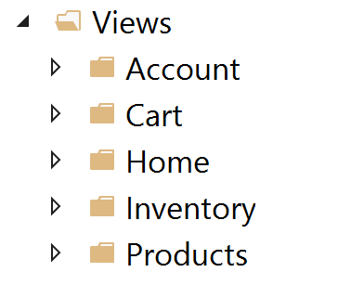
Logical relationships

Slide 5
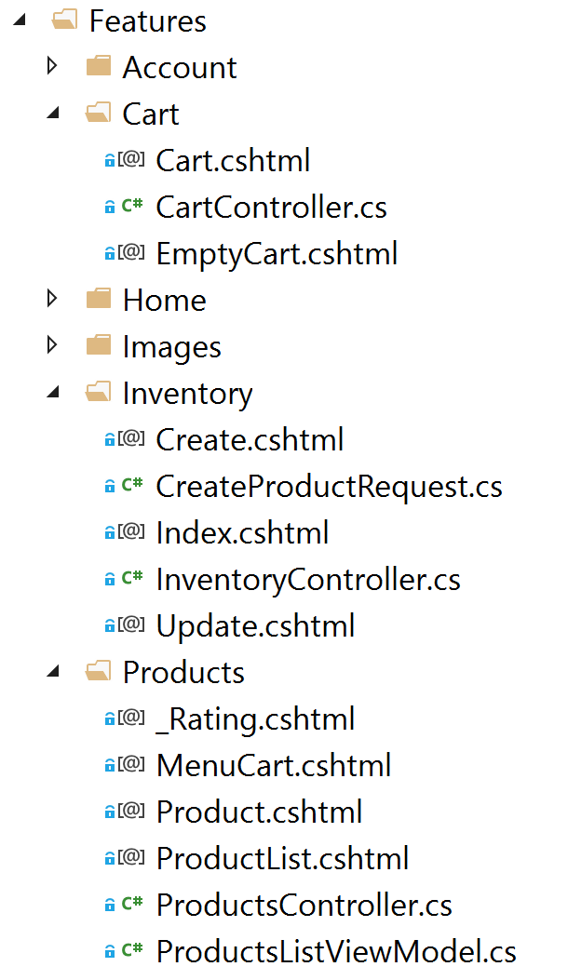
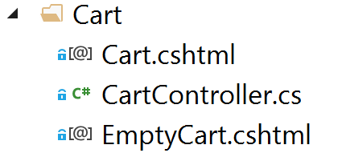

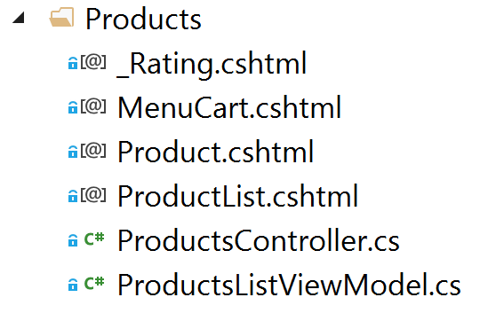
Feature Folders

Slide 6
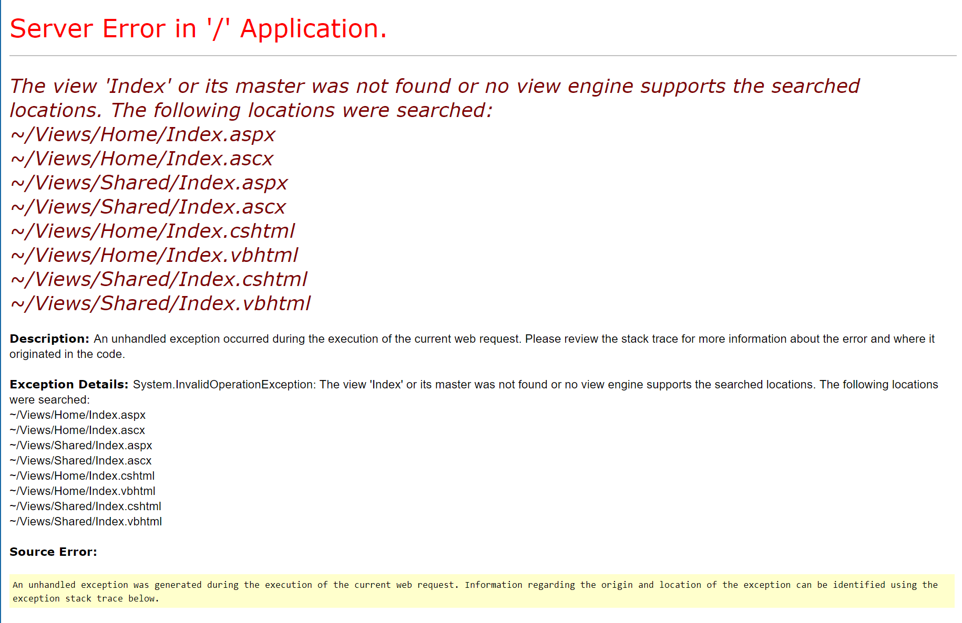

Slide 7
Feature Folders: an opinionated approach
Might not be for everyone
If the out-of-the-box ASP.NET MVC convention of Models, Views, and Controllers folders works for you – keep using it!

