Slide 1
Creating separate projects for UI and non-UI code

Slide 2
Model-View-Controller Pattern
Separation of concerns: Business logic, view logic, and application logic should remain independent

Slide 3
“Business Logic”
Defines how your business works
Not related to any framework or platform.

Slide 4
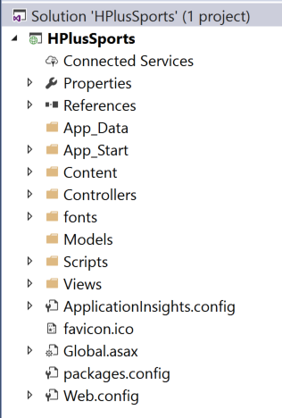
New ASP.NET MVC Project

Slide 5

New ASP.NET MVC Project
Models Business or data access logic

Slide 6
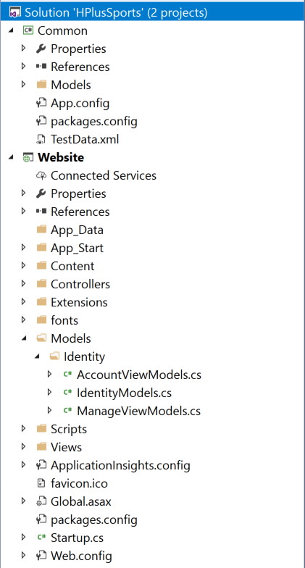
Models Business or data access logic

Slide 7
Enforcing separation of concerns
Think twice about adding an ASP.NET MVC assembly to your business logic project

Slide 8
Recommendation:
Create a separate project (or projects) to enforce a hard separation between business logic and application logic.

