Slide 1
Predicting Breast Cancer Tumor Malignancy

Slide 2
UCI Dataset
The “breast-cancer-wisconsin.data” file was downloaded from the UCI and loaded into R studio
The data has 11 total attributes
ID number
Clump thickness
Uniformity of cell size
Uniformity of cell shape
Marginal adhesion
Single epithelial cell size
Bare nuclei
Bland chromatin
Normal nuclei
Mitosis
Class
The class variable was equal to 2 if benign and 4 if maignant

Slide 3
Data Cleaning and Partitioning
16 missing columns in the bare nuclei column
After removing these records, 699 rows were reduced to 683
The remaining data was separated into training and testing sets
Used “createDataPartition” package in R
80% training
20% testing

Slide 4
Random Forest Modeling
Nine attributes were used to predict tumor malignancy
All but ID number, which does not have an effect on the outcome
“randomForest” package and method was used in R
2000 trees in the forest

Slide 5
Results
On training data:
97.8% accuracy on benign tumor classification
98.4% accuracy on malignant tumor classification
On testing data:
94.9% accuracy on benign tumor classification
93.0% accuracy on malignant tumor classification

Slide 6
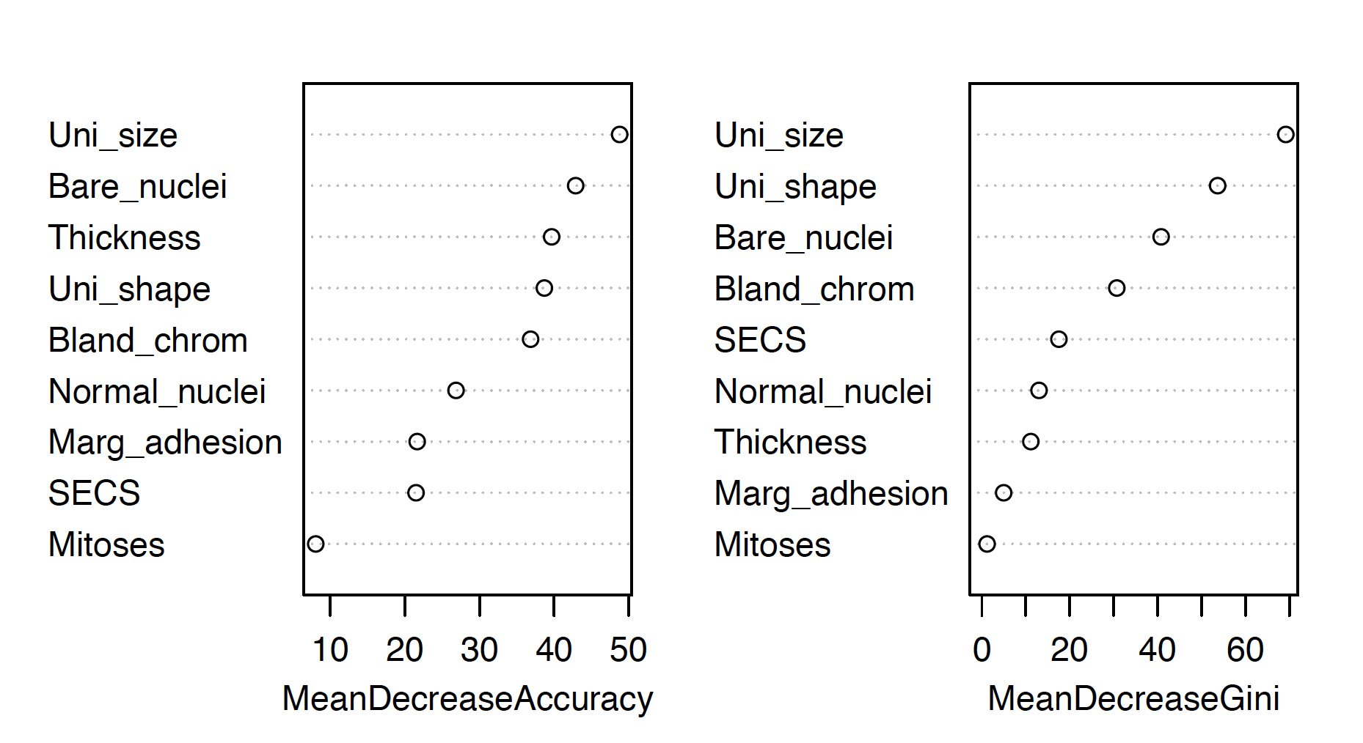
Variable Importance
Notes:
Mean decrease accuracy – the decrease in accuracy when an attribute is removed
Mean decrease gini – the decrease in the gini index (a node purity measure) when an attribute is removed

Slide 7
Conclusions and Future Work
Relatively successful numbers, but not good enough when predicting something as serious as tumor malignancy
Other models such as SVM or neural networks could be used
Leaving out some less important attributes could change the accuracy slightly

