Slide 1
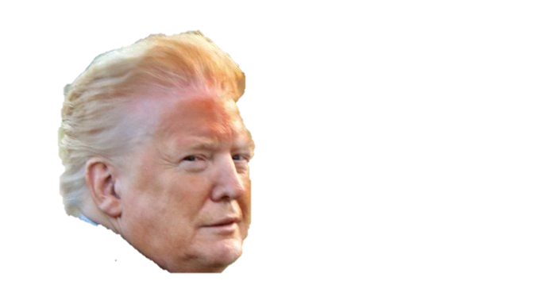
Trump Twitter vs The Stock Market
General Assembly DS5K, Wave 10 Final Project
Justin Chaphiv

Slide 2
Introduction
Introduction: A reddit user compared President trump's Tweets to price changes in stocks. The reddit user took tweets in which Trump talked about trade negotiations with China and compared them to the stock values of companies that relied heavily on production in China like computer hardware manufacturers, clothing retailers, etc. They noticed that every time Trump tweeted negatively about trade negotiations there would be decline in the stock's value the following trading day and vice-versa for positive tweets.
Problem Statement: Does Trump’s use of Twitter have an affect on the overall stock market?
Data Sources:
http://www.trumptwitterarchive.com/ An archive of every tweet that @realDonaldTrump tweets since May, 2009
https://finance.yahoo.com/ Historical data on markets and tickers

Slide 3
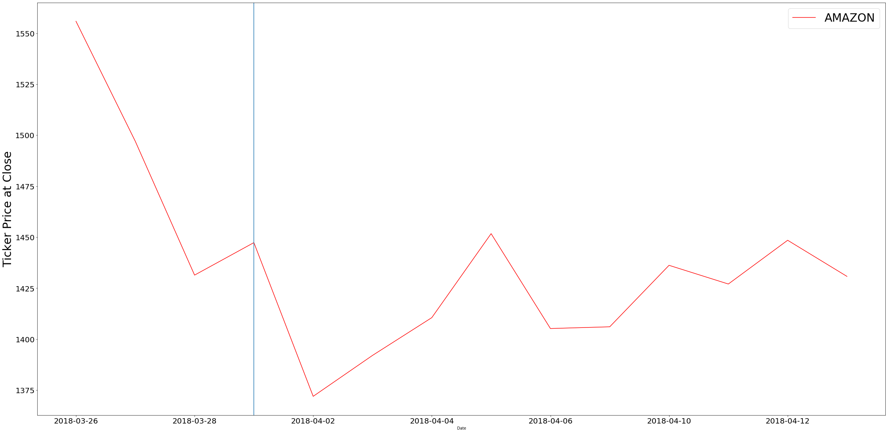
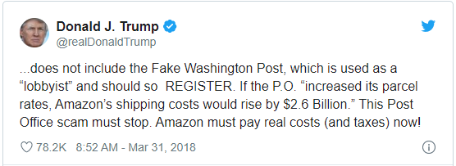
Example
Notes:
Caused about a 5% decrease in the value of amazon stock

Slide 4
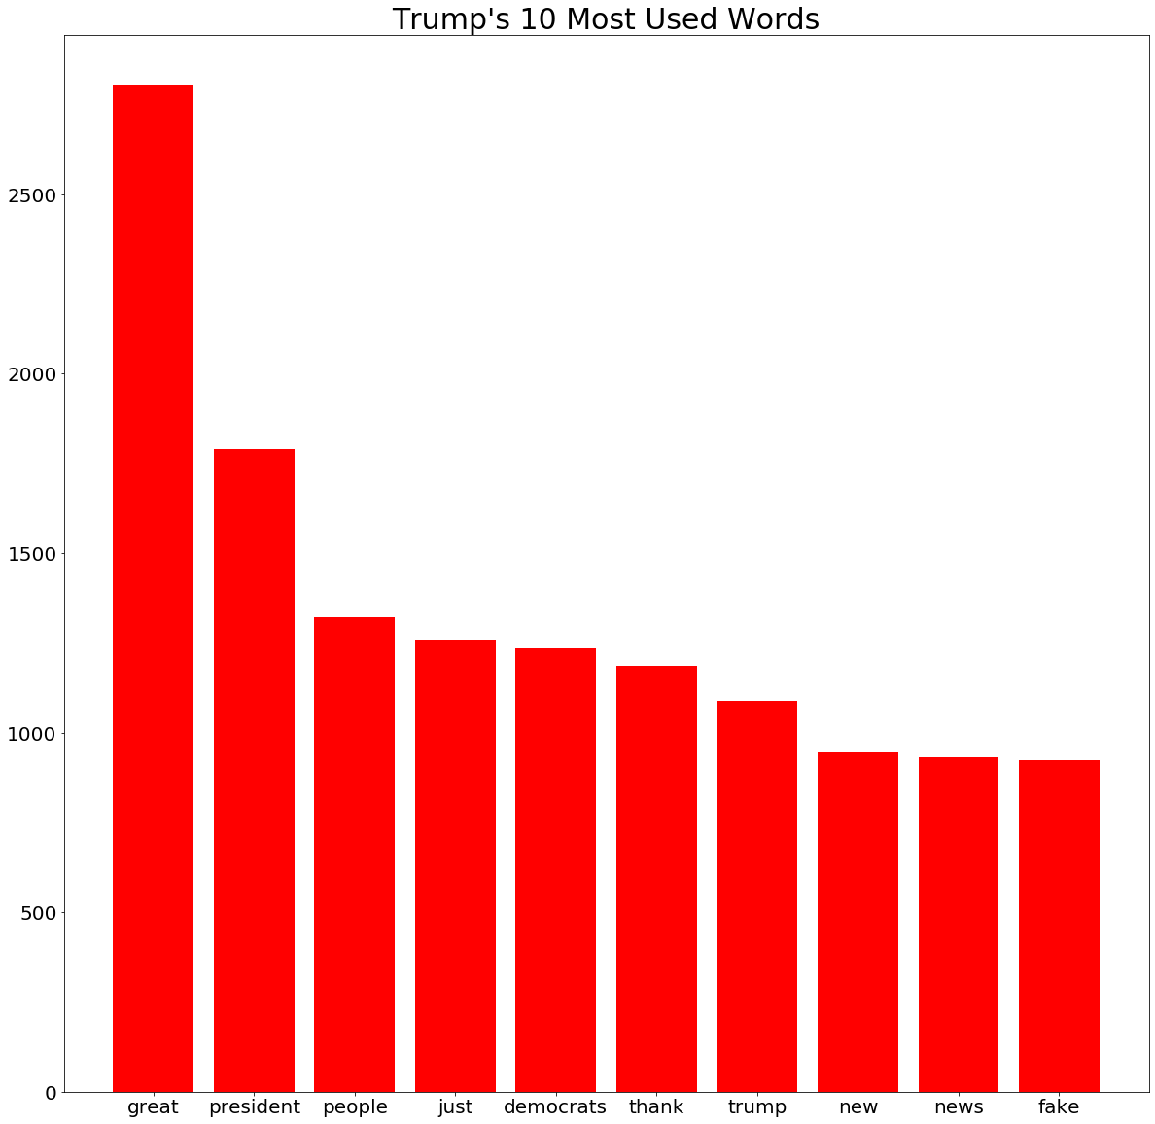
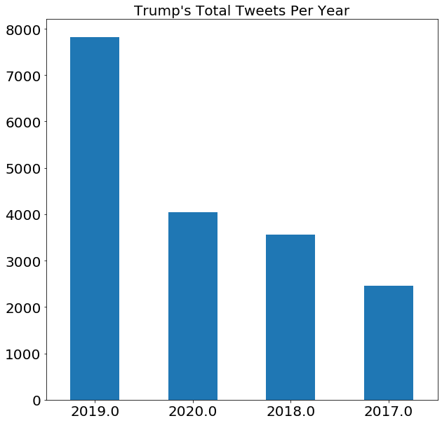
Exploratory Data Analysis
17,883 Tweets since taking office in January 20, 2017
His favorite day to tweet are on Wednesdays
Has been retweeted 316,051,483 times and favorited 1,051,428,160 times

Slide 5
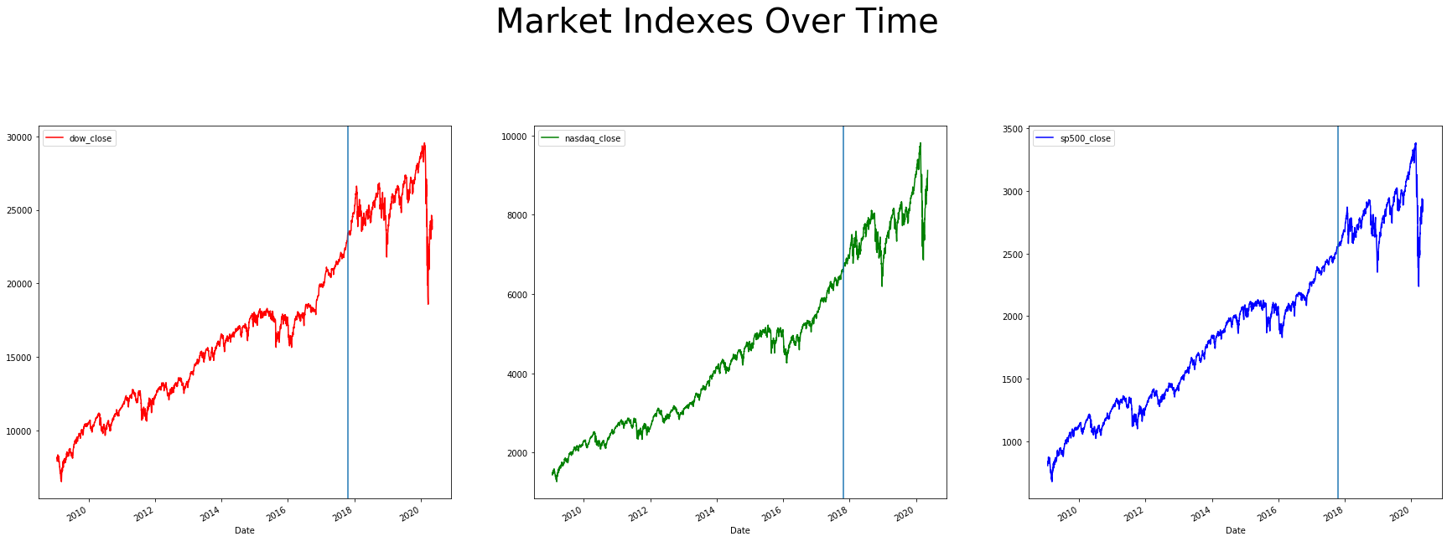
EDA on Stock market
The blue line indicates when Trump took office*
Index | Obama | Trump
Dow | 11,783 | 4,504
Nasdaq | 4,099 | 3,565
S&P 500 | 1,458 | 658
Total points added to each index during their presidency

Slide 6
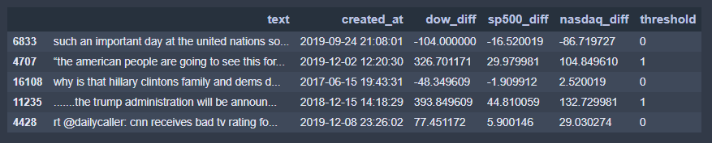
Approach and process
Every one of Trump’s tweets was merged with the change in points in each corresponding to the date the tweet was sent out
The “threshold” column is assigned a 1 or 0 based on whether the markets experienced an abnormal change
Using NLP, create a model that can successfully classify whether or not the tweet will cause an abnormal change in the market based on whether certain words/features are present

Slide 7

Model
Naives Bayes model was used with the following parameters:
Stop_words: English
N grams: (1,2)
Max_features = 100,000
No min_df or max_df
Data was split 75% training and 25% testing
Resulted in a model accuracy of 80.6%
Beat the null baseline of 78.5%
Model predication was applied back onto a new dataset resulted in 87.5% accuracy in predicting threshold values
Notes:
Sample was 16,686

Slide 8
Conclusion
I don’t believe there’s enough evidence to prove that Trump’s tweets have an affect on the overall stock market
From the dataset itself, only 25% of his tweets were associated with an abnormal change in the indexes
Even in the instances of major abnormalities in the market within the dataset, they can be explained through extraneous events/variables happening in the world such as the global pandemic, rising geopolitical tensions, rise of new technologies, etc.

Slide 9
Next Steps
Improve the tuning of the model in order to improve the accuracy
Isolate the tweets that specifically focus on policy changes, the economy, or concerning specific corporations (like the amazon tweet) in order to better measure the impact the tweets
Improve the method of classification and possibly try to predict the magnitude of the upcoming change given a tweet occurs

