Slide 1
Predicting Invasive Species growth in the Arboretum
Josh Chapman

Slide 2
Researching the Arboretum
Research continued from this past summer
Used the Bolleswood Natural Area land survey from the ES department
Attempted to predict future growth of invasive species

Slide 3
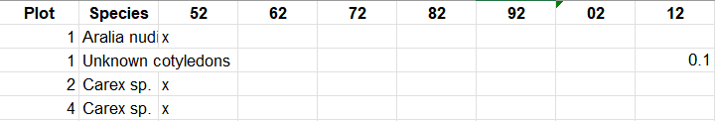
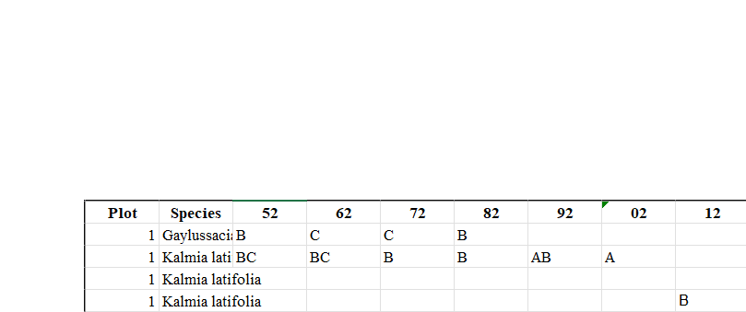
Structure of Data

Slide 4
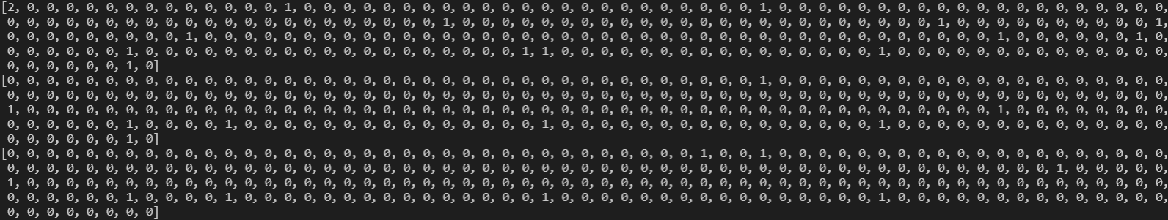
Extracted Features
Employed a list of species within the Arbo to form totals for each plot

Slide 5
Methods of analysis
Random Forest
Large feature space, many meaningless features
K-Means with PCA
Wanted to see if clusters formed in line with size classes, needed to reduce feature space

Slide 6
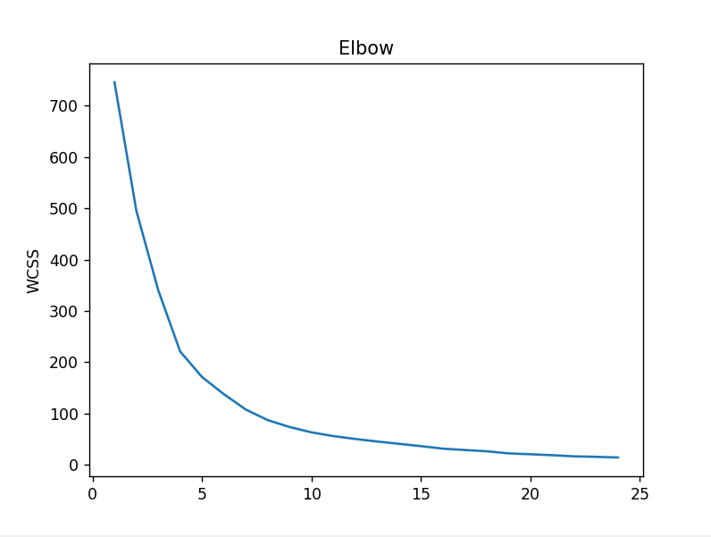
K-means w/PCA
PCA reduced features to two Principal Components
Used K-Fold CV with six folds to form test and train sets
Use a for loop to collect kmeans.inertia_ and create an elbow test

Slide 7
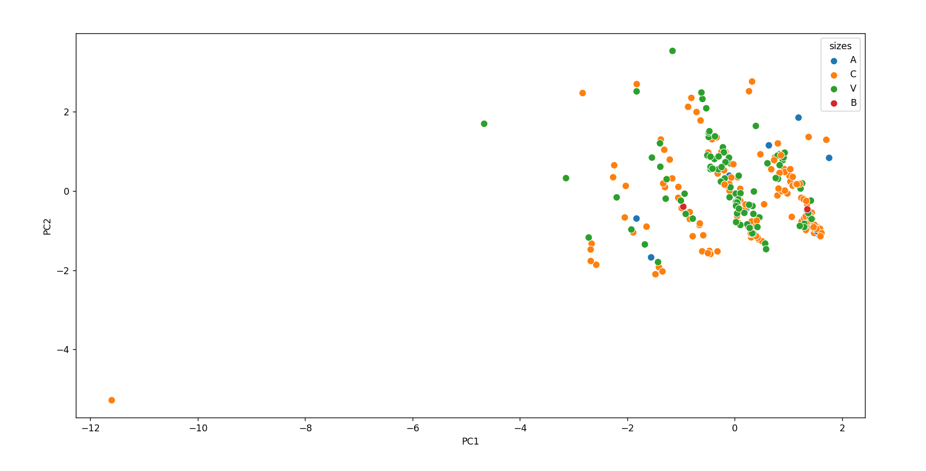
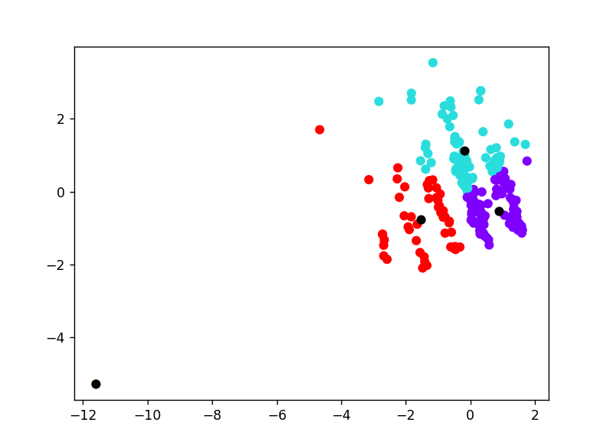
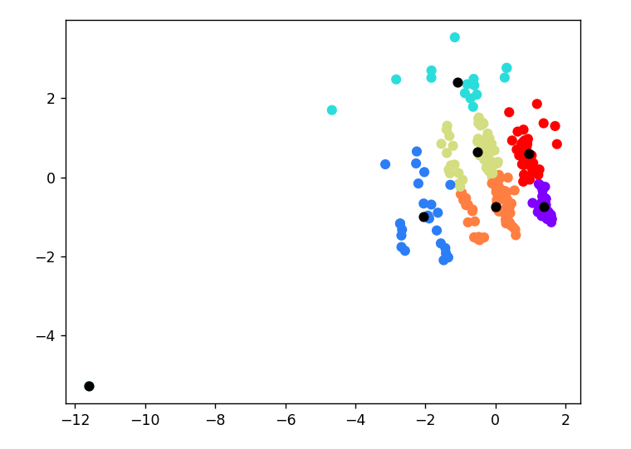

Slide 8

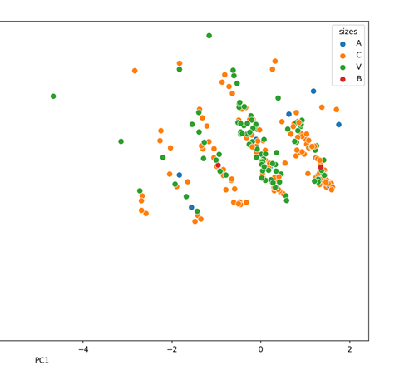
Random Forest
Performed K-Fold here as well, with six folds
Created a Forest using each possible combo features, found best accuracy score
Accuracy topped at about 83%

Slide 9

Tested 2012 plots with Celastrus orbiculatus in them
Found no ‘A’ class plants predicted
Found the largest predicted class to be ‘V’
Inaccuracy likely generated through similarity of features in compared plots, and classification changes in the data over time

Slide 10

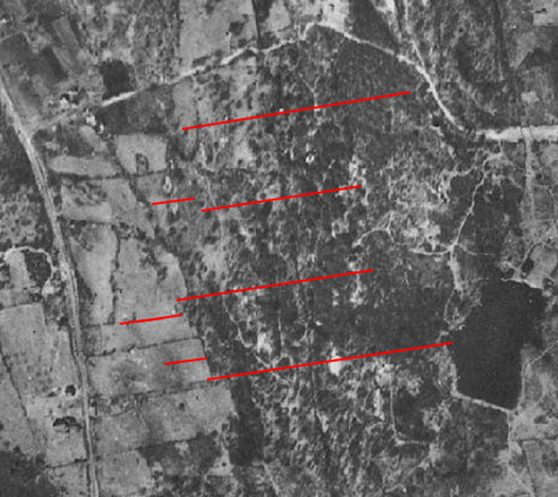
1
201
375
611

Slide 11
Sources
https://www.askpython.com/python/examples/principal-component-analysis
https://scikit-learn.org/stable/modules/generated/sklearn.model_selection.KFold.html
https://scikit-learn.org/stable/modules/generated/sklearn.cluster.KMeans.html
https://www.geeksforgeeks.org/elbow-method-for-optimal-value-of-k-in-kmeans/
https://scikit-learn.org/stable/modules/generated/sklearn.metrics.accuracy_score.html
https://scikit-learn.org/stable/modules/generated/sklearn.ensemble.RandomForestClassifier.html

