Slide 1
Seagull-eye group 3 Beach Recommendation System using Deep Learning
Gerardo Bohorquez Restrepo
Javier Chapto
Naeer Amin

Slide 2
The PROBLEM
Helping app users in determining the optimal times to visit beaches based on their preference for crowd levels.
MOTIVATION
Sydney’s beach culture.
Impact beach experience.
Benefit users and beaches.
Learning while thinking of real-life solutions.

Slide 3
DATASET & PRE-PROCESSINg
Videos from beach cameras and youtube (approx. 10 sec/ea).
1103 annotated images (CVAT).
Getting images and labels on right format and paths.
Cleaning.
APPLICATION
Object detection using YOLOv5. (Count).
Web application.
Use your camera or see different beaches (prototype).

Slide 4
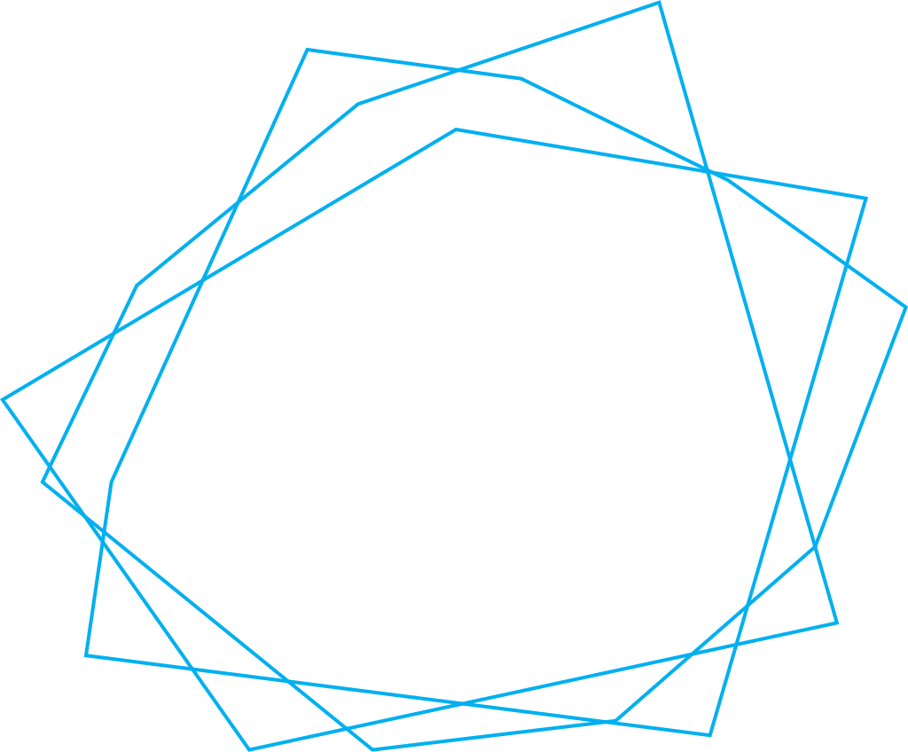
MODELING
1
Experiment with YOLOv5 and Faster RCNN.
2
Test different versions of YOLOv5 (LAB, 6.0: S, M, L, X).
3
Experiment with Hyperparameter tuning.
4
Evaluate experiments and choose best option.

Slide 5
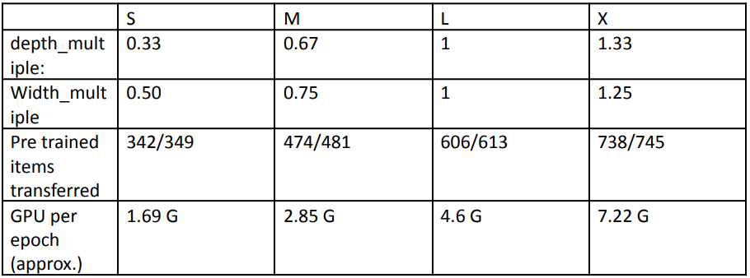
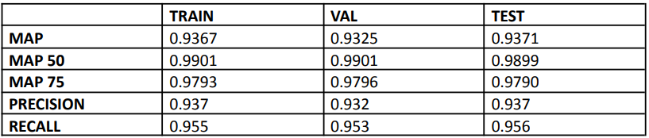
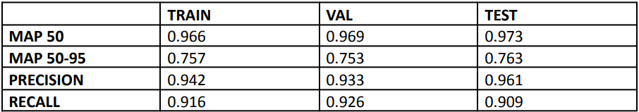

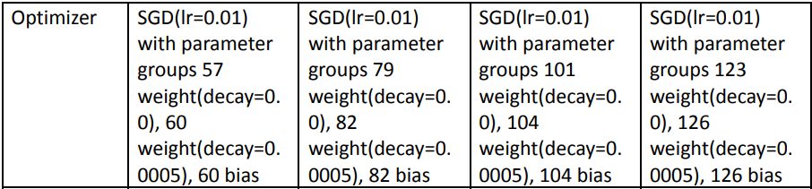
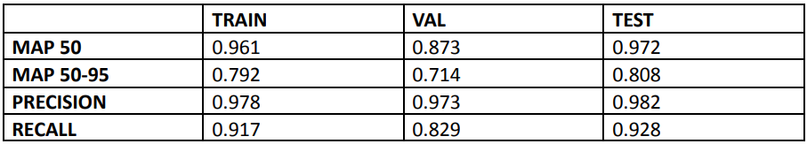
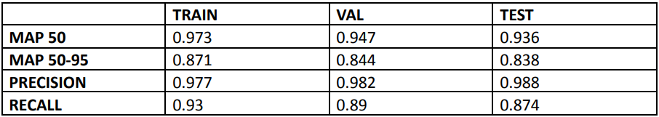
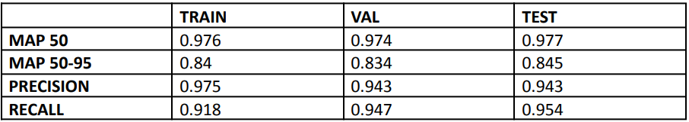
RESULTS AND CHOSEN MODEL
FASTER RCNN
S
M
M-H
lr0=0.01, lrf=0.01, momentum=0.937, weight_decay=0.0005, warmup_epochs=3.0, warmup_momentum=0.8, warmup_bias_lr=0.1, box=0.05, cls=0.5 (0.6) , cls_pw=1.0, obj=1.0 (1.4), obj_pw=1.0 (1.3), iou_t=0.2, anchor_t=4.0, fl_gamma=0.0 (1.5), hsv_h=0.015, hsv_s=0.7, hsv_v=0.4, degrees=0.0, translate=0.1, scale=0.5, shear=0.0, perspective=0.0, flipud=0.0, fliplr=0.5, mosaic=1.0, mixup=0.0, copy_paste=0.0
* Default hyperparameters, ones in blue were subsequently tuned.
L
X

Slide 6
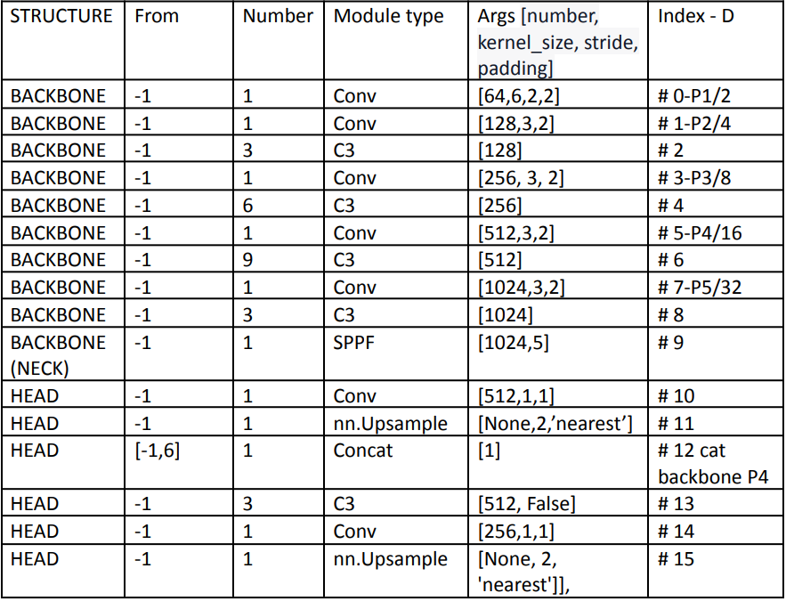
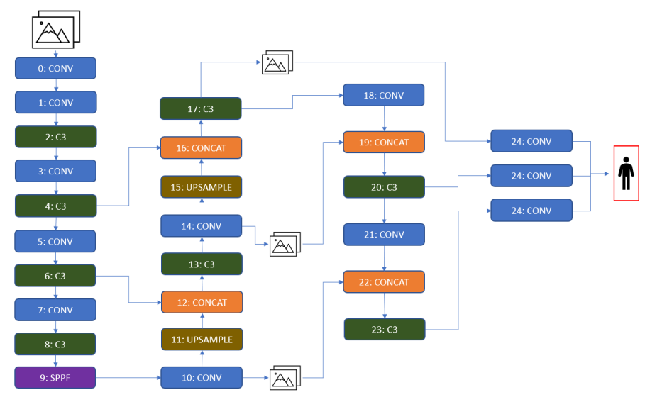
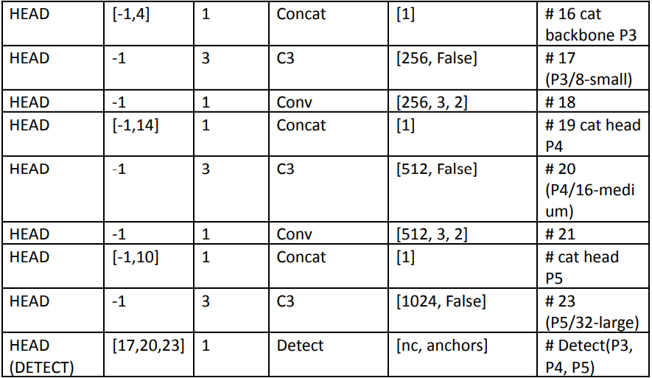
ARCHITECTURE OVERVIEW AND FLOW

Slide 7
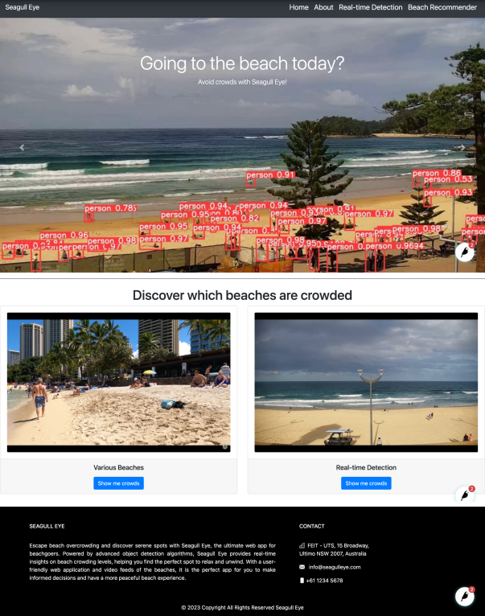
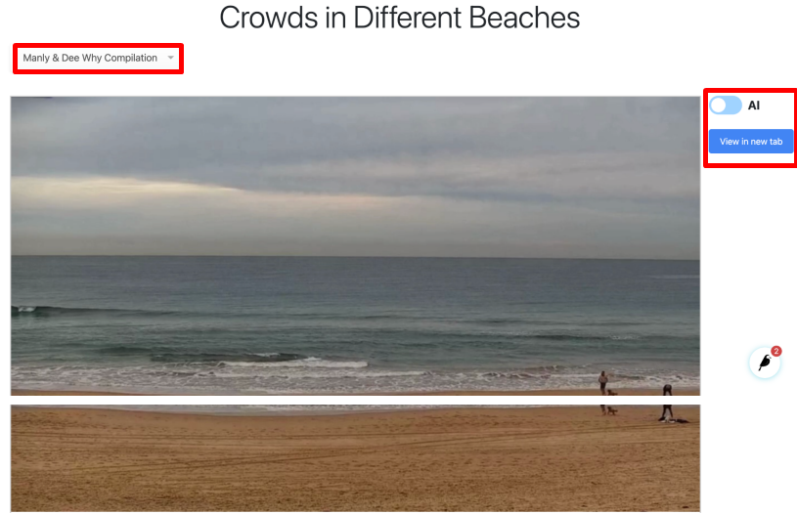
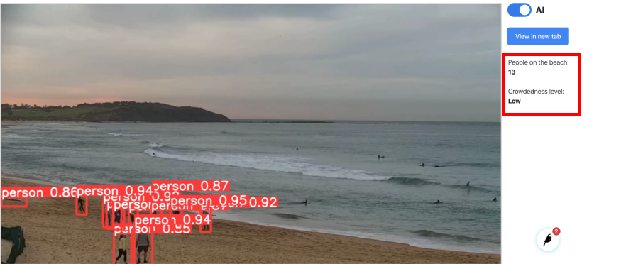
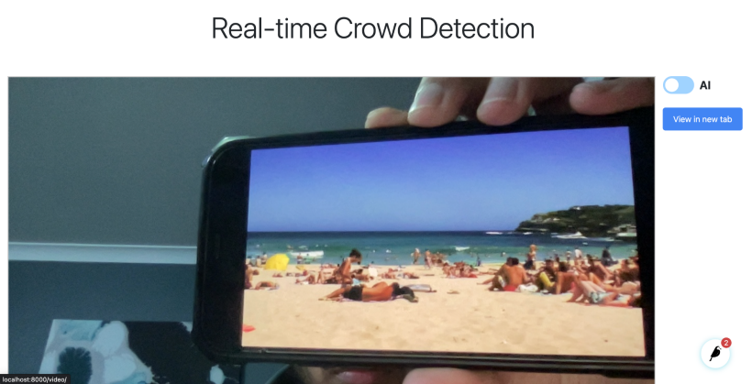
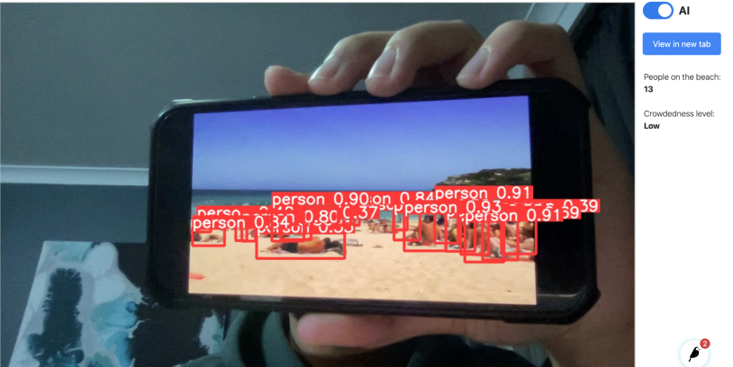
THE APP: SEAGULL-EYE

Slide 8

LIMITATIONS and future improvements
Dataset size.
Redundancy among train-validation-test.
False positives and negatives: Low
Limited experience in web application design.
Just getting started with deep learning.
Omitted features.
No access to livestreams on app (prototype built using laptop camera and pre-uploaded videos).
Mobile app.
Different Scenarios.
Further customization on model settings and architecture.
Improve design and UX.
Include new features

Slide 9
Thank you

