Slide 1
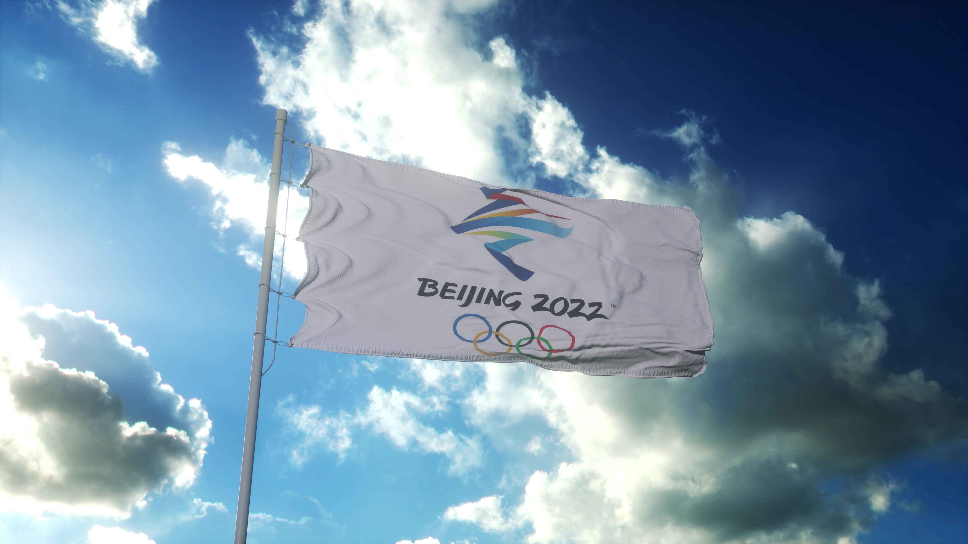
Analysis of National Performance in the Winter Olympics (1998 – 2022)
By Joydeep Chatterjee

Slide 2
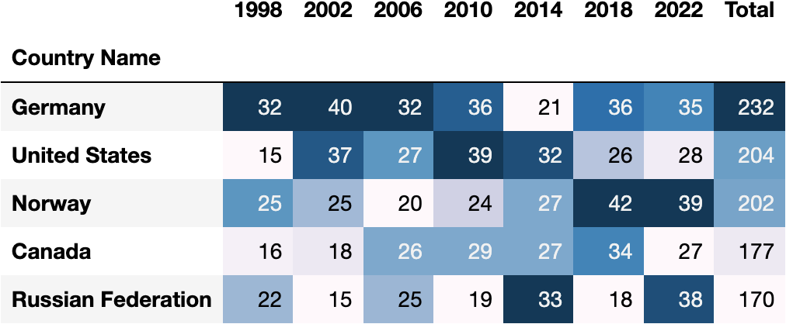
Top Winter Olympic Nations (1998 – 2022)

Slide 3
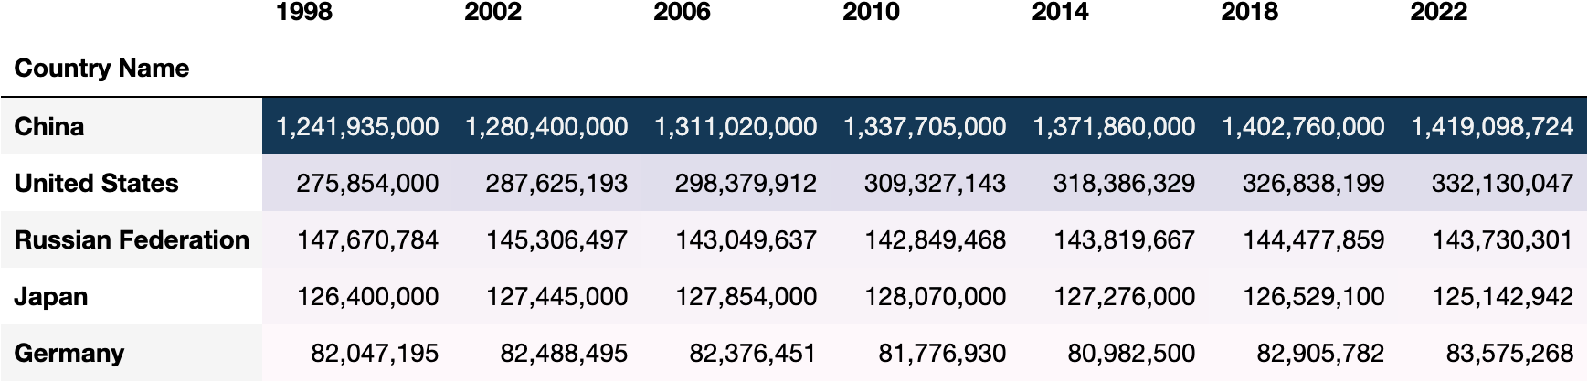
Most Populated Nations Winning Medals in the Winter Olympics (1998 – 2022)

Slide 4
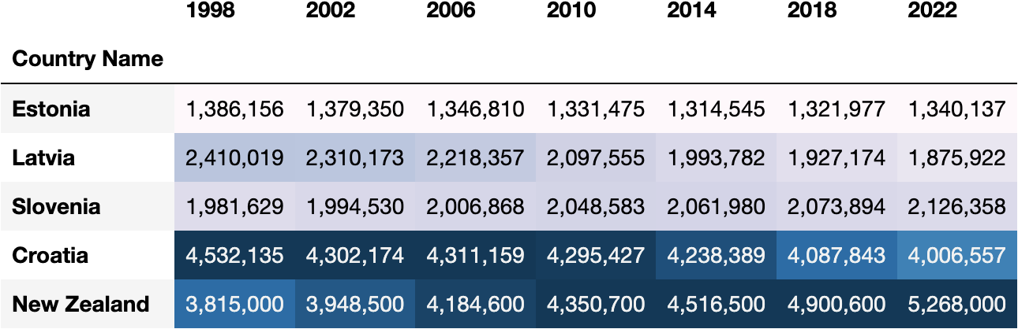
Least Populated Nations Winning Medals in the Winter Olympics (1998 – 2022)

Slide 5
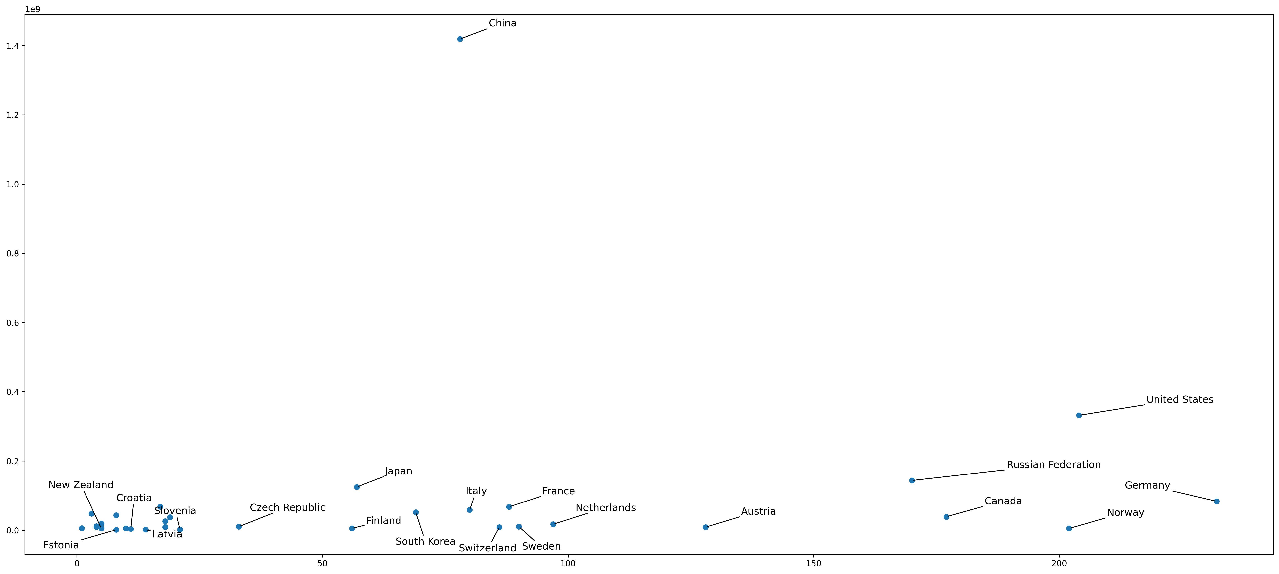
Medals per Capita (1998 – 2022)

Slide 6
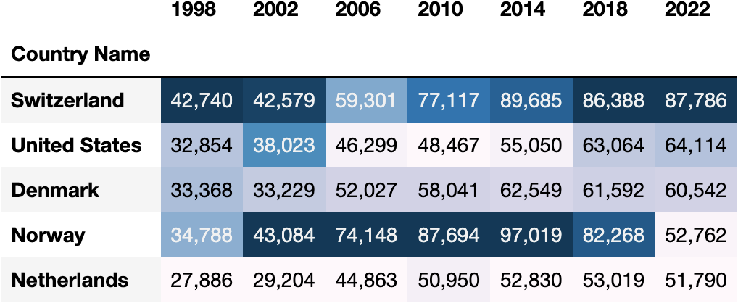
Most Affluent Nations Winning Medals in the Winter Olympics (1998 – 2022)

Slide 7
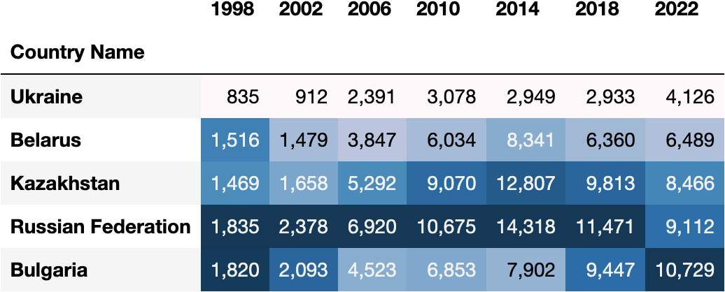
Least Affluent Nations Winning Medals in the Winter Olympics (1998 – 2022)

Slide 8
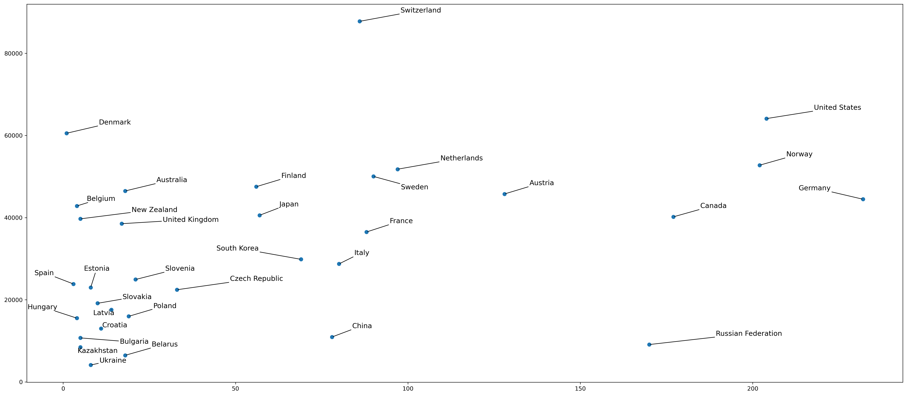
Medals per GDP per Capita (1998 – 2022)

Slide 9
Types of Events
Sledding (Bobsleigh, Luge, Skeleton)
Skating (Long Track, Short Track)
Skiing (Alpine, Biathlon, Cross Country, Nordic Combined, Ski Jump)
Snowboarding
Excludes: Figure Skating
Freestyle Skiing
Ice Hockey
Curling

Slide 10
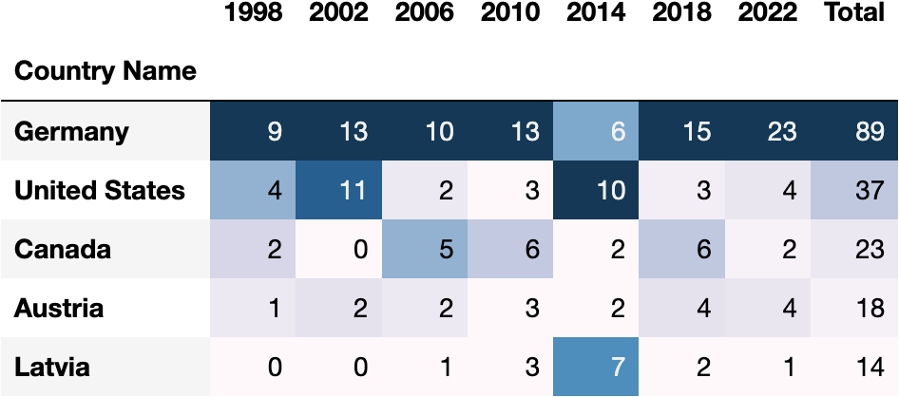
Top Sledding Nations (1998 – 2022)

Slide 11
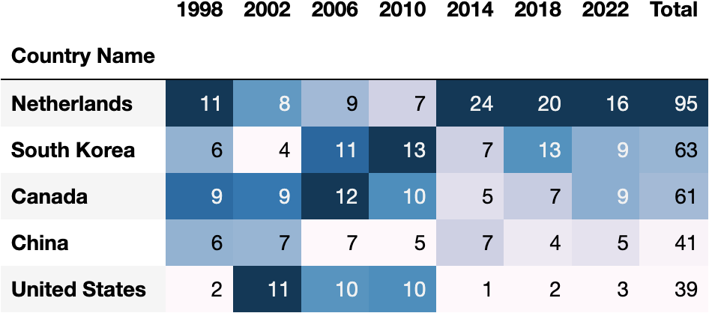
Top Skating Nations (1998 – 2022)

Slide 12
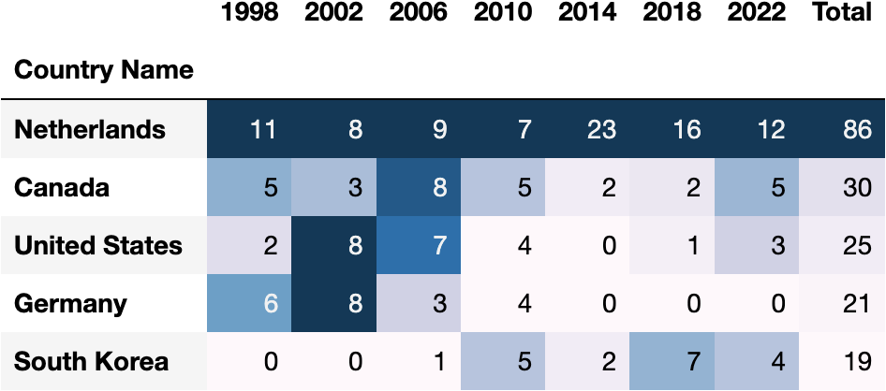
Top Long Track Nations (1998 – 2022)

Slide 13
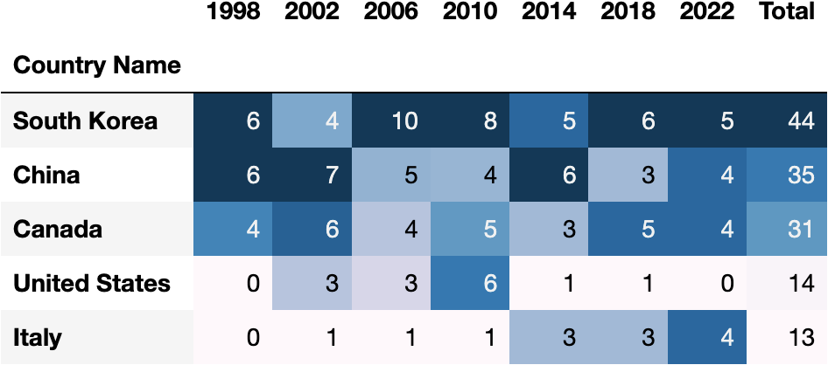
Top Short Track Nations (1998 – 2022)

Slide 14
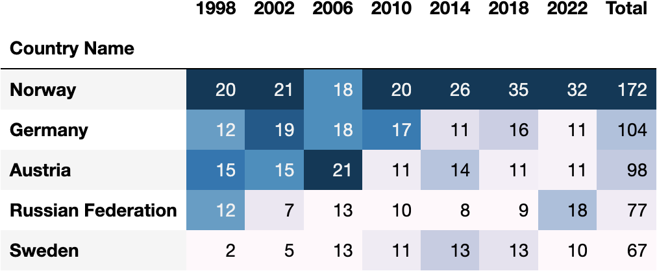
Top Skiing Nations (1998 – 2022)

Slide 15
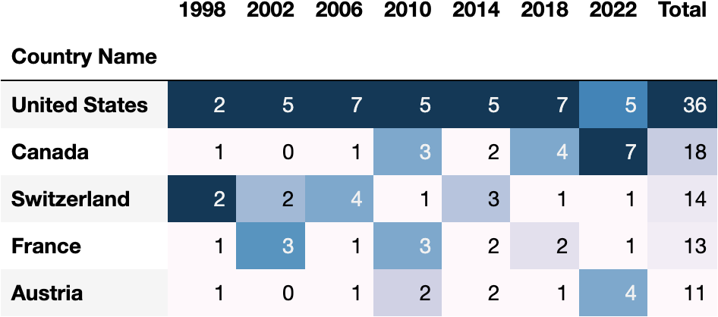
Top Snowboarding Nations (1998 – 2022)

Slide 16
Conclusions
Sledding shall remain overwhelmingly Germain dominated with some North American and other European competition.
Skiing shall remain overwhelmingly European dominated.
Snowboarding shall remain primarily North American dominated.
Asian countries and beyond are untapped potential for short track speed skating and possibly long track.

Slide 17
Resources
Historic Olympic Medal Count (1896 - 2022) [Kaggle]
https://www.kaggle.com/datasets/piterfm/olympic-games-medals-19862018/
Population, Total [World Bank]
https://data.worldbank.org/indicator/SP.POP.TOTL
GDP, Current US$ [World Bank]
https://data.worldbank.org/indicator/NY.GDP.MKTP.CD

