Slide 1
AI and climate change
A meta-study on research & application domains to survey the impact of AI, Machine Learning, and Deep Learning

Slide 2
Structure
Scopus Crawl
Keywords
Dataset
Topic Modeling
Clusters/topics
Most frequent words
Representative Documents
Hierarchical Clustering
Clustering Analysis
Homogeneity index
Dependency parsing
Outlook & further research

Slide 3
Scopus Crawl
Keywords: ( TITLE-ABS-KEY(“artificial intelligence”) OR TITLE-ABS-KEY(“machine learning”) OR TITLE-ABS-KEY(“deep learning”) )
AND
( TITLE-ABS-KEY(“climate change”) OR TITLE-ABS-KEY(“climate crisis”) OR TITLE-ABS-KEY(“global warming”) OR TITLE-ABS-KEY(“climate action”) OR (TITLE-ABS-KEY(“sustainab*”) AND TITLE-ABS-KEY(“climate”)) )
Limited to Conference Proceedings (“cp”) or Articles (“ar”); english only; no time limit
8.191 records

Slide 4
Topic Modeling
Clusters/topics:
142 micro-topics
‘Auto’ mode reduces to 4
2027 outliers (~30%), down to 0 after outlier reduction (without threshold to assign all records)
Using MaximalMarginalRelevance(diversity=0.3) as representation model > more diverse keywords representing the topic
‘Manual’ classification reduces to 11 macro-topics

Slide 5
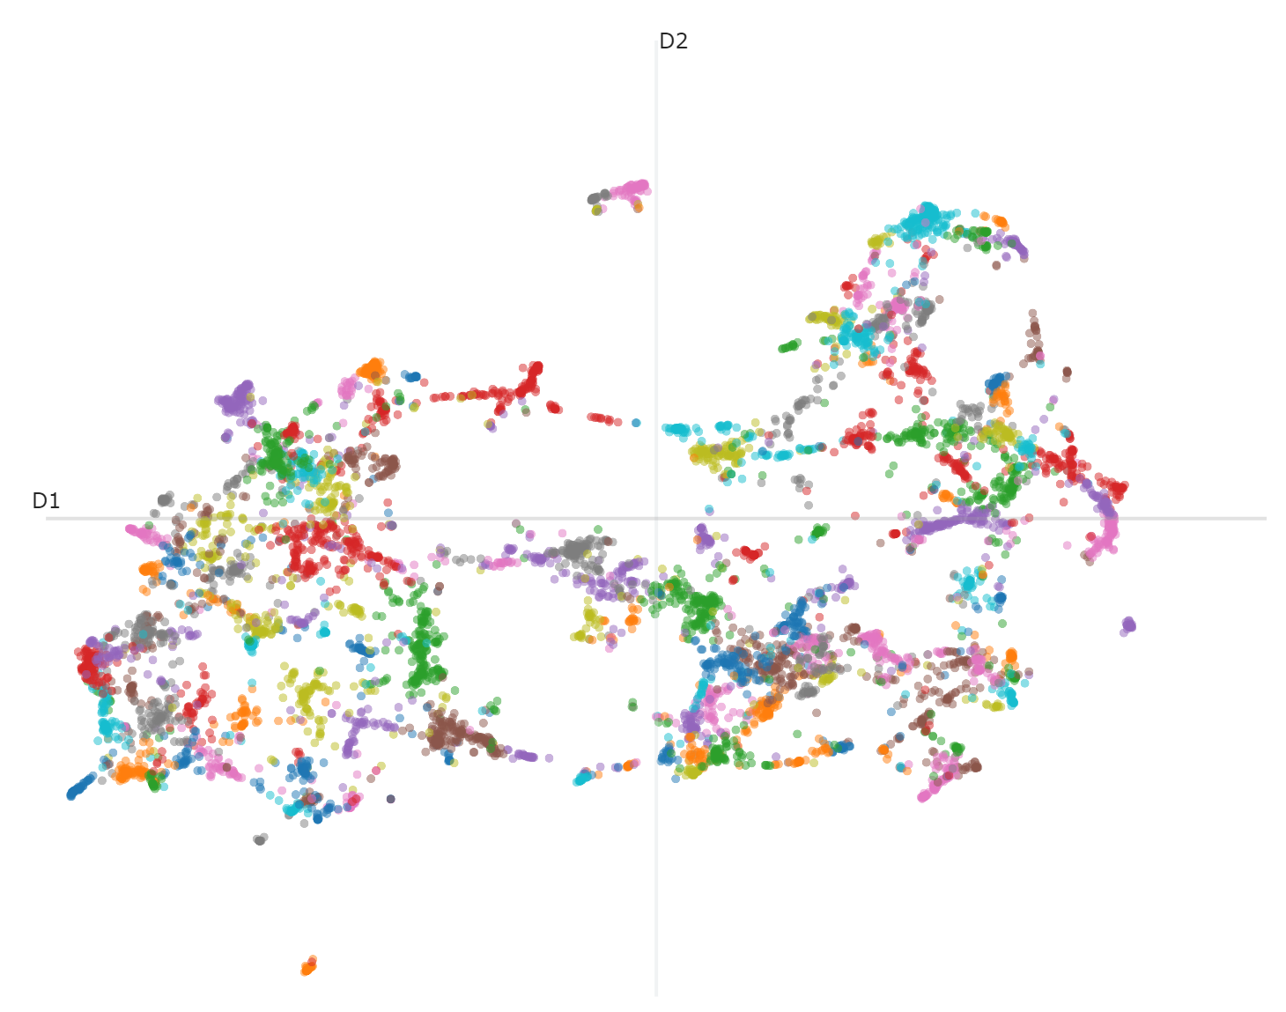

Slide 6
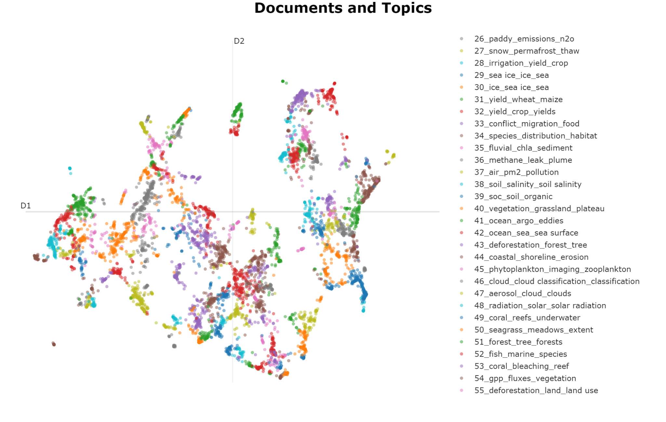
Manual topic classification
ENERGY
Wind power
Power forecasting
Cleaner production
Scheduling problem
Power grid
Outage
Renewable power
Hydrogen production
Power plant
Electrification
Energy storage
Battery state
Smart charging
Photovoltaic
Energy management
Solar cell
Building

Slide 7
Manual topic classification
EMISSIONS
Carbon emissions
Co2
Energy consumption
GHG emissions
Carbon price
Waste recycling
Ships
Electricity
Smart Grid

Slide 8
Manual topic classification
AI
Artificial Intelligence
Digitalization
Society
Sustainability
Future
Research
EMISSIONS
Carbon emissions
Co2
Energy consumption
GHG emissions
Carbon price
Waste recycling
Ships
Electricity
Smart Grid

Slide 9
Manual topic classification
MEDIA/RESEARCH/EDUCATION
Sentiment
Topic modeling
Social media
Twitter
Text analysis
Bibliometric
Natural language processing
Discourse
Mitigation adaptation
Disaster management
Climate change

Slide 10
Manual topic classification
DISEASE/HEALTH
Covid 19
Dengue
Mosquito
Diabetes
Heat stress
Air pollution
MEDIA/RESEARCH/EDUCATION
Sentiment
Topic modeling
Social media
Twitter
Text analysis
Bibliometric
Natural language processing
Discourse
Mitigation adaptation
Disaster management
Climate change
CONFLICT
Migration
Food security
Farming

Slide 11
Manual topic classification
WILDFIRES
Burned areas
Forests
Forest fires
Vegetation
Topography
Risk
Smoke detection

Slide 12
Manual topic classification
AGRICULTURE/YIELD
Plant disease
Plant phenology
Detection
Smart farming
Crop
Irrigation
IoT
Adaption
Production
Maize/Wheat/Grains/Barley
Soil
Prediction
Genomics
Drought tolerance
Irrigation

Slide 13
Manual topic classification
FORESTS/VEGETATION
Deforestation/Reforestation
Soil
Organic
Salinity
Ecosystem
Mangrove
GHG
Species
Habitat
Biodiversity/Wildlife
Grasslands
Desertification
Remote Sensing
Tree growth
Forest management
Carbon fluxes
Land cover/Land use
Biomass

Slide 14
Manual topic classification
OCEAN
Water
Temperature
Sea surface
Sea level
Ice/Ice sheet
Glacial lakes
Satellite/Remote Sensing
Snow
Permafrost
Sediment
Arctic/Antarctic
Forecasting
Coastal protection
Shorelines
Phytoplankton
Algae
Carbon sequestration
Coral reefs
Seagrass
Fish/Marine species
Fishery
Extinction risk

Slide 15
Manual topic classification
AIR/WEATHER/WATER
Cloud
Aerosol
Ozone
Radiation
Meteorological
Evapotranspiration
Water
Freshwater
Moisture
Groundwater
Hydrological
Forecasting
Temperature
Downscaling
Precipitation
Drought
Rainfall
Climate
Weather
Flooding
Climate Change
Extreme events

Slide 16
Manual topic classification
RISK MANAGEMENT
Flood detection
Flood warning
Landslides
Earthquake
Natural disasters
Emergency management
Infrastructure
Earth observation
Stakeholder
Decision support
Change adaption
Resources management
Water management

Slide 17
Manual topic classification
MATERIALS/SUBSTANCES
Concrete
Natural gas
Gasification
Methane
Emissions
PM2
Air quality
Air pollution
Traffic
CO2
Engine
Diesel
Bioenergy
Synthesis
Catalyst
Shale
CO2 capture
Permeability

Slide 18
Manual topic classification
URBAN
Heat
Local climate
Thermal comfort
Planning
Global warming Land cover

Slide 19
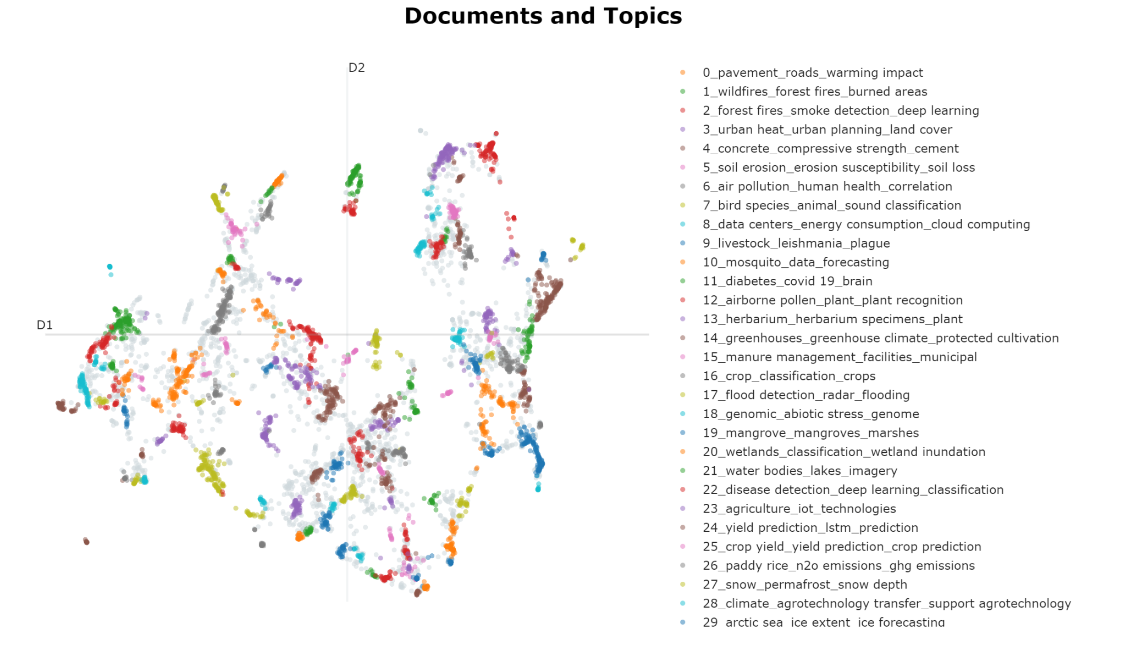
Clustering Analysis
Most homogeneous clusters (overall HDBScan index = 0.38)

Slide 20
Clustering Analysis
Topic 8, 0.99, 15 papers*, ['data centers', 'energy consumption', 'cloud computing', 'mapreduce', 'virtual machines', 'resource utilization', 'computational energy', 'clusters', 'energy cooling', 'based optimization']
*without outlier reduction

Slide 21
Clustering Analysis
Topic 4, 0.96, 23 papers, ['concrete', 'compressive strength', 'cement', 'materials', 'mix design', 'silica', 'waste', 'warming potential', 'construction', 'aggregate']

Slide 22
Clustering Analysis
Topic 26, 0.94, 13 papers, ['paddy rice', 'n2o emissions', 'ghg emissions', 'greenhouse gas', 'ch4 emissions', 'greenhouse', 'fertilizer rate', 'tillage', 'emissions different', 'management variables']

Slide 23
Clustering Analysis - to finalise this week
For each cluster (or specific clusters):
Dependency Parsing
Identification of keywords, verbs
Bag of words for selected keywords/terms (impact, mitigate, ai, ml, climate, carbon, energy, emissions)

