Slide 1
Project 3 Game of LIfe
By. Gautam Ravichandran
Jim Chemmalakuzhy

Slide 2
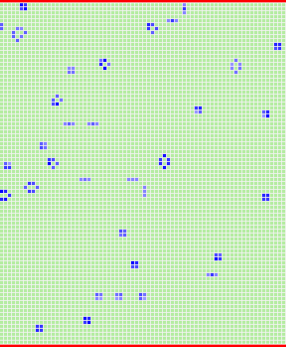
Resizeable matrix
var GOL = {
columns : 0,
rows : 0,
waitTime: 0,
generation : 0,
}

Slide 3

increment
increment : function() {
for(var i = 0; i<23; i++){
if(!GOL.running){
GOL.nextStep();
}}},
step : function() {
if (!GOL.running) {
GOL.nextStep();
} },

Slide 4
reset
Reset : function() {
this.listLife.init(); // Reset/init algorithm
this.prepare();
}

Slide 5
Display count
<div class="box">
<p class="info"><abbr title="Current Generation">Generation</abbr>: <span id="generation"></span> |
<abbr title="Number of live cells">Live cells</abbr>: <span id="livecells"></span> </p>
<span id="hint"></span>
</div>

