Slide 1
Boss Monster
By.
Gautam ravichandran
Zain Qamar
Jim Chemmalakuzhy

Slide 2
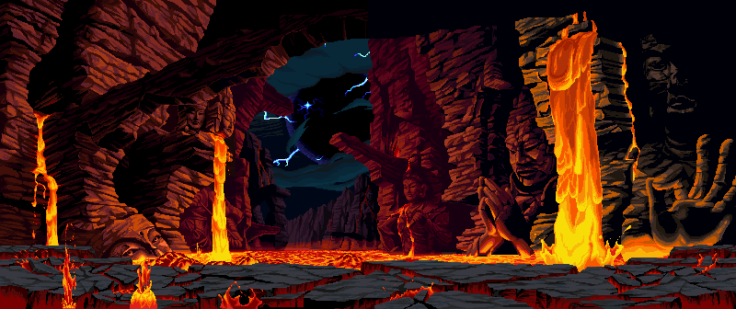
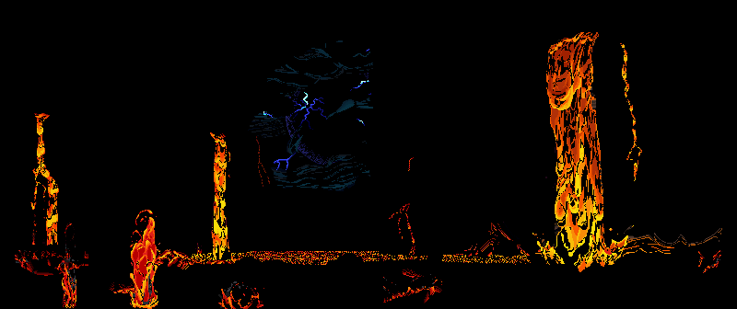
Stage.php
include('Battle.php');
include('Player.php');
include('Boss.php');
if(!isset($_COOKIE["PHPSESSID"])){
session_start();
$_SESSION['player'] = new Player(10,100,10,10);
$_SESSION['boss'] = new Boss(100,10,10);
$_SESSION['battle'] = new Battle($_SESSION['player'],$_SESSION['boss']);
}else{
session_start();
}
<?php
if(isset($_GET['attack'])){
$_SESSION['battle'] -> rollAttack(); } ?>
<form action="Stage.php" method="get">
<button type="submit" name="defend">Defend</button>
</form>
<?php
if(isset($_GET['defend'])){
$_SESSION['battle'] -> rollDefense(); } ?>
<form action="Stage.php" method="get">
<button type="submit" name="heal">Heal</button>
</form>
<?php
if(isset($_GET['heal'])){
$_SESSION['battle'] -> heal(); } ?>

Slide 3
Battle.php
function rollAttack(){
$this->player_attack = $this->player -> attack();
$this->boss_attack = $this->boss -> attack();
if($this->player_attack > $this->boss_attack){
$this -> boss -> decreaseHealth(($this->player_attack)-($this -> boss_attack));
}else{
$this -> player -> decreaseHealth(($this->boss_attack)-($this -> player_attack));
}}
function rollDefense(){
$this->player_attack = $this->player -> defend();
$this->boss_attack = $this->boss -> attack();
if($this->player_attack < $this->boss_attack){
$this -> player -> decreaseHealth(($this->boss_attack)-($this -> player_attack));
}}
function heal(){
if($this->player->getMana() >= 2){
$this->player-> decreaseHealth(-40);
$this->player-> decreaseMana(2);
}}

Slide 4
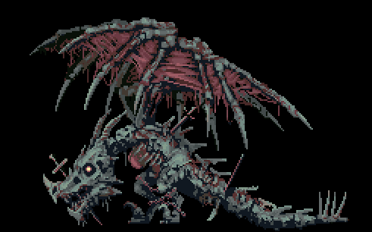
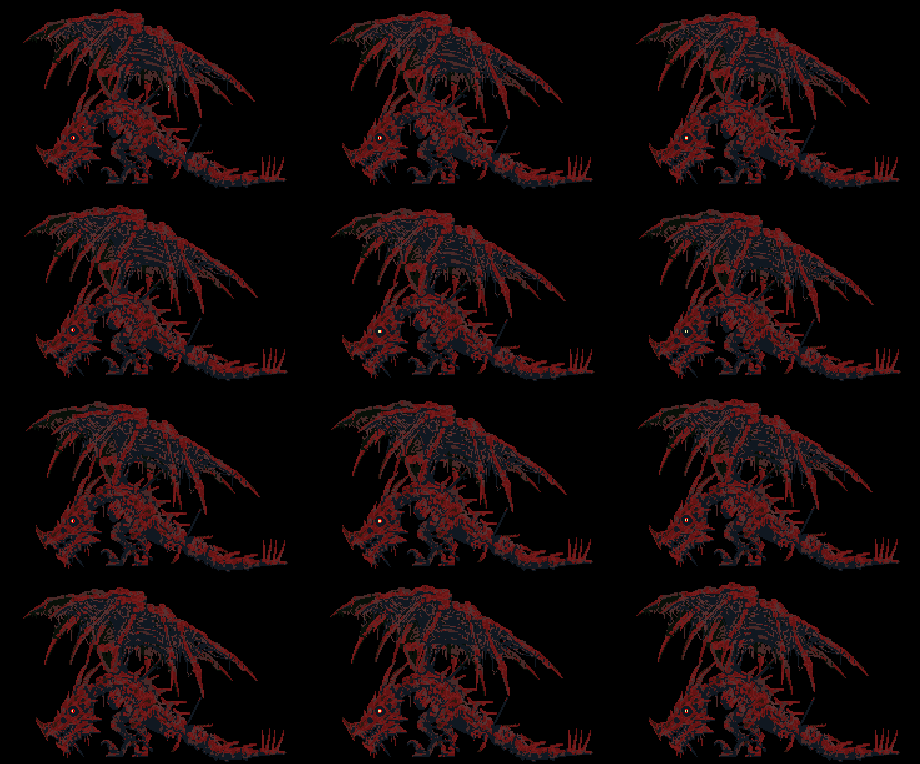
Character.php
class Character{
private $health;
public $atk;
public $def;
function __construct($x,$y,$z){
$this-> health = $x;
$this -> atk = $y;
$this -> def = $z;
}
function attack(){
$total = 0;
for($i=0; $i<$this->atk; $i++){
$total += rand(1,6);
}
return $total;
}
function getHealth(){
return $this-> health;
}
function setHealth($health){
$this->health =$health;
} }

Slide 5
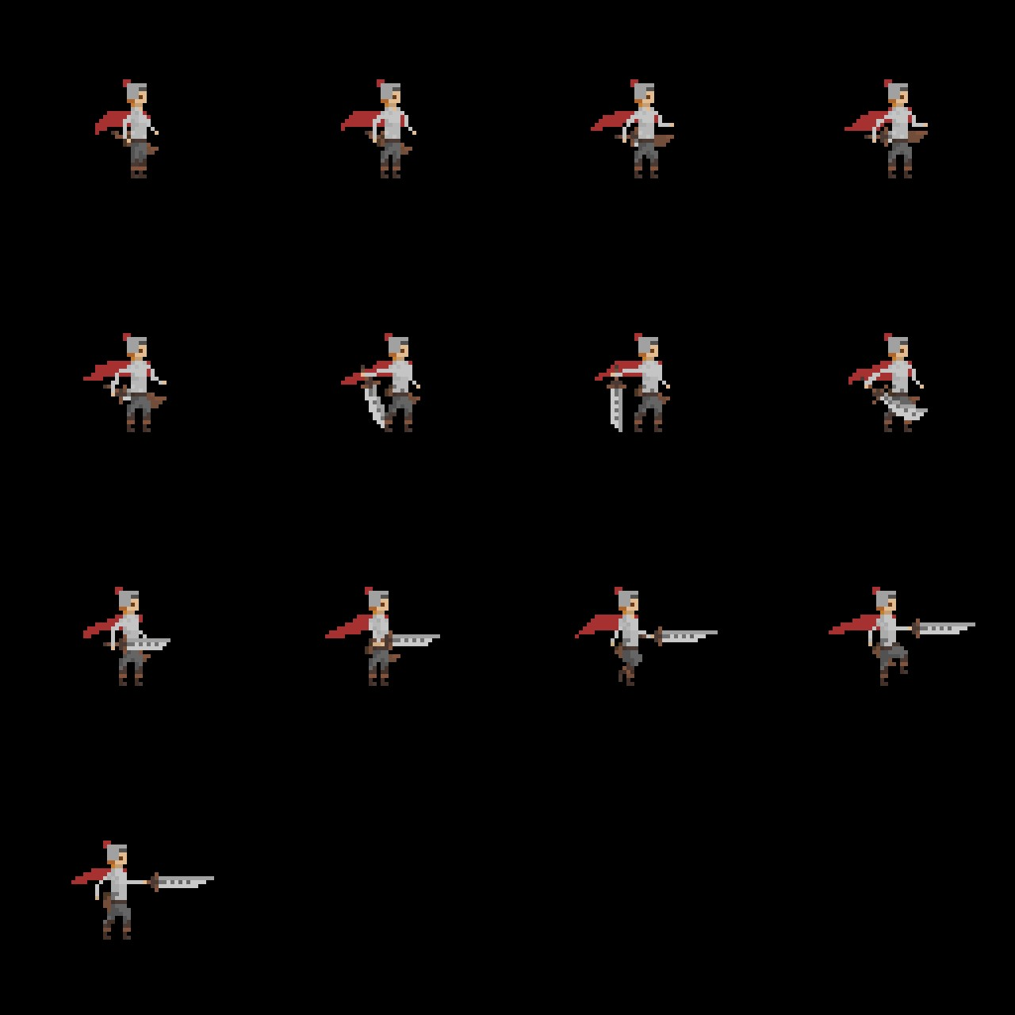
Player.php
class Player extends Character{
private $mana;
function __construct($w, $x, $y, $z){
parent:: __construct($x, $y, $z);
$this -> mana = $w;
}
public function defend(){
$total = 0;
for($i=0; $i<$this->def; $i++){
$total += rand(1,6);
}return $total;
}
public function getMana(){
return $this -> mana;
}
public function setMana($mana){
$this -> mana = $mana;
}
public function decreaseMana($mana){
$this->mana -= $mana;
}}

Slide 6
Stage_style.css
.arena {
width: 100%;
height: 80%;
display: inline-block;
overflow: none;
}
.player {
height: 100%;
width: 35%;
float: left;
margin-left: 50px;
margin-top: 19%;
margin-bottom: -10%;
padding: 0px;
overflow: none;
}
.player img {
width: 200px;
margin-top: 20%;
margin-left: 62%;
}
.boss {
height: 100%;
width: 60%;
float: right;
}
.boss img {
width: 100%;
}

Slide 7
Thank YOu

