Slide 1
CIS-546 Final Project
Jiusheng Chen
04/30/2018

Slide 2
Introduction
https://github.com/reisanar/datasets/blob/master/AllCountries.csv

Slide 3
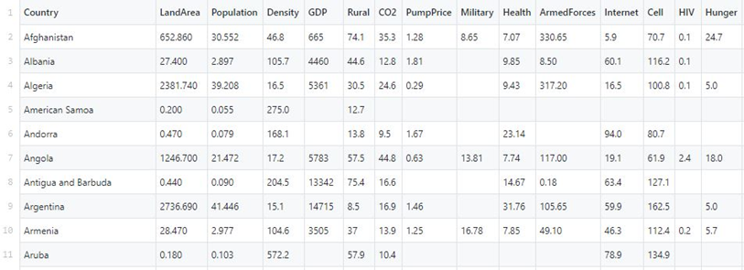

Slide 4
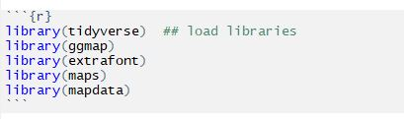

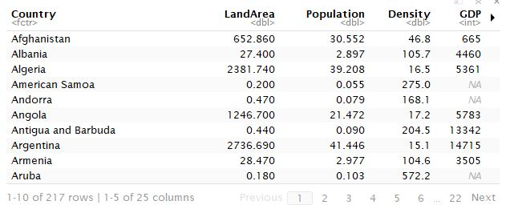

Slide 5

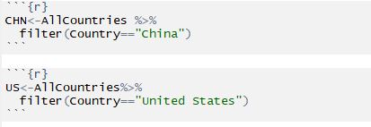

Slide 6
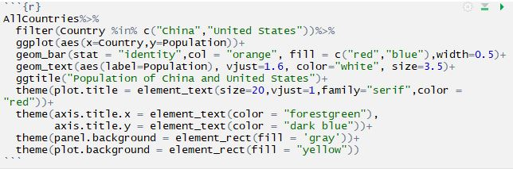

Slide 7
Font in R
R family | Font on Windows
sans | Arial
serif | Times New Roman

Slide 8
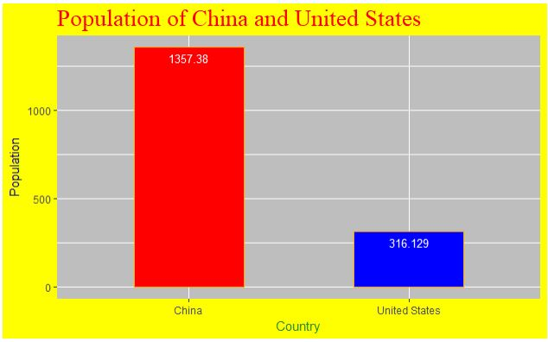

Slide 9
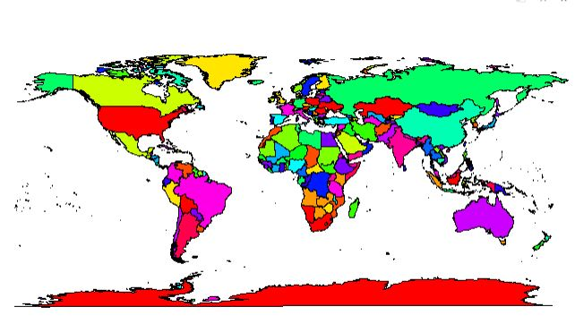

Slide 10
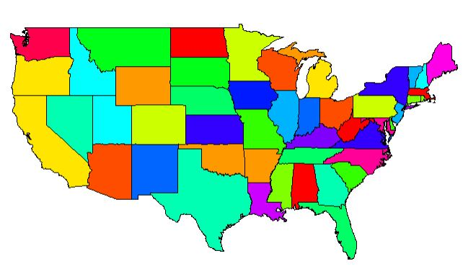

Slide 11
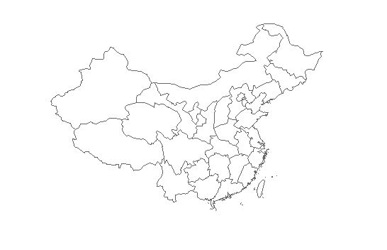

Slide 12
References
Zhang, Z. (2015, October 16). R map part 1 -- introduction. Retrieved from http://imzhen.com/note/2015/09/14/20150914/
Contributors, D. C. (n.d.). Retrieved from http://www.datacarpentry.org/dc_zurich/R-ecology/05-visualisation-ggplot2.html#plotting-with-ggplot2
Ggplot2 barplots : Quick start guide - R software and data visualization. (n.d.). Retrieved from http://www.sthda.com/english/wiki/ggplot2-barplots-quick-start-guide-r-software-and-data-visualization

