Slide 1
Distinctive Image Features from Scale-Invariant Keypoints
David Lowe
University of British Columbia

Slide 2
Introduction
Invariant to image scaling and rotation
Partially invariant to change in illumination and 3D camera viewpoint
Highly distinctive features

Slide 3
Image feature Generation
Scale-space extrema detection
Keypoint localization
Orientation assignment
Keypoint descriptor

Slide 4
Detection of Scale Space Extrema
Search for stable features across all possible scales
Only possible scale-space kernel is the Gaussian function (Koenderink 1984, Lindeburg 1994)
S
Difference of Gaussian function to efficiently detect stable keypoint locations

Slide 5
Detection of Scale Space Extrema (cont’d)
Each octave contains images convolved with Gaussians at different standard deviations
Each scale is the down sampled image by 2 convolved with the same Gaussians

Slide 6
Local Extrema Detection
Each sample point is compared to its 26 neighbors
The extremas are selected

Slide 7
Frequency of sampling in scale

Slide 8
Frequency of sampling in spatial domain
There is a prior smoothing applied to each image level
Pre-smooth image discards highest spatial frequencies
Double size of input image using linear interpolation
Assume original image has blue of σ=0.5
Doubled image has σ=1.0

Slide 9
Accurate keypoint localization
Scale-space function:
D and derivatives are evaluated at keypoints
D(x) is useful for rejecting unstable extrema with low contrast
If D(x) is below some threshold, then that keypoint is rejected

Slide 10
Eliminating Edge Responses
DoG function have strong response along edges
Principal curvatures are computed with Hessian Matrix:
Derivatives are estimated by taking differences of neighboring sample points
Eigenvalues of H are proportional to principal curvatures
Principal curvatures are proportional to eigenvalue ratios

Slide 11
Stages of keypoint selection
Original image
Initial DoG features with scale, orientation, and location
Threshold of minimum contrast
Threshold of principal curvatures

Slide 12
Orientation Assignment
Keypoint descriptor with orientation to achieve image rotation
Scale of keypoint used to select Gaussian smoothed image, L
In L, we perform:
Magnitude and theta as image gradients
Gaussian weighted window

Slide 13
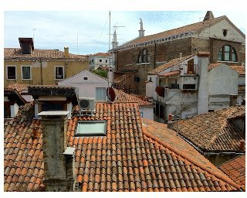
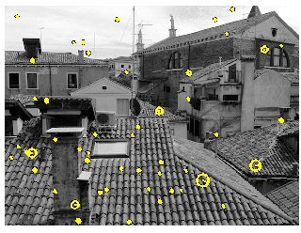
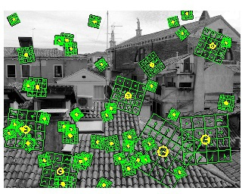
Example
Input image
SIFT descriptors
Gradients overlayed

Slide 14
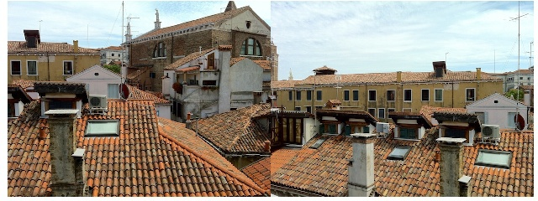
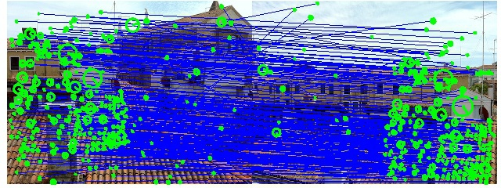
SIFT in action
Uses nearest neighbor approach
To find the matching descriptor

