Slide 1
Portable Testing Chamber
Mueller Lab
CAD models by Jason Chen

Slide 2
Introduction
There is a need for accessible and affordable laparoscope and camera characterization modalities
Our solution aims to be:
Compatible option for a variety of laparoscopes and imaging test targets
Made from accessible components that can be sourced globally
Low-cost compared to commercial alternatives
Easy to assemble, disassemble, and repair
Fabricable with minimal tools
Free of permanent fixtures (e.g., no superglue)
Printable on a regular-sized 3D printer (220mm × 220mm footprint)

Slide 3
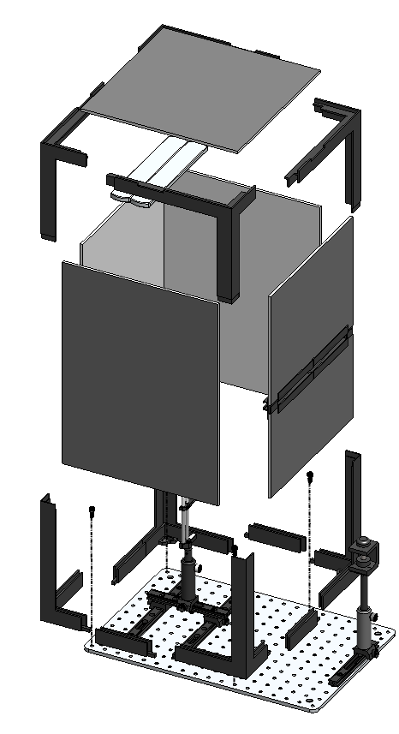
Portable Testing Chamber Model
Foam boards
Magnetic LED light bars for flexible positioning
Easy-to-print 3D-printed frame
Slide target holder
Brush-lined slit
Adjustable laparoscope clamp
Rail carriers
Adjustable post
Dovetail rails
Two types of bolts used

Slide 4
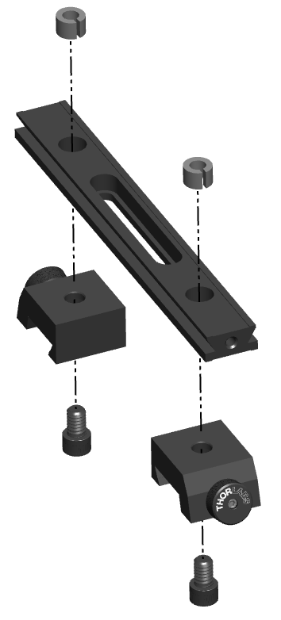
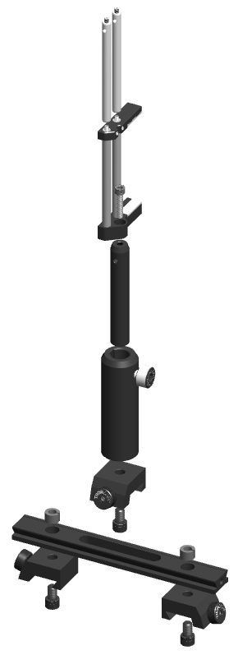
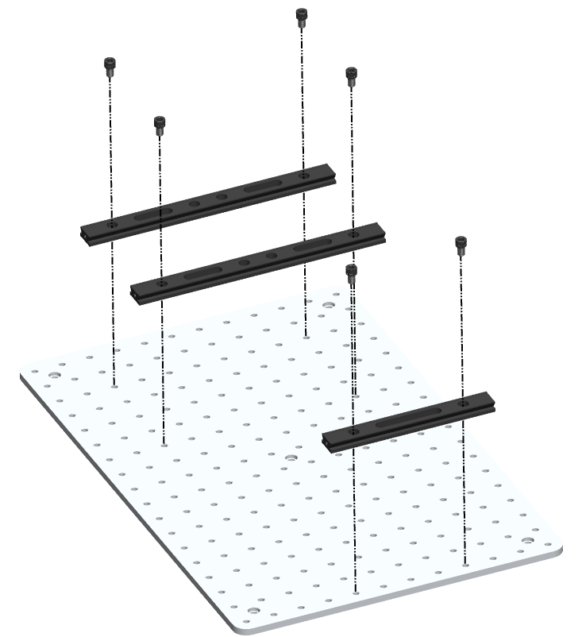
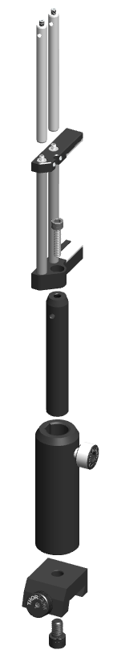
Model Close-ups

Slide 5
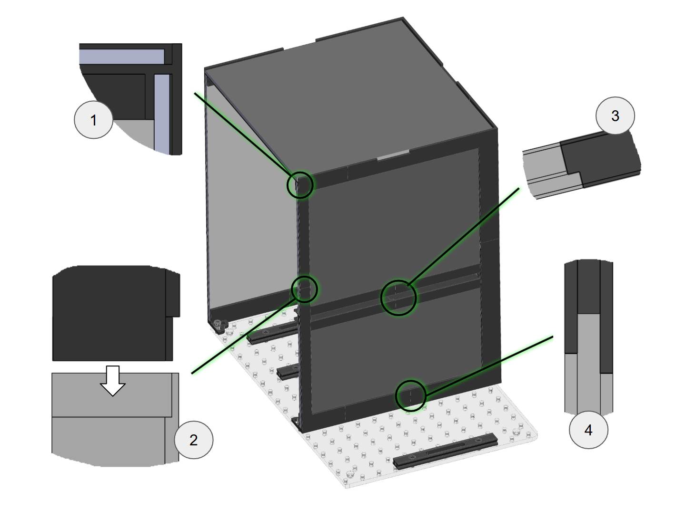
Overlapping Joints
Overlapping joints create friction-fit connections and reduce external light leakage.
Boards with black outer surfaces and white inner surfaces optimize the lighting environment.

Slide 6
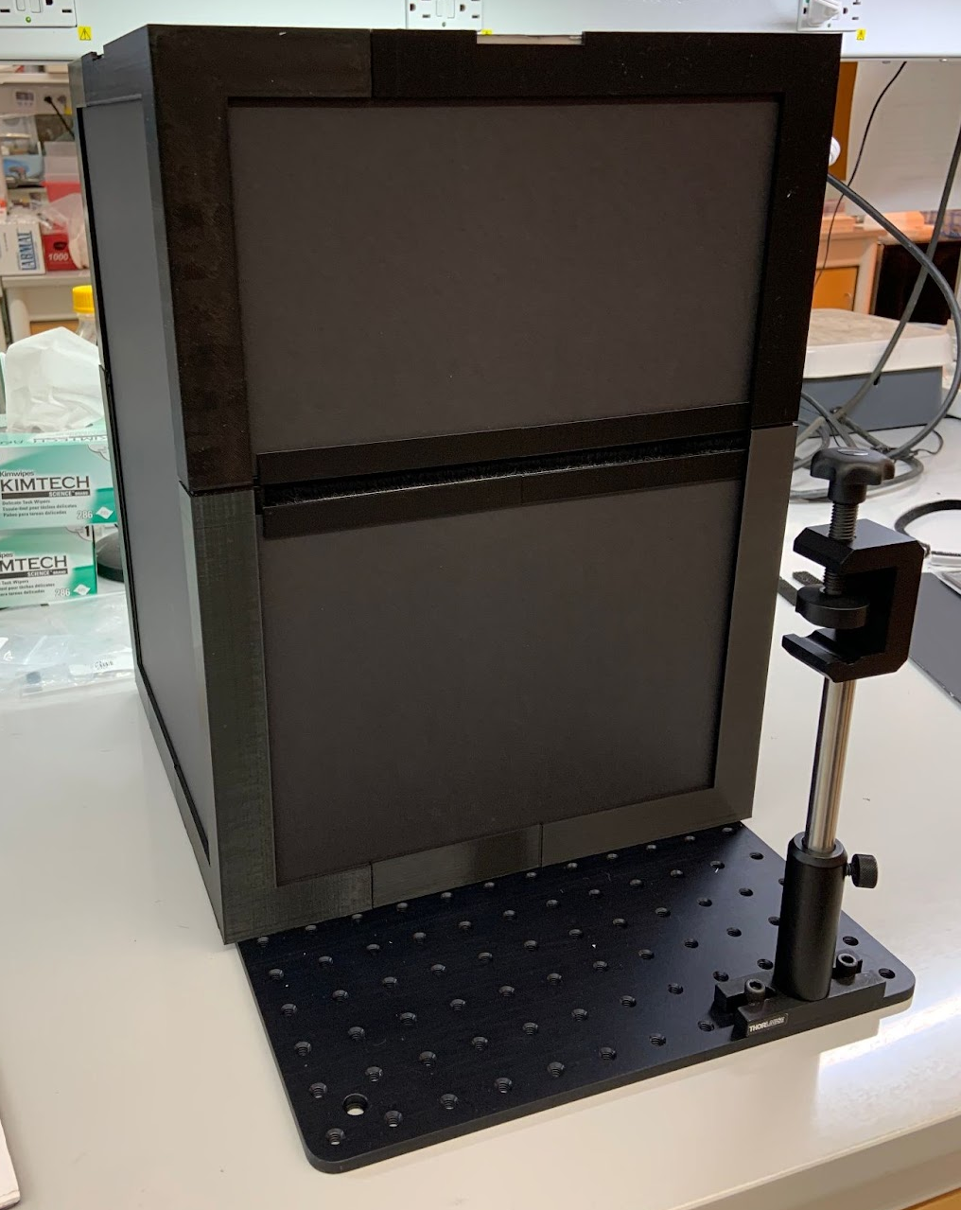
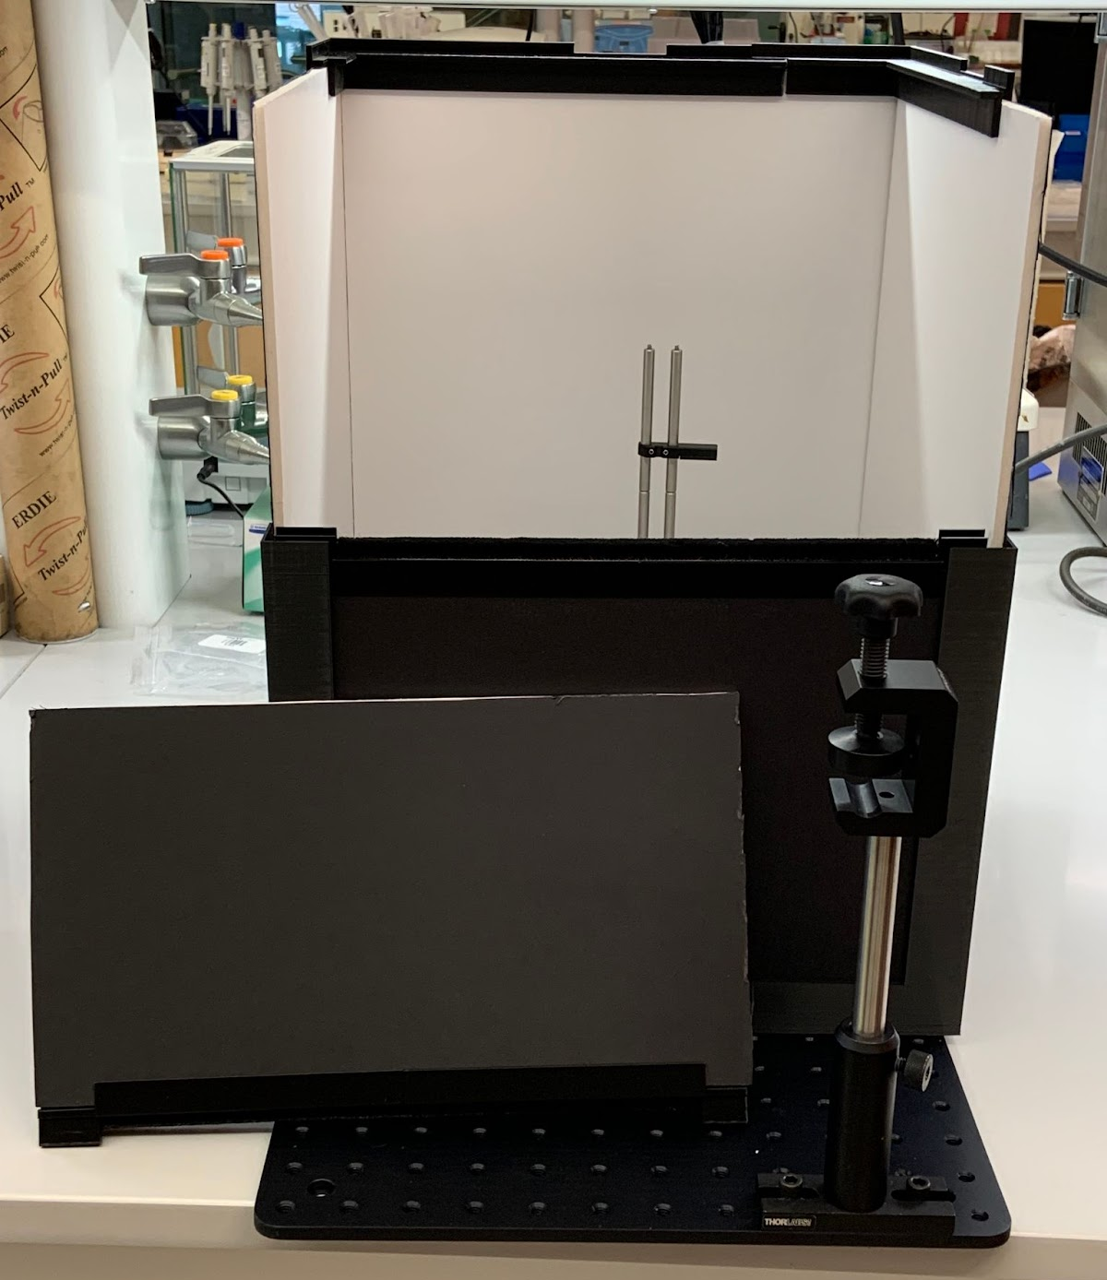
Final Portable Testing Chamber Prototype
Brush opening obstructs light
Fixed to reduce material and lower costs

Slide 7
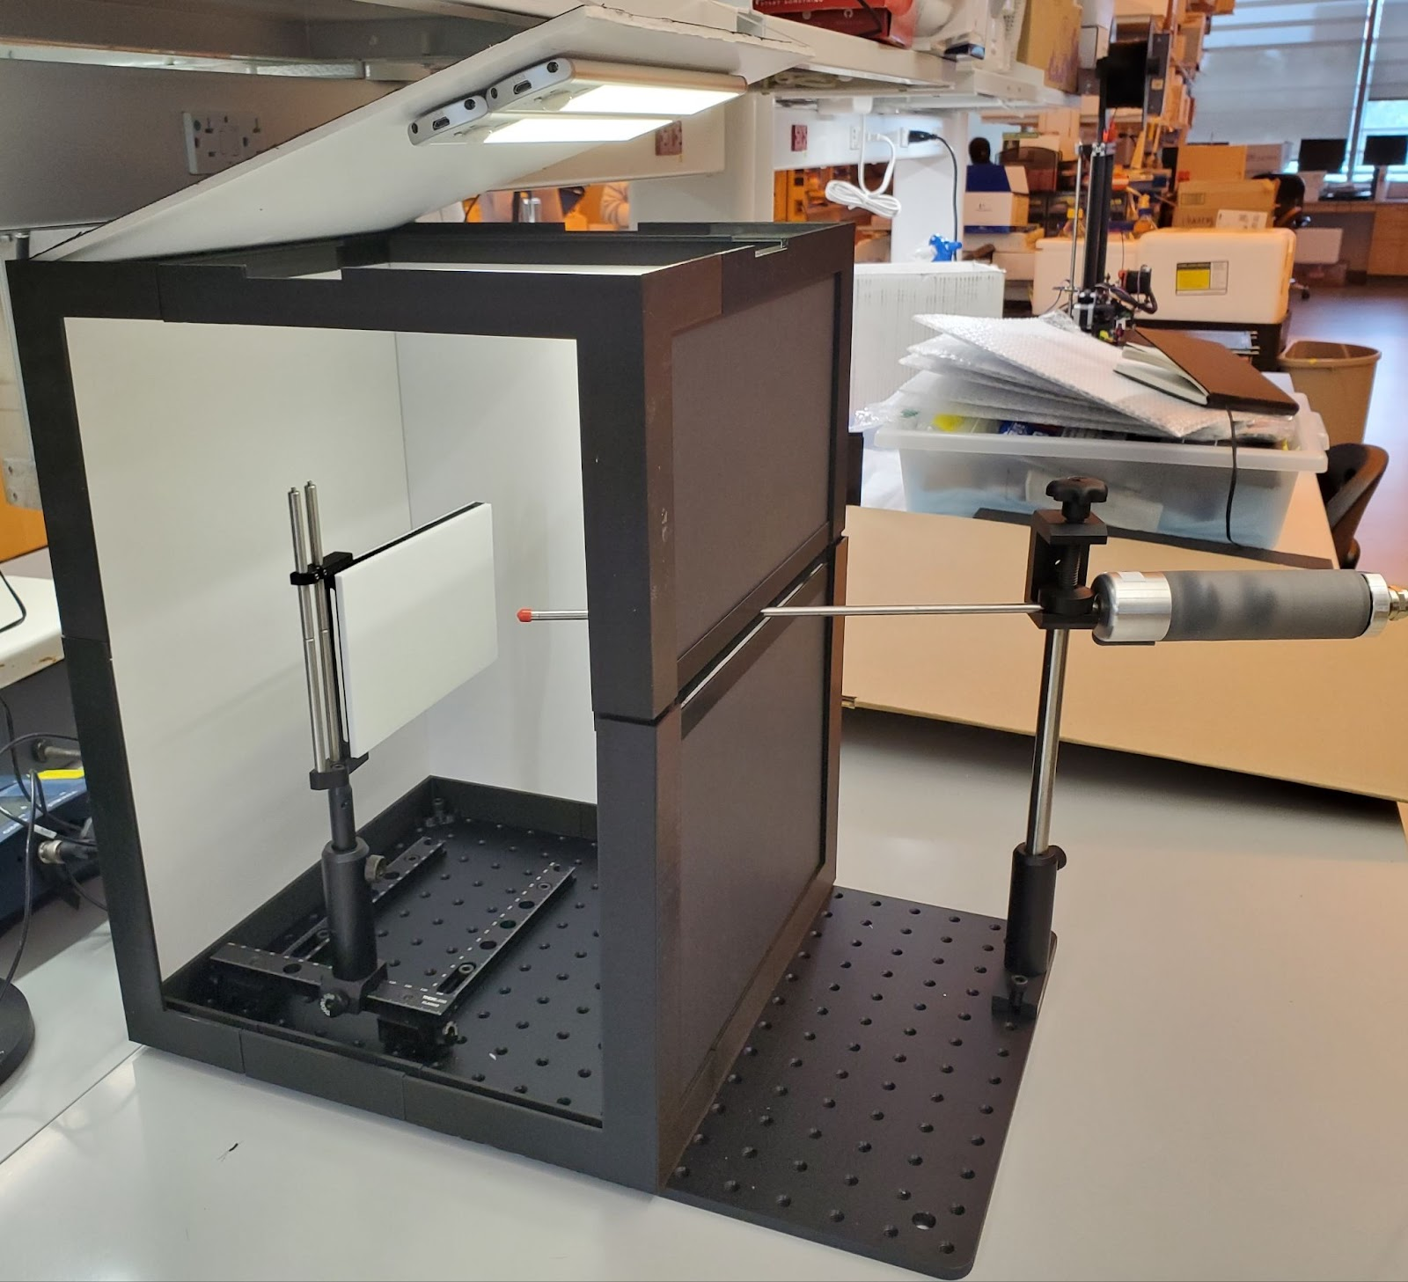
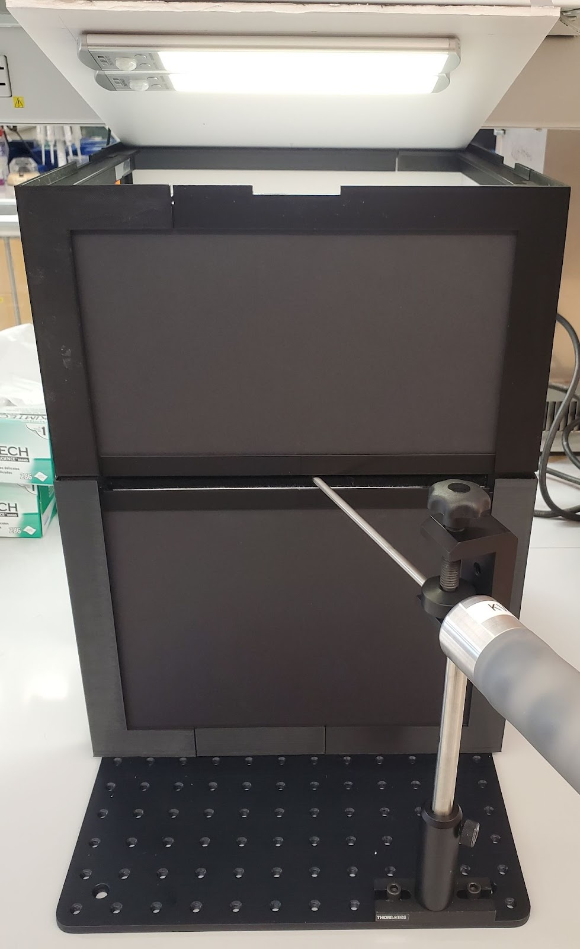
Bench-testing Demonstration
Image test targets can be affixed here

