Slide 1
Bobblestat Biosensor
Robert E. Fischell Institute for Biomedical Devices
Potentiostat PCB by John Rzasa, PhD.
CAD models by Quinn Burke and Jason Chen

Slide 2
Introduction
Design an effective electrode using different plating methodologies.
Iteratively bench-test to optimize the fabrication process.
Integrate the electrode into a device that is:
Modular
Water-resistant
Buoyant with adjustable depth
Designed to prevent trapping major internal air bubbles
Optimized for antenna orientation

Slide 3
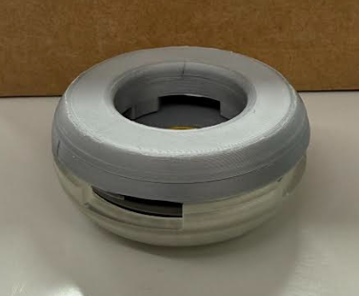
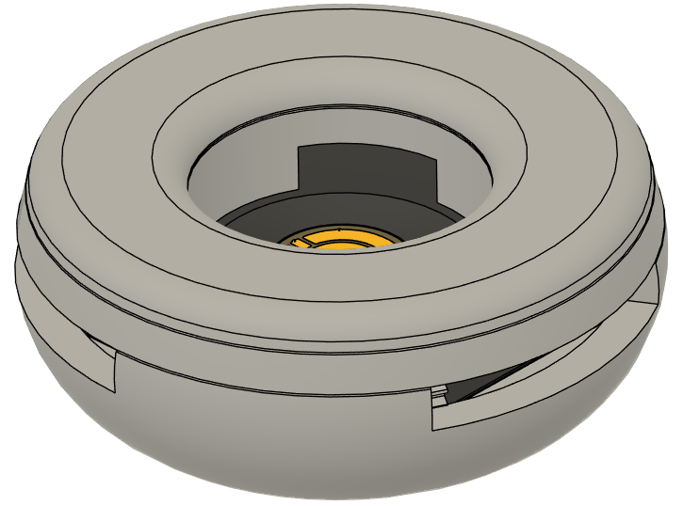
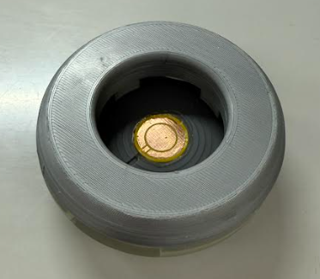
Bobblestat Prototype
NOTE: the CAD model is an updated version of the prototype. Material selection is not final.

Slide 4
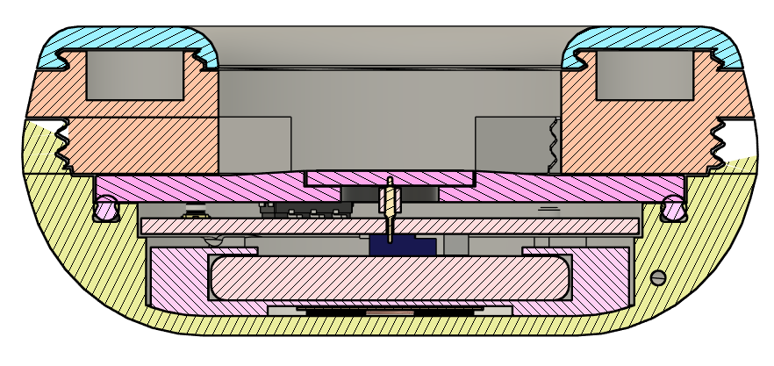
Bobblestat Cross-section Diagram
Slots for Weights
PCB-based Electrode
POGO Pin
Threaded Lids
O-ring
Air Bubble Escape
Dovetail O-ring Groove
Antenna Path
Battery Scaffold
Potentiostat PCB
Charging Coil

Slide 5
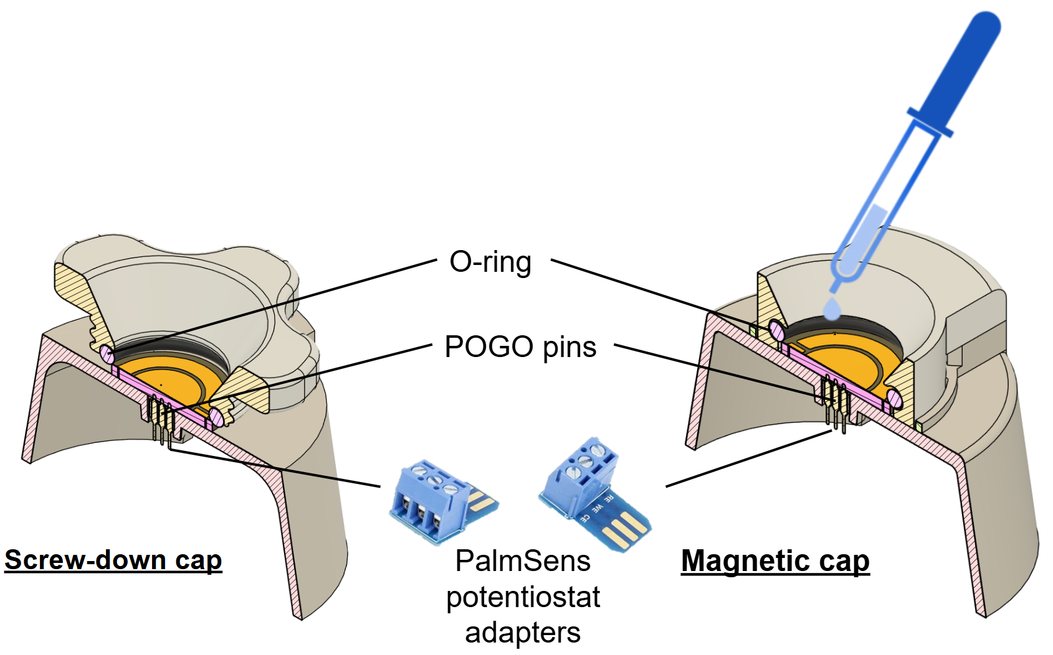
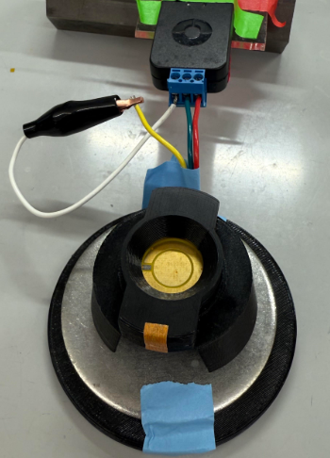
Test Rig
Designed testing rigs that snugly contain electrode for preliminary bench-testing prior to device integration.
Used light-curing resin and soldering to fix and connect the POGO pins.

Slide 6
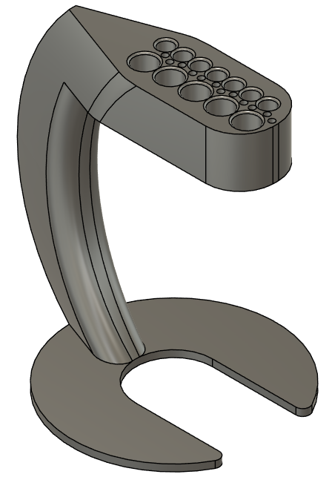
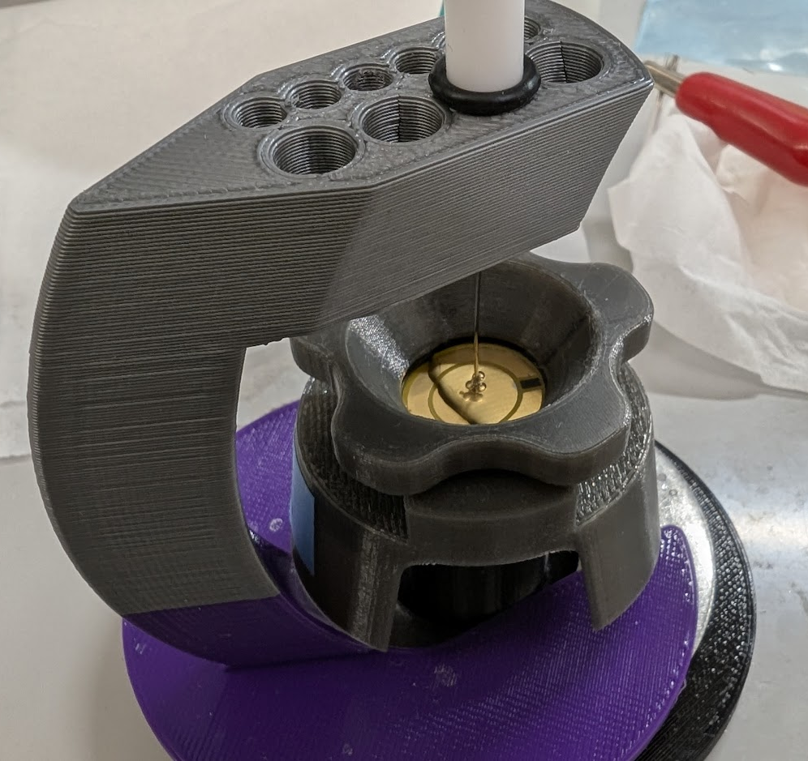
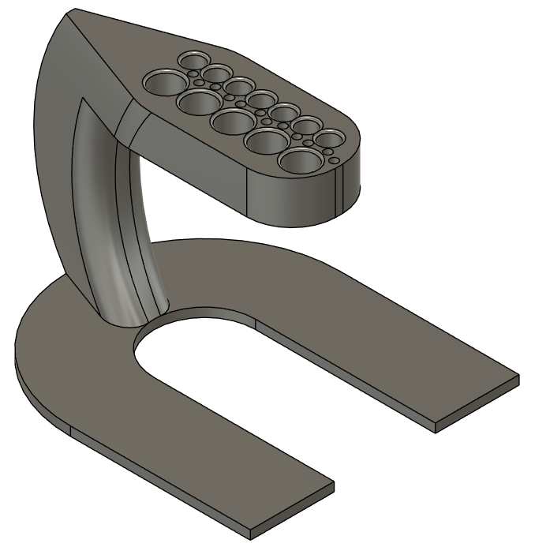
Electrode Holders
Designed to be compatible with both the custom testing rigs and commercial electrodes.
For Reference Electrodes
For Working/Counter Electrodes

Slide 7
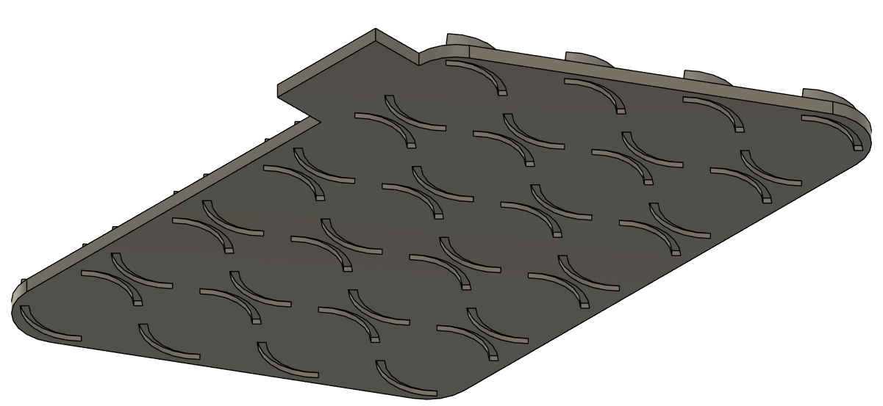
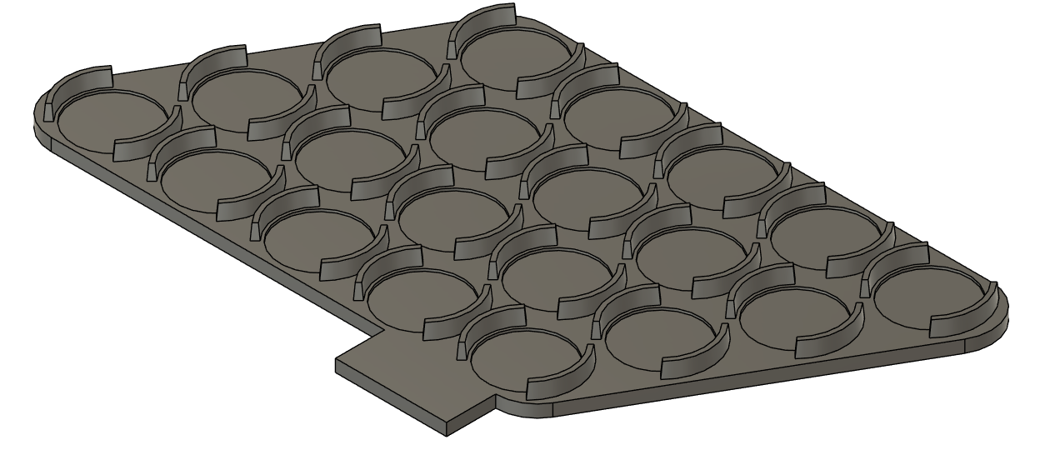
Electrode Container Plate
Stackable design protects the electrode from surface damage.
Can be labeled using staggered tabs.

