Slide 1
Auto-injector
Robert E. Fischell Institute for Biomedical Devices
Mueller Lab
CAD models by David Garvey and Jason Chen

Slide 2
Introduction
The Auto-injector is a device that:
Delivers three simultaneous deposits of ethyl cellulose ethanol (ECE)—a therapeutic developed by the Mueller Lab
Relies solely on pressurized air and spring mechanisms
Expels viscous ECE solution in a timely manner
Retracts its needles to prevent injury
The device must also be:
Easy to use and repair
Compatible with a speculum
Reusable and low-cost

Slide 3
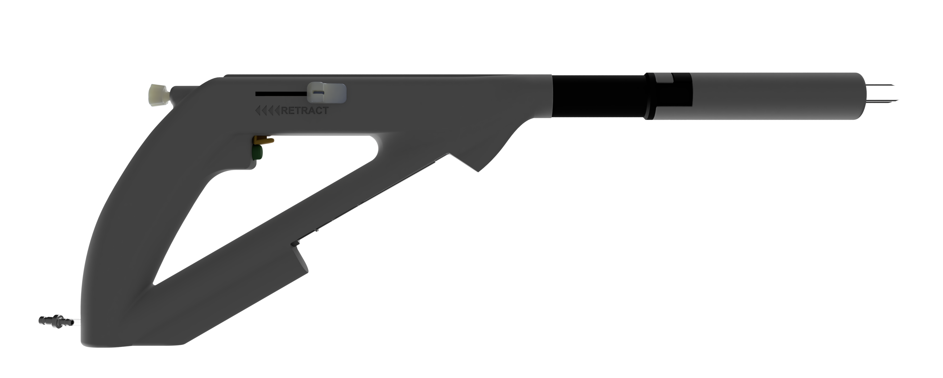
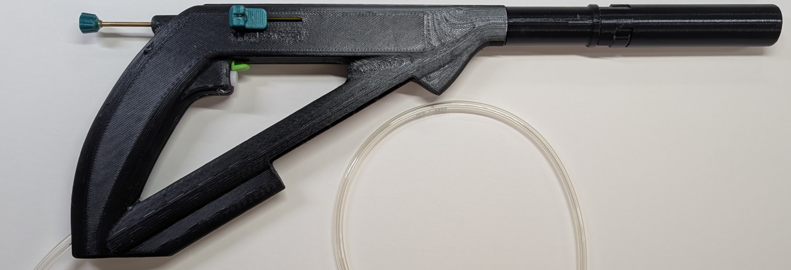
Auto-injector Prototype

Slide 4
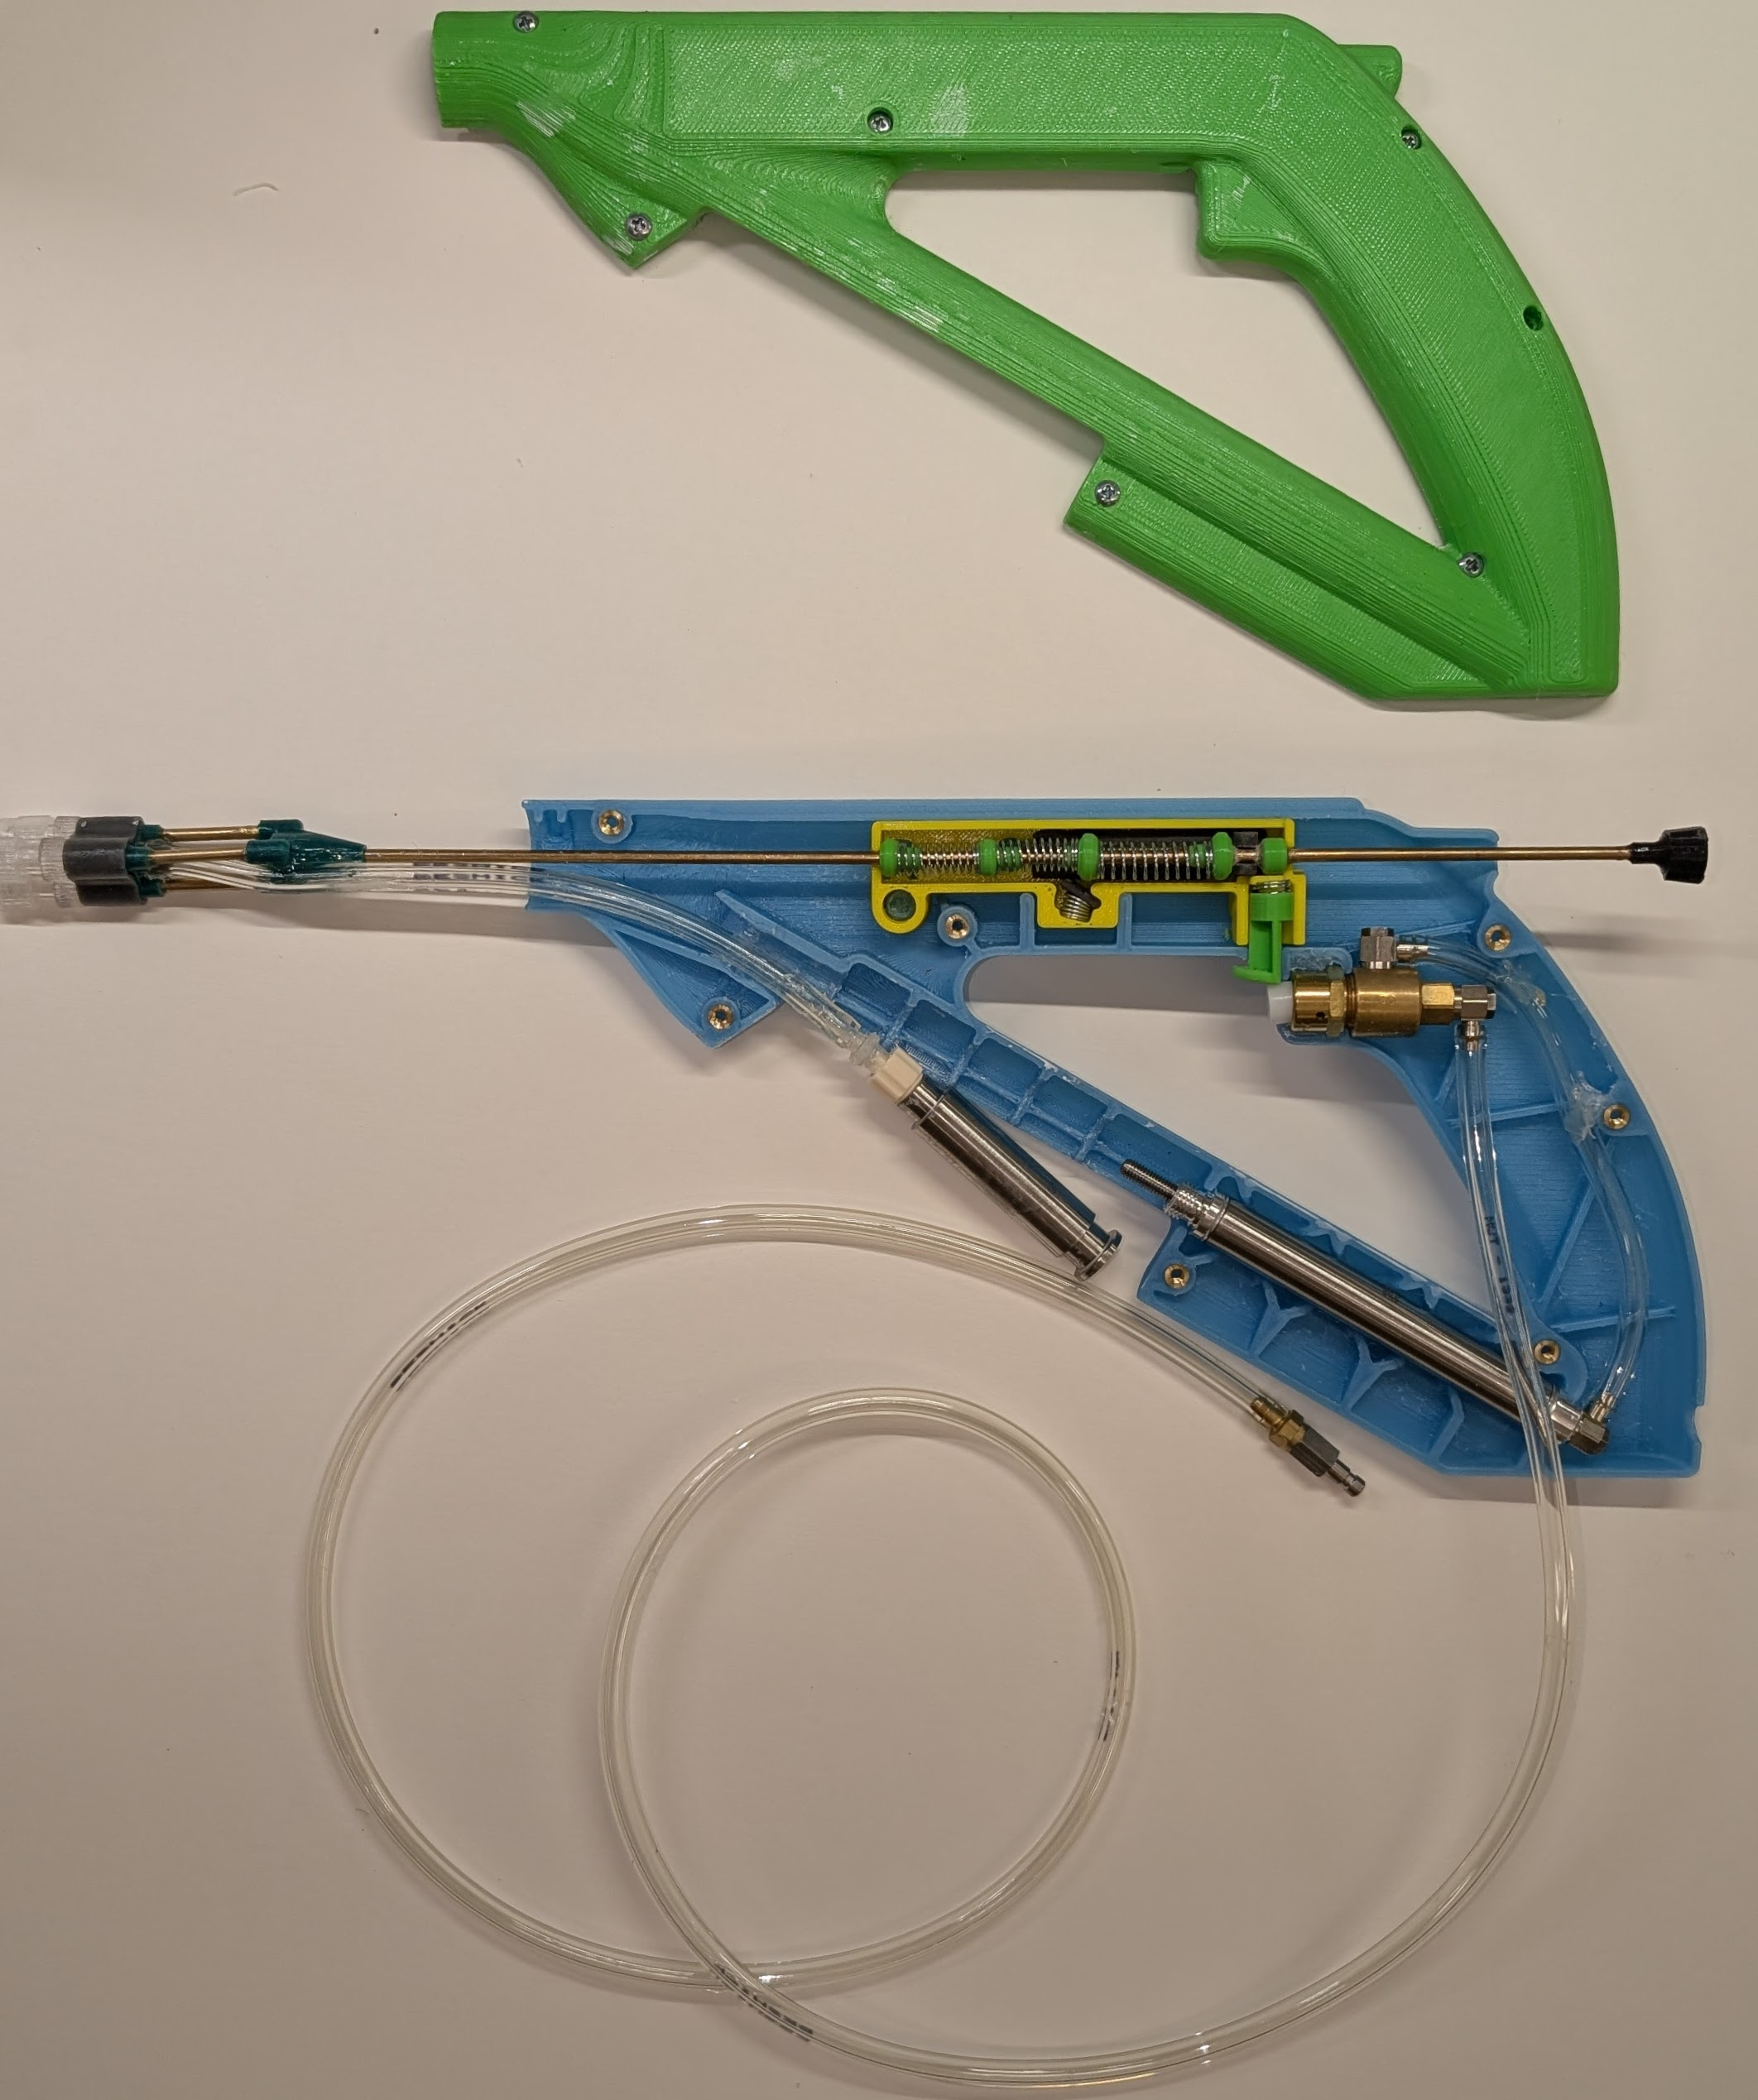
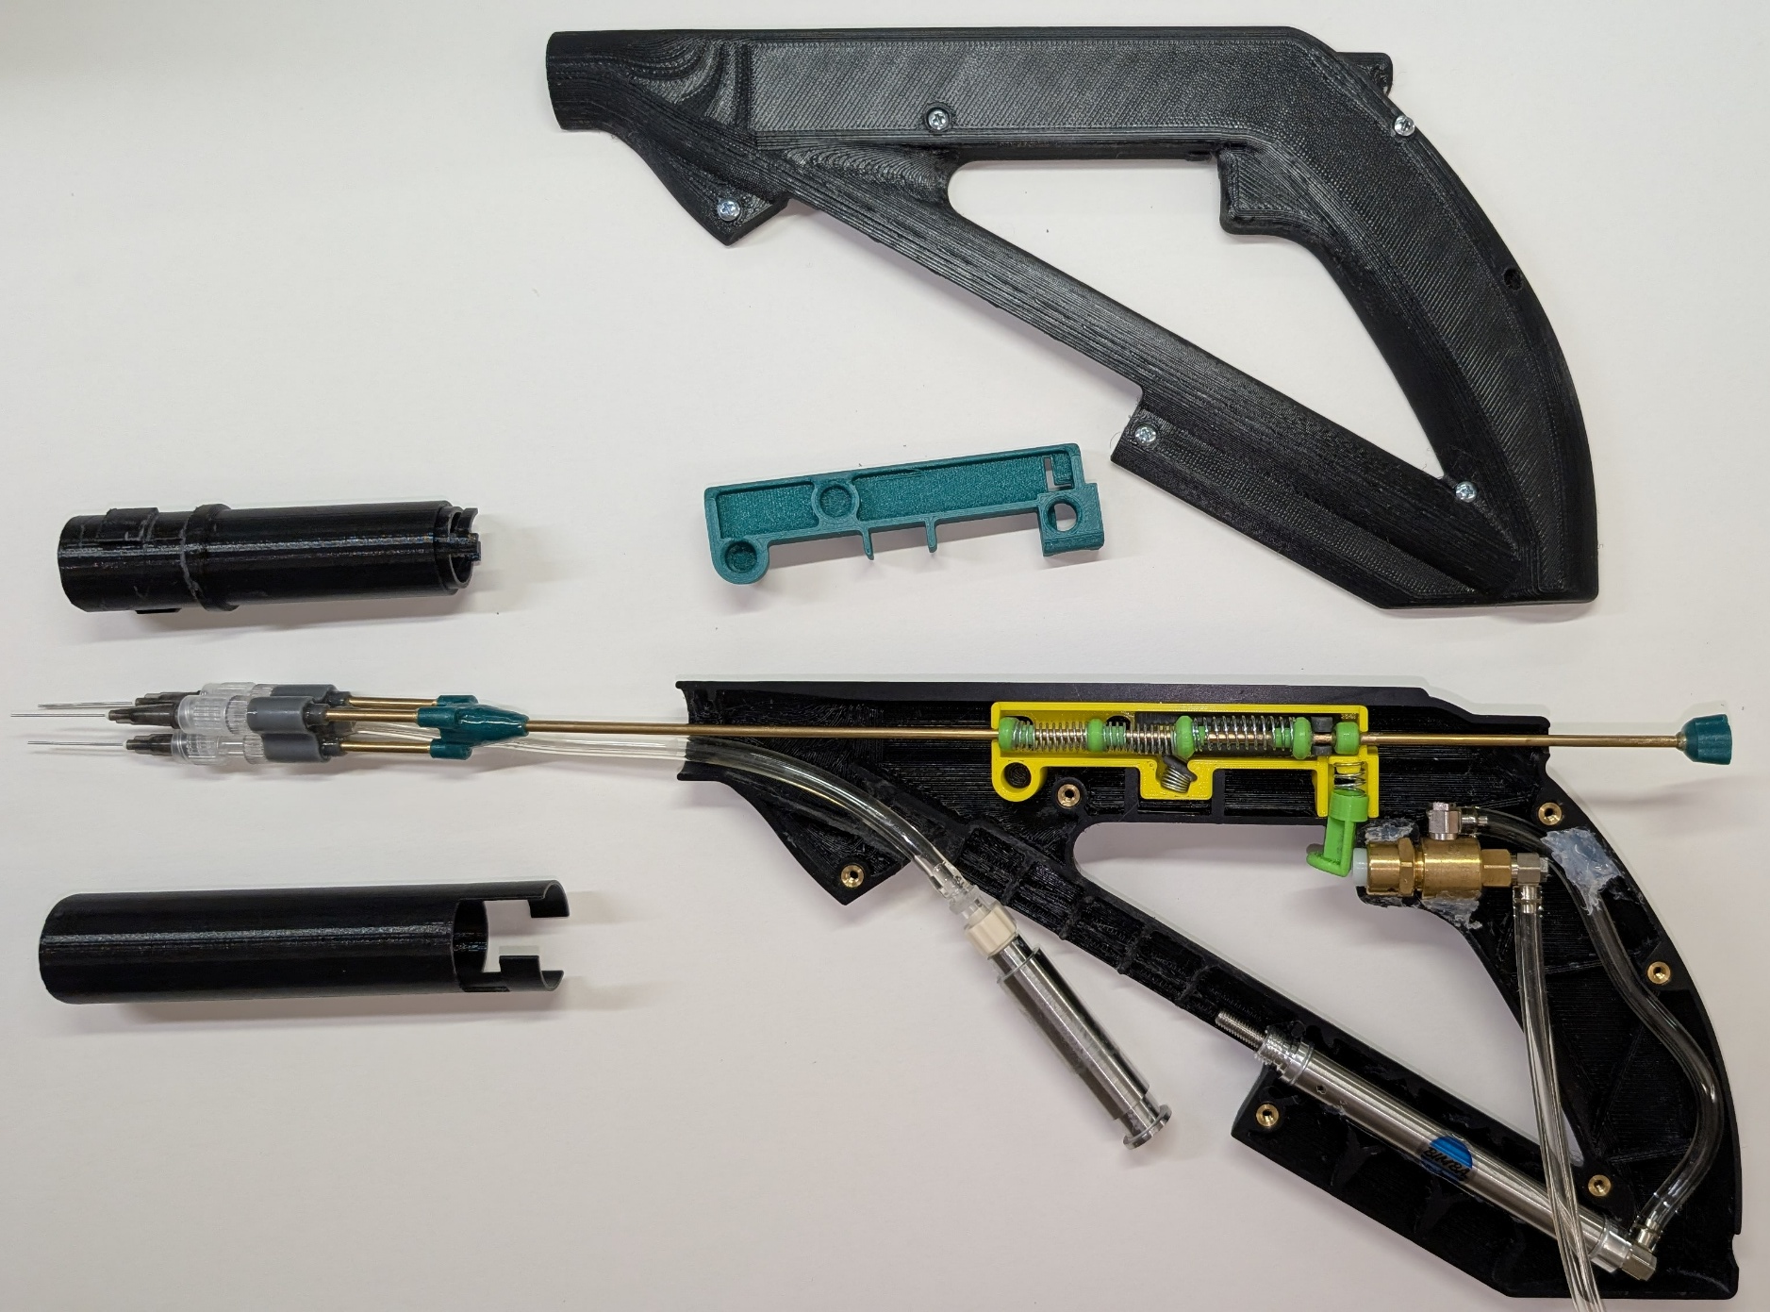
Auto-injector Prototype

Slide 5
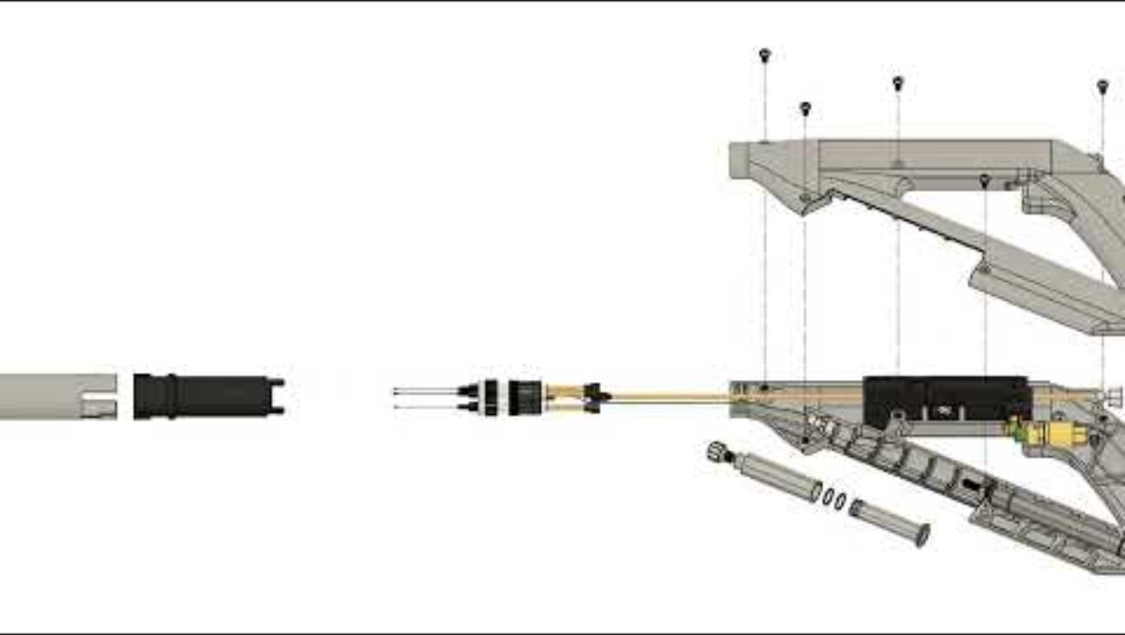
Exploded Assembly Animation

Slide 6
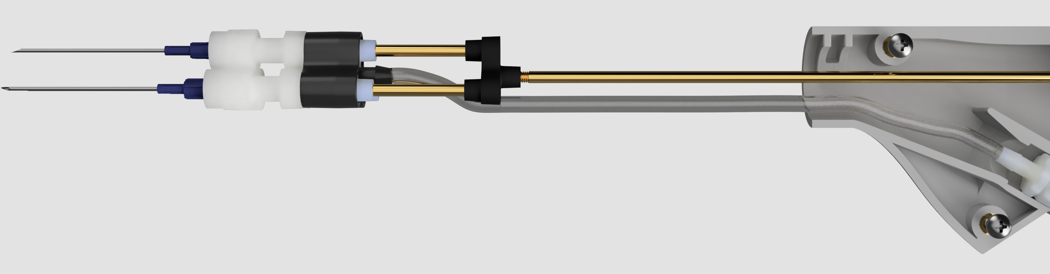
Triple-needle Sub-assembly
Male Luer adapter with spin lock
Embedded threaded insert
Hose barb
Groove for twist-on needle cover
Syringe tip with female Luer lock
Adhesive applied here
1/8” ID tubing
3mm brass rod
Hose barb

Slide 7
Retraction Sub-assembly and Motion
Spring joint minimizes lateral deflection
Spring-driven latch
Spring-driven latch
Alignment ribs
Syringe barrel is secured via a friction fit
Alignment pins (right one hidden)

Slide 8
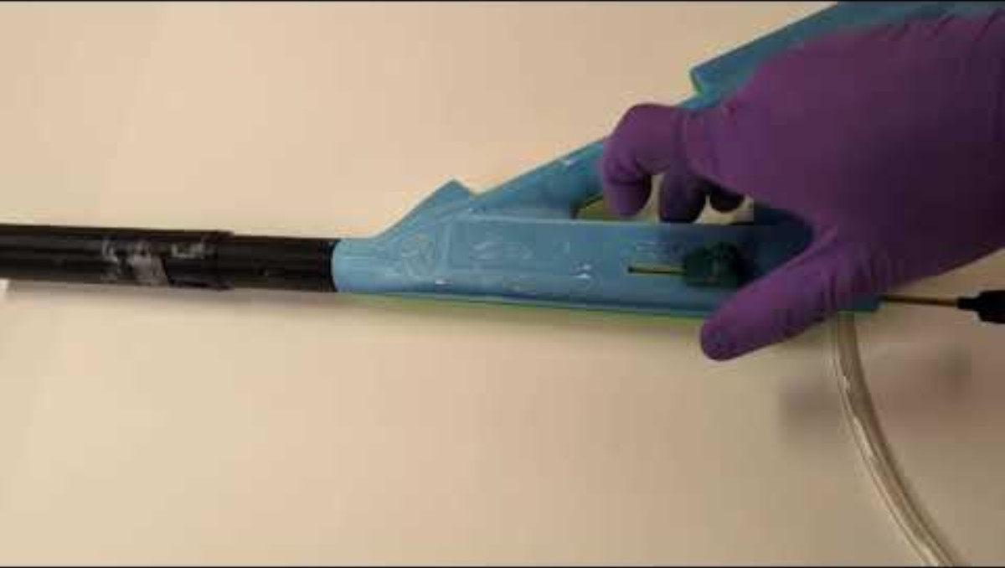
Spring-driven Retraction

Slide 9
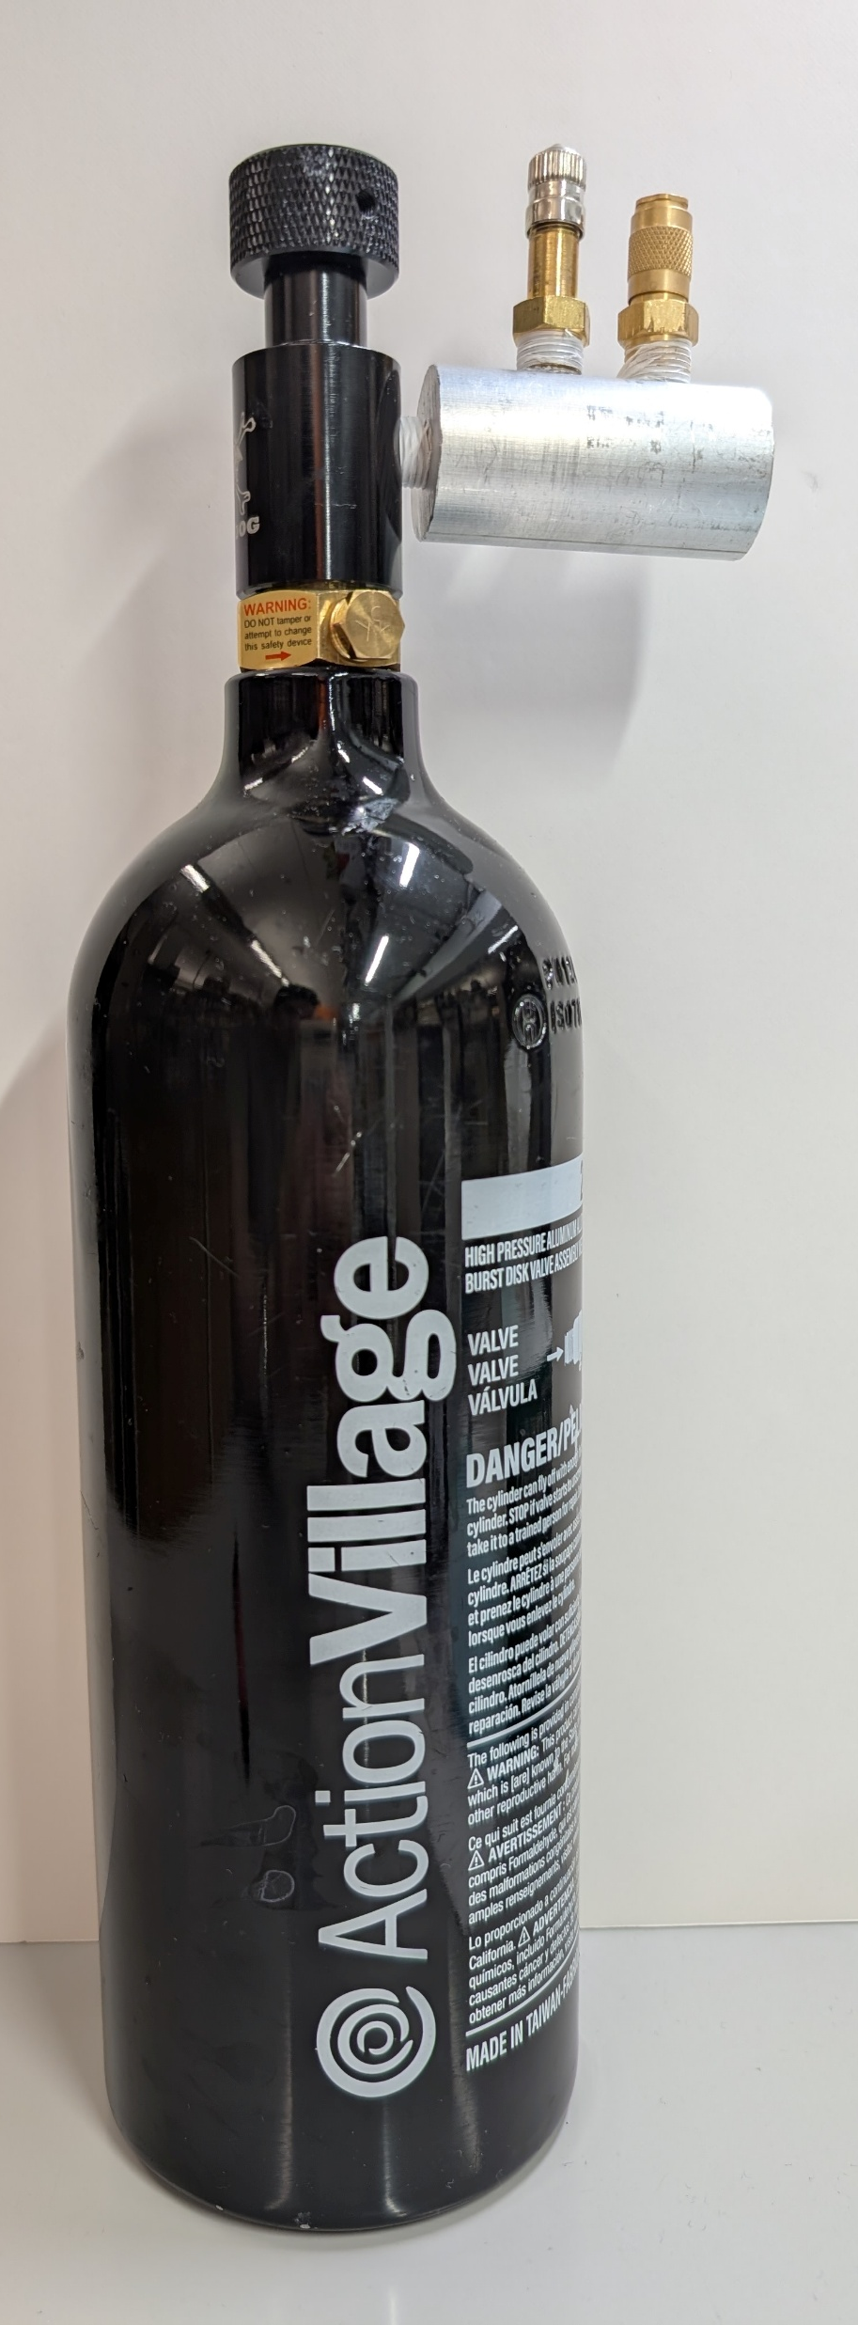
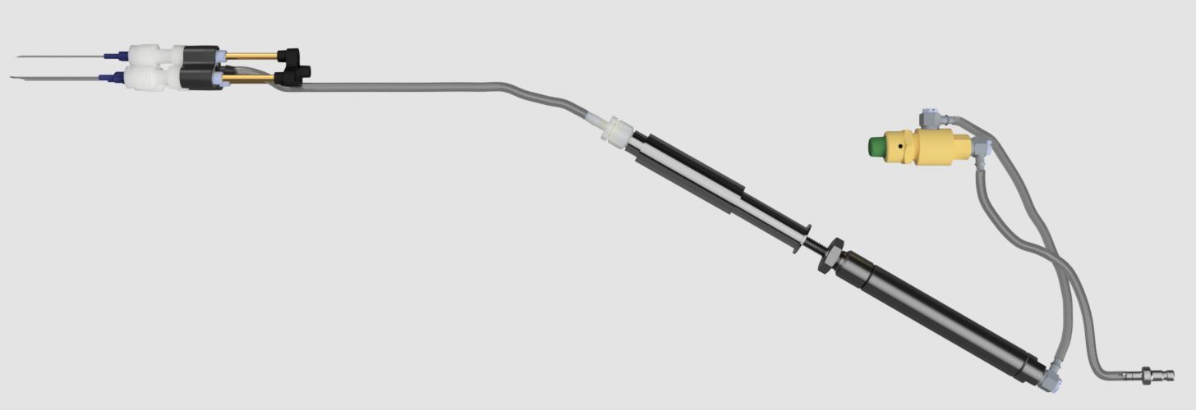
Pneumatic Sub-assembly
Shrader valve
ECE splitter
Model tubing
Male Luer lock x 1/4-28 male UNF adapter
Pneumatic Valve with Button
ECE outflow
Quick disconnect internal
Air inflow from canister
Aluminum syringe barrel and plunger
Air cylinder
Quick disconnect external

