Slide 1
CIS600 Presentation
Jingyuan Chen, Yifei Guo, Shu Li, Yanchen Li, Zirui Liu, Wenzhe Ma, Qingyuan Mao

Slide 2
Introduction
XiaoFish - Natural language executes terminal command system
Terminal command line interface (CLI) has become the preferred tool for many developers and system administrators.
1.difficult for most non-technical users
2.spend a lot of time learning and remembering complex terminal commands
Notes:
Good afternoon, everyone. I am excited to introduce our project, ‘XiaoFish - Natural Language Executes Terminal Command System.’
With the rapid advancements in computing, command-line interfaces remain powerful but complex tools, especially for non-technical users. Many struggle with memorizing and executing commands, which often limits accessibility and efficiency.
Our project, XiaoFish, simplifies command-line usage by allowing users to execute terminal commands in natural language. This reduces complexity and makes the terminal more accessible to all users.

Slide 3
Data Cleaning Process
1.cleaned up the ID column. Converting all IDs to lowercase and removing spaces
2.de-duplicated the data, keeping only the first record for each ID
3.remove redundant noise by cleaning the text of commands and descriptions
4.removed the brackets and their contents
5.extracted the keywords describing the text using TF-IDF
Notes:
And I will introduce the Data Cleaning Process
We use the nl2bash dataset
And it consists of two parts: the Commands dataset, which contains commands, and the Descriptions dataset, which describes the meaning of commands. These two datasets are related by the ID field.
In the preprocessing steps:
1. In the first step, we cleaned up the ID column. Converting all IDs to lowercase and removing spaces ensured that the IDs of commands and descriptions would match correctly.
2. Second step, we de-duplicated the data, keeping only the first record for each ID. This reduces data redundancy and improves data consistency.
3. Third step, we remove redundant noise by cleaning the text of commands and descriptions. Example:
In commands, regular expressions were used to replace sensitive information, such as replacing IP addresses with <IP_ADDRESS>, paths with <PATH>, and numbers with <NUM>.
4. For the description text, we removed the brackets and their contents to reduce unnecessary information interference.
Fourth step, we merged the two datasets via outer joins and marked missing data with <MISSING> to ensure that all commands and descriptions were preserved.
Finally, we extracted the keywords describing the text using TF-IDF, thus providing a concise summary of the core content of the natural language description.
Let me give you an example of exactly how these steps work and the results.

Slide 4
Suppose we have the following data:
ID: Example_123
Command: ping 192.168.1.1 -c 4
Description: Send 4 packets to a specific IP address (e.g., 192.168.1.1)
Cleaned up:
IDs were standardized to lowercase: example_123
Command cleaned up to: ping <IP_ADDRESS> <FLAG> <NUM>
Description cleaned up to: Send 4 packets to a specific IP address
The keyword extracted using TF-IDF is: send packets specific address

Slide 5
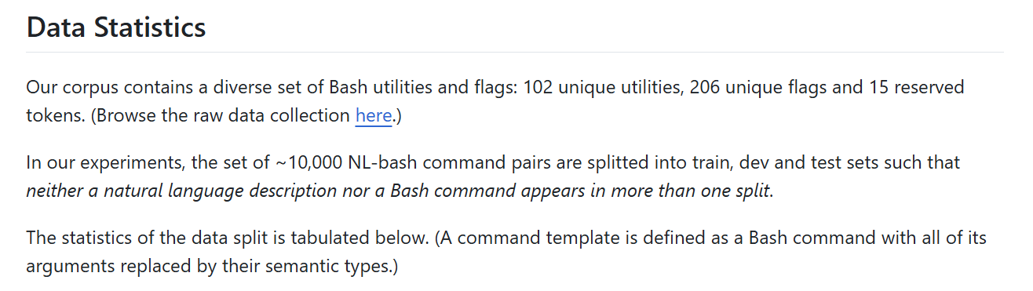
Dataset Generation

Slide 6
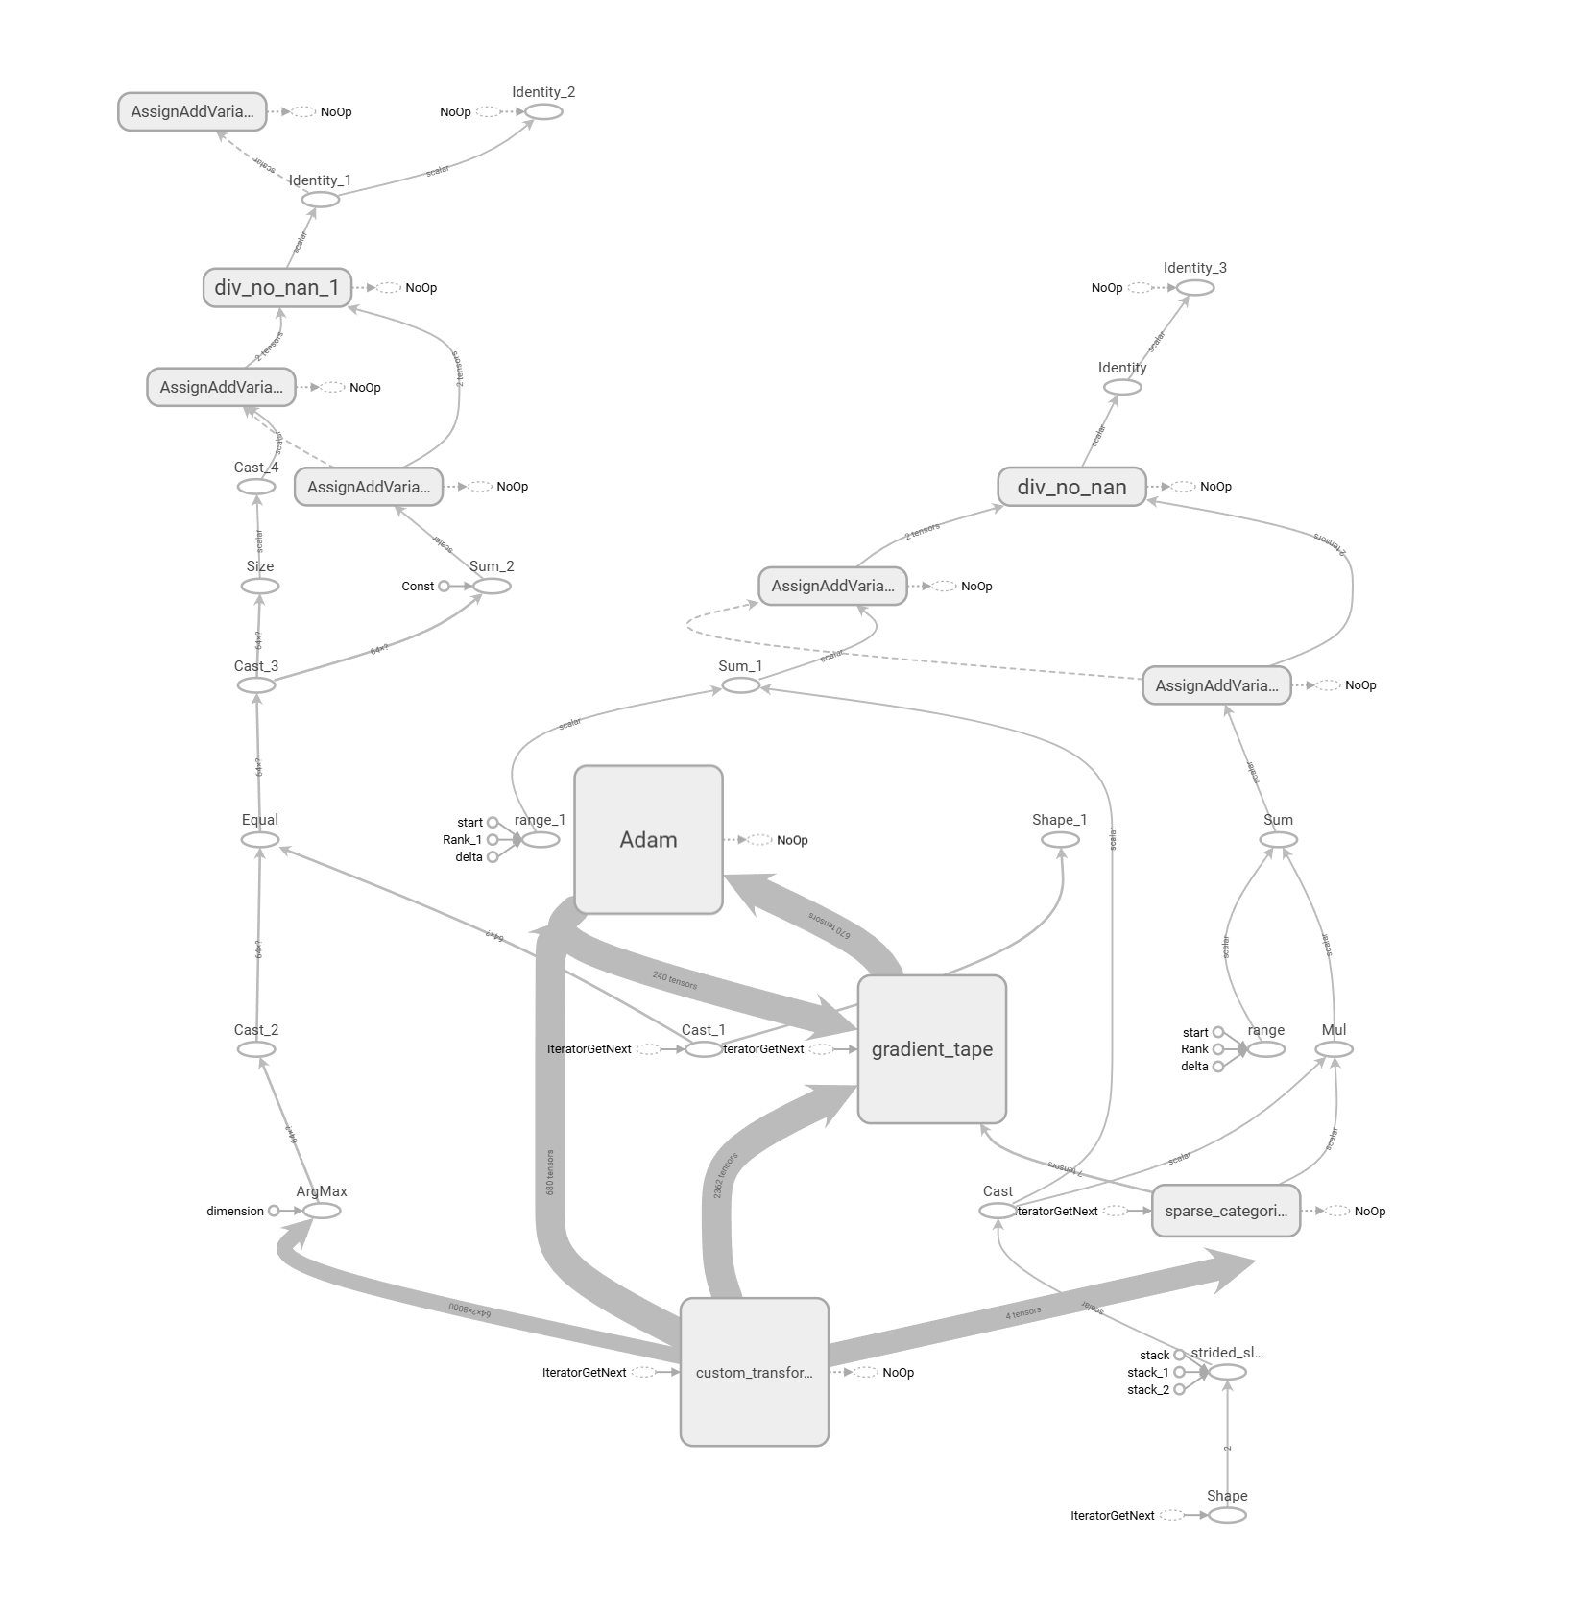
Model Architecture
Transformer model: about 5.7M parameter
4 number of layers
8 number of heads
128 dimension of model
512 dimension of feed forward network
Notes:
Transformer models have been very popular in the field of natural language processing in recent years. Our goal is to use them to complete sequence-to-sequence text conversion tasks, such as translation or question-answer generation. The code implements a multi-layer encoder and decoder architecture, each of which contains a multi-head attention mechanism and a feedforward neural network.
Model architecture
We build the model from the basics:
Position encoding: To make up for the lack of position information in sequence data, the code uses sine and cosine functions to generate position encodings.
Multi-head attention mechanism: This module achieves richer information extraction by decomposing query, key, and value matrices.
Encoder and decoder: The encoder converts the input sequence into context representations, and the decoder uses these representations to generate the target sequence.
Custom optimizer: The convergence of the model is enhanced through the learning rate scheduling strategy.
Dataset partitioning: The code partitions the dataset in a ratio of 8:1:1 and ensures the length consistency of the sequences.

Slide 7
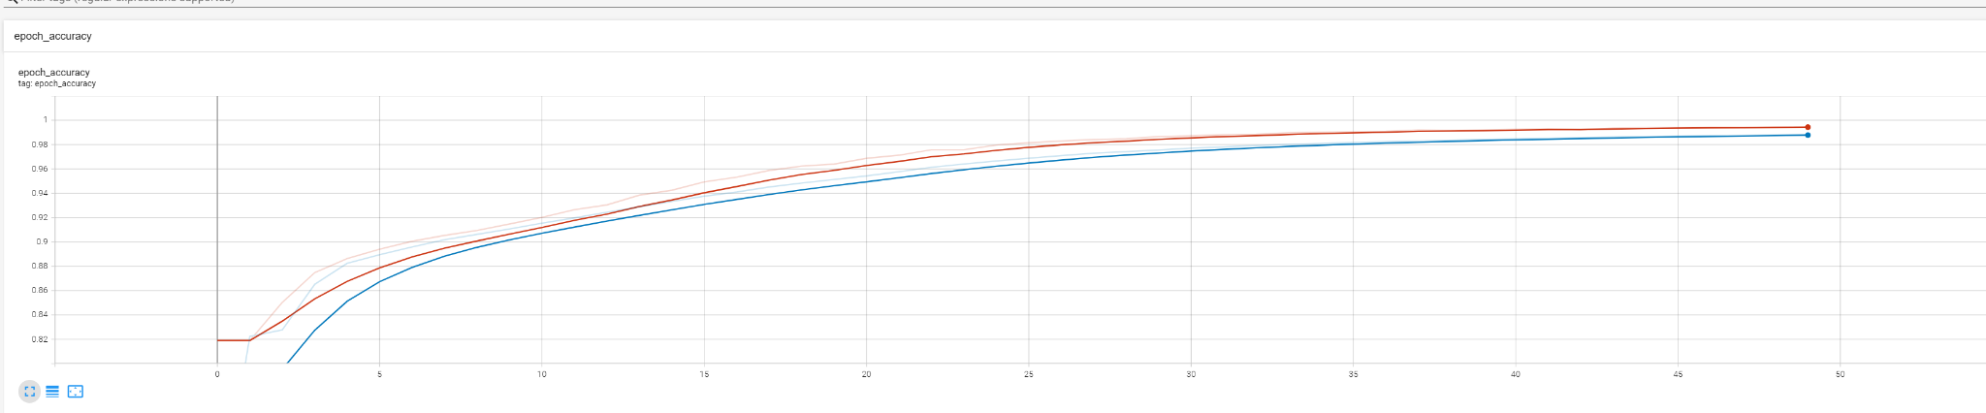
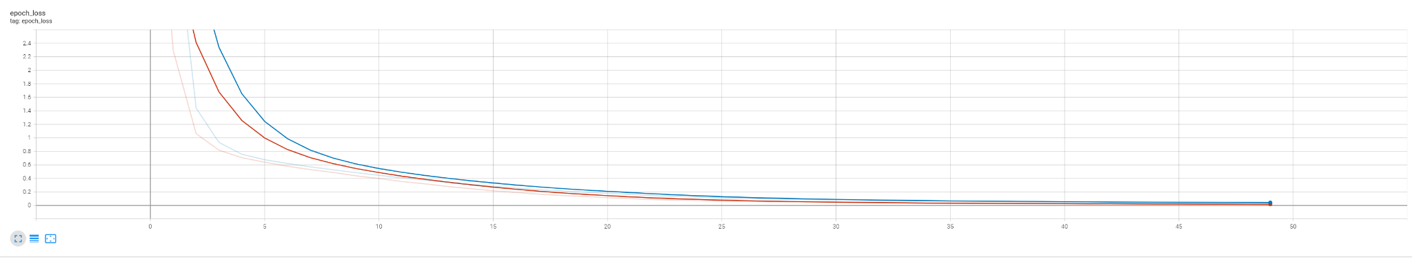
Training
Notes:
We splitted the dataset as 80% of training, 10% of validation, 10% of testing
We trained for 50 epochs on the training set
The result is show as the following graph.

Slide 8
Evaluation and Testing
Bilingual Evaluation Understudy(BLEU)
Functional Testing

Slide 9
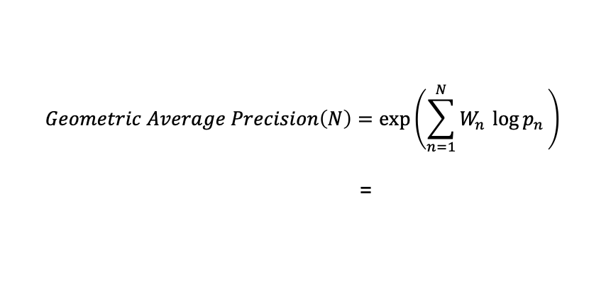
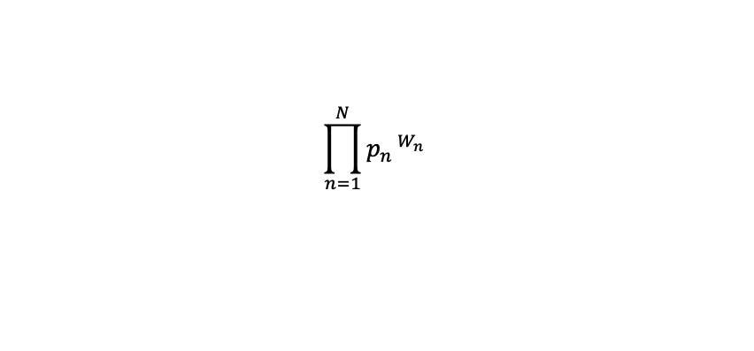
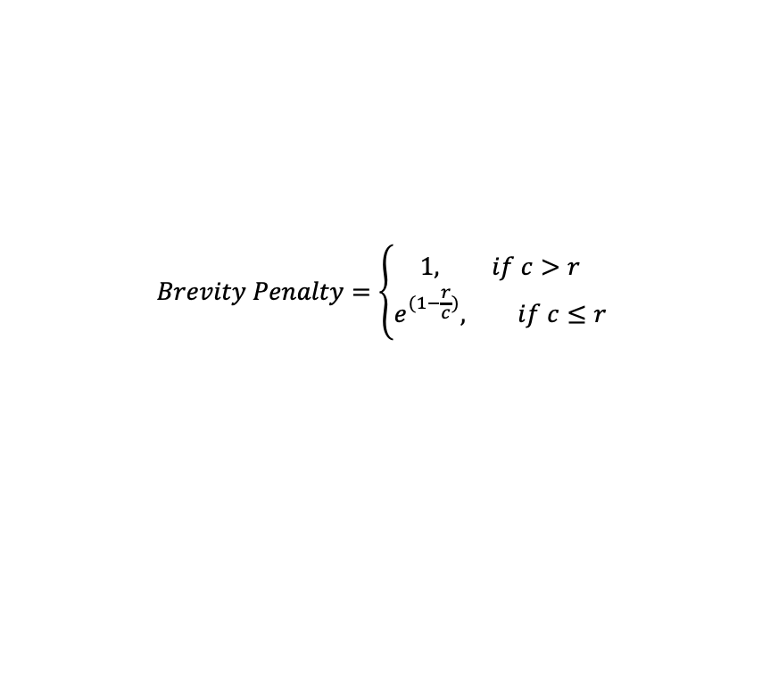
BLEU
N-gram Precision
Brevity Penalty
c is predicted length = number of words in the predicted sentence
r is target length = number of words in the target sentence

Slide 10
Functional Testing
Execute both the reference commands and the model-generated
Capture standard output & the error output
Compare & Match
Accuracy

Slide 11
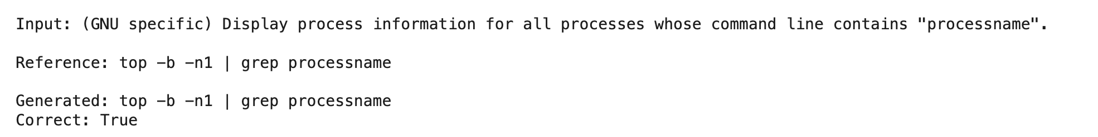
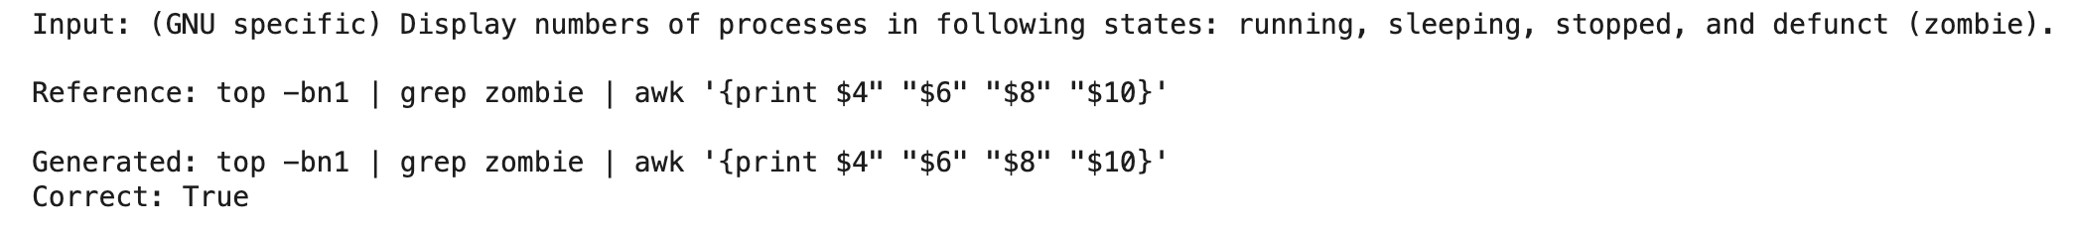
Functional Testing
Sample Output

Slide 12
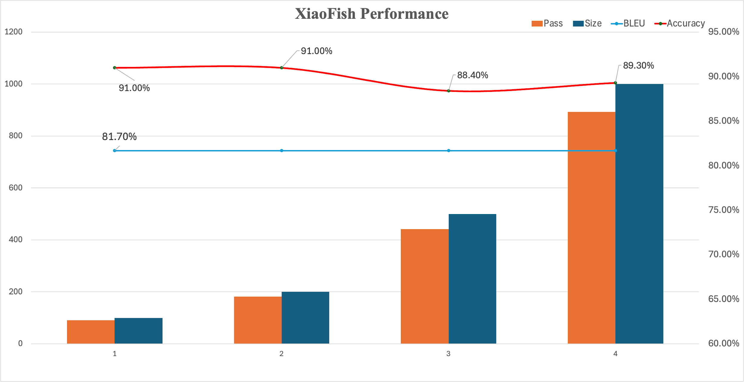
Results

Slide 13
Future Directions
Pretrained weights
loss function
Notes:
In the future, we can fine-tune this model on a larger corpus, or introduce pre-trained weights to improve the initialization effect. In addition, exploring different optimizers or more complex attention mechanisms may further improve performance. We will use different models and different datasets to compare with our method. In addition, due to the way the loss is calculated and the poor performance of traditional accuracy evaluation on NLP problems, we also plan to customize the loss function. The current idea is to use our method to evaluate the accuracy during training, and then multiply it by a weight and add it to the original loss function.

Slide 14
Questions?

