Slide 1
EBOOK DATABASE
GROUP 21 JING-YAO CHEN, DONGGYU KIM, SHAWN WESTVEER

Slide 2
OUTLINE OF PRESENTATION
Application description
Implementation
ER diagram
Demonstration
Evaluation
Conclusion

Slide 3
APPLICATION DESCRIPTION
Motivation
Physical bookstores are dying
Book shopping moves to online interfaces
Books have many attributes
Database is needed to keep track of records
Objective
Create an ebook database
Main usage as a bookstore
Managers: update and upload ebook data
Customers: look up interested author, publisher, seller, and book info (price and publish date)
Functionalities
Search, insert, modify

Slide 4
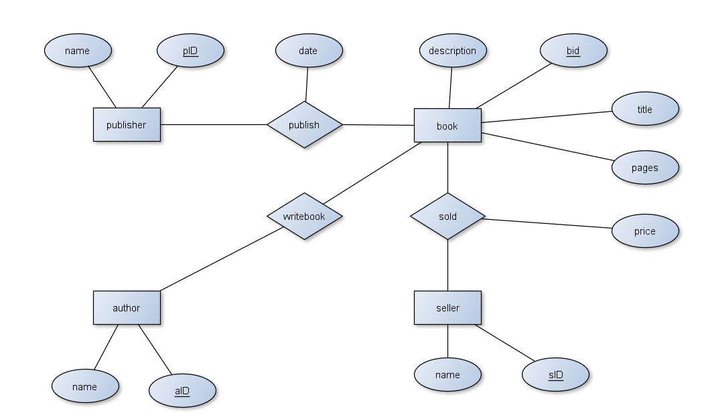
ER Diagram
Note: all relations are many to many for flexibility in the database. All relations are in BCNF as only two entities are involved in a relation.

Slide 5
IMPLEMENTATION
Dataset
17,878 Book (bid, title, length, description)
15,987 Author (aid, aname)
17,824 Publisher (pid, pname)
698 Seller (sid, sname)
Database
4 entities, 3 relations
Database Software
PostgreSQL 10.0
Interface
Java based
GUI implemented using Eclipse IDE and WindowBuilder Swing addon
rs2xml.jar dynamically builds tables from queries

Slide 6
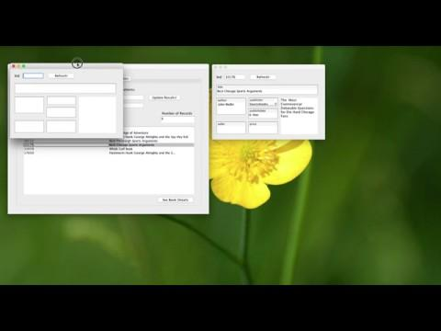
Search
Search based on matching strings and involves subqueries
Statistics of each entities

Slide 7

Insert
Insert with appropriate input
Verified through direct database access using pgAdmin 4.0

Slide 8
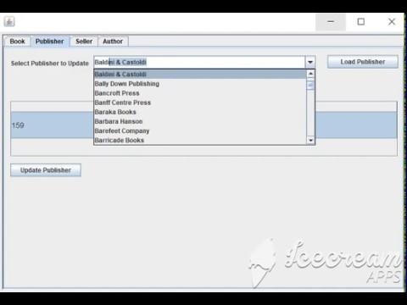
Modify
Modification of existing tuples

Slide 9
EVALUATION
Data cleaning
Scroll through the data to check for correct parsing
Non-ascii symbols are eliminated from database upon loading
Access and modify database via Java
Verify operation by checking database itself
Query through interface
Print query statements to ensure correctness

Slide 10
CONCLUSION
Data cleaning takes a long long time
How to install database management software …
MySQL installation and connection problem
Ultimately switched to PostgreSQL
How to use a database management software
Creating stored procedures in PostgreSQL
Non-intuitive administration software
Software
Java, WindowBuilder
Conclusion
Can only learn database through implementation!

