Slide 1

Computational Neuroscience Tutorial Week 4 NEURON I Instructor: Salvador Dura-Bernal

Slide 2
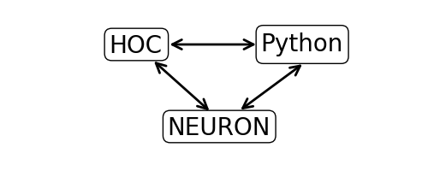
Interface language: Python
One of the cleanest languages (cf. >>> import this)
Advantages:
Easy to learn
Writing portable, readable code
Interfacing with 100s of other packages (NumPy, SciPy, Matplotlib, PyNN, etc.)
Access to all Neuron objects/functions via module (from neuron import h)

Slide 3
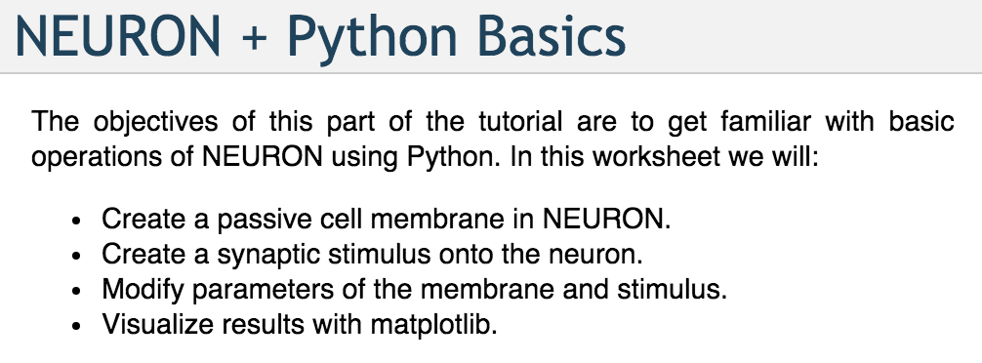
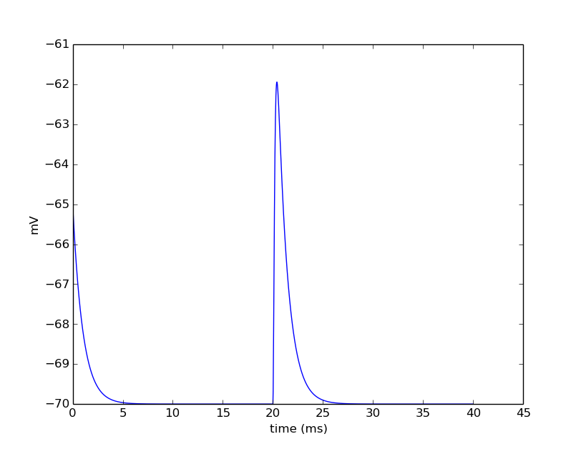
First steps
http://neuron.yale.edu/neuron/static/docs/neuronpython/firststeps.html

Slide 4
Step 1: Import the NEURON module
Any code that is not part of Python’s Built-in Functions must be imported.
The Python interface to NEURON works through the “h” module.
The h module permits a direct interface to NEURON as well as to NEURON’s other interpreter language, hoc.

Slide 5
Step 1: Import the NEURON module
We begin by loading NEURON’s h module and its graphical user interface:
from neuron import h, gui
The results of evaluating this code in Python should look something like the following output:
NEURON -- VERSION 7.5 master (0388d94) 2017-08-09
Duke, Yale, and the BlueBrain Project -- Copyright 1984-2016
See http://neuron.yale.edu/neuron/credits

Slide 6
Step 2: Create a cell
We create a simple model cell as a NEURON Section. Evaluate the line:
soma = h.Section(name='soma')
There is no output, so how can we tell we successfully created a section?

Slide 7
Note 1: Checking cell exists
NEURON’s psection() (short for “print section”) function can provide a lot of detail on sections.
Let’s validate that we have a soma and view some of its properties:
soma.psection()
This shows the soma is a cylinder with:
length 100 um,
diameter 500 um,
axial resistivity 35.4 ohm*cm,
specific membrance capacitance 1 mu F/cm^2

Slide 8
Note 1: Checking cell exists
We can also probe objects with Python’s built-in dir() function. Let’s see what it says about soma:
dir(soma)
This tells us all of the Python methods and variables associated with the object.
Those starting with ‘__’ are reserved by Python
To see all of the functions available to the NEURON module h, try calling dir(h).

Slide 9
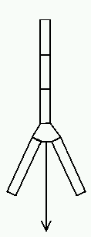
Note 2: Sections and Segments
mechanisms
A NEURON Section is considered a piece of cylindrical cable.
To increase spatial resolution, you can divide the cable into a number of segments of equal length where voltage is calculated separately
The number of segments within a section is given by the variable, nseg
Do not confuse sections with segments!
segment
section
segment
segment

Slide 10
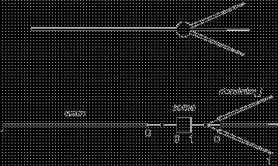
Note 2: Sections and Segments
To access a part of the section, specify a value between 0 and 1, where 0 is typically the end closest to the soma and 1 is the distal end.
Because nseg divides the cable into equal-length parts, use an odd number so that to address the middle of the cable, (0.5), gives the middle segment.

Slide 11
Note 2: Sections and Segments
To summarize, we access sections by their name and segments by some location on the section.
Section: section
Segment: section(loc)
Using the Python type() function can tell us what a variable is:
print "type(soma) =", type(soma)
print "type(soma(0.5)) =", type(soma(0.5))
soma.nseg
soma.nseg=3
soma(0.1)
soma(0.5)
soma(0.9)
soma.nseg = 1

Slide 12
Step 3: Add dendrite and connect
Create a dendritic section ‘dend’ and connect it to the ‘1’ end of the soma.
dend = h.Section(name='dend')
dend.connect(soma(1))
Let’s check the connection.
h.psection(sec=dend)
Let’s further confirm with NEURON’s topology() function.
h.topology()
Both of these approaches show that dend[0] is connected to soma[1].

Slide 13
Step 4: Set geometry
Let’s set the spatial properties of the cell using a “stylized” geometry. Later we will explore setting 3D points explicitly.
# Surface area of cylinder is 2*pi*r*h (sealed ends are implicit).
# Here we make a square cylinder in that the diameter
# is equal to the height, so diam = h. ==> Area = 4*pi*r^2
# We want a soma of 500 microns squared:
# r^2 = 500/(4*pi) ==> r = 6.2078, diam = 12.6157
soma.L = soma.diam = 12.6157 # Makes a soma of 500 microns squared.
dend.L = 180 # microns
dend.diam = 1 # microns
dend.nseg = 11 # odd number of segments
print "Surface area of soma =", h.area(0.5, sec=soma)

Slide 14
Step 5: Set biophyisical variables
All sections include a variable to store its axial resistance (Ra) and membrance capacitance (cm).
We can use the h.allsec() method which iterates over all sections
for sec in h.allsec():
sec.Ra = 100 # Axial resistance in Ohm * cm
sec.cm = 1 # Membrane capacitance in micro Farads / cm^2

Slide 15
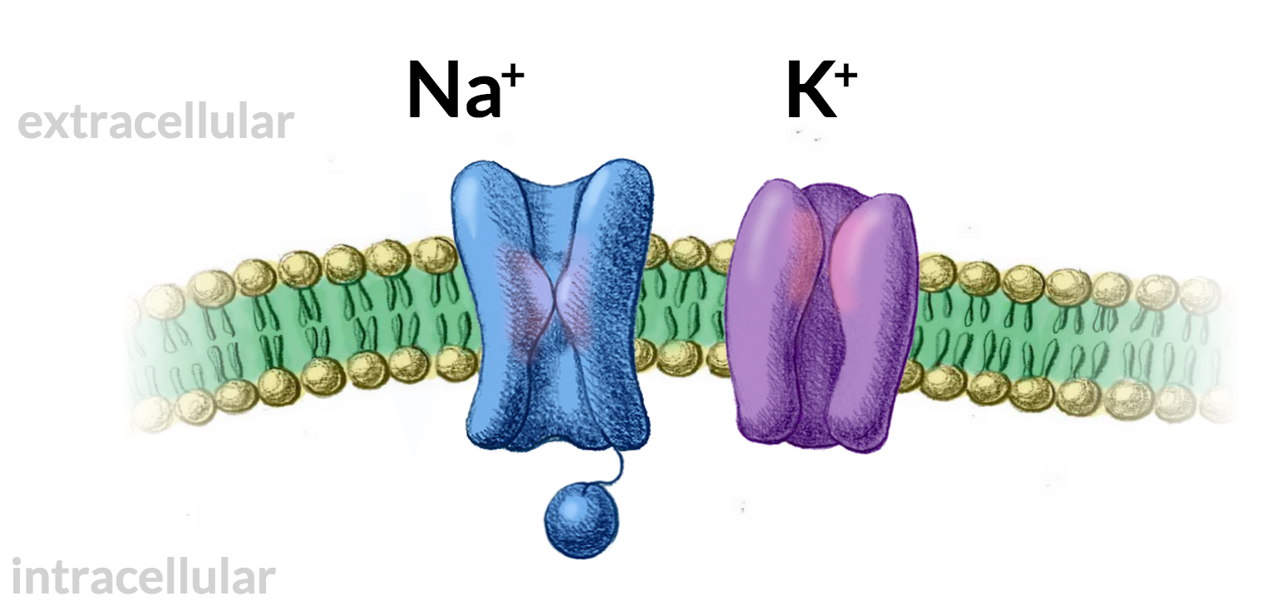
Note 3: Distributed mechanisms
Distributed mechanisms modify membrane properties eg. V or g_{Na}
They are inserted in a Section, and automatically distributed to all of its Segments
Hodgkin-Huxley sodium, potassium and leakage channels
sec.insert(‘hh’)
Passive channels
sec.insert(‘pas’)
Other NMODL (.mod) mechanisms defined (eg. other ionic channels)

Slide 16
Step 6: Insert mechanisms
NEURON comes with a few built in biophysical mechanisms that can be added to a model.
pas | Passive (“leak”) channel.
hh | Hodgkin-Huxley sodium, potassium, and leakage channels.
The ‘insert’ method is used to insert mechanisms into the membrane. Let’s insert an active Hodgkin-Huxley conductance in the soma and a passive leak conductance in the dendrite:
# Insert active Hodgkin-Huxley current in the soma
soma.insert('hh')
# Insert passive leak current in dendrite
dend.insert('pas')

Slide 17
Note 4: Accessing segment variables
Segment variables follow the idiom:
section(loc).var
And for mechanisms on the segment:
section(loc).mech.var
or
section(loc).var_mech
Try:
print dend(0.5).pas.g
print dend(0.5).g_pas
mech = dend(0.5).pas
print dir(mech)
print mech .g

Slide 18
Note 4: Accessing segment variables
To access or set the variables of ALL segments in a section you can use:
section.var_mech
Try:
dend.g_pas = 0.001
print dend(0.1).pas.g
print dend(0.9).pas.g

Slide 19
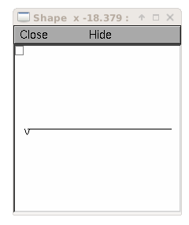
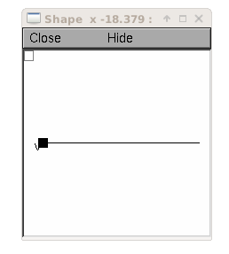
Bonus: Visualize your cell
Try:
shape_window = h.PlotShape()
shape_window.exec_menu('Show Diam')

Slide 20
Step 7: Set mechanism variables
Lets set the variables of the soma hh and dend pas mechanisms:
soma.gnabar_hh = 0.12 # Sodium conductance in S/cm2
soma.gkbar_hh = 0.036 # Potassium conductance in S/cm2
soma.gl_hh = 0.0003 # Leak conductance in S/cm2
soma.el_hh = -54.3 # Reversal potential in mV # Insert passive current in the dendrite
dend.g_pas = 0.001 # Passive conductance in S/cm2
dend.e_pas = -65 # Leak reversal potential mV

Slide 21
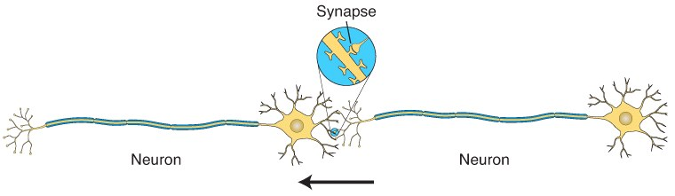
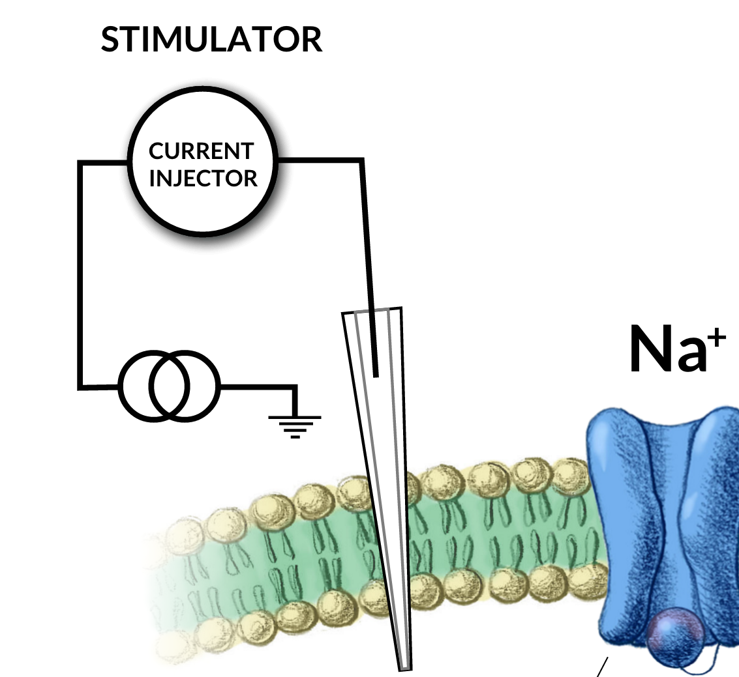
Note 5: Point Processes
Point processes are sources of current in specific segment
Synapses
syn = h.AlphaSynapse(soma(0.5))
syn = h.ExpSyn(dend(0.8))
Current Clamp
stim = h.IClamp(soma(0.5))
Artificial Cells (special type of point process)
ns = h.NetStim()
cell = h.IntFire1()
cell = h.IntFire2()

Slide 22
Step 8: Insert current clamp
Let’s insert an current clamp (IClamp) object onto the end of the dendrite to induce some membrane dynamics.
stim = h.IClamp(dend(1.0))
When making a new PointProcess, you pass the segment to which it will bind.
Again, with dir() function, we can validate that stim is an object and contains some useful parameters. Let’s set some of those parameters.
dir(stim)
stim.amp = 0.1 # input current in nA
stim.delay = 20 # turn on after this time in ms
stim.dur = 3 # duration in ms

Slide 23
Step 9: Set up recording variables
We need to set up variables we wish to record from the simulation.
We will store them using h.Vector(), a NEURON class used to store and operate on 1D arrays of numbers.
We will record the soma membrane potential, which is soma(0.5).v
and dendrite membrane potential at 1.0: dend(1.0).v
But note that references to variables are available as _ref_variable, so to record we need:
v_vec_soma = h.Vector() # Membrane potential vector
v_vec_dend = h.Vector() # Membrane potential vector
t_vec = h.Vector() # Time stamp vector
v_vec_soma.record(soma(0.5)._ref_v)
v_vec_dend.record(dend(1.0)._ref_v)
t_vec.record(h._ref_t)

Slide 24
Step 10: Run the simulation
To run the simulation, we execute the following lines.
h.tstop = 40.0
h.run()
Note: If we had not included gui in the list of things to import, we would have also had to execute the following code which defines the run() func:
h.load_file('stdrun.hoc')

Slide 25
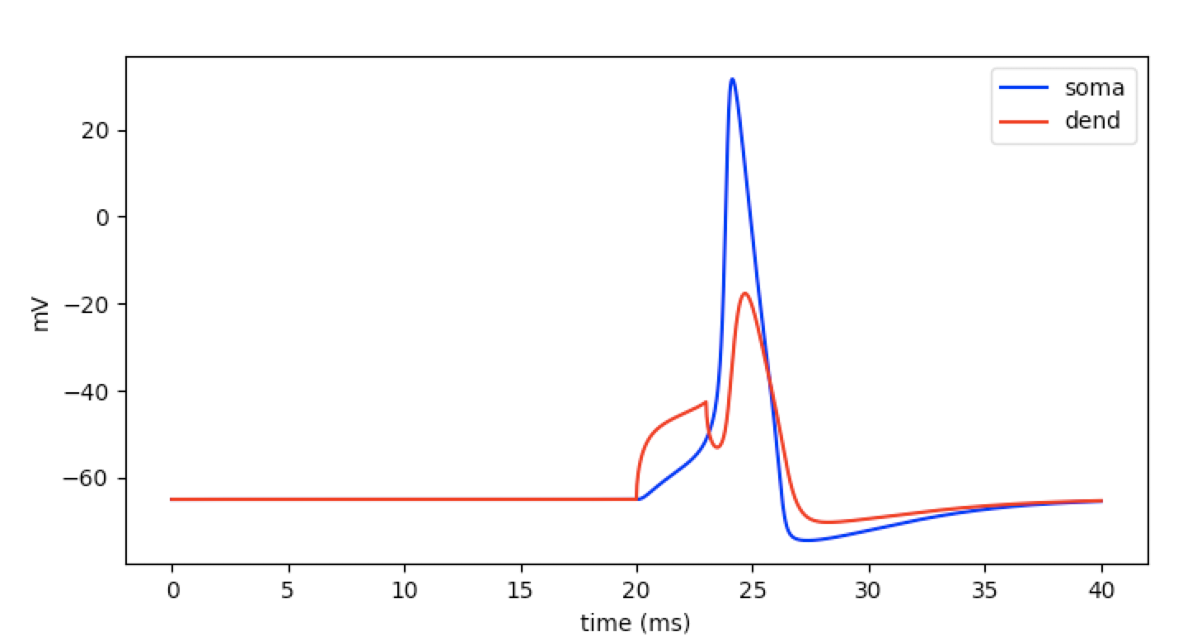
Step 11: Plot the results
We utilize the pyplot module from the matplotlib Python package to visualize the output.
from matplotlib import pyplot as plt
plt.figure(figsize=(8,4)) # Default figsize is (8,6)
plt.plot(t_vec, v_vec_soma, 'b', label='soma')
plt.plot(t_vec, v_vec_dend, 'r', label='dend')
plt.xlabel('time (ms)')
plt.ylabel('mV')
plt.show()

