Slide 1
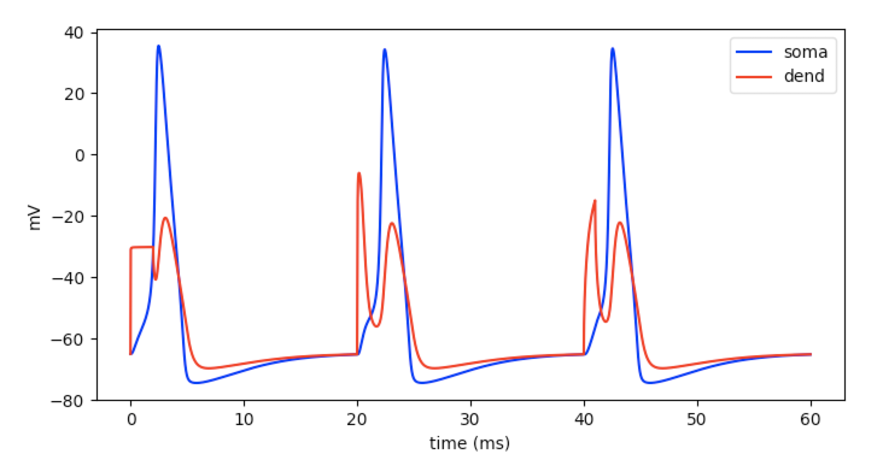
Computational Neuroscience NEURON Exercises (Weeks 4 and 5) Instructor: Salvador Dura-Berna

Slide 2
Exercise Week 4
1. Create a cell with at least 3 connected sections – call them whatever you want.
2. Make the lengths and diameters of all sections different (any values you want)
3. Make the axial resistance and membrane capacitance of all sections the identical (any values you want) using a for loop.
4. Make one of the section have 101 segments, and make all segments in location 0.7 to 1.0 have a lower membrane capacitance – we didn’t explicitly do this in class but you should be able to figure it out using your Python skills!
5. Print the parameters of all sections
6. Print the topology of your cell

Slide 3
Week 5 - Modify cell properties
Start with code at the end of Week 4 and modify as described in the following slides.
Note: The code resulting after these exercises will be the starting point for the next week
Change the dendrite length to 200 um
Change the maximum sodium conductance of the middle segment of the soma to 0.13
Change the equilibrium potential of the passive mechanism in the middle segment of the dend to -65

Slide 4
Modify cell properties
Start with code at the end of Tutorial 3 (tut3.py) and modify as described in the following slides.
Note: The code resulting after these exercises will be the starting point for Tutorial 4 (tut4_start.py).
Change the dendrite length to 200 um
Change the maximum sodium conductance of the middle segment of the soma to 0.13
Change the equilibrium potential of the passive mechanism in the middle segment of the dend to -65

Slide 5
Iterate cell mechanisms
4) Iterate all mechanisms in all segments in all sections, and print the section name, location of the segment and mechanism name.
Tip 1: Use nested for loops
Tip 2: h.allsec() returns all sections
Tip 3: the .name() method returns the name of a section or mechanism
Tip 4: The output should look like this:
soma 0.5 k_ion
soma 0.5 na_ion
soma 0.5 hh
dend 0.0454545454545 pas
dend 0.136363636364 pas
dend 0.227272727273 pas
dend 0.318181818182 pas
dend 0.409090909091 pas
dend 0.5 pas
dend 0.590909090909 pas
dend 0.681818181818 pas
dend 0.772727272727 pas
dend 0.863636363636 pas
dend 0.954545454545 pas

Slide 6
Modify current clamp + add alpha syn
5) Modify the current clamp amplitude to 300 pA, start time to 40 ms, and duration to 1 ms
6) Add a an alpha synpase point process at dendrite location 1.0 with the following properties (use NEURON’s documentation if needed):
syn = h.AlphaSynapse(dend(1.0))
reversal potential: 0 mV
start time: 20 ms
max conductance: 0.1 uS
time constant: 0.1 ms
Note: we will explain more about the alpha synapse in the next Tutorial
new_doc -> py_doc

Slide 7
Add voltage clamp
7) Add a single electrode voltage clamp at dendrite location 1.0, with the following properties (use NEURON’s documentation if needed):
duration: 2 ms
amplitude: -30 mV
Hint: You can just set .dur1 and .amp1
Note: The voltage clamp documentation can be confusing; in the next tutorial we will explain a bit more about it.

Slide 8
Simulation
8) Change the simulation duration to 60 ms and run ... make sure you get this figure:

Slide 9
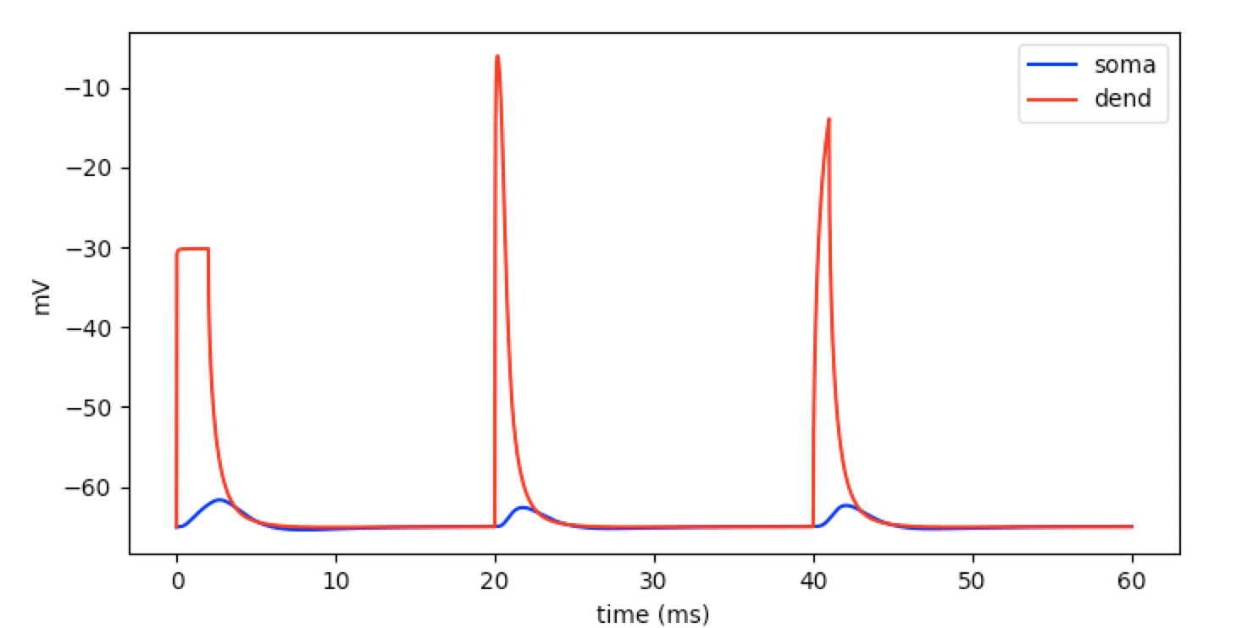
Change dendritic length
9) Change the dendritic length to 400 ms and run the simulation
What happened?
Why?
This will be the starting point of Tutorial 4!

Slide 10
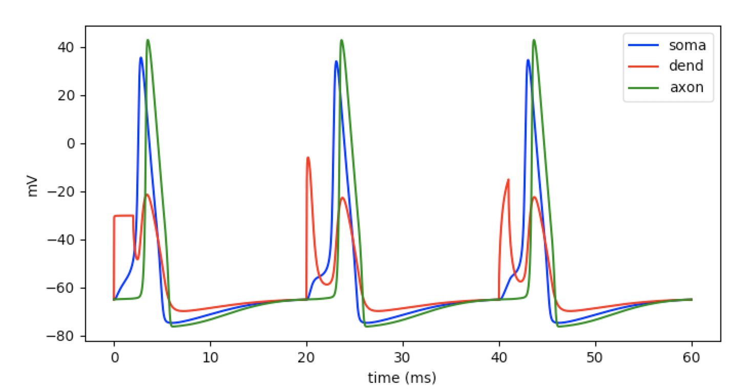
Bonus: Add an axon
The code added here is extra and not required for Tutorial 4 (make sure you save with a different file name – tut3_axon.py):
Add an axon to the cell
Connect the axon to location 0.0 of the soma
Set the axon’s length to 1000 um and diameter to 1 um
Set the axon’s membrane capacitance to 0.2 uF/cm^2
Add an HH mechanism with the same properties as for the soma
Record and plot the axon voltage at 1.0 in green color

