Slide 1
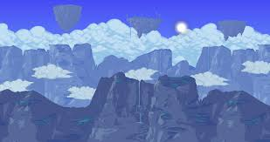

PandaMan By: jiaqi cheng and chenghao zheng

Slide 2





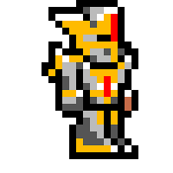

Kill or Be Killed

Slide 3
Elements of the game
The devil will chase and try to kill you , if devil hits you 5 times ,game is over.

Slide 4



After you kill 10 monsters , your HP will increased.

Slide 5
The devil and monsters will try to kill you , each time they hit , you will lose HP,if the hp goes to 0 . game is over .

Slide 6
The devil and monsters will try to kill you , each time they hit , you will lose HP,if the hp goes to 0 . game is over .

Slide 7
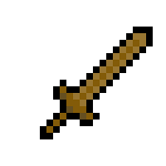
There are two ways to win the game. Kill enough monster and hurt devil.

